Slide 1
Cybersecurity: Tying it all together
Blake Carver
Senior Systems Administrator, LYRASIS
April 2021
Cybersecurity Training for Libraries
Week #4
Notes:
Include a Title Slide

Slide 2
This project was supported in whole or in part by the U.S. Institute of Museum and Library Services under the provisions of the Library Services and Technology Act, administered in California by the State Librarian. The opinions expressed herein do not necessarily reflect the position or policy of the U.S. Institute of Museum and Library Services or the California State Library, and no official endorsement by the U.S. Institute of Museum and Library Services or the California State Library should be inferred.
Notes:
This is a quick FYI that this workshop is part of a project supported by the Library Services and Technology Act, so thank you to the grant authority for providing resources for this project. You can find this statement in the slide handouts as well.

Slide 3
Today’s Schedule
10:00 – 10:20 Welcome & course housekeeping
10:20 – 10:45 Training
10:45 – 10:50 Break
10:50 – 11:25 Training
11:25 – 11:30 Wrap up
Notes:
This cybersecurity train the trainer webinar series runs on Wednesdays from 10 to 11:30. Each week we’ll try to keep close to the schedule posted in the slide. There will be some time for Q&A at the end of the session, so if any questions pop up during the presentation, you can enter them in the chat box so we can answer them then.

Slide 4
Outline
Week One – Welcome – Explanations of why and what’s wrong
Touch on some privacy issues.
Why are libraries, and all of us, targets?
Why is security important?
Professionals and Incentives, big money.
What are they after and where are they working?
Passwords
Week Two – Securing our things
Passwords
What things do we have to secure?
Hardware, software, etc
How do things actually get infected? How can we spot it?
Email, phishing, browsers, VPNs, Tor, desktop, mobile, everything else.
Week Three - Making Your Library Defensible & Resilient
What and why of things around the library
Hardware, networks, ransomware
Week Four – Wrapping It All Up
Training, planning, vendors
Websites
Checklists and specific steps to take next.
Notes:
This week we are starting off with an overview of libraries and data privacy. For those of you who too last year’s training, this should be a refresher. Week two is where we get into library privacy training, including training development and ways of supporting staff outside of training. Week three goes back into library operations with three main topics that go beyond basic data privacy training, including risk assessment and patron programming. Week Four brings everything together to focus on building a culture of privacy in all areas of the library, including what to do after the series.

Slide 5
Reactive vs. proactive security: You want a proactive cybersecurity strategy
What is reactive security?
Reactive security requires that measures are put in place to spot the tell-tale signs of a breach and react to it, as it happens, or during a prolonged attack.
Examples of reactive cybersecurity measures include:
Cybersecurity monitoring solutions: These solutions monitor a network looking for possible attacks as they happen.
Forensic analysis of security events: It is extremely useful to understand the methods used in an attack to help make cybersecurity policy decisions.
Anti-spam/ anti-malware solutions: Important, but can fail when new malware enters the landscape (e.g., fileless malware)
Firewalls: Important, but configuration issues can leave organizations vulnerable

Slide 6
What is proactive security?
Proactive security is a more holistic approach to securing IT systems. It focuses on prevention rather than detection and response.
Proactive security measures include:
Security awareness training: Preempting a social engineering or other phishing attacks by ensuring a user base knows how to spot the tell-tale signs and tricks of fraudsters. The CRAE report found that phishing was the biggest concern for 59% of US and 68% of Canadian respondents.
Penetration testing: Using white-hat hackers to test IT systems to find exploitable vulnerabilities. Penetration tests will produce a report that can be used to close off potential exploits.
Proactive endpoint and network monitoring: New technologies, such as machine learning, are helping to make reactive measures more proactive by reducing false positives and negatives.
Threat hunting and threat intelligence: This is a set of complementary tasks performed by internal or external skilled staff. These tasks can be thought of as proactive digital forensics. An organization will engage an internal or external Red Team to hunt for vulnerabilities. These gaps in security can then be hardened against real attacks in a proactive way.

Slide 7
Filtering: Email, Web, DNS, Firewall
Allow List: (AKA Whitelist)
Blocks every application from running by default, except for those you explicitly allow.
Patch: Everything updated always
Hardening: Browsers get locked down (no flash, java).
Office, macros off.
Segment your networks
RDP
File Shares
Privileged Accounts
PowerShell Bad!
Monitoring: Automated monitoring of logs, network, file access, logins

Slide 8
What About Your Vendors?
Ask them questions
Higher Education Community Vendor Assessment Toolkit (HECVAT)
Ask other users
Things to look for:
SSL on the website
Privacy Statement
Security Statement
A software bill of materials (SBoM)

Slide 9
https://www.iii.com/security/
https://www.iii.com/privacy-policy/

Slide 10
Securing Your Files

Slide 11
Securing Your Files
Backups
Local & Remote
WORM storage
Updates
Permissions
Encryption
Passwords

Slide 12
The NetworkS
BIG S. At least TWO networks.
Change all default passwords to something unique and strong.
Patch all computers, routers, and other devices on the network.
Enable 2FA
Change your DNS to
1.1.1.2, or 1.1.1.3, 9.9.9.9 etc
Run a network scanner to inventory everything
Run a canary or two
Use professional equipment

Slide 13
Protective DNS
PDNS is a security service that uses existing DNS protocols and architecture to analyze DNS queries and mitigate threats. Its core capability is leveraging various open source, commercial, and governmental threat feeds to categorize domain information and block queries to identified malicious domains. This provides defenses in various points of the network exploitation lifecycle, addressing phishing, malware distribution, command and control, domain generation algorithms, and content filtering. PDNS can log and save suspicious queries and provide a blocked response, delaying or preventing malicious actions – such as ransomware locking victim files – while enabling an organization to investigate using those logged DNS queries.
OpenDNS
Cloudflare
Google Public DNS
Comodo Secure DNS
Quad9
Verisign DNS
https://media.defense.gov/2021/Mar/03/2002593055/-1/-1/0/CSI_PROTECTIVE%20DNS_UOO117652-21.PDF

Slide 14
Canaries / Honey Pots
Security honeypots—systems that look like they contain valuable data and are ripe targets for attack, but which are really traps—are a well-known technique for detecting intrusions. Hackers will inevitably discover and explore the honeypot systems, unwittingly alerting their victims to their intrusion. However, they're not commonly used. Creating and maintaining a honeypot that looks authentic, but is reliably able to report intrusion attempts, isn't easy, and most organizations don't bother.
OpenCanary

Slide 15
Adopt a Zero Trust mindset
To adequately address the modern dynamic threat environment requires:
Coordinated and aggressive system monitoring, system management, and defensive operations capabilities.
Assuming all requests for critical resources and all network traffic may be malicious.
Assuming all devices and infrastructure may be compromised.
Accepting that all access approvals to critical resources incur risk, and being prepared to perform rapid damage assessment, control, and recovery operations.
Embrace Zero Trust guiding principles
A Zero Trust solution requires operational capabilities that:
Never trust, always verify – Treat every user, device, application/workload, and data flow as untrusted.
Authenticate and explicitly authorize each to the least privilege required using dynamic security policies.
Assume breach – Consciously operate and defend resources with the assumption that an adversary already has presence within the environment. Deny by default and heavily scrutinize all users, devices, data flows, and requests for access. Log, inspect, and continuously monitor all configuration changes, resource accesses, and network traffic for suspicious activity.
Verify explicitly – Access to all resources should be conducted in a consistent and secure manner using multiple attributes (dynamic and static) to derive confidence levels for contextual access decisions to resources.
Leverage Zero Trust design concepts
When designing a Zero Trust solution:
Define mission outcomes – Derive the Zero Trust architecture from organization-specific mission requirements that identify the critical Data/Assets/Applications/Services (DAAS).
Architect from the inside out – First, focus on protecting critical DAAS. Second, secure all paths to access them.
Determine who/what needs access to the DAAS to create access control policies – Create security policies and apply them consistently across all environments (LAN, WAN, endpoint, perimeter, mobile, etc.).
Inspect and log all traffic before acting – Establish full visibility of all activity across all layers from endpoints and the network to enable analytics that can detect suspicious activity.
https://media.defense.gov/2021/Feb/25/2002588479/-1/-1/0/CSI_EMBRACING_ZT_SECURITY_MODEL_UOO115131-21.PDF

Slide 16
Adopt a Zero Trust mindset
To adequately address the modern dynamic threat environment requires:
Assuming all devices, people and all network traffic may be malicious and compromised.
Be ready for things to fall apart.
Embrace Zero Trust guiding principles
A Zero Trust solution requires operational capabilities that:
Never trust, always verify – Treat every user, device, application/workload, and data flow as untrusted.
Don’t let anyone/thing do anything that’s not necessary.
Assume you’re breached.
https://media.defense.gov/2021/Feb/25/2002588479/-1/-1/0/CSI_EMBRACING_ZT_SECURITY_MODEL_UOO115131-21.PDF

Slide 17
Training

Slide 18
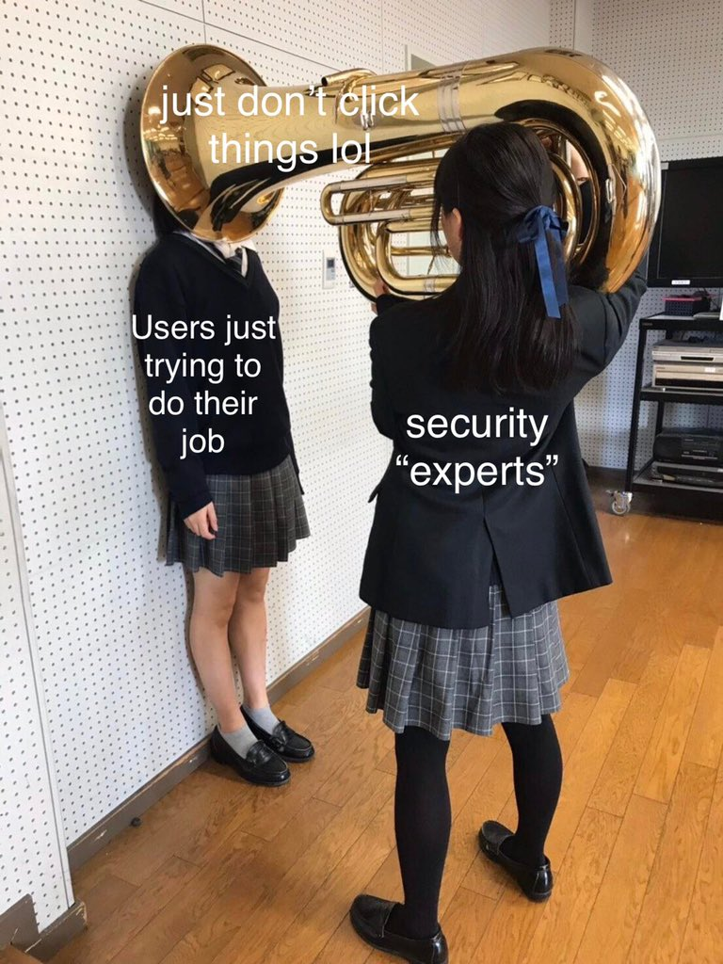

Slide 19
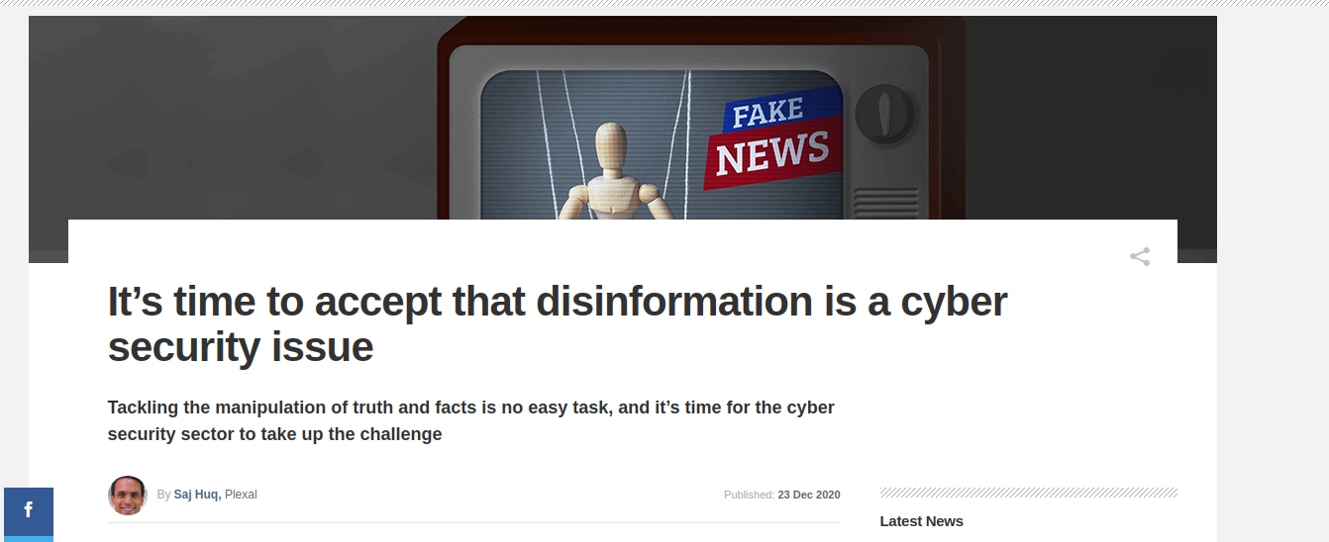
https://www.computerweekly.com/opinion/Its-time-to-accept-that-disinformation-is-a-cyber-security-issue

Slide 20
Good security awareness programs help everyone know where to get help
Who they should call when there is trouble
Where they can look for guidance & policies
They should know that they will not be looked down on for making a mistake
Someone’s job is to help them through whatever difficulty they are having

Slide 21
We can't make everyone an expert
We do NOT need to train the non-technical employees about what the deep level geek employees already know.

Slide 22
How do we reach EVERYONE and do it in a way that teaches them without lecturing and/or yelling at them. They only care about their job, so we need to work with them, not tell them.
Meet them where they live and bring security up in their lives and make it part of their work and tell them why.

Slide 23
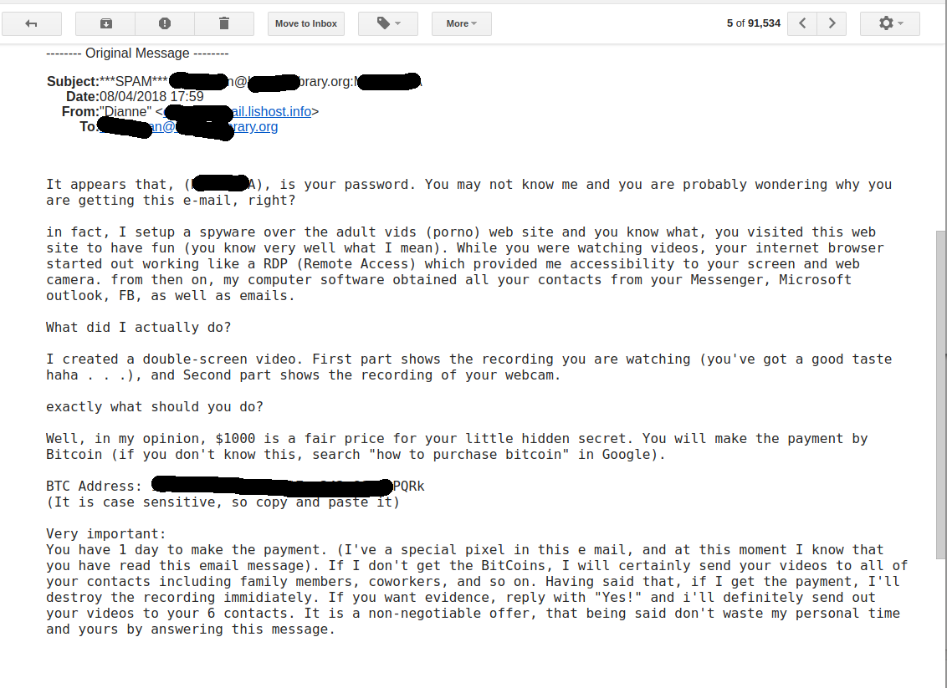

Slide 24
Understanding awareness, training, and development
What we want is policies that reinforce good security principles that will foster over time a new instinct in people, a new way of looking at things, a new way of acting in a more secure way.
This will require a huge amount of patience and buy in from every at your library.
Notes:
https://securitycatalyst.com/understanding-awareness-training-and-development/
April 16, 2013 by Michael Santarcangelo
Email
Print
The key to learning and teaching new skills lies in a three-step advancement: awareness, training, and development. These steps guide learning new skills, including effective communication, how to build better passwords, and even activities like archery and yoga.
Understanding this advancement allows us to build better communication. To ease the process of change. It’s a construct to build on, to model specific concepts. Each step plays a role in guiding the journey from where we are to where we need to be. By focusing on the needs of individuals, the entire organization advances.
Getting the terms right is the first step in experimenting with and ultimately advancing through each of the phases.
Awareness
Awareness: the individual realization of the consequences of an action, in their own context of intention and impact. Awareness often leads to action, but the action needs to be guided and supported.
“Once there is seeing, there must be acting. With mindfulness, we know what to do and what not to do to help.” ~Thich Nhat Hanh
Take passwords, for example. What does awareness of passwords mean? What does it look like?
Start by applying the definition of awareness to the concept of passwords. What is the consequence of selecting and using a password? Or of password reuse? The challenge isn’t the answer to the questions (especially from someone already aware). The problem is the lack of broad, individual understanding of the connection between intention and impact — in context. Instead, people know only that passwords are a pain to endure.
The key to awareness is to create an environment for individual realization.
Present familiar information readily embraced and understood by the audience. Focus on what matters to them. Guide a journey from a decision to an outcome. Allow them to work through the elements. Support the realization of the consequences — based on their intention, and with their impact.
I teach people how to build better passwords by providing a functional overview. No jargon. No math. A whiteboard diagram with boxes, arrows, and a discussion (not a lecture). For many, it’s the first time the information has made sense. It’s finally in context. Like light bulbs going off, people become aware of the consequences of poor passwords.
Awareness does not generally mean individuals have the understanding and experience to take the proper actions. Awareness is the realization. Nothing more. Once aware of the consequences, people often seek a desire to learn. They seek training.
Training
Training: a specific, timed situation to acquire and demonstrate new skills. Training is defined, measurable, and the outcomes demonstrable.
Training can be formal, informal, scheduled or ad-hoc. Training can take minutes, hours, days or longer. The key is training is the learning of new skills. The result of training is the demonstration of those skills.
Aware of how passwords work, training to build a better password starts with strategies. Participants learn different methods. Armed with information, the key to the training is how they use it. Built using the Information Interaction Model (IIM), people form small teams, plan their strategy and then compete against others.
In a matter of minutes, participants upset about the insanity of 8-character passwords confidently build, share, and explain the methodology to create 32-character passwords. I’ve even had a person come up to me over five years later to recite the password learned on a Tuesday afternoon! They learn, practice, and demonstrate the skills they need to build and use better passwords.
The challenge of training is that the new skills are often shelved in favor of familiar routines when faced with a consistent (read: unchanged) working environment. In other words, just training someone may not lead to lasting change in behavior.
Development
Development: the consistent practice of skills gained in training, exercised for the purpose of improvement.
Development can be formal or informal (personal, ad-hoc), structured or unstructured, long or short. Development must be adapted to the outcomes. Successful development incorporates a mechanism for measurement, assessment and recording progress.
During development, people gain experience and a deeper understanding of the skills and how to apply them. This often generates new awareness, inspires new (supplemental) training and encourages people to continue to develop their skills.
Effective development provides the right structure to guide individual improvement. Eases the process of change. Keeps development focused on applying the skills. Helps to prevent misunderstanding and bad habits.
The development path for passwords has a lot of options. It often starts as an extended dialogue. Build on newfound knowledge and skills to build better passwords. Talk about password reuse, proper development and operation, handling exceptions, and candid insights about common challenges. Encourage questions. Amplify experiences. Look for experiences to allow people to continue to apply and develop their skills.
Place emphasis on progress over perfection.
The more the organization supports and promotes development, the more successful the efforts to encourage new behaviors.
Shifting the culture, focusing on individuals
People make up companies. To shift the culture and influence change, use the advancement through awareness, training, and development to target and shift specific, individual behaviors. Address the needs of individuals to advance the organization.
I use these steps for my own learning. I guide clients, audiences, and workshop participants through this advancement. Understanding these three steps creates better outcomes.
Test it out. Let me know how it works. Get stuck, have a breakthrough or want to chat about it? Let’s connect and revive the art of conversation!

Slide 25
Notes:
If we look at something we know, something we’re an expert about, then it looks different. I know bikes, I know all about that bike just by looking at it.
This is how we want everyone to look at a bad site, or a phising email.
25

Slide 26
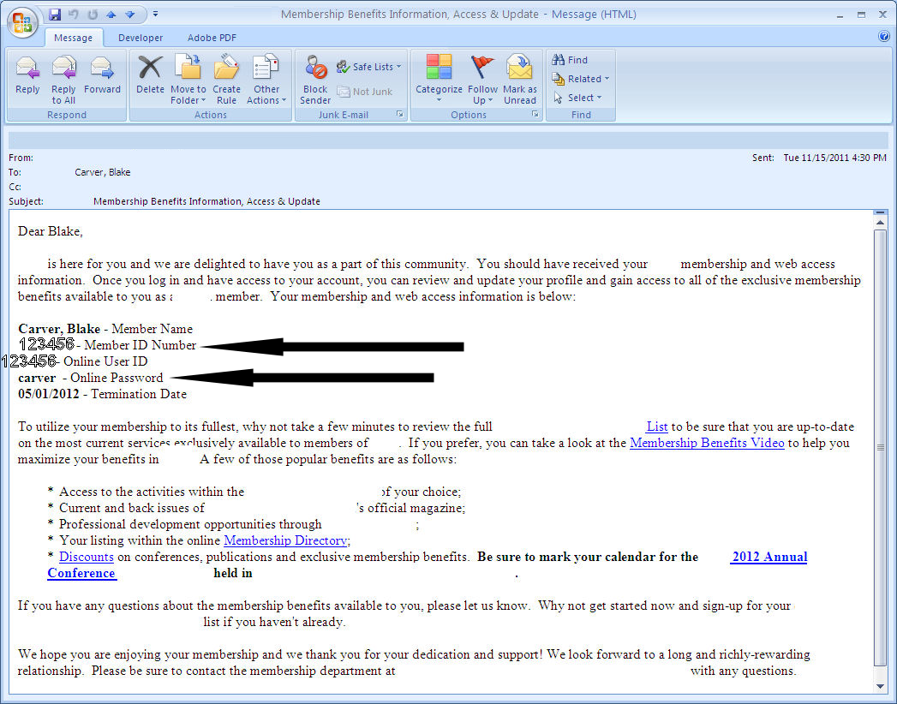
Notes:
This was my welcome email from a professional organization I joined last year. They assigned all new members a sequential number and set their password to their last name. I was able to login to the next 10 new members accounts.

Slide 27
Training
Phishing
Social Engineering
Privacy
Passwords
Email Attachments
Virus Alerts
Social Networking
Updates
Notes:
So what should we traing? All the things we outline here.
27

Slide 28
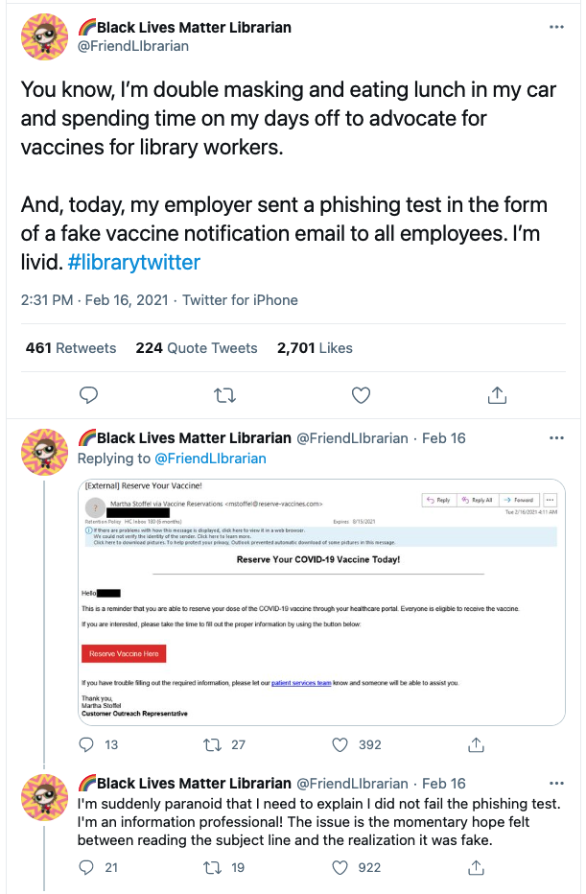

Slide 30
The goal is to make doing things the right way become the default in your library

Slide 32
Well then what?!
Criteria for good metrics.
Consistently measures (no subjective criteria).
Cheap to gather (preferably automated).
Expressed as a cardinal number or percentage.
Expressed using at least one unit of measure.
Contextually specific (i.e. relevant to decision makers so they can take action).
Two general categories for metrics. Categories that measure who took the training and metrics that measure the impact of the training.
WHO: This measures how many people took the awareness training.
IMPACT: This measures how effective the training was, are you getting a return for your investment.
Andrew Jaquith's book Security Metrics.
Notes:
https://www.sans.org/security-awareness-training/blog/security-awareness-metrics
https://drive.google.com/file/d/1U6QX60nZoHlTKRbjY0UQfq4rsGE-KGDA/view?usp=sharing

Slide 33
Training…. Patrons?
Your patrons don't care much for security
Their habits are inviting malware
Look for ways to make things safer in ways that don't interfere with people's everyday tasks as much as possible.
Principle of Least Privilege
Notes:
There is simply too much malware out there to be strictly focused on keeping your users infection free. They would become the modern corporate equivalent of “bubble people” whereby they can only interact with the world from a sterile environment. It’s impractical, and frankly impossible when you look at how business operates. Instead, you provide them with hand-washing education, the basics of how infection works, and rounds of anti-viral and antibiotic remedies when they do catch the common cold. Assume your users will get infected, but don’t assume infection means loss.
\
Integrating Security For Patrons
Information literacy!
Your patrons don't care much for security. They just want to get some work done. Or worse, they are actively trying to break it. This is why it's important to build security in, make it a part of everything from the start. Security needs to be an integrated process in everything your library does, and everyone needs to play a part. Sometimes your security policies will get in the way. Of course this will make people angry, Your users don’t want to be saved. They want to do what they want to do, when they want to do it. Somehow you'll need to define a set of acceptable behaviors and then put the hammer down on everything else. Do you allow everyone to install anything on their workstations? Companies are essentially split on whether to allow users to install applications -- 51 percent yes, 49 percent no, according to a survey of 765 professionals by security vendor Bit9. Do you block access to Flash and PDFs (frequently attacked programs)? Probably not, even though they are both a very common attack vector. Do you switch to a different PDF reader with fewer features that may be more secure? Perhaps. This is just one decision, among many, that should be made at the policy level to help make things safer. Look for ways to make things safer in ways that don't interfere with people's everyday tasks as much as possible. People will always find a way around policies if those policies get in the way.

Slide 34
Offer Training At Your Library
http://www.pewinternet.org/files/2015/09/2015-09-15_libraries_FINAL.pdf

Slide 35
What about training UP?
How do we communicate up?
Is your boss/director/board/dean/whatever aware of IT Security? If they were, would that help make the library more secure?
It may be up to you to help everyone at your library become Security Literate.
So how do you do it?
Start talking & training.
Make sure everyone understands that we are all targets.
If they ask “How secure are we? What’s this going to cost?”…
the answer will most likely scare them.

Slide 36
They (board/boss/whatever) need to know there’s other costs attached to new technology.
The technology costs $X
Securing that also costs $X

Slide 37
Boards should discuss cybersecurity regularly.
A recent McKinsey survey of financial services companies suggests best practices.
Nearly 95% of the firms reported that one of their board committees discussed cybersecurity and technology risks four times or more per year. Almost half the companies involved the board in cybersecurity exercises, and nine in 10 provided regular updates on cybersecurity to the full board.
Financial services firms furnish a good model because they have long been targets of attacks and have advanced cybersecurity programs. Their approach hints at what shareholders, regulators and others are likely to demand from boards in other industries.

Slide 38
Don’t Be Afraid To Brag

Slide 39
Security Exercises
It’s Gone
Pick a system, any system. Think of a reason why it’s completely hosed–failure of the entire RAID array, fire in the datacenter, evil script kiddies, sysadmin mistake–and see how your team copes.
Stowaway
Connect an unauthorized network device into your network and let it talk to something. See how your team tracks it down and removes it.
Blame the Mailman
A system that should never send mail starts sending
Naughty Ned
Choose a team member with elevated privileges (any member of your security or systems administration / ops team is usually a good choice, so might be a leadership team member or a developer). Pretend he or she has been fired, and revoke all of his or her privileges.
Evil Patron
You walk into your library as a patron with a Kali Linux laptop. Start exploring...
Notes:
Example Security Exercises 1 It’s Gone Pick a system, any system. Think of a reason why it’s completely hosed–failure of the entire RAID array, fire in the datacenter, evil script kiddies, sysadmin mistake–and see how your team copes. Some questions to ask when all is done: • If you don’t have another of these systems to fail over to, where are your users going while the system is down? What stopped working and for how long? • If you have a failover system, how long did it take to fail over? What did your users experience in the mean time? • How hard was it to replace the system? Were backups adequate? Did the available personnel know what to do and have the authority to do it? • What data was lost? Are backups being made often enough? • Were any other systems impacted by this system’s death? For example, if your LDAP server died suddenly, did administrators still have access to other systems? Did anything fail open? 2 Naughty Ned Choose a team member with elevated privileges (any member of your security or systems administration / ops team is usually a good choice, so might be a leadership team member or a developer). Pretend he or she has been fired, and revoke all of his or her privileges. Now he or she gets to cause whatever chaos he or she can with any privileges that remain. This is a great way to test your offboarding checklist. 3 Wolf in Sheep’s Clothing Most of the Red Team plays the part of ordinary users here. One plays a malicious user. Can the blue team terminate the malicious user’s activity without negatively impacting any of the nice users? 4 Committer Should Be Committed This is a great one for software development teams. A developer, working while sleep deprived (thank you red team), has committed something to the master branch of the repo that he or she 1 shouldn’t have. It might have been login credentials for an internal system, or naked pictures of the boss’s dog, the content doesn’t matter. The important thing is that it has to go. See how your team removes the offending data both from the working tree AND the repository history, without breaking everyone’s workflow beyond recognition. 5 Operation! If you run a devops environment, this one is for you. It’s far too easy for deployment workflows to end up with very low bus factors (the number of people who must be hit by a bus before the project is doomed or at least in serious trouble). Watch a deployment or two and figure out who the 1-3 most critical people are in that path, then declare them unreachable for the purpose of the exercise. Now, suppose that a critical security vulnerability has been found in your deployed product. Challenge your team to make a trivial code change (e.g. add a comment saying ”We did it!” to the code at a specified point) then run your entire test suite and deploy the code with those critical people gone. 6 Finger in the Dam Find a (hopefully fairly harmless) proof-of-concept for the most recent security vulnerability you applied patches for. Run it against everything and find out whether or not the hole was really plugged. 7 Negative Nancy Have a red team member contact your primary customer support avenue, playing the part of a user who is absolutely certain that their private information entrusted to your service has been compromised. Bonus points if the character is a ”difficult” personality. See how the team handles it. 8 Fell Off a Truck Your primary authentication database has fallen off a truck (your choice whether this is your database of external user accounts or something for internal personnel only). Demonstrate how you would notify those affected and force password resets. Bonus points if you can detect and flag attempts to use compromised credentials. 9 Ewe Did It Start an (otherwise innocuous) process on one of your system that occupies as much RAM as it can get its hands on. See how long it takes for anyone to notice, and how they respond. 10 Stowaway Connect an unauthorized network device into your network and let it talk to something. See how your team tracks it down and removes it. 2 11 Exfiltration One of your employees has decided that they would like your big, valuable, internal database. The Red Team tries to exfiltrate the target (any way they like) without being detected. 12 Nosy Nelly One of your systems starts nmapping the network. Does anyone notice? 13 Blame the Mailman A system that should never send mail starts sending (or trying to send) spam. What happens next? 14 Delivery Someone not known to your staff tries to talk their way into some limited-access area of the building, such as your datacenter. It helps to appear pregnant, talk on your phone, tailgate someone, carry something heavy, or insist you are making a delivery or have an appointment. See if anyone stops you. 15 Pick-up Stix Drop some USB sticks around the building: in the parking lot, the restroom, a conference room, a lobby. Place an autorun executable on the sticks that notifies you when they are inserted in a machine that autoruns USB devices, and place an interesting-looking file on there that also tries to call home when opened. 16 Phishing Expedition Send a convincing phishing email (with at least one flaw that a reasonable person would pick up on) to your staff, directing them to a fake login page and see who gives up their credentials. Note: this one is likely to rankle some people who feel duped when you come out and tell them what happened, but is really good at driving home the importance of phishing awareness if you can afford the political fallout. 17 Compromising Positions Suppose that a rootkit has been discovered on a critical piece of infrastructure on your internal network (e.g. your Satellite server or your LDAP server). Challenge your team to prove that none of your *other* systems have been compromised. Not assume: prove. 18 Failure is Always an Option Single points of failure are frequently discussed in meetings. Pay attention, and document these, then break one. Does the scope of the outage match expectation? Does the recovery time/process match expectations? 3 19 Free For All This is a big, high-investment exercise to run, but it’s also the best: Set up a dedicated environment for your exercise to run in that is not connected to your other internal networks or to the public internet. Provide a set of services that need to be kept running, and consider adding some data meant to be kept confidential. Don’t set up that environment in the most secure way possible. Set targets for the Red and Blue teams with various point values, e.g. 10 points to each team for each system they control at the end of the exercise, 20 points for the blue team for every half-hour that a particular service continues without interruption, 50 points for the red team if they find and decrypt such-and-such a file. Then set both teams loose with nothing but a time limit and see what happens. This work is licensed under the Creative Commons Attribution 4.0 International License. To view a copy of this license, visit http://creativecommons.org/licenses/by/4.0 Other licensing terms may be available by contacting sons@security.engineering or sesons@iu.edu 4

Slide 40
Create an Employee Offboarding Process
Your organization’s HR department likely has an offboarding process. That process should include IT and security personnel from the very beginning. Their role in the offboarding process should begin as soon as notice is given or as plans are in place to terminate an employee. IT and security should work together to create a checklist of their offboarding responsibilities, which should include the following:
1. Create an inventory of the employee’s digital life in the company. There should be a record of every company device in the employee’s possession, accounts they have access to and any admin permissions and responsibilities. The more that is known about the employee’s digital footprint, the easier it will be to delete it.
2. Set deadlines. Working with the employee’s manager, IT can set up specific times to delete access to accounts or have devices returned. At this point, the employee should only be able to access the data they are currently using to finish up projects. Also, begin to revoke software licenses for the outgoing user.
3. Audit what users do. Security should keep watch over network activity to ensure the employee isn’t downloading a high volume of files or moving them to personal clouds.
4. Deploy a data management solution that can easily silo employee data that must be retained.
5. Delete the employee’s access before they leave the building for the last time. Whether it is during the exit interview or the goodbye party, access to email, software, cloud services, apps and other digital properties should be removed.
6. Create a thorough list of digital devices to make sure everything has been recovered.
7. Shut access to any apps on personal devices.
8. Change passwords and set up forwarding for email and voicemail.
9. Use a zero trust model for security. Once the person leaves, security should consider a zero trust model (if it isn’t used already) as part of the offboarding process. They should also assume that any attempt to log in is a potential threat that means action is required.
https://securityintelligence.com/articles/offboarding-checklist-safely-closing-doors/

Slide 41
Treat security like a special collection
LFI: Privacy & Security in Public Libraries:

Slide 42
Securing Your Library’s Website

Slide 43
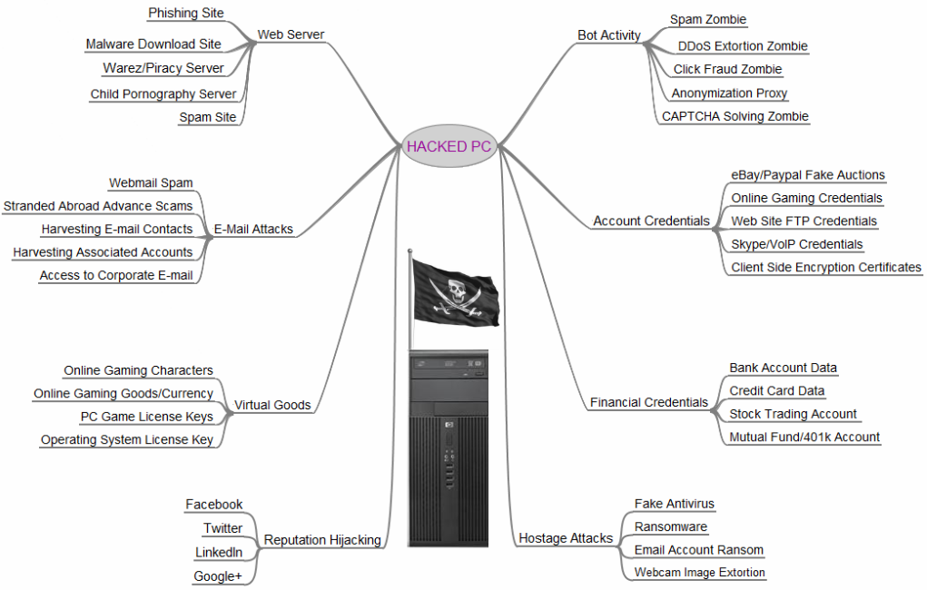
Server
http://krebsonsecurity.com/2012/10/the-scrap-value-of-a-hacked-pc-revisited/

Slide 44
Servers Are Better!
Bigger
Better
Faster
Always On
Unattended
Bigger Pipes!
Full of stuff!!
People come to visit!!!
Notes:
Reliable and always on: By their very nature, web servers are always on, more so than your typical home or office laptop or desktop. Web servers are typically located in secure facilities with backup power. They are generally immune to power outages but also configured to restart in the event of a power cut, or any other “event” for that matter. This makes them ideal for criminal activity which needs 7×24 access to processing power, storage, and bandwidth. Such activity includes executing Distributed Denial of Service attacks and distributing malicious code used for financial fraud, spamming, DDoS, spying, identity theft, illegal pharmaceutical sales, and more.
Largely unattended: Have you or your company ever started a web project and then abandoned it or put it on the back burner? I’m betting that millions of people have, creating a large pool of under-administered web servers out there, ripe for takeover from owners who are not paying attention. That lack of attention translates into lower detection rates and longer service times per compromise.
Plenty of bandwidth: Most web servers are sitting on high speed Internet connections designed to handle large amounts of traffic. This adds to their appeal to the bad guys who may want to tap that bandwidth for nefarious activities.

Slide 45
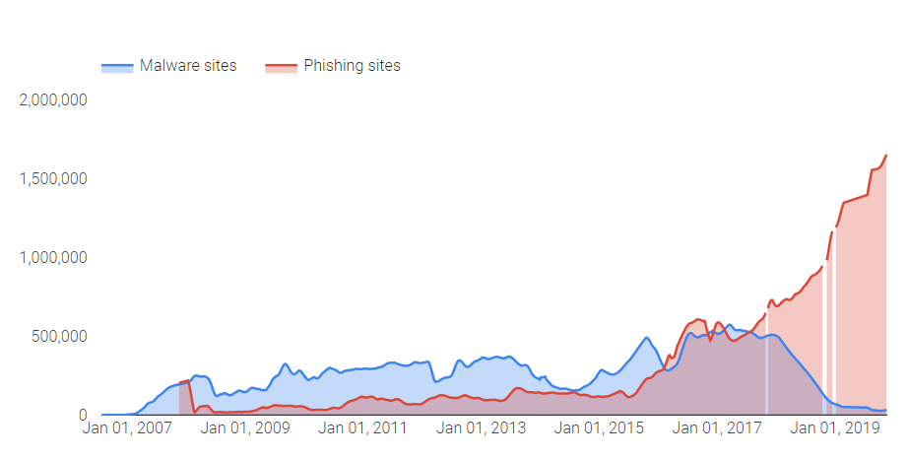
Attackers are shifting to phishing
https://transparencyreport.google.com/safe-browsing/overview

Slide 46
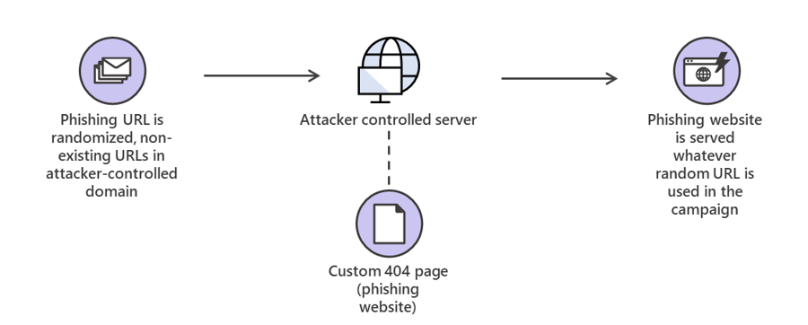
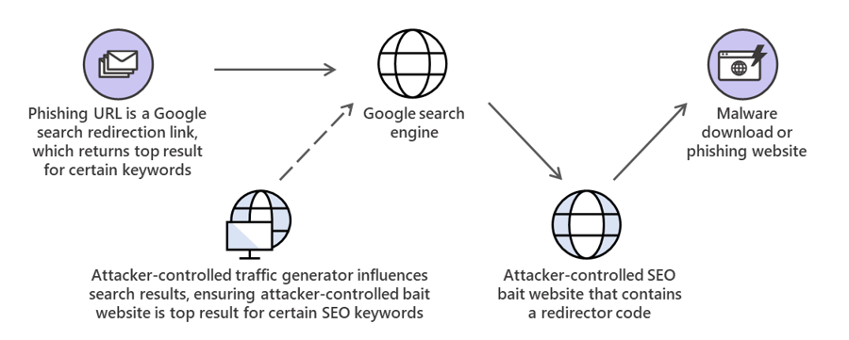
https://www.microsoft.com/security/blog/2019/12/11/the-quiet-evolution-of-phishing/
Phishing Links Using 404s or Google Results

Slide 47
Any Good Web Site Can Go Bad
At Any Time
Notes:
May 2, 2012, 1:59PM
Nine Percent of Websites May be Malicious
Share on twitterShare on facebookShare on redditShare on google_plusoneShare
2 Comments
by Brian Donohue
Just fewer than 10 percent of websites serve some sort of malicious purpose, with an additional nine percent of sites being characterized as “suspicious” by Zscaler in a new research report.
Zscaler ran 27,000 website URLs through a tool they developed to assess the security of websites and give them a score from zero to 100. Nearly 81 percent of sites scored between zero and 49 (benign). 9.5 percent scored between 50 and 74 percent (suspicious) and another 9.5 percent scored somewhere between 75 and 100 (malicious), according to the company's State of the Web Report.
The report also indicates that outdated plug-ins and the users that refuse to update them continue to be a serious but improving problem in the enterprise. Zscaler cites the Flashback outbreak, which exploited known java vulnerabilities, as anecdotal evidence of this. The report shows that more than 60 percent of Adobe Reader users are running an outdated version of that software. Adobe Shockwave came in second, with 35 percent of users running an outdated version. Java came in fourth, with a only five percent of users running an outdated version.
Editor's Pick
Celebrity Ashton Kutcher Firesheep'd at TED Conference
Network Of 7K Typo Squatting Domains Drives Huge Traffic To Spam Web Sites
New Clickjacking Scam Uses Facebook, Javascript, Our Primate Brain To Spread
Threatpost Newsletter Sign-up
It appears also that enterprises are increasing their efforts to block employees from visiting social networking sites. When the quarter opened, social networks only accounted for 2.5 percent of policy blocks; by the end of the quarter, that statistic had increased to four percent.
Some other interesting info-morsels include Zscaler’s findings that Apple devices are becoming more prevalent in the work place as Android and BlackBerry devices become less prevalent. Facebook’s share of Web 2.0 traffic is down slightly from 43 percent in Q4 2011 to 41 percent in Q1 2012. On the other side, Twitter saw its share of such traffic increase over the same period from five percent to seven percent. Zscaler claims that the drop in Facebook’s traffic share is due to corporate policies that are increasingly blocking employee access to that social network while remaining noticeably less concerned about employee access to Twitter. Zscaler also believes that Twitter’s traffic-share increase may suggest that the service is being more widely adopted for use in the enterprise.
Sports and gambling sites generally see a spike in traffic in Q1 that can very likely be attributed to events like the NFL playoffs, Super Bowl, and March Madness in America and the International Cricket Council's Cricket World Cup in places like India and Australia. This year, those sites’ traffic increased a dramatic 74 percent.
Commenting on this Article will be automatically closed on August 2, 2012.

Slide 48
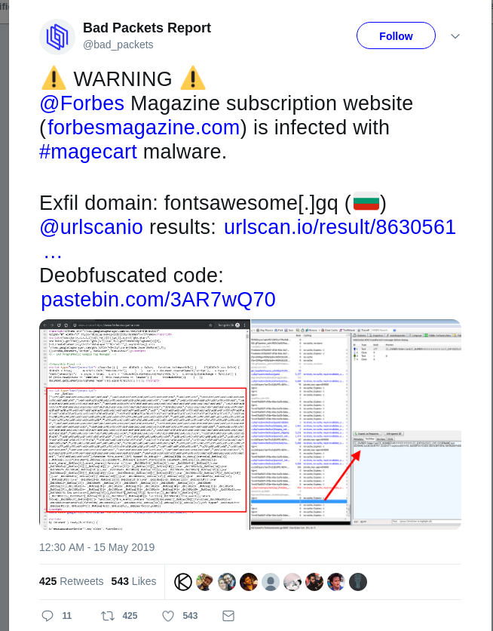

Slide 49
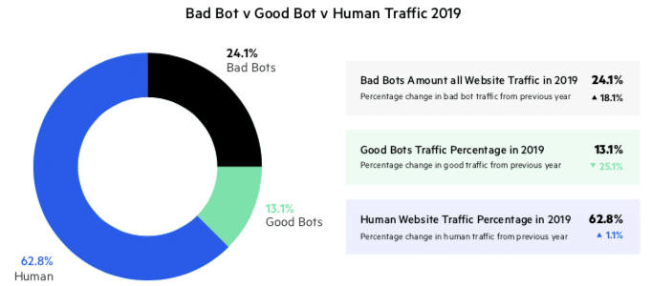
https://www.imperva.com/blog/bad-bot-report-2020-bad-bots-strike-back/
Notes:
Parasitic Drag: The Hidden Cost of Bots
from Security Bloggers Network by Rob Rachwald
Incapsula (full disclosure: Incapsula is a subsidiary of Imperva) today released a great bit of research. They asked: "What is the overhead of all the automated bot traffic?" Today, most people think that a cost is incurred from bad bots only when a breach occurs. Not true if more than up to 80% of your total web traffic comes from machines. The automated traffic has a drag-like effect seen in aerodynamics. They write: Most of this traffic is automated and is entirely unrelated to the website’s real human traffic. Basically, each website spun up by a hosting provider will suffer...

Slide 50
Key Findings from the 2020 Bad Bot Report:
Bad bot traffic rises to highest levels ever. In 2019, bad bot traffic comprised 24.1% of all website traffic, rising 18.1% from the year prior. Good bot traffic consisted of 13.1% of traffic—a 25.1% decrease from 2018—while 62.8% of all website traffic came from humans.
Financial services industry hit hardest by bad bots. Every industry has a unique bot problem ranging from account takeover attacks and credential stuffing to content and price scraping. The top 5 industries with the most bad bot traffic include financial services (47.7%), education (45.7%), IT and services (45.1%), marketplaces (39.8%), and government (37.5%).
Moderate to sophisticated bad bots make up almost three quarters of bad bot traffic. Advanced persistent bots (APBs) continue to plague websites and often avoid detection by cycling through random IP addresses, entering through anonymous proxies, changing their identities, and mimicking human behavior. In 2019, 73.7% of bad bot traffic was APBs.
More than half of bad bots claim to be Google Chrome. Continuing to follow browser popularity trends, bad bots impersonated the Chrome browser 55.4% of the time. The use of data centers reduced again in 2019, accounting for 70% of bad bot traffic—down from 73.6% in 2018.
For the third year in a row, the most blocked country is Russia. In 2019, 21.1% of country blocks were Russia, followed closely by China at 19%. Despite this, with most bad bot traffic emanating from data centers, the United States remains the “bad bot superpower” with 45.9% of attacks coming from the country.

Slide 51
Analyzing a malicious site
Use a VPN Use the command line - wget / curl
VirusTotal.com
UrlScan.io
Google Safe Browsing
https://zeltser.com/lookup-malicious-websites/

Slide 52
Notes:
Keep those things updated!!!
Does this mean WP and Draupl are insecure? NO. They really set the standard for how they respond to security troubles. They have a team to work on security, and ways to announce fixs. They are attacked frequently because they are so popular. So the point here is WP and Drupal ARE INSECURE IF YOU DON'T KEEP THEM PATCHED. Security Depends on Your Paying Attention

Slide 53
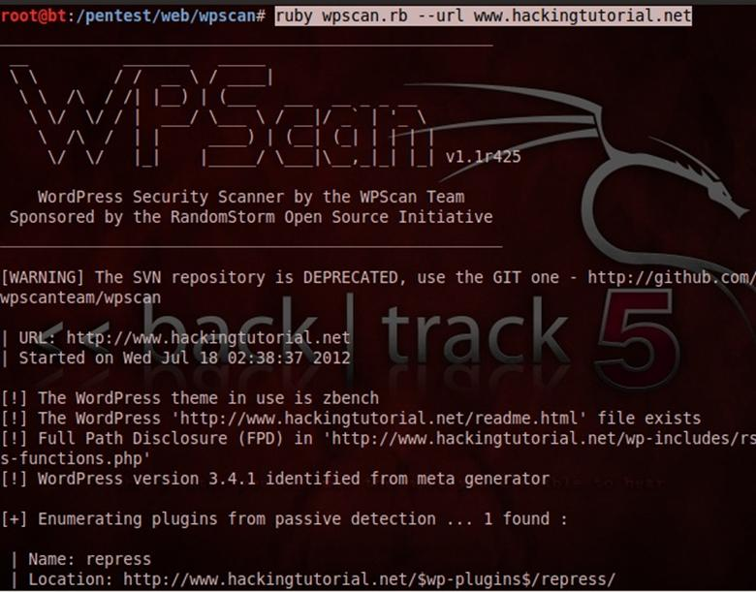

Slide 54
How Do I Know My Site's Been Hacked?
1. Errors on the pages
2. Errors In The Logs
3. New server side processes, users, jobs
4. Files have changed or appeared
5. You show up on black lists
6. Random things in your ad blocker
7. Weird redirects

Slide 55
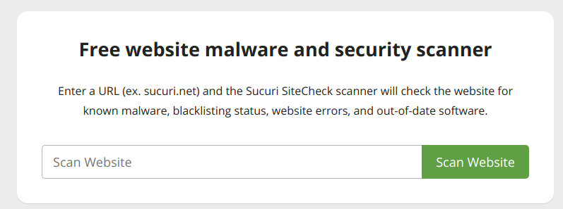
https://sitecheck.sucuri.net/

Slide 56
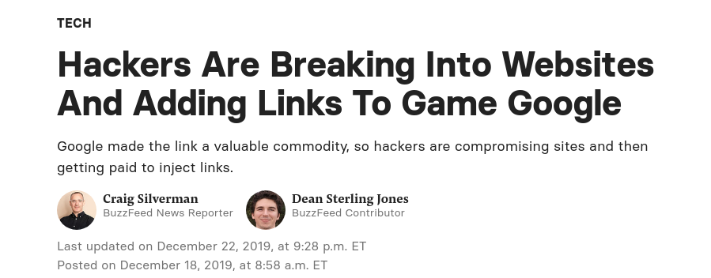

Slide 58
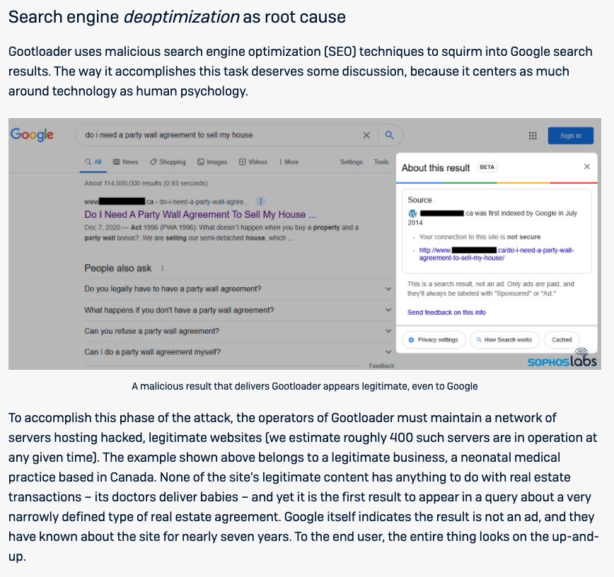
https://news.sophos.com/en-us/2021/03/01/gootloader-expands-its-payload-delivery-options/

Slide 59
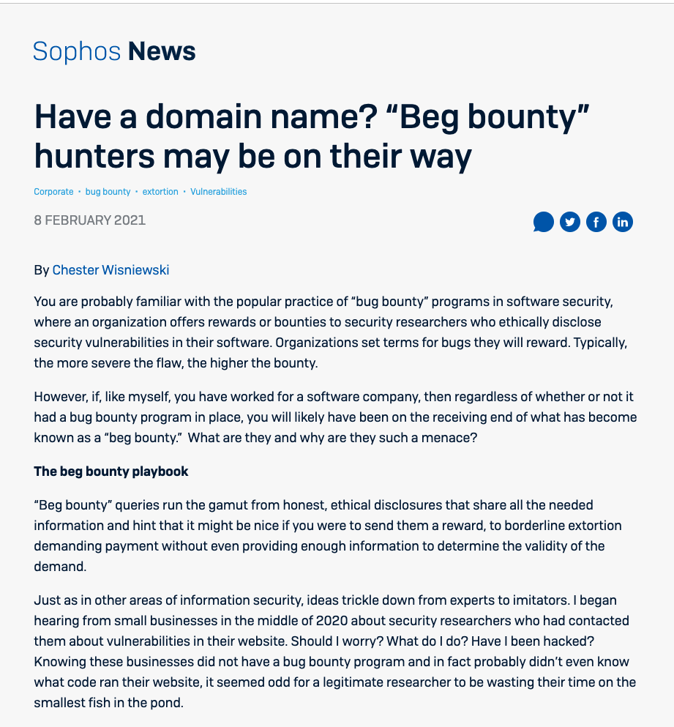
https://news.sophos.com/en-us/2021/02/08/have-a-domain-name-beg-bounty-hunters-may-be-on-their-way/

Slide 60
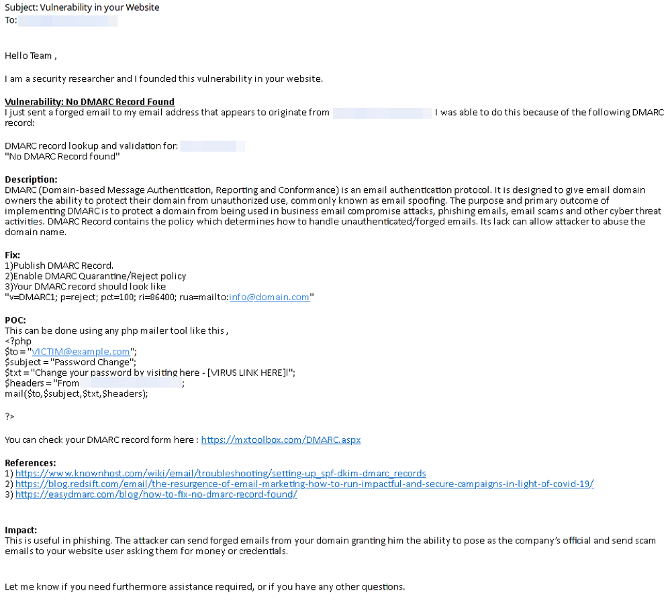

Slide 61
Now What??

Slide 62
Strategies to Mitigate Cyber Security Incidents:
https://goo.gl/ctaecX
Now What?
https://goo.gl/Xavh6s

Slide 63
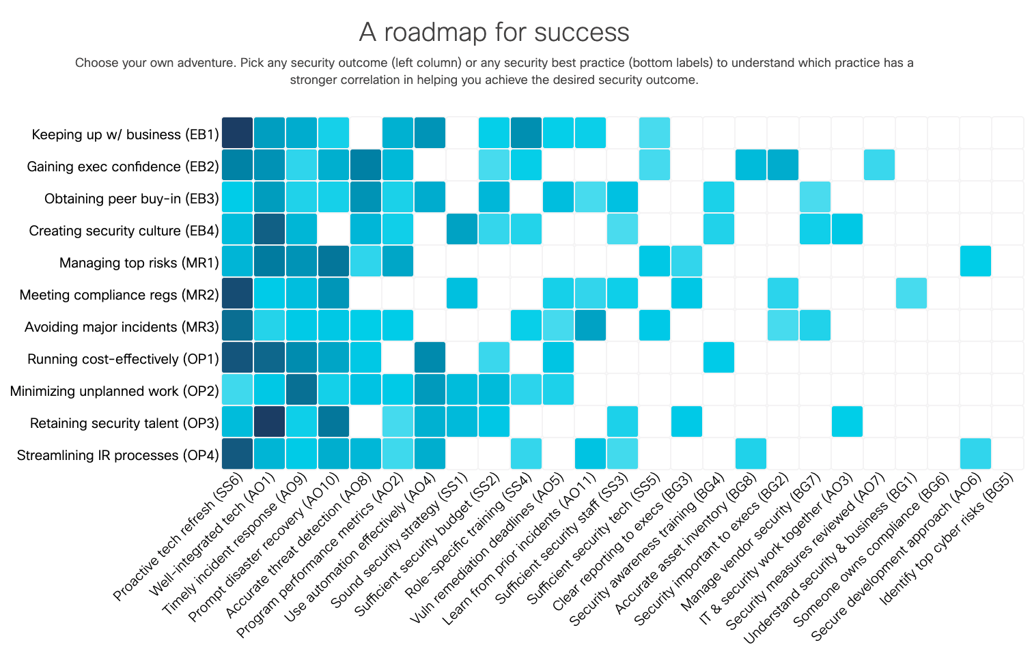

Slide 64
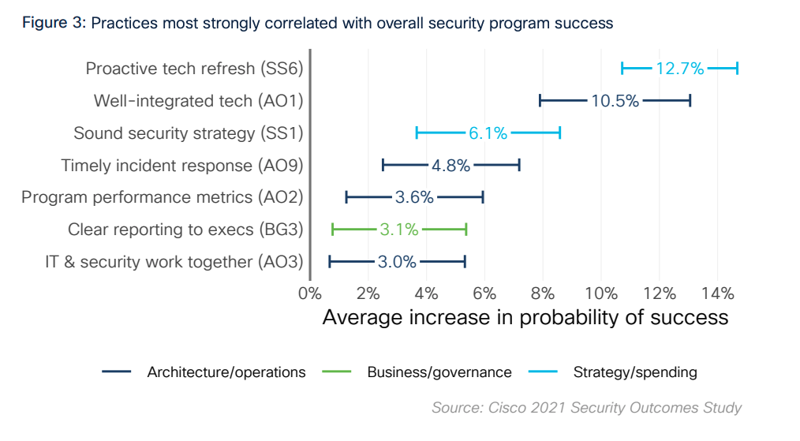
https://www.cisco.com/c/en/us/products/security/security-outcomes-study.html

Slide 65
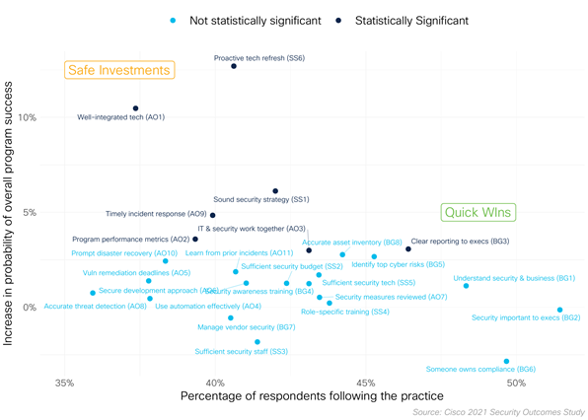
Proactive Tech Refresh
Well Integrated Tech
Sound Security Strategies
Timely Incident Response
IT & Security Departments Work together
Program performance metrics
Clear reporting to executives

Slide 66
You
Use a password manager & 2FA
Encrypt your disks in portable devices (FileVault, BitLocker, TrueCrypt)
Using a public network? Use a VPN
Browser Plugins
Updates / Patches
Don't run as root / admin
Firewalls
Remove Programs / Processes / Services
Clean Up Your Footprints
Stay Current

Slide 67
Your Library
Threat Modeling
Lock down all the “things”
Hardware Security Checks
Limit Users - Least Privilege
Browser Plugins
Updates / Patches
Networks
Training & Planning

Slide 68
Your Library
Remove programs / Processes / Services
Logging and auditing
Backup & Encrypt
Passwords
Website

Slide 69
Stay Current
https://ldhconsultingservices.com
Schneier on Security
http://www.schneier.com/blog/
SANS Newsbites
https://www.sans.org/newsletters/newsbites
Naked Security – Sophos
http://nakedsecurity.sophos.com/
Troy Hunt :
http://www.troyhunt.com/
SANS Reading Room
http://www.sans.org/
Podcasts :
http://grc.com/securitynow.htm Security NOW https://risky.biz/netcasts/risky-business/ Risky Business
https://securityinfive.libsyn.com/ Security In 5

Slide 70
Questions \ Feedback?
Blake Carver
LYRASIS Systems Administrator
@blakesterz
@lisnews
blake.carver@lyrasis.org
Notes:
70

