Slide 1

Cybersecurity: Week 2
Securing Our “Things”
Blake Carver
Senior Systems Administrator, LYRASIS
April 2021
Cybersecurity Training for Libraries
Week #2
Notes:
Include a Title Slide

Slide 2

This project was supported in whole or in part by the U.S. Institute of Museum and Library Services under the provisions of the Library Services and Technology Act, administered in California by the State Librarian. The opinions expressed herein do not necessarily reflect the position or policy of the U.S. Institute of Museum and Library Services or the California State Library, and no official endorsement by the U.S. Institute of Museum and Library Services or the California State Library should be inferred.
Notes:
This is a quick FYI that this workshop is part of a project supported by the Library Services and Technology Act, so thank you to the grant authority for providing resources for this project. You can find this statement in the slide handouts as well.

Slide 3
Today’s Schedule
10:00 – 10:20 Welcome & course housekeeping
10:20 – 10:45 Training
10:45 – 10:50 Break
10:50 – 11:25 Training
11:25 – 11:30 Wrap up
Notes:
This cybersecurity train the trainer webinar series runs on Wednesdays from 10 to 11:30. Each week we’ll try to keep close to the schedule posted in the slide. There will be some time for Q&A at the end of the session, so if any questions pop up during the presentation, you can enter them in the chat box so we can answer them then.

Slide 4
Series Housekeeping - Outline
Week One – Welcome – Explanations of why and what’s wrong
Touch on some privacy issues.
Why are libraries, and all of us, targets?
Why is security important?
Professionals and Incentives, big money.
What are they after and where are they working?
Passwords
Week Two – Securing our things
Passwords
What things do we have to secure?
Hardware, software, etc
How do things actually get infected? How can we spot it?
Email, phishing, browsers, VPNs, Tor,
desktop, mobile, everything else.
Week Three - Making Your Library Defensible & Resilient
What and why of things around the library
Hardware, networks, ransomware
Week Four – Wrapping It All Up
Training, planning, vendors
Websites
Checklists and specific steps to take next.
Notes:
This week we are starting off with an overview of libraries and data privacy. For those of you who too last year’s training, this should be a refresher. Week two is where we get into library privacy training, including training development and ways of supporting staff outside of training. Week three goes back into library operations with three main topics that go beyond basic data privacy training, including risk assessment and patron programming. Week Four brings everything together to focus on building a culture of privacy in all areas of the library, including what to do after the series.

Slide 5
The Importance Of Passwords For You & Your Library

Slide 6
Passwords
Reuse
Weak
Notes:
The average Web user maintains 25 separate accounts but uses just 6.5 passwords to protect them, according to a landmark study (PDF) from 2007. As the Gawker breach demonstrated, such password reuse, combined with the frequent use of e-mail addresses as user names, means that once hackers have plucked login credentials from one site, they often have the means to compromise dozens of other accounts, too.
A comment on an LISNews post from last week asked me about passwords. It seems like such simple, obvious topic, but when you stop and think about it, passwords are difficult, and a good answer does indeed take 1,399 words.
Do you always use unique passwords? Are those passwords always "strong"? Does your library's web presence require strong passwords for all users? Do you have password recommendation clearly posted on your web resources for your users? What makes a good password? Are complex passwords the most secure? Is it uniqueness? Is length the most important thing in a password? I'll start by saying the single most important thing is uniqueness, never reuse a password on everything.
Using the same password for everything is THE WORST thing you can do. If you learn just one thing from this post make sure it's password reuse is dangerous. Doing this will allow anyone who gets your password from an insecure site (and the chances of this happening are probably higher than you'd think) to use it elsewhere. Your password could have been taken from any number of large data breaches and you'd never know it. When these big hacks happen the only thing saving you from becoming an easy target is having a unique password. It's easy for a hacker to use your email address and password taken from a site like Gawker and use it as a starting point to cause some serious trouble.
New School Approaches to Passwords
from The New School of Information Security by adam
Adam Montville left a comment on my post, “Paper: The Security of Password Expiration“, and I wanted to expand on his question:
Passwords suck when they’re not properly cared for. We know this. Any other known form of
authentication we have is difficult because of the infrastructure required to pull it off. That
sucks too. Does this leave us at a stalemate where we need to get people to care about their
passwords?
I think the answer is “almost.” We need to agree that passwords suck when they’re not properly cared for, and that caring for them is hard. So we need to assume that passwords will tend to be poor, reused, etc, and develop methods to deal with that. Most of our mechanisms today punish users. We tell them to memorize 100 or more unique passwords, and then “security experts” abuse them for re-use or using a password management tool.
Cormac Herley has claimed that the password has a set of properties including being subject to memorization that make it impossible to replace, and we should accept that and start engineering for it. (“A Research Agenda Acknowledging the Persistence of Passwords” and “Passwords: If We’re So Smart Why Are We Still Using Them?“)
Similarly, Nate Lawson posted “On the evolving security of password schemes” which closes “most admins focus too much on increasing entropy of user choices and not enough on decreasing the attacker’s guess rate and implementing responses to limit their access when they do get a hit.” Indeed.
We need to observe the world, and ask how we can work within the constraints it presents regardless of if those constraints are economic, sociological or evolutionary.

Slide 7
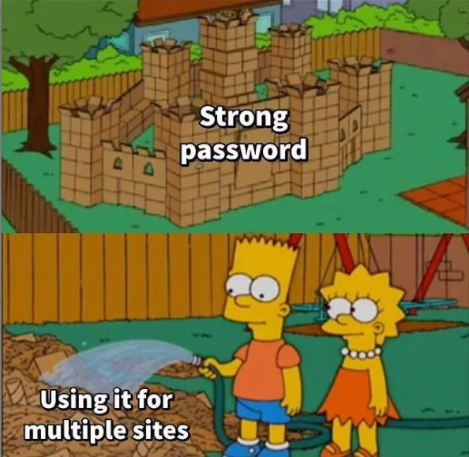

Slide 8
How Did They Get My Password?
Guessed
Password Reset
Stolen Mobile Device
Phishing
Trojans/Virus/Malware
API Exploitation
Third Party App Exploitation
Website Breach
Notes:
Protect Twitter Accounts from Seven Types of Hacking Attacks
Sending embarrassing tweets, posting merchandising spam, or deliberate lock outs are a normal consequence of hacked twitter accounts. An account is compromised when an unauthorized user has been able to obtain (and perhaps change) the original username and password or has gained access to an open twitter session (such as via access to a phone or tablet with stored credentials). Indications of a
Attack
Description
Defense
Limitation
Guess You Password
Your weak password was easily guessed by a hacker e.g. twitter123
Use Twitter two factor authentication (2FA) i.e additional authentication using SMS), which forces a hacker to obtain additional access to your phone or to intercept the twitter 2FA SMS to take control of your account, which poses quite a challenge.
Use strong passwords
Twitter 2 FA Service is not offered by all mobile companies
Password Resets
Your password was changed by a hacker who previously compromised your email id registered for twitter password resets. The hacker simply reset you twitter password, received the reset link in the compromised email account and then changed the twitter password
For both your twitter and email accounts
Use 2FA (additional authentication using SMS)
Use strong passwords
Twitter 2FA Service is not offered through all mobile companies
Not all email services offer 2FA
Obtain Access to your cell phone or tablet
The hacker obtains access to your cell phone. Normally, users remain logged on to twitter as well as to their personal email account on mobile devices. Accounts can then be easily used or passwords reset.
Password protect your cell phone, and set the phone to lock out on ten failed tries. For a higher level of security, one can erase the phone data on ten failed lock out attempts. This works when you take a regular backup of the cell phone data.
Use complex passwords as simple passwords can be easily cracked with software. This is an inconvenience, which is worth the effort. Even a complex six digit numeric code, with ten lock out attempts will do
Reset your twitter, email and other passwords if your phone has been lost or stolen
Slight inconvenience when using the phone or tablet.
Phishing
You part with your twitter credentials, in response to a con mail claiming to come from either twitter or your email providers customer support team
Be aware that you should never part with your credentials. No firm asks for these credentials
Trojan (malware) based attack
You download Trojans on your desktop or phone which steals credential and forwards them to the hackers
Use antivirus software
Use 2FA
It is difficult for users to recognize malicious apps and websites.
2FA Service is not offered through all mobile companies
Exploitation of Vulnerable Twitter API‘s
Your password is stolen through the exploitation of a technical vulnerability in the Twitter service
Twitter, on detecting such breaches, locks these accounts and sends a password reset notification
Exploit third party applications
Access to your twitter accounts is obtained via third party applications that have been given rights to write to your twitter feed.
Review your list of third party applications in the twitter account setting page (application tab) and revoke these applications.
Use strong passwords for these applications
Change the twitter password on detection of unintended posts through these accounts
Do not grant access to websites which promise more followers or applications which post advertisement. Some of these may be malicious or prone to being hacked themselves

Slide 9
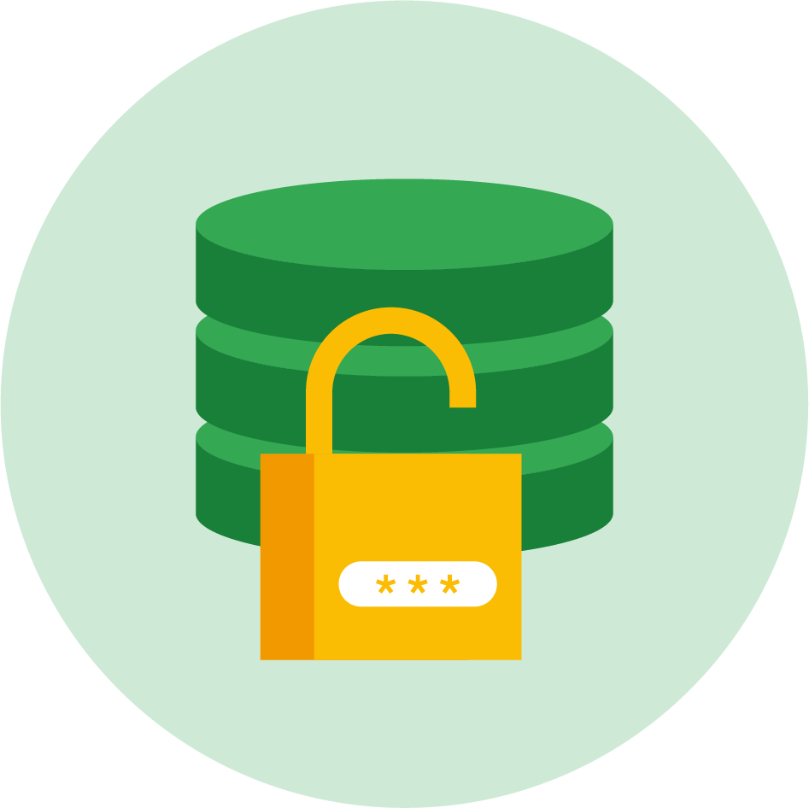
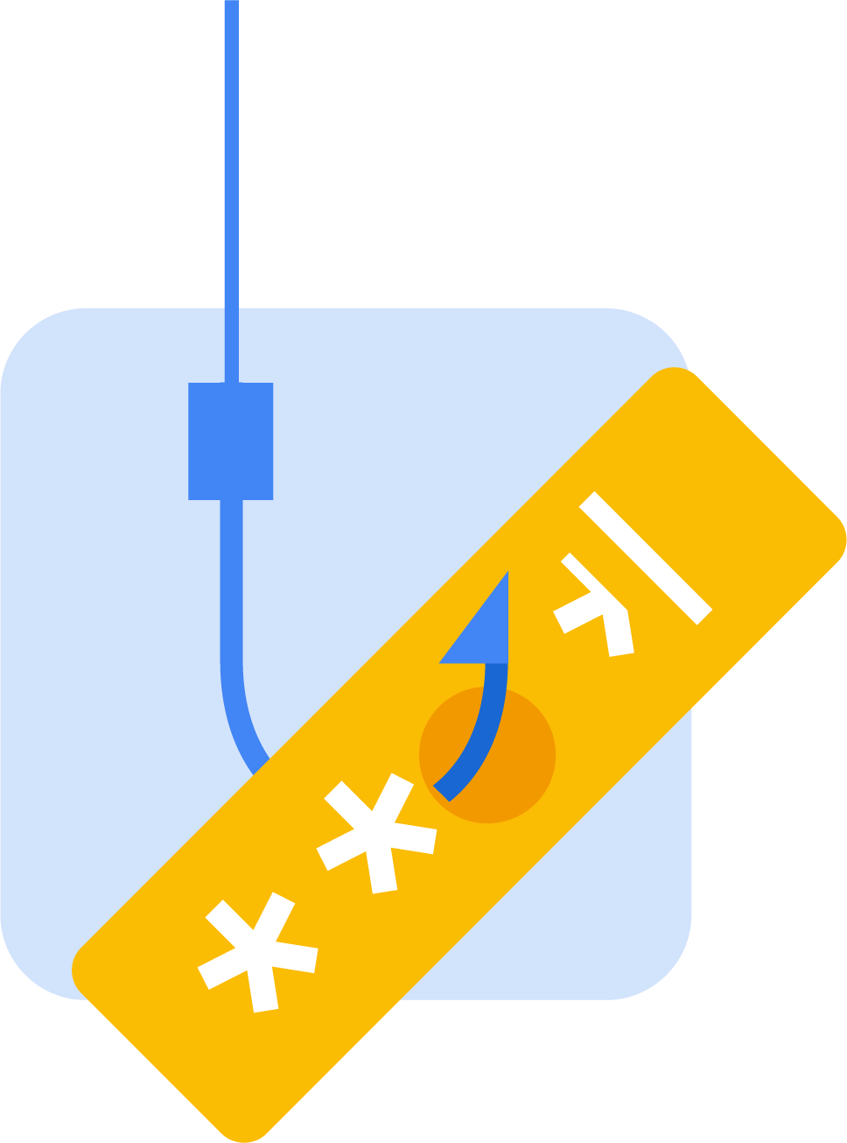


Data breach
Stolen credentials volume
Phishing
Keyloggers
Targeted attack
Risk

Slide 10
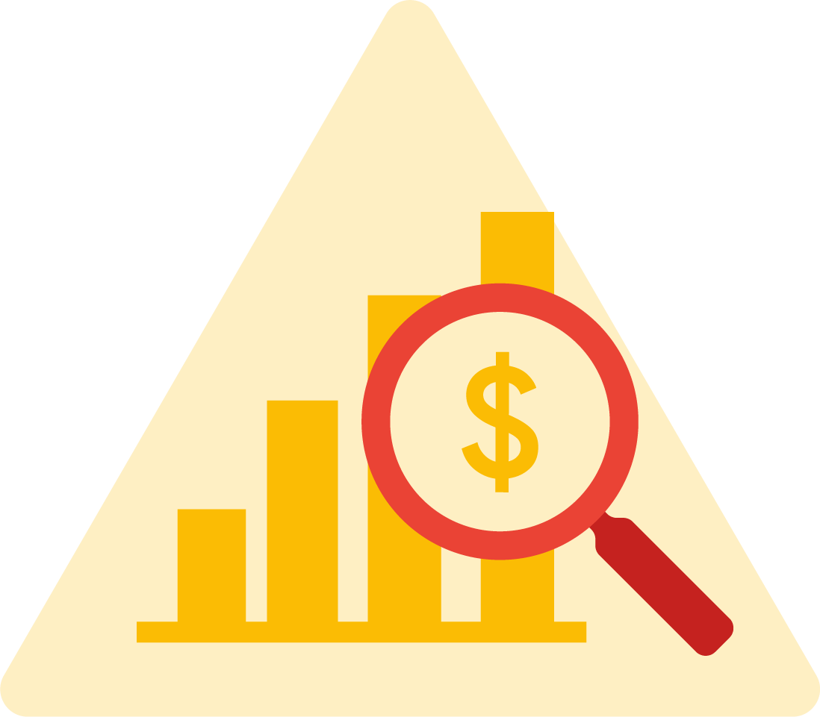
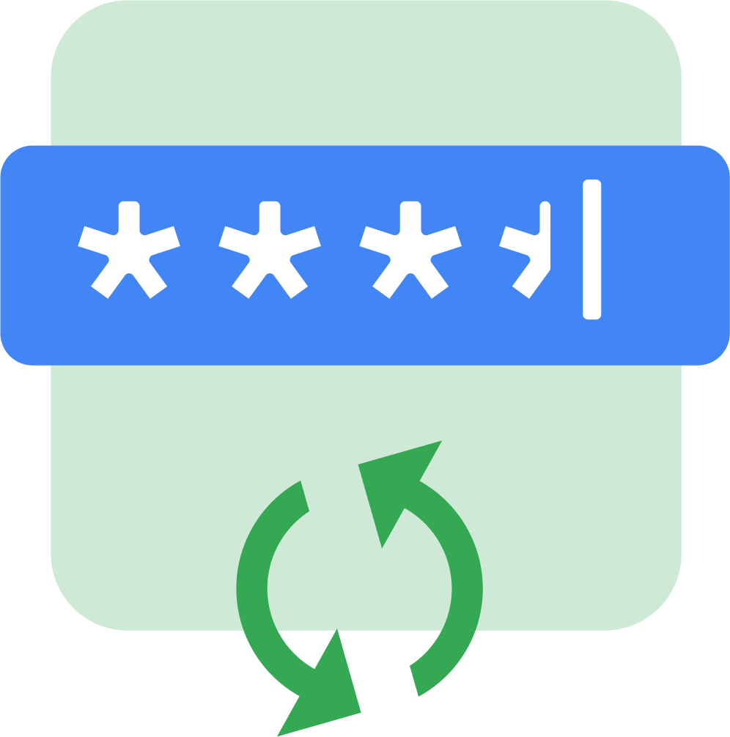
Stolen credential origin takeaways
The black market fuels account compromise
Password reuse is the largest source of compromise
Phishing pose significant risk

Slide 11
people respond to policies, perversely
ZAQ!@#$
P@5sw0rd1!
Passwords
Notes:
The fourth principle is that people respond to incentives, perversely. A straightforward example is that of complicated password policies, the more complicated they are, the more a person is likely to write down the password on a sticky note underneath their keyboard, thus making the system less secure, not more so. The consequence of this is that people have a fixed risk tolerance. When you make things safer, people behave more recklessly. If you install anti-virus on their desktop, they are more likely to run e-mail attachments. Measured one way, such as on an obstacle course, talking on a mobile phone impairs a person's ability to drive. Measured with economics, we find that while people are on the phone, they slow down and otherwise drive more safely, to accommodate the distraction. Drivers slow down and pay attention when it rains to compensate for the additional danger, which means they speed up and drive more recklessly when the roads dry up to compensate for the increase safety.

Slide 12
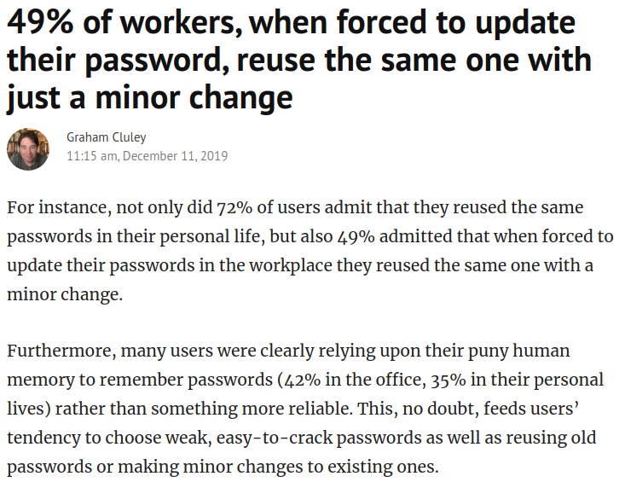

Slide 13
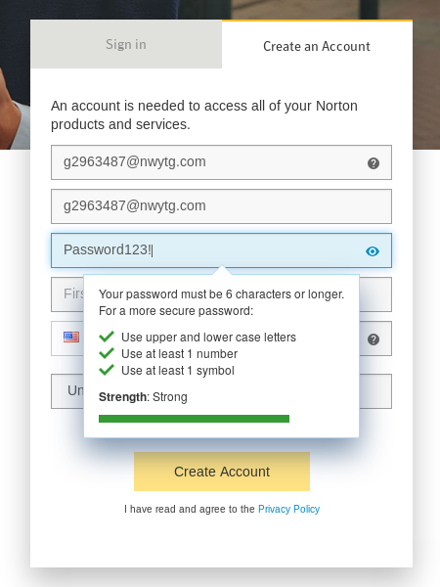
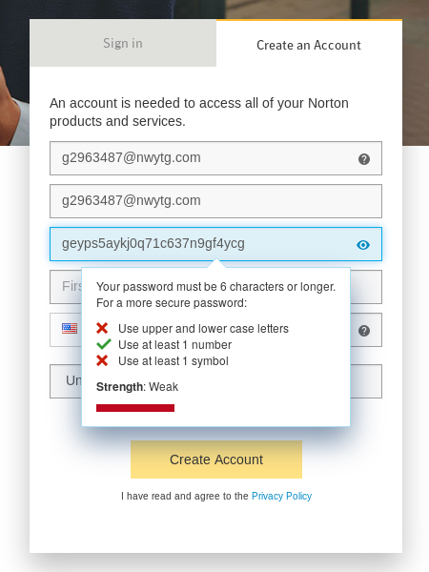

Slide 14
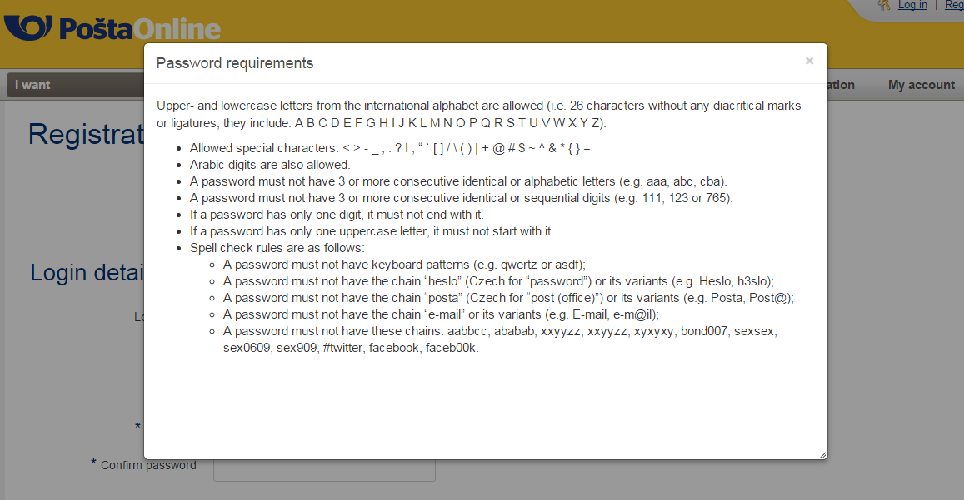

Slide 15
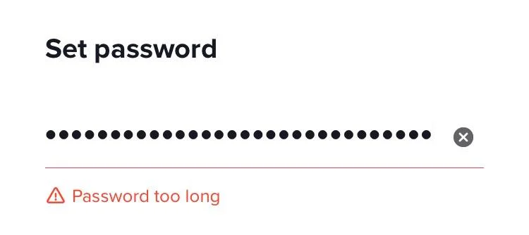

Slide 16
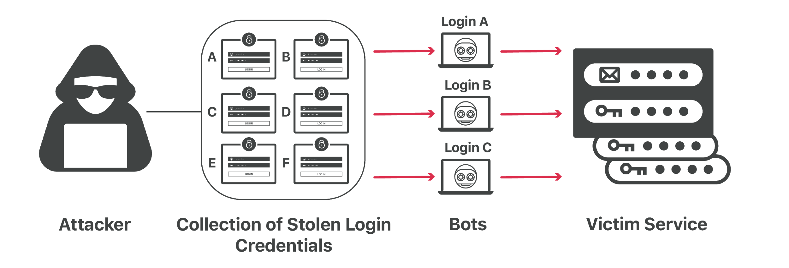

Slide 17
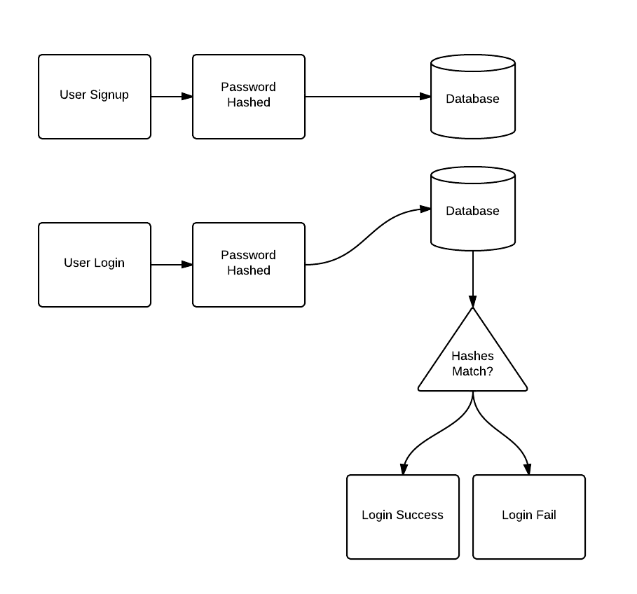

Slide 18
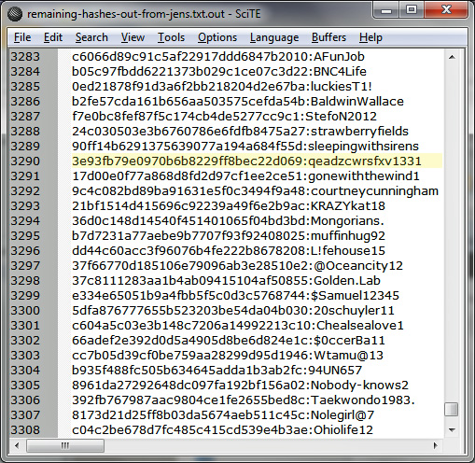

Slide 19
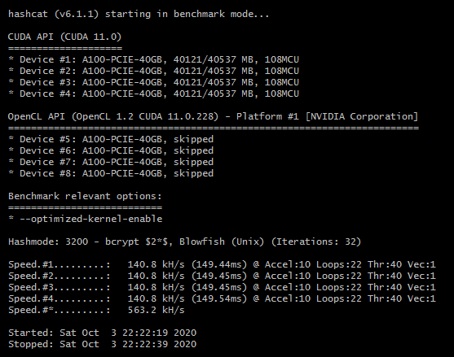

Slide 20
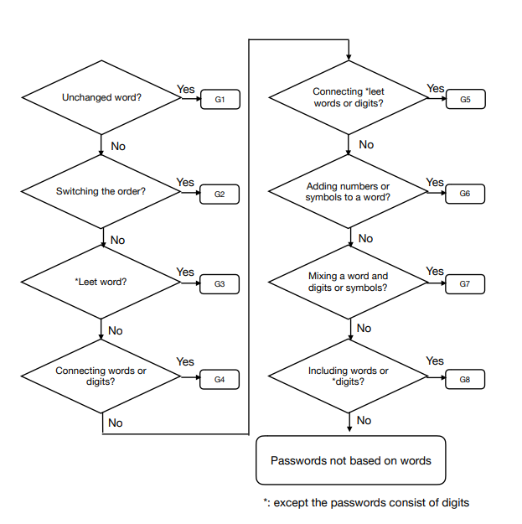
PCFG Cracker - Probabilistic Context Free Grammar (PCFG) Password Guess Generator

Slide 21
Traditional Brute-Force Attack: A dedicated, purpose-written software package generates all combinations of letters, numbers, and other characters such as punctuation and symbols, in progressively longer strings. It tries each one as the password on the account under attack. If it happens to generate a combination of characters that matches the password for the account under attack, that account is compromised.
Dictionary Attack: A dedicated, purpose-written software package takes one word at a time from a list of dictionary words, and tries them as the password against the account under attack. Transformations can be applied to the dictionary words such as adding digits to them and substituting digits for letters.
Password Look-Up Attack: Similar to a dictionary attack, but the word lists contain actual passwords. Automated software reads a password at a time from a huge list of passwords collected from data breaches.
Intelligent Password Look-Up Attack: Like a password attack, but transformations of each password are tried as well as the “naked” password. The transformations emulate commonly used password tricks such as substituting vowels for digits.
API Attack: Instead of trying to crack a user’s account, these attacks use software to generate strings of characters they hope will match a user’s key for an Application Programming Interface. If they can get access to the API they may be able to exploit it to exfiltrate sensitive information or intellectual copyright.
https://www.cloudsavvyit.com/7132/how-to-protect-your-organization-against-password-dictionary-attacks/

Slide 22
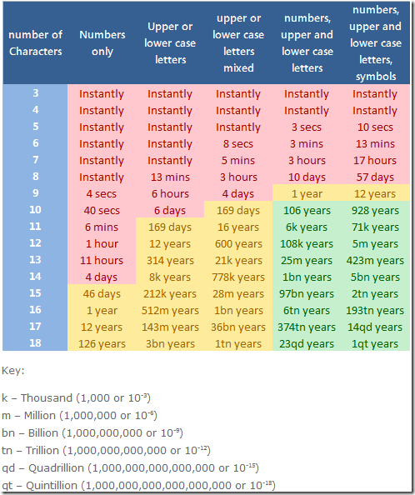

Slide 23
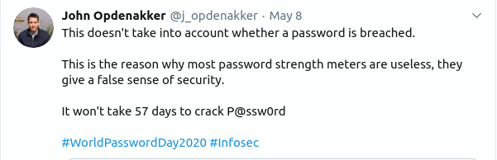
https://johnopdenakker.com/every-day-should-be-worldpasswordday/

Slide 24
Simple Things Make Strong Passwords
(Slow Them Down)
DO Make it as _l o n g_ as you can
Do not reuse it on multiple sites
Do not use numb3r5 1n pl@c3 of l3tt3rz
Some Letters – UPPER and lower case
Use some numbers
Have a something else <>(*%$@!-+=)
S P A C E S
Notes:
Choosing A Good Password
So, it turns out a key to a strong password isn’t its obscurity but its complexity — things that make it less likely to be guessed by an automated password cracker. However, making a good complex password means knowing a bit about how passwords get broken.
Passwords don't necessarily need to be hard. Pick a good memorization strategy, pick a good password, and you'll be on your way to being more secure.
Choose NON obvious, NON dictionary passwords. If we assume someone has time to just sit and guess your password on a system, they will check common passwords first, then they check a dictionary. Since they don't know your passwords, they look for the easiest guesses first. Given enough time, and if they are persistent enough, they will just start throwing every possible combination of letters, and then numbers, and then letters and numbers, and so on. So after using things that aren't common, the most important thing is length. There's no different between a simple long password as a complex long one as far as guessing goes. So start with an easy to remember password, then pad it with something else easy to remember. So get your own password and pad it. But don't just use Password1 as this is easily guessed, and don't pad by easily guessed numbers. The password plus padding shouldn't be easily guessed or obvious. E.g. most common (therefore easily guessed) padding is done by adding a 1,2,3,4 at the end of some word. This increase in length and complexity defends against Brute Forcing. We get protection by adding more digits because they need to guess every possible combination of everything up to that length, each digit adds A LOT of time required. If you use special characters and upper/lower case you add even more time because they know most passwords are all lower case numbers. Some places will allow the use of spaces in your password, which gives you the opportunity to use a pass phrase e.g. Correct Horse Battery Staple.
Simple Things Make a Good Strong Password
At least 1 Uppercase
At least 1 Lowercase
At least 1 Number (And don't put those numbers on the end)
At least 1 Something else (*%$@!-+=)
Make it as long as you can
Are complex passwords better? Well, maybe. Longer passwords are better, no doubt. If we knew exactly what each password was defending against, we would know what kind of password to choose. You have no idea how your passwords are stored or shared. Given enough time any captured password can be broken. Remember, we don't know HOW people are going to get your password. Given enough time and resources any password can be guessed. BUT, that is no excuse to not use a good password, because chances are good no one will have the time and resources to crack a good password.
One more random piece of password changing advice, if you break up with someone who knew your passwords, change them all.

Slide 25
Don’t Test Your Memory
Anything dependent on memory doesn’t scale
Use a password manager
  Bitwarden, LastPass, KeePass[X], 1Password, Dashlane..
Use A Pass Phrase
Nobody – nobody – is immune from getting hacked
Notes:
But I Can't Remember All My Passwords!
If you're like most people you probably have user accounts on what seems like an infinite number of sites. This makes using a unique password for each site next to impossible. PC Magazine recently did a nice round up of some of the many tools that can help you with this. If all that seems like too much, at the very least, have one easy to remember password for most common and unimportant websites. Then have a second password for things like facebook and twitter or other somewhat more important sites. Then have a third good solid password for banks & other super important things. If you have the same password for your network login at work and your account on LISNews, you're doing it wrong. There are entire classes of websites for which you should simply pretend that your password is already public because you just shouldn't trust them. You may also want to use a passwordcard, another simple idea to help you remember your passwords. Also, check out Diceware, Diceware™ is a method for picking passphrases that uses dice to select words at random from a special list called the Diceware Word List.

Slide 26
Should You Change Your Passwords Every X # of Months?
Email?
Bank Account?
Network? Server? Router?
Facebook & Twitter?
code4lib.org?
ala.org?
Notes:
What happens when your user changes his password?
from Security Bloggers Network by Aviram
You just forced the user to change his password; periodic password changing is good policy, right?
Now lets see what happens next:
The user sends the password to himself by email, in plaintext, so he won’t forget. Now it’s in his inbox, viewable on the email ‘preview’ section to anyone shoulder surfing
He then writes it on a post-it note. The cleaning person threw out the previous password (but that’s ok, he finally remembered it). Now there’s a post it with the password in the top right drawer
He then sends it to his wife/friend/colleague who also uses the account sometimes. Now it’s in another person’s inbox, again in a preview pane. He might have typed their email wrong and sent it to someone else by mistake, or maybe they put it on a post-it note too
The next time he tries to login he will use the old password (that he remembers) and fail. Your system will lock him out, and he will call to have it released. Another false positive that makes the person auditing the log for lock outs not pay attention to the warnings
He will then sign up to the new and cool social web site and use this last password as his password there. It’s already on the post-it note: Why write another? This new social web site will soon be cracked and your user’s password will be available online
Remind me again why changing passwords periodically is good for security? Oh, I get it. You were just living up to the bad reputation and preventing ease of use.
Only do it if you think it’s necessary.
Should you as an administrator force users to change passwords? Maybe. If you have good policies already in place, it may be needed. That is, don’t define complexity, force long passwords and maybe little else.
Should You Change All Your Passwords Every 3 Months?
Before I cover some recommendations, I'll ask, how often do you change your password? Is changing your passwords every 3 months a good idea? Is forcing your users to change their password every so often a good idea? I'll stick my neck out and say, in general, no, changing your passwords every so often isn't going to help things, with one exception: network or server logins. Network and server passwords should probably be changed every so often. I'll explain why by first explaining why other things probably won't matter. Say for example your bank... Your money is gone if anyone gets your password, you'll notice that right away. You'll only need to be change that one if it's taken along w/ all your money. Your email? Chances are good if someone gets your email password they'll start causing trouble right away. Hopefully you'll be able to change it back and lock them out. In general: you don't need to regularly change the passwords you use, UNLESS it's to something like a network or a web server. The bad guys can just sit and wait once they've gotten into your network or your web server. They don't need to do anything that will be instantly obvious like an empty back account. It may be good practice to change those types of passwords on a regular basis.

Slide 27
Assume Your Password
Will Be Stolen
Most of your passwords should be almost worthless. Some will be very important.
Notes:
Instead, what's important is that the password be unique. Most sites are like StratFor and have poor cybersecurity. (StratFor wasn't even close to good cybersecurity, they were horrible on almost any measure). Any information you give them, such as your password, will eventually get stolen by hackers. If you use the same password for all websites, then eventually hackers will break into one of those sites, then gain access to all your other accounts.
There are essentially three tiers of websites. At the first tier is your e-mail account. Since a hack of your e-mail account means hackers can reset passwords on all your other accounts, it would be terrible if that password were lost. This should both be very complex, as well as wholly unrelated to any other accounts.
At the second tier are important e-commerce sites, like Amazon.com, NewEgg,com, Apple.com, and so on. The major sites are unlikely to be hacked. You could probably share the same password for all these accounts.
At the third tier are the unimportant accounts, like StratFor, where it wouldn't be catastrophic if your password were lost. Again, you could choose a third, simple password, like "passwd1234" for all these accounts. It'll probably get stolen within a year, but who really cares?
Thus, you really only need three passwords for each tier, so it's not too much trouble. However, even then, you might consider adding uniqueness. For example, on the last tier, you might use the domain name as your password, like "passwdStratfor1". When a hacker breaks in and runs an automated script to see if your password is unique, the script will fail to find a match on any other site. Sure, a hacker looking at the password individually will figure out your scheme, but in a huge hack like the 800,000 StratFor accounts, hackers are unlikely to manually check every password.
In conclusion, your first password policy shouldn't be complexity, but uniqueness. When hackers break into a site like StratFor and discover your password is "password1", you shouldn't be embarrassed. You should instead say you don't care about your free StratFor account, or that hackers break into it, and that knowing this password doesn't help break into any account you do care about.

Slide 28
What Else Ya Got?
Biometrics
Hardware
Your face
Iris scans
Voice files
Your DNA
Your voice
2 Factor Authentication
Security Questions
...More Confusion ...More Work
...More Money
Notes:
It seems like every other thing we come up with his problems

Slide 29
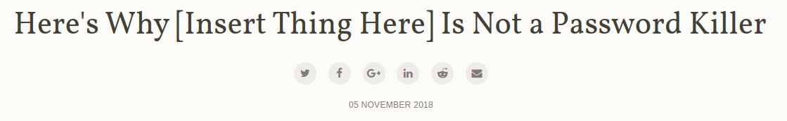
Every single solution I've seen that claims to "solve the password problem" just adds another challenge in its place thus introducing a new set of problems.
This is why [insert thing here] is not a password killer and why, for the foreseeable future, we're just going to have to continue getting better at the one authentication scheme that everyone knows how to use: passwords.
https://www.troyhunt.com/heres-why-insert-thing-here-is-not-a-password-killer/

Slide 30
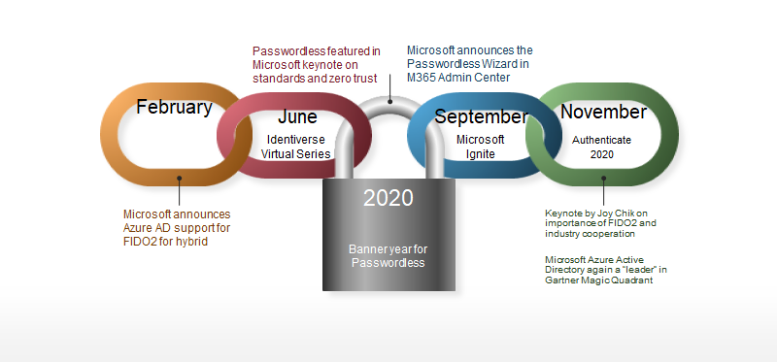
Microsoft: Next steps for passwordless in 2021
Our team has been working hard this year to join these partners in making passwords a thing of the past. Along with new UX and APIs for managing FIDO2 security keys enabling customers to develop custom solutions and tools, we plan to release a converged registration portal in 2021, where all users can seamlessly manage passwordless credentials via the My Apps portal.
https://www.microsoft.com/security/blog/2020/12/17/a-breakthrough-year-for-passwordless-technology/

Slide 31
Securing The “Things”

Slide 32
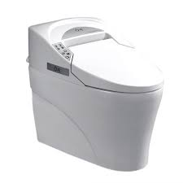
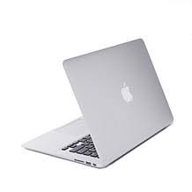
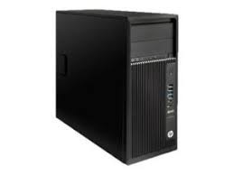

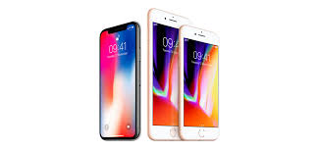
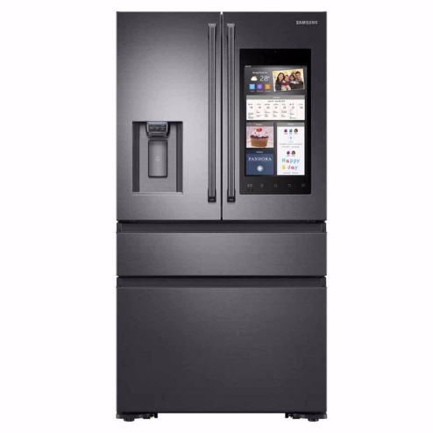

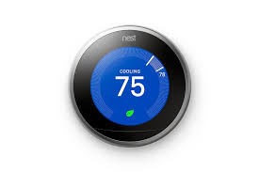
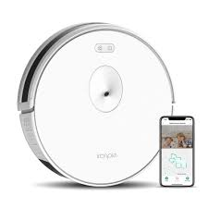

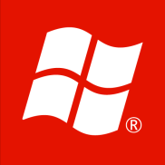

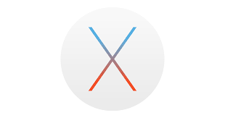
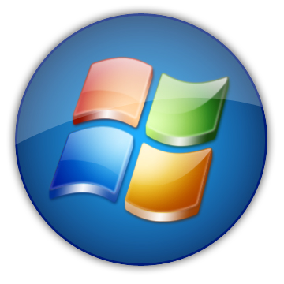
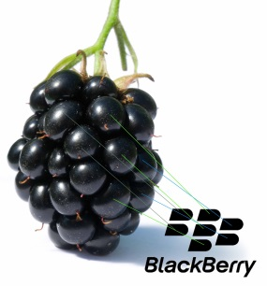

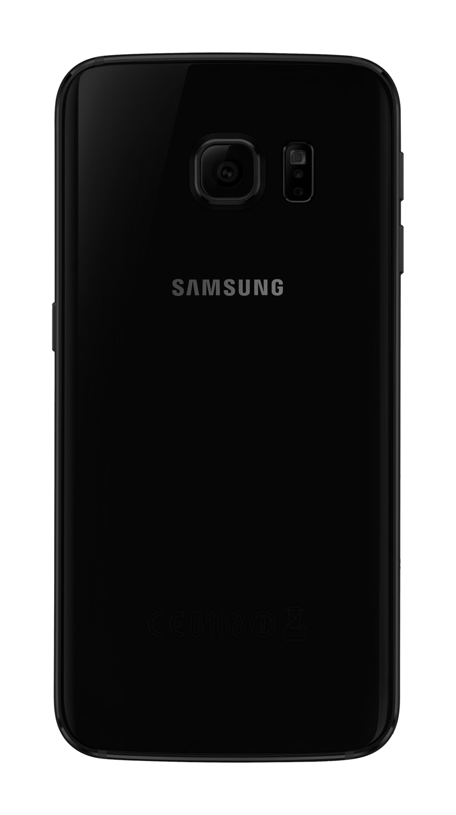
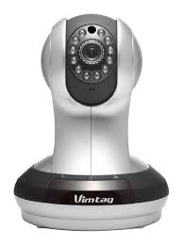
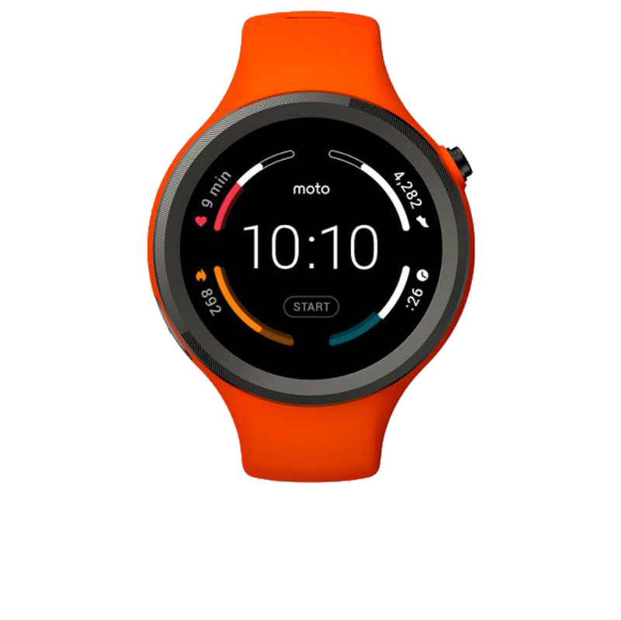
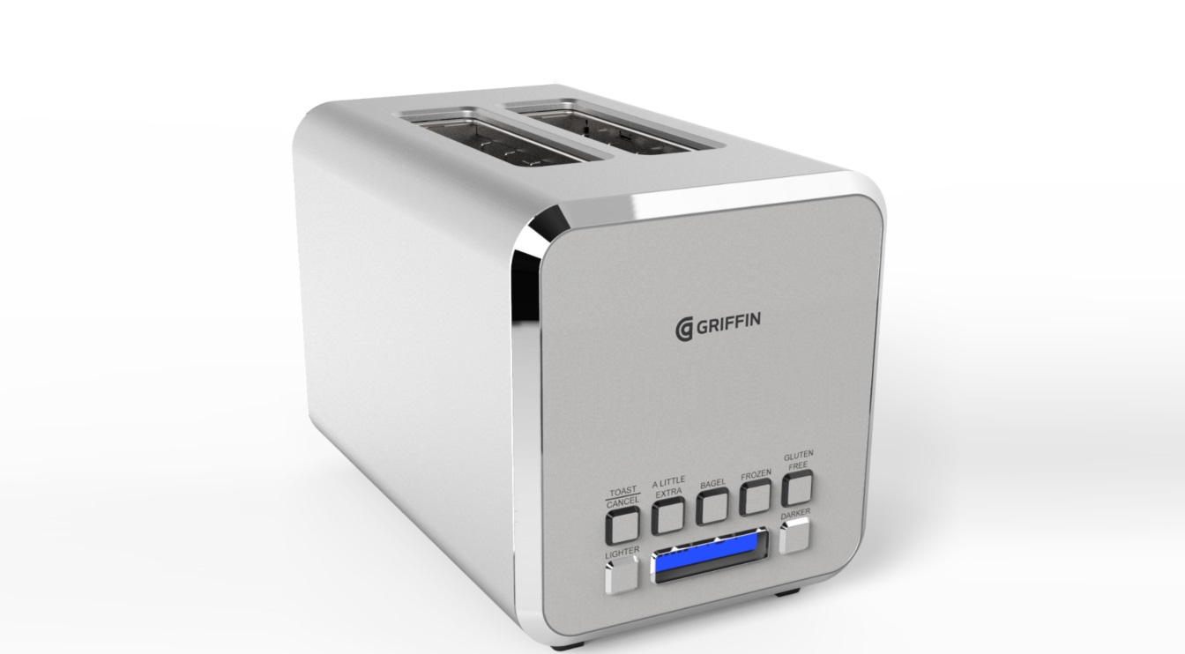
“Things”
Staying Safe Online
Notes:
A very brief discussion on which OS might be safest, or at least how using Apple or Linux makes you MORE safe... NOT safe.

Slide 33
It’s not about what’s most secure…
it’s about what the bad guys focus on
Notes:
http://www.sectorix.com/2013/03/03/the-thing-with-0-day-java-vulnerabilities-is/

Slide 34
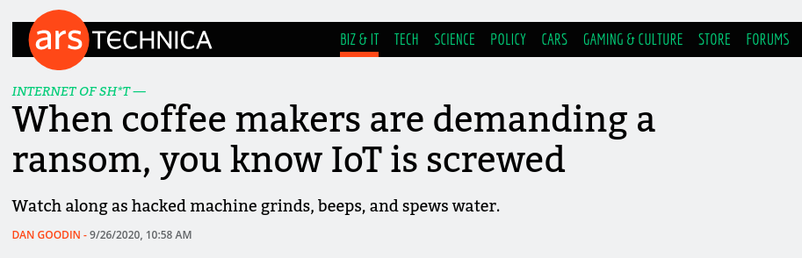
Additionally, this case also demonstrates one of the most concerning issues with modern IoT devices: “The lifespan of a typical fridge is 17 years, how long do you think vendors will support software for its smart functionality?” Sure, you can still use it even if it’s not getting updates anymore, but with the pace of IoT explosion and bad attitude to support, we are creating an army of abandoned vulnerable devices that can be misused for nefarious purposes such as network breaches, data leaks, ransomware attack and DDoS.
https://arstechnica.com/information-technology/2020/09/how-a-hacker-turned-a-250-coffee-maker-into-ransom-machine/

Slide 35
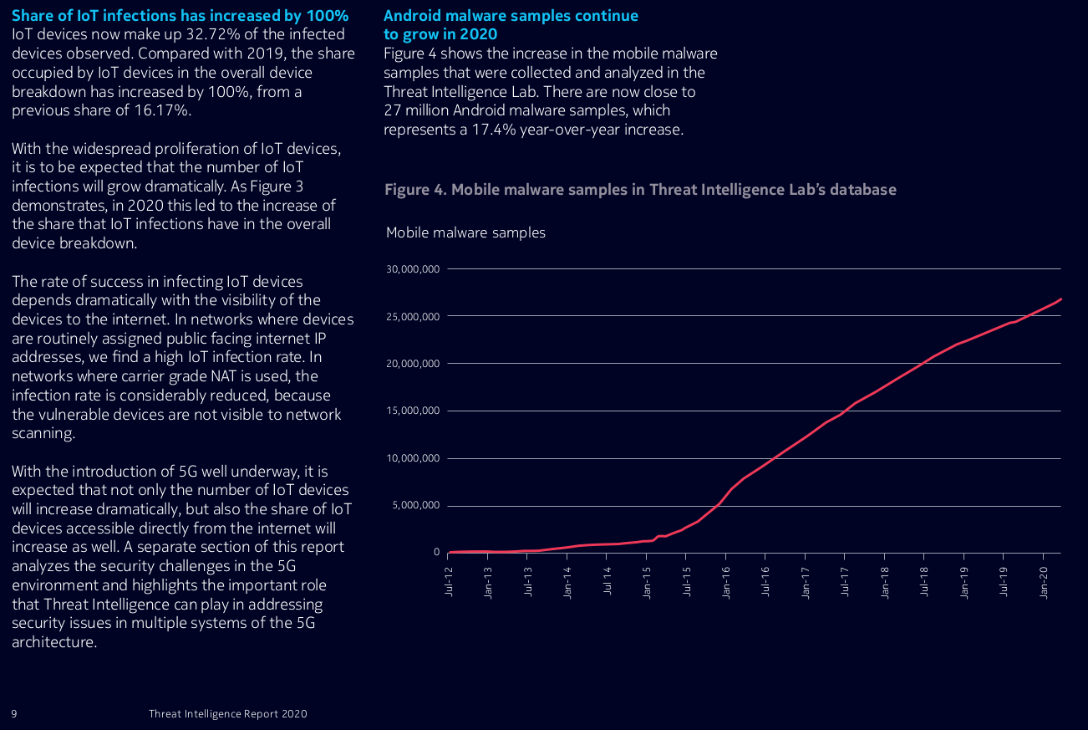
Nokia_Threat_Intelligence_Report_2020_Report_EN.pdf

Slide 36
How Do You Know If You Are Infected?
Fans Spinning Wildly
Programs start unexpectedly
Your firewall yells at you
Odd emails FROM you
Freezes
Your browser behaves funny
Sudden slowness
Change in behavior
Odd sounds or beeps
Random Popups
Unwelcome images
Disappearing files
Random error messages
Notes:
Here’s a big list of
Common computer troubles
Common symptoms of malware infections
You don’t know which one it is!

Slide 37
How Do You Know If You Are Infected?
You Don’t
Fans Spinning Wildly
Programs start unexpectedly
Your firewall yells at you
Odd emails FROM you
Freezes
Your browser behaves funny
Sudden slowness
Change in behavior
Odd sounds or beeps
Random Popups
Unwelcome images
Disappearing files
Random error messages
Notes:
Here’s a big list of
Common computer troubles
Common symptoms of malware infections
You don’t know which one it is!

Slide 38
Your Browser Goes Rogue
If your browser has acquired new Toolbars/Extensions that you didn’t install
People Receive Fraudulent Invitations/Emails From You
Threat actors set up fraudulent and copycat profiles on social media platforms and send invitations to the friends of the person with the real profile, or they gain access to the real profile probably through a phishing attack.
Passwords Mysteriously Change
If you cannot log in to an online service or platform, make sure the service is operational.
Software Materializes On Your Computer
If software appears on your computer and you have no idea where it came from, it might be enemy action.
The Cursor Flies Solo
A moving mouse pointer without your hand on the mouse may indicate hardware issues or be due to “drift” in the software drivers.
Your Shields Are Down And Won’t Come Up
If your defensive software such as personal firewall, anti-virus, and anti-malware are turned off and refuse to come back into service, you’ve been infected with a virus or other malware.
Your Own Systems Tell You So
Any and all alerts from your intrusion detection system (IDS) or other monitoring software should be treated as genuine incidents until an investigation proves otherwise.
https://www.cloudsavvyit.com/7259/have-you-been-hacked-10-indicators-that-say-yes/

Slide 39
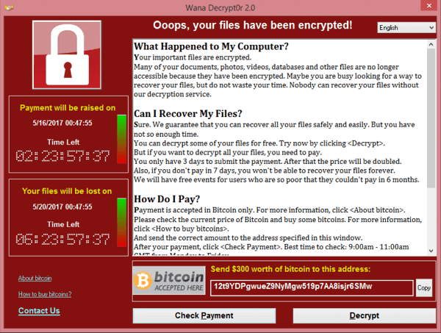

Slide 40
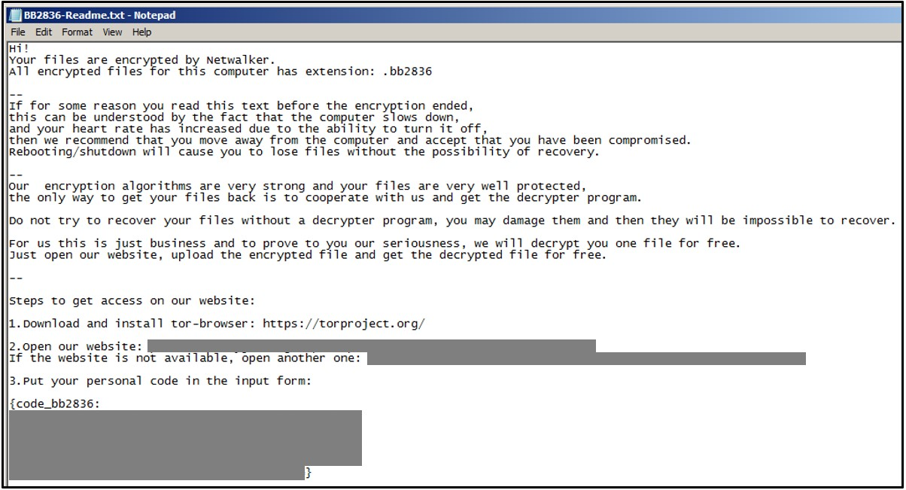

Slide 41
Your antivirus software is a seat belt – not a force field.
- Alfred Huger
Notes:
Symantec reports they have seen the technique in malicious Droid apps hosted on Russian websites. Polymorphism has long been used to evade signature-based detection on PCs, with no little success. Server-side polymorphic techniques create a new version of the malware each time it is downloaded. The combination of these mechanisms, sophisticated obfuscation and the sheer volume of unique malware samples — tens millions annually — have rendered client-based antimalware far less effective that it was just a few years ago.

Slide 42
Infection Flow
Attacker sends weaponized e-mail
Spam Filter
failed
Anti-Virus
failed
Microsoft
Word
Inbox
Invoice.doc
Sender IP, reputation,
content not blocked
User opens malicious attachment
Malicious attachment not detected
Enable Macros
Create and run batch file
Run Windows Script
Download
binary
Web Filter
failed
Anti-Virus
failed
User enables
macros
Lah.bat
Cscript.exe
Fail.exe
Web address not blocked
Binary is obfuscated thus unknown
Run Fail.exe
(ransomware)
Negotiate encryption (C&C)
Web Filter
failed
Delete Shadow
Copies
Encrypt data
Display Ransom Note
Continues as svchost.exe
Communication is not blocked
Removes local
backups of files
Notes:
When you look at the flow of a typical Locky ransomware infection, security defenses have 7 opportunities to stop the malicious encryption of your data.
42

Slide 43
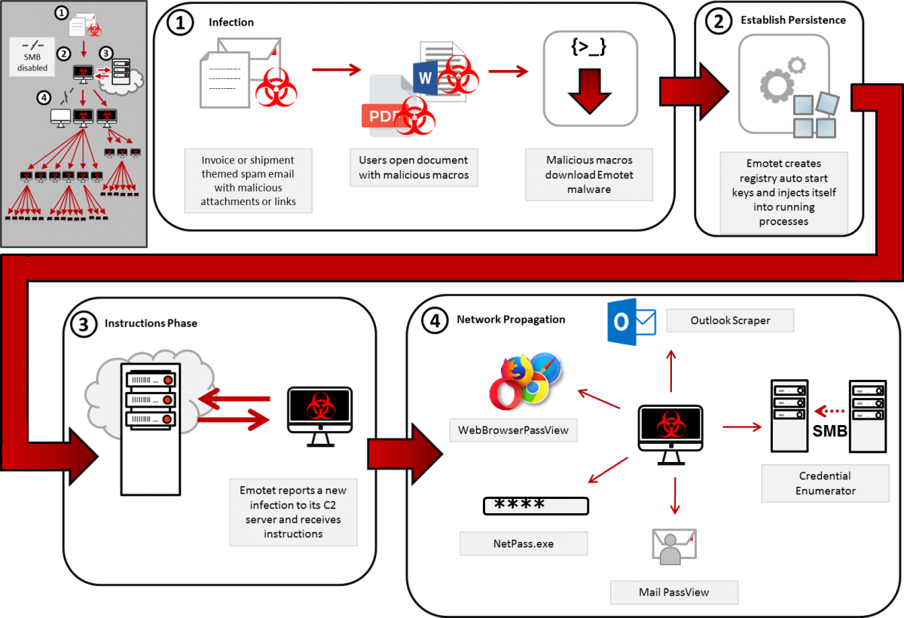

Slide 44
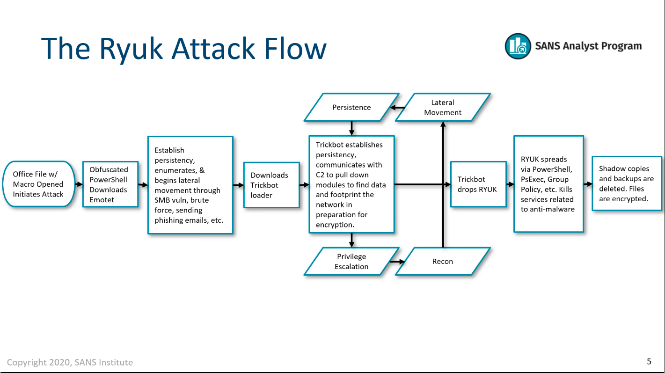

Slide 45
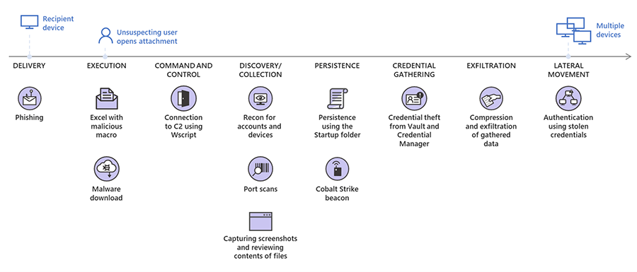
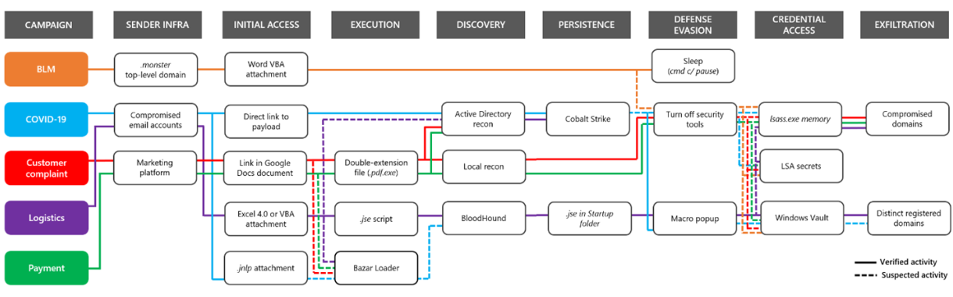
https://www.microsoft.com/security/blog/2020/10/12/trickbot-disrupted/

Slide 46
Phishing
IT experts...
The expert... tries to make sense of the email, and understand how it relates to other things in their life. As they do this, they notice discrepancies: little things that are “off” about the email. As the recipient notices more discrepancies, they feel a need for an alternative explanation for the email. At some point, some feature of the email — usually, the presence of a link requesting an action — triggers them to recognize that phishing is a possible alternative explanation.
At this point, they become suspicious (stage two) and investigate the email by looking for technical details that can conclusively identify the email as phishing.
Once they find such information, then they move to stage three and deal with the email by deleting it or reporting it.
https://dl.acm.org/doi/10.1145/3415231

Slide 47
Fear of Missing Out Predicts Employee Information Security Awareness Above Personality Traits, Age, and Gender
Lee Hadlington, Jens Binder, and Natalia Stanulewicz
Published Online: 10 Jul 2020 https://doi.org/10.1089/cyber.2019.0703
Abstract
The role of human factors in employee information security awareness (ISA) has garnered increased attention, with many researchers highlighting a potential link between problematic technology use and poorer online safety and security. This study aimed to present additional evidence for this by exploring the relationship between of Fear of Missing Out (FoMO) and ISA in employees. A total of 718 participants completed an online questionnaire that included a measure of FoMO, ISA, as well as the Big Five personality inventory. Participants who reported higher levels of FoMO had lower overall ISA, as well as having poorer knowledge, a more negative attitude, and engaged in riskier behaviors in relation to ISA. FoMO was also demonstrated to be the largest single negative predictor for ISA, above that of age, gender, and the key personality traits tested. The potential reasons for the influence of FoMO over ISA are discussed, as well as the implications for organizational information security.

Slide 48
Locking Down Computers
Keep Things Updated
  The Operating System
  All Applications (Browsers!)
Application Allowlisting (whitelisting)
Reboot to restore
Secure Microsoft Office Macros
Don’t use Windows?
What About Anti-virus Applications?

Slide 49
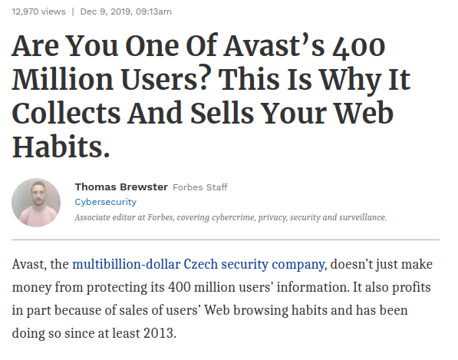

Slide 50
Securing The Other “Things”
We use

Slide 51
Which of your online accounts is most valuable?
Email
Bank
Social Network
Shopping
Gaming
Blogs

Slide 52
Own the Email, Own the Person
Notes:
For many people, their personal email account is where they store their lives. Bank statements, bills, personal correspondence, work files, anything you can get in electronic form can often be found in a given target's email inbox. And a large number of email systems protect users' inboxes with nothing more complicated than a simple password.
http://threatpost.com/en_us/blogs/own-email-own-person-082012
Having control over an email account can be a lot of power, even though most people would probably say they do not care if someone else is reading their private emails. But it’s not always about reading those private emails. Of course there have been quite a few attacks where secrets were revealed by snooping through emails of hacked accounts. The reasons vary from jealous spouses searching for proof of an assumed affair or as serious as corporate espionage in which certain parties are seeking essential information about a critical deal. Other attackers may use the compromised account to send social engineering messages to all contacts stored in the email account posing as the person whose account has been hacked.
Nowadays an email account is much more than just sending and receiving emails. Many free service providers like Microsoft or Google have various additional services attached to email accounts. Having access to these accounts means having access to such things as private photos that were uploaded to the account. There have been a few cases where attackers broke into email accounts and found sensitive pictures, like naked photos, and then blackmailed the owner of the account. While most people are smart enough not to upload such pictures, with the integrated cloud storage that is available with many services now there may be all kinds of files stored in those accounts, such as password files, license files, tax records, passport scans, company documents, and more.
The power of an email can be even larger than this, as its scope is much greater. Many online services use the email address as a user name. Therefore, knowing the email address and the email account password can give the attacker access to many different accounts besides the email provider as many services offer to reset a forgotten password through email, even if the user does not use the same password on different services. Controlling the email account means controlling the password reset emails of other services and therefore giving access to many different services regardless of what password it uses.
Every time there is a data breach and email and passwords are publicly posted, other attackers will take this information and start new attacks with it. The first thing they usually try is to check whether the same password also accesses the email account.
Of course, not all services are of interest to attackers. Losing control of your social media account may not be enjoyable—especially if you are a news agency—but it will not really hurt most people. For companies this might be a different story, as it could lead to brand damage if something happens to their accounts. Last year there was the widely publicized situation of Mat Honan, a Wired reporter whose Apple devices were wiped when hackers gained access to his iCloud account. This can be troublesome, but as a user you can help to avoid it by registering for the additional security measures provided.
Some services are of interest to attackers. Companies can allow goods and services to be ordered for instance, charging the on-file credit card or sending an invoice to the account owner. Financial services, auctions, and payment services are definitely high on the list of services that hackers would check. There are many services that you probably do not want to lose control over. With companies adding more and more features it is even more important to protect your email account. For example, Google announced recently the integration of Google Wallet into Gmail. This allows you to send money from your email account in the same way you attach a picture to an email. You can attach money to an email as well. Or an attacker might do it for you.
To ensure that such attacks will not happen, Google was one of the first service providers to introduce two-factor authentication to the masses. Other services, including Apple have followed and have started to integrate two-factor authentication or out-of-band authentication in the form of a code being sent to a previously registered mobile phone or one time password (OTP) generator applications. This is a good solution to secure your account beyond passwords. It is definitely better than just forcing the user to fill out security questions that can easily be guessed with public information.
Not proactively enrolling in additional authentication measures, if they are available, also might leave you vulnerable to rare attacks for which a password is not even required as there is always a chance of a glitch, like the one in Apple’s password reset function in 2013. While Apple acted quickly and fixed the issue, users who had enrolled in two-step verification were protected the entire time. There have also been some cases where an attacker could use a cross-site request forgery (CSRF) attack to hijack an active session and reconfigure your email account. For example, a long time ago there was a simple attack where a website could add a forwarding filter to your Gmail account, resulting in all emails being forwarded to an additional address. Of course Google fixed this issue quickly and increased account security even further. For example, now the user is warned with a UI message if any new filters have been added. Those attacks are harder to prevent for the user, as logging out of the account whenever it is not used is often not really practical advice.
You should use a strong password for your main email account that is unique and also different than the passwords you use for other services. Also keep yourself aware of new security features introduced by your email account.

Slide 53
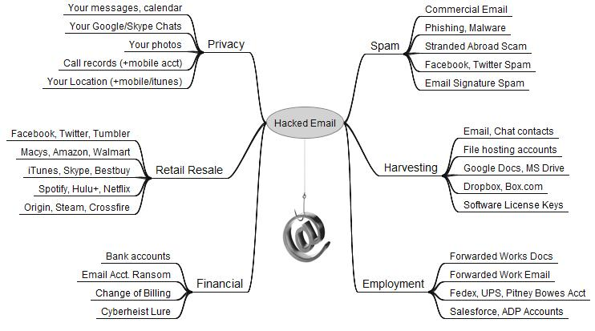
Notes:
10
Jun 13 The Value of a Hacked Email Account
One of the most-viewed stories on this site is a blog post+graphic that I put together last year to illustrate the ways that bad guys can monetize hacked computers. But just as folks who don’t bank online or store sensitive data on their PCs often have trouble understanding why someone would want to hack into their systems, many people do not fully realize how much they have invested in their email accounts until those accounts are in the hands of cyber thieves.
This post aims to raise awareness about the street value of a hacked email account, as well as all of the people, personal data, and resources that are put at risk when users neglect to properly safeguard their inboxes.
Sign up with any service online, and it will almost certainly require you to supply an email address. In nearly all cases, the person who is in control of that address can reset the password of any associated services or accounts –merely by requesting a password reset email.
Your email account may be worth far more than you imagine.
How much are these associated accounts worth? There isn’t exactly a central exchange for hacked accounts in the cybercrime underground, but recent price lists posted by several miscreants who traffic in non-financial compromised accounts offer some insights.
One prominent credential seller in the underground peddles iTunes accounts for $8, and Fedex.com, Continental.com and United.com accounts for USD $6. Groupon.com accounts fetch $5, while $4 buys hacked credentials at registrar and hosting provider Godaddy.com, as well as wireless providers Att.com, Sprint.com, Verizonwireless.com, and Tmobile.com. Active accounts at Facebook and Twitter retail for just $2.50 apiece.
As I’ve noted in previous stories, some crime shops go even lower with their prices for hacked accounts, charging between $1 to $3 for active accounts at dell.com, overstock.com, walmart.com, tesco.com, bestbuy.com and target.com, to name just a few.
Even if your email isn’t tied to online merchants, it is probably connected to other accounts you care about. Hacked email accounts are not only used to blast junk messages: They are harvested for the email addresses of your contacts, who can then be inundated with malware spam and phishing attacks. Those same contacts may even receive a message claiming you are stranded, penniless in some foreign country and asking them to wire money somewhere.
If you’ve purchased software, it’s likely that the license key to that software title is stored somewhere in your messages. Do you use online or cloud file-storage services like Dropbox, Google Drive or Microsoft Skydrive to backup or store your pictures, files and music? The key to unlocking access to those files also lies in your inbox.
If your inbox was held for ransom, would you pay to get it back? If your Webmail account gets hacked and was used as the backup account to receive password reset emails for another Webmail account, guess what? Attackers can now seize both accounts.
If you have corresponded with your financial institution via email, chances are decent that your account will eventually be used in an impersonation attempt to siphon funds from your bank account.
Until recently, some of the Web’s largest providers of online services offered little security beyond a username and password. Increasingly, however, the larger providers have moved to enabling multi-factor authentication to help users avoid account compromises. Gmail.com, Hotmail/Live.com, and Yahoo.com all now offer multi-step authentication that users can and should use to further secure their accounts. Dropbox, Facebook and Twitter also offer additional account security options beyond merely encouraging users to pick strong passwords.
Of course, all of this additional security can be defeated if the bad guys gain control over your machine through malicious software. To keep your computer from being compromised, consider adopting some of the recommendations in my Tools for a Safer PC primer.

Slide 54
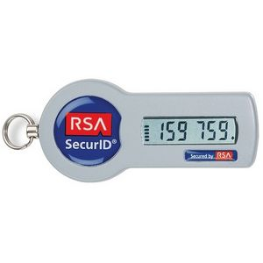
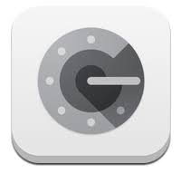
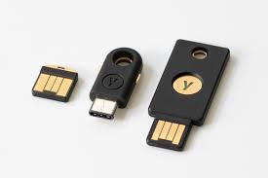
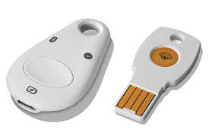
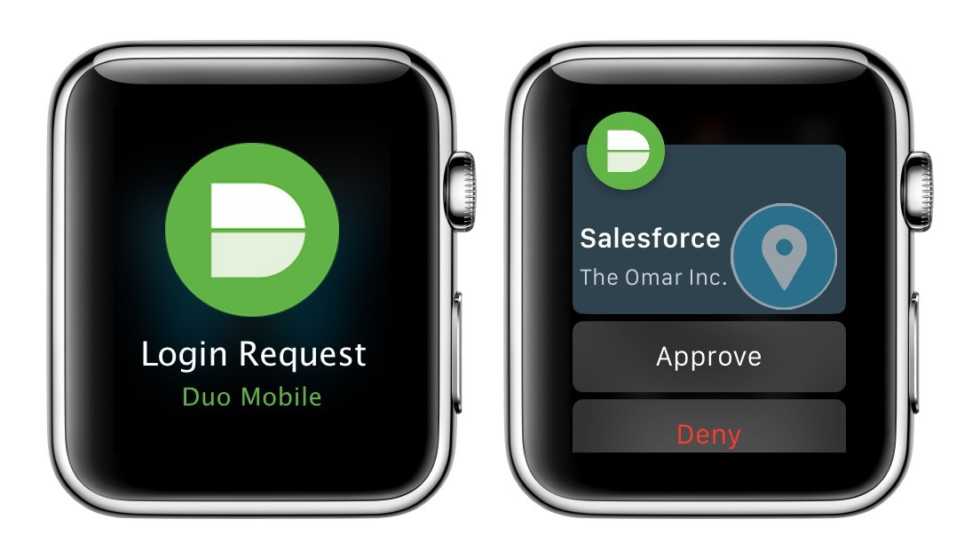
Second Factor Authentication
Notes:
On your computer:
Keep that OS patched and updated. Related: Don’t use Windows XP
Disable hidden filename extensions
Make sure ALL those programs are updated. Especially don’t miss anything made by Adobe (e.g. Flash & Acrobat)
Never install things you’re not sure are safe. Especially don’t trust anything from Torrents or P2P sites. Avoid downloading programs from unknown sources
If you're not using something, just remove it. Every program installed on your computer opens a potential new hole.
Make sure your firewall is turned on
Make sure file sharing is turned off
Use a reputable virus & malware protection software program, keep it up to date and run it often
Make sure that the Macro Virus Protection feature is enabled in all Microsoft applications
Never trust any links, attachments, short links, or anything else from anywhere or anyone unless you are SURE what’s inside
Have a recovery plan - Is your stuff backed up?
If it's a laptop, use something like Prey Project
Advanced: Consider changing up your hosts file and/or using something like OPEN DNS.

Slide 55
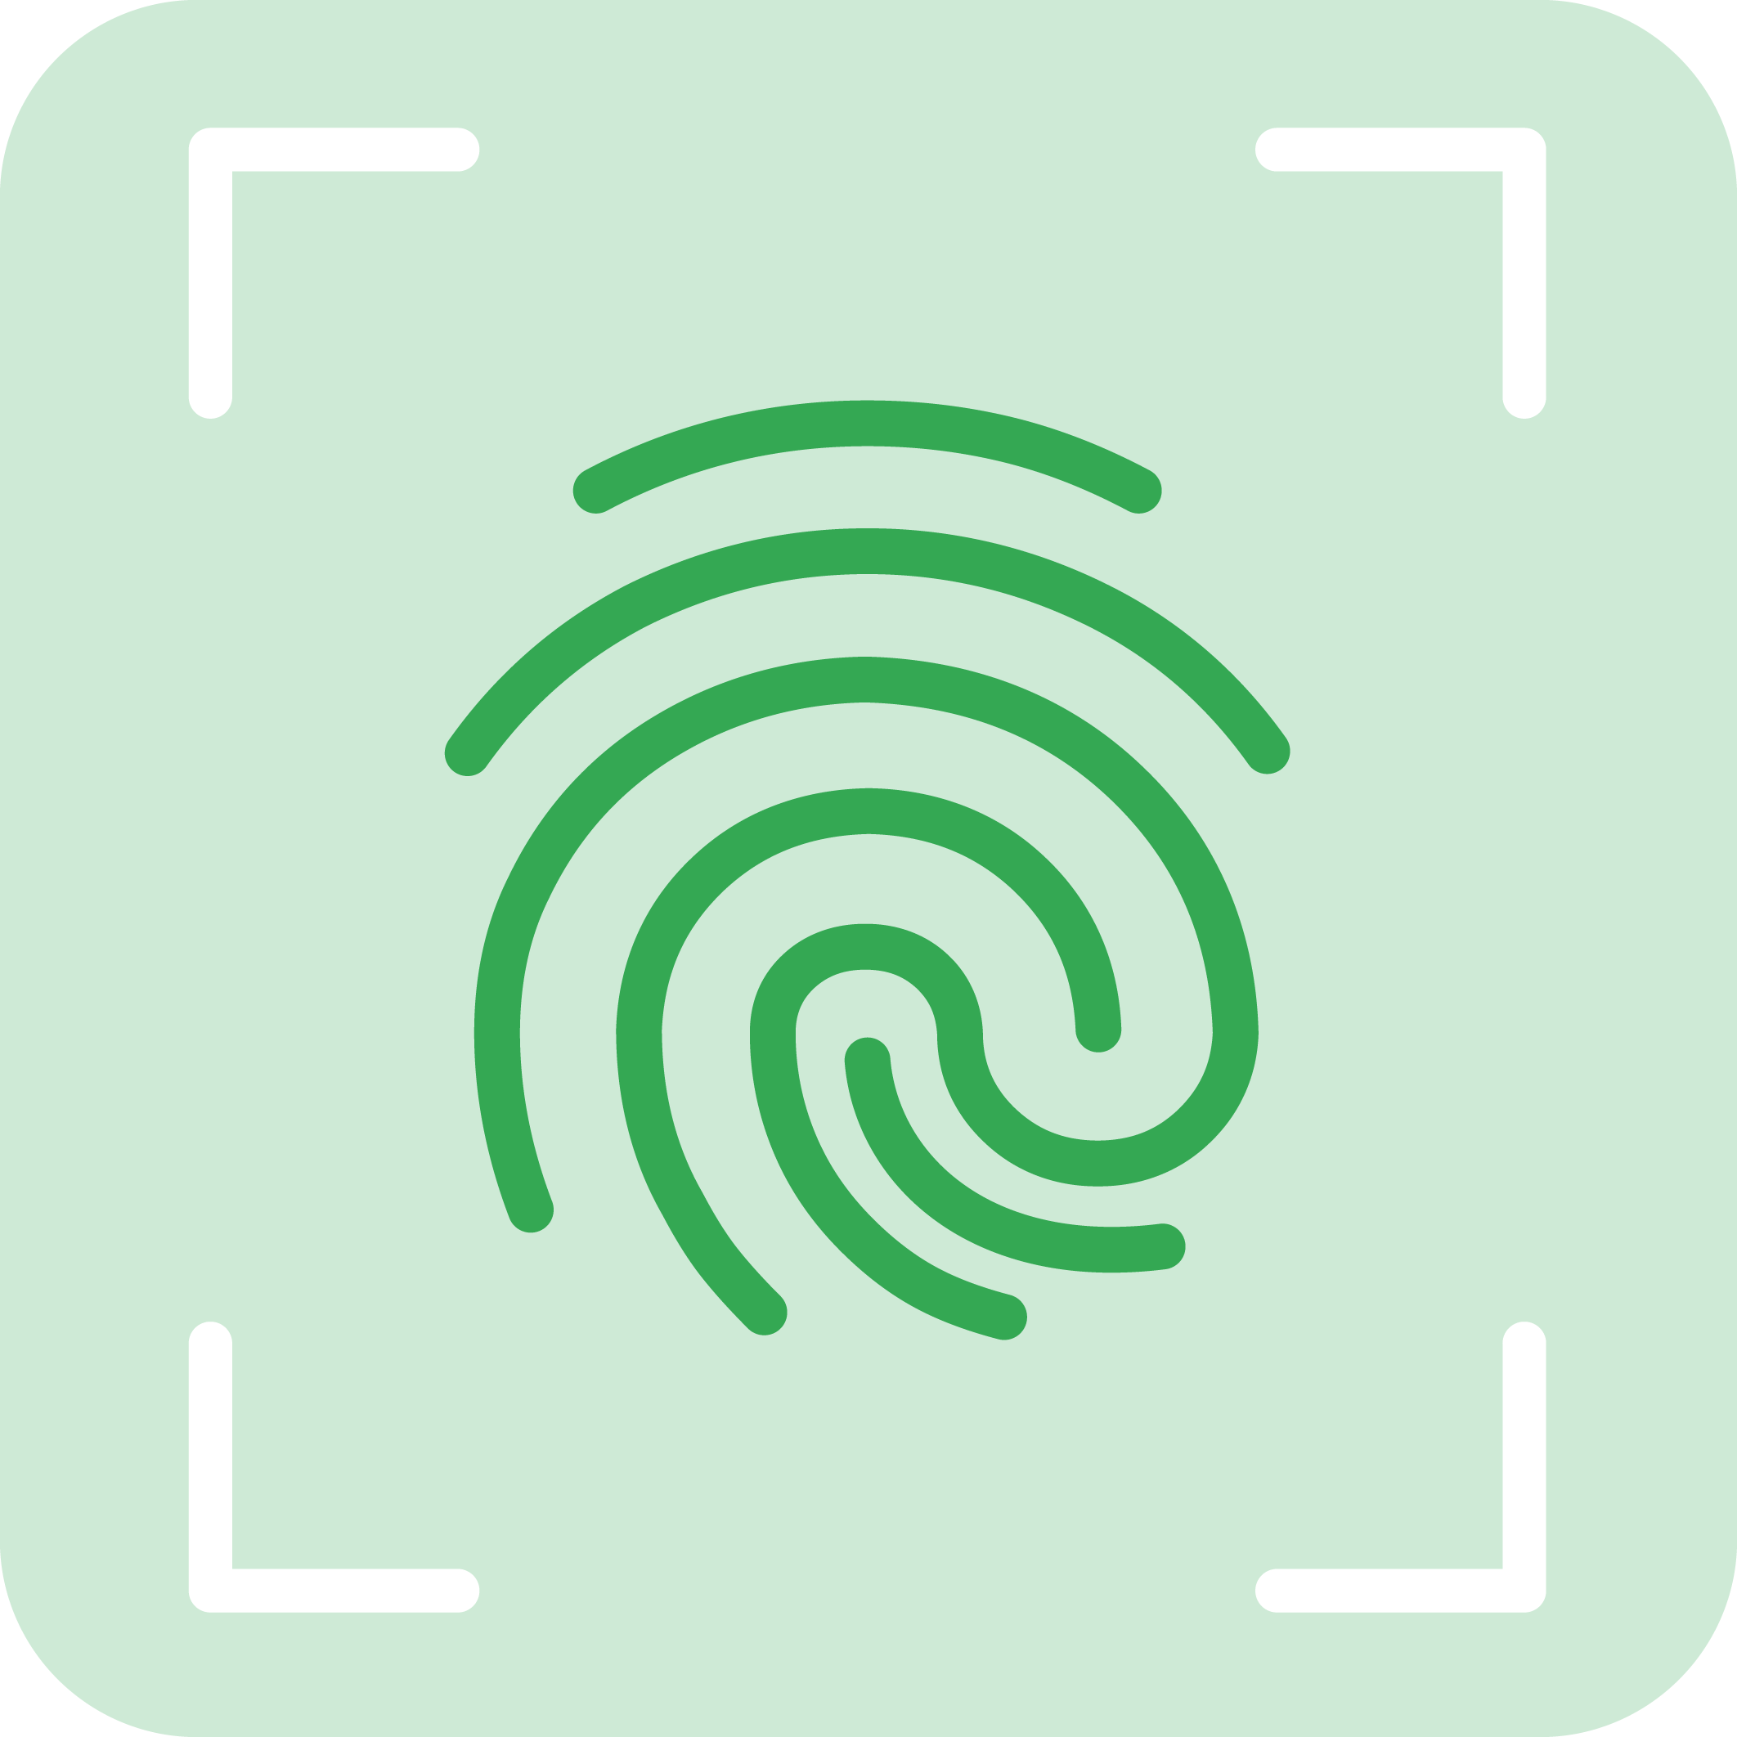


Types of additional information
Who you are
What you have
What you know

Slide 56






Not all 2FA technologies are equal
Security level
Secondary email
SMS verification
Device prompt
Security key
Boutique phishing | 68% | 96% | 99% | 100%
Spear-phishing | 53-100% | 76% | 90% | 100%
Evaluating Login Challenges as a Defense Against Account Takeover - WWW19
Security and Privacy Group

Slide 57

https://danielmiessler.com/blog/casmm-consumer-authentication-security-maturity-model-2/

Slide 58

Looking down at my phone, there was no sign it had been hacked. I still had reception; the phone said I was still connected to the T-Mobile network. Nothing was unusual there. But the hacker had swiftly, stealthily, and largely effortlessly redirected my text messages to themselves. And all for just $16.
I hadn't been SIM swapped, where hackers trick or bribe telecom employees to port a target's phone number to their own SIM card. Instead, the hacker used a service by a company called Sakari, which helps businesses do SMS marketing and mass messaging, to reroute my messages to him. This overlooked attack vector shows not only how unregulated commercial SMS tools are but also how there are gaping holes in our telecommunications infrastructure, with a hacker sometimes just having to pinky swear they have the consent of the target.
https://www.vice.com/en/article/y3g8wb/hacker-got-my-texts-16-dollars-sakari-netnumber

Slide 59


Slide 60


Slide 61


Slide 62


Slide 63


Slide 64
Email
Don’t trust anything
Don’t leave yourself logged in
2 Factor Authentication
Passwords
Email is not a secure storage facility
OpenPGP
Notes:
Your Email:
Never open email attachments unless you know for sure what that file contains
Never click a link unless you know for sure where it leads is safe
Check your mail filters and forwards for things you didn’t add
Use good passwords
Sign out when you're done
Use two factor authentication when possible (e.g. Google Authenticator for Gmail)
Be sure to use https when on public Wi-Fi
Consider using 2 separate email accounts to keep important things separate from everyday stuff
Watch out for short links, it's hard to know where they'll lead you

Slide 65

Surfing The Web
Notes:
The Original Surfing the Web mouse pad! Did you know that term was coined by a librarian?
65

Slide 66
The majority of encounters
happen in the places that online
users visit the most—and think
are safe.
2013 Cisco Annual Security Report

Slide 67

Browsers
Use Two & Keep Updated
Know Your Settings
  Phishing & Malware Detection - Turned ON
  Software Security & Auto / Silent Patching - Turned ON
A Few Recommended Extensions:
  Something to Limit JavaScript
  Something to Force HTTPS
  Something to stop trackers
  Something to Block Ads
Notes:
http://searchenginewatch.com/article/2237541/Google-224-Million-Bad-Ads-Disabled-in-2012
Once again, the Google AdWords team has reported on its continued efforts to eliminate bad AdWords ads. This year, they've released an infographic (see below) that recounts all they have done over the past year to reduce the number of bad ads that appeared in the AdWords network.
Citing that Google's business "depends on keeping people safe and secure," the infographic identifies how the search giant defines "bad ads", how they discover them, and what they do once they find them.
By the numbers:
224 million: The number of banned ads.
889,000: The number of advertisers banned.
223: The number of countries and territories where bad advertisers originated from – the U.S., China, Japan, and India were the biggest offenders.
78: The number of languages used by abused in bad ad attempts Scots Gaelic, Kyrgyz, Tatar, and Esperanto were particularly troublesome.
The rest of the infographic contains horn-tooting numbers to give law-abiding advertisers and consumers the warm-and-fuzzies. Their AdWords blog post closes stating Google's "zero-tolerance" policy for bad ads and reiterates commitment to do "whatever it takes" to keep the web – and Google users and advertisers – as safe as possible.
Google's commitment to reducing "bad ads" isn't a new resolution for 2013. In previous years, the AdWords team has gone through what they call "bad ads" to weed them out in an effort to protect consumers and "legitimate businesses in harm's way." Google's ad team has gone through multiple iterations of taking extra procautions to keep ads safe.
"In 2011, advertisers submitted billions of ads to Google, and of those, we disabled more than 130 million ads. And our systems continue to improve—in fact, in 2011 we reduced the percentage of bad ads by more than 50% compared with 2010. That means that our methods are working. We’re also catching the vast majority of these scam ads before they ever appear on Google or on any of our partner networks. For example, in 2011, we shut down approximately 150,000 accounts for attempting to advertise counterfeit goods, and more than 95% of these accounts were discovered through our own detection efforts and risk models."
Your Browser:
Keep your browsers updated to the latest secure releases
Keep ALL Plugins updated to the latest secure releases, especially anything from Adobe
Don’t install things from sources you don't trust
Block cookies, flash, and JavaScript (use with caution, will cause you trouble)
Use a password manager to store all your many passwords
Watch out for short links

Slide 68






Privacy Badger
uBlock Origin
uMatrix???
Disconnect
Notes:
https://www.eff.org/privacybadger
https://github.com/gorhill/uBlock
https://disconnect.me/
https://www.ghostery.com/
https://www.eff.org/https-everywhere
https://www.torproject.org/projects/torbrowser.html.en
68

Slide 69
But The Internet Is Free Because Of Ads...
Malicious content is 27 times more likely to be encountered via search engines than counterfeit software
Online ads were 182 times more likely to deliver malware than an adult site
Cisco’s 2012 Annual Security Report
Notes:
Original URL: http://www.theregister.co.uk/2013/01/30/cisco_security_report/
Web smut sites are SAFER than search engines, declares Cisco
Network giant: Perimeters are porous, get used to it
By Joe Fay
Posted in Security, 30th January 2013 17:03 GMT
Free whitepaper – A private Cloud-based approach
Cisco proclaimed that it is more dangerous to click on a web ad than a porn site these days as it unveiled the latest version of its security threat report.
The vendor also expanded its security offering, pulling in mobile management support for its ISE platform and announcing it had hoovered up Czech-based real-time security intelligence firm Cognitive Security.
Chris Young, senior veep for Cisco's Security and Government Group, said the nature of IT security threats were changing in the same way as the industry as a whole, meaning "the cloud" and "mobility" are trends for the cybercrime community too. This means that security managers should worry less about securing the perimeter and consider the "any-to-any" problem (any user, on any device, on any connection).
Cyber criminals and other miscreants were hitting their targets where they were most likely to gather, he said, and were increasingly launching "combinational" attacks.
This throws up some, arguably counterintuitive, conclusions. Malicious content is 27 times more likely to be encountered via search engines than counterfeit software, the vendor's 2012 Annual Security Report claims.
On the upside, perhaps, online adverts were 182 times more likely to deliver malware than a porno site, the survey said.
"We've been led to believe you have to go to an unsavoury place [to encounter malware]," he said. "That's not the case."
The report also said that mobile malware accounted for barely a half a per cent of malware encounters, though it also showed a whopping 2,577 per cent jump on Android-based malware last year.
The report also noted a spike in malware encounters in the Nordics, something which was ascribed to fans of Julian Assange hitting sites in Sweden to show their displeasure at extradition proceedings against the WikiLeaker-in-chief.
Young said that with the change in computing models, including the shift to the cloud, old attacks had become "new" again. For example, a DDoS attack becomes a bigger threat to a company when it relies on the cloud for its enterprise applications or data.
Unsurprisingly, Cisco has answers to these threats, or at least for those whose preferred solution is not to spend all their web time browsing for porn.
While continuing to focus on access control, companies should "expect the perimeter is porous," he said.
With threats lingering and propagating within organisations, this means discovery and remediation - cleansing devices - was more important. "This is a cycle," he declared. Young said that scalability is also becoming increasingly important for security tools.
The vendor has just announced an upgrade to its Identity Services Engine, 1.2, which sees it partnering with device management partners, including SAP, Citrix and Good.
The firm has also bolstered the intelligence part of its proposition with the acquisition of Prague-based firm Cognitive Security. The 30-strong company offers a machine learning service that analyses security threats.
Cisco plans to integrate Cognitive's tech into its own cloud-based security offering by the end of the calendar year, and will retire its standalone product. While the Czech firm's customer base is pretty minuscule, Cisco VP of engineering Mike Furhman promised no one would be left high and dry. ®

Slide 70


Slide 71


Slide 72

https://palant.info/2021/03/08/how-amazon-assistant-lets-amazon-track-your-every-move-on-the-web/

Slide 73


Slide 74

https://krebsonsecurity.com/2021/03/is-your-browser-extension-a-botnet-backdoor/

Slide 75
Never Trust Public Wi-Fi
Use A PAID VPN
Notes:
Yet Another Reason to Secure Your Wi-Fi Network: Child Porn Charges
Published by Jay Rivera
on April 28, 2011
in Criminal Law
. 0 Comments Tags: internet, password, police, privacy, search, unsecured, warrant, wi-fi.
By now we all know that privacy and the internet mix just about as well as water and BP. Previously we have blogged about privacy concerns and technology, specifically how police need a warrant to search e-mails. But did you know that you could get accused for internet activity that you didn’t even do, or weren’t even aware of?
That’s exactly what happened in a recent New York case regarding unsecured wi-fi internet connections and privacy rights.
In Buffalo, New York, police raided the house of a man because they suspected he was downloading child pornography. After viewing the man’s wi-fi internet activity, they believed that he might be responsible for the downloads, which were traceable to the user screen name “Doldrum”.
It turns out he wasn’t “Doldrum” at all- after further investigation, the police discovered that Doldrum was actually a neighbor who had been mooching download time off of the man’s unsecured wireless wi-fi. In this case, the man was found to be innocent. However, the police stated that the unfortunate situation might have been avoided if he had protected his internet connection with a password (which of course he didn’t).
On a much broader note, the Buffalo case does raise some very relevant issues regarding wi-fi usage and citizen’s privacy rights. That is, do the police have the right to obtain information from unsecured wi-fi internet activities? If you are using a neighbor’s unsecured internet connection (which is completely commonplace nowadays), who is responsible for activities such as illegal downloads? As this case illustrates, it can initially be difficult to tell who is responsible for what when it comes to openly shared and unsecured wireless wi-fi connections.
Copyright lawsuit targets owners of non-secure wireless networks
Failure to secure routers may let others download copyrighted content, Liberty Media contends
By Jaikumar Vijayan, Computerworld
February 06, 2012 04:35 PM ET
Sponsored by:
A federal lawsuit filed in Massachusetts could test the question of whether individuals who leave their wireless networks unsecured can be held liable if someone uses the network to illegally download copyrighted content.
The lawsuit was filed by Liberty Media Holdings LLC, a San Diego producer of adult content.
The company has accused more than 50 Massachusetts people, both named and unnamed, of using BitTorrent file-sharing technology to illegally download and share a gay porn movie.
According to the compliant, the illegal downloads and sharing were traced to IP addresses belonging to the individuals named in the compliant and to several John Does. The complaint alleges that each of the defendants either was directly responsible for downloading and sharing the movie or contributed to the piracy through their negligence.
To continue reading, register here to become an Insider. You'll get free access to premium content from CIO, Computerworld, CSO, InfoWorld, and Network World. See more Insider content or sign in.
A federal lawsuit filed in Massachusetts could test the question of whether individuals who leave their wireless networks unsecured can be held liable if someone uses the network to illegally download copyrighted content.
The lawsuit was filed by Liberty Media Holdings LLC, a San Diego producer of adult content.
The company has accused more than 50 Massachusetts people, both named and unnamed, of using BitTorrent file-sharing technology to illegally download and share a gay porn movie.
Your Wi-Fi At Home:
Make sure you set a good password and use WPA or WPA2
Be sure to change the default Administrator Passwords (and Usernames)
Change the Default SSID and also disable SSID Broadcast
Turn off DHCP and set a fixed IP address range instead
Use MAC Address Filtering
When you're not using it, just turn it off
Be sure to keep the firmware upgraded
Change your passwords every so often

Slide 76


Slide 77


Slide 78

The advice stems from the early days of the Internet, when most communication was not encrypted. At that time, if someone could snoop on your network communications—for instance by sniffing packets from unencrypted Wi-Fi or by being the NSA—they could read your email. They could also steal your passwords or your login cookies and impersonate you on your favorite sites. This was widely accepted as a risk of using the Internet. Sites that used HTTPS on all pages were safe, but such sites were vanishingly rare.
However, starting in 2010 that all changed. Eric Butler released Firesheep, an easy-to-use demonstration of “sniffing” insecure HTTP to take over people’s accounts. Site owners started to take note and realized they needed to implement HTTPS (the more secure, encrypted version of HTTP) for every page on their site. The timing was good: earlier that year, Google had turned on HTTPS by default for all Gmail users and reported that the costs to do so were quite low. Hardware and software had advanced to the point where encrypting web browsing was easy and cheap.

Slide 79








Social Media
Understand and adjust your privacy settings
Be skeptical of everything
  especially ANYONE asking you for money
Notes:
Some tips on social media
Understand and adjust your privacy settings
Be careful with Usernames and Passwords
Know how to recover accounts if they are compromised
Use HTTPS
Think about what you're sharing
Be skeptical of everything, especially ANYONE asking you for money
Just assume anyone can read everything you post, AND every post is permanent
Make sure your OS, browsers and Plugins are all updated

Slide 80
Free Services Are Expensive
“...if you're not the customer
you're the product being sold”
metafilter.com/95152
Staying Safe Online
Notes:
"You think you're the user, but you're the used, or you're the product, and then you end up doing all this stuff to control your online presence, and your online reputation, and people become obsessed with that. But the real representation of you is the one you can't access, which is the one that's used to sell access to you to third parties. ... When [users] contribute to services like Google+, or Facebook, or other social networks, what's happening is they're working for the benefit of someone else's fortune by creating data that can be used to grant or deny access based on pay to these third parties, the tawdry third parties... "

Slide 81
Mobile Devices - Threats
Trojans, Viruses & Malware
Lost and/or Stolen
Opaque Apps Permissions
Access To Everything
Open Wi-Fi Networks and Public Hotspots
Data leakage
Insecure Wi-Fi
Network spoofing
Phishing and social engineering attacks
Spyware
Poor cyber hygiene, including weak passwords and improper or no use of multifactor authentication (MFA)
Poor technical controls, such as improper session handling, out-of-date devices and operating systems, and cryptographic controls
Notes:
Transparency is lacking – Far too often apps are taking more than you want them to. Right now there’s not much attention paid to mobile devices by the bad guys
A newly discovered malicious application circulating on third party Android markets in China has created a botnet that contains more than 100,000 compromised devices, researchers report.

Slide 82
Mobile / Portable / Cellular
Solid Operating Systems
Encrypted
Super Secure Hardware (secure enclave)
End to end secure apps available
Biometrics

Slide 83
But...
Endless Apps means endless points of insecurity
OS design can hide really bad practices
lack of TLS, client app no longer validates certs, bad coding, basic security stuff
You don't see it in the UI

Slide 84
The privacy is even worse...
More apps collecting more stuff storing it in more places and sharing widely

Slide 85
Current attacks are generally tough & against High Value Targets
High value most often means rich financial gains for the threat actors.
They require significant financial backing, top-tier technical skills, a lot of man-power, and operational guidance and control.
Riskware is the name used for free apps that offer to do something entertaining or useful—and actually deliver on that promise—but secretly siphon off information and send it back to the app publishers to be sold to advertisers or criminals.
Smishing Attacks
Loss / Swiper got swiped
SIM Swapping
Public Wi-Fi and Network Spoofing
https://www.cloudsavvyit.com/8514/why-cyber-criminals-love-cellphones/

Slide 86


Slide 87
Mobile Devices
Encrypt it
Password it
Backup it
Case it
Know those settings
Watch your Wifi
It is not forever
Notes:
Being aware off and alert in the situations where the probability of losing these devices is the highest - is in itself an effective safeguard against loss. Based on statistics, theft is most likely to occur at home or from a car, physical damage through lax handling during travel, and misplacement at security checkpoints in airports, hotel rooms and in rented cars. Individuals are most vulnerable when in a hurry, have things on their mind, act carelessly or in anger and carry to many gadgets.
Safety tips that can be kept in mind are:
1. Label the device with your name, address, email id and telephone number to assist in its return
2. Use full disk encryption to prevent access to data - both personal and business
3. Use strong passwords to log onto the Operating System (e.g. Windows) to delay access to email and social networking application where passwords were automatically saved by the browser. We can only delay and not prevent access, as the operating system password can be found out using password cracking tools.
4. Take backups
5. Use protective cases to prevent physical damage during travel
6. Immediately change all passwords to email and social networking applications where passwords were saved by the browser. Preferably, disable the browser function which saves passwords and take the trouble to key in passwords each time.
7. Carry fewer devices
iPad 3 Out–Now Keep It Safe
from Security Bloggers Network by Stefanie Hoffman
Apple’s latest greatest toy, iPad 3, shipped today. But before you brave the lines at your nearest Apple or other mobile store, here are a few safety tips to remember.
Stay On The Alert For Suspicious Activity: On mobile devices such as the iPad, malware and scams are often distributed via malicious or infected links. Pay close attention to your mobile bill—with an especially close eye on your SMS and Internet usage—says Axelle Apvrille, Fortinet security mobile antivirus researcher. Report any suspicious activity or aberrations to AV vendors, such as submitvirus@fortinet.com.
Store Passwords Safely: Don’t store passwords—especially passwords to sensitive accounts such as banking or PayPal–in a browser-based application, Apvrille says. You’ll be giving miscreants the keys to the kingdom should you become the victim of a cyber attack and unintentionally download information-stealing malware. Instead, invest in a reliable and well-established password protection application.
Avoid Geo-Location Apps: Don’t let an iPad geo-location app publicly reveal your current location, or any other private data, Aprville says. The more information you reveal of your whereabouts, the more you put yourself at risk for attack–or at least let hackers and other miscreants know where your new iPad is.
Avoid Jailbreaks: Don’t jailbreak your iPad, Apvrille says. Or at least be cautious if you absolutely need to do so. While it may open the platform for new and interesting apps not approved by the App Store, it also swings the door wide open for hackers to easily distribute malware and questionable apps on users’ devices. Best not to give them an easy way in.
Update Frequently: Keep your device in sync with iTunes and stay on top of the latest performance and security updates. Updates will keep the iPad fortified with the latest security features and plug security holes, some of which may already be exploited in active attacks. Updating frequently narrows that window of potential infection.
Set Up A Passcode Feature: In light of the fact that the iPad doesn’t automatically require a password, the data is fair game to anyone who gets a hold of the device. Setting up a passcode or device lock system is a good idea if you know you might leave your device laying around unattended or if you’re in situations—such as the airport, coffee shops, or taxi cabs—where it may get lost or stolen. You can do this by going to the Settings tab, followed by General and switching on the Passcode Lock feature.
Bolster The Device With Other Security Features: You can ensure your device is equipped or updated with e-mail session encryption, as well as a slew of other security features such as remote device wipe if it gets lost or stolen, and auto lock after a predetermined period of inactivity. You can also choose to switch on a feature that wipes the device after 10 failed login attempts. (however, if you implement the latter, you’ll want to make sure you backup your data frequently and take pains to remember your password.)
Encrypt Your Data: Users have the option of encrypting their data when they back it up via iTunes, which will provide an extra layer of security should your iPad fall into the wrong hands without your knowledge or consent.
Play It Safe With Safari: Apple’s flagship browser might not be entirely secure, but there are ways you can make your browsing experience on your new iPad a tad safer. For one, you can activate fraud alerts and choose the block pop-up options. As with any browser, regularly clear cache, browsing history and cookies, and of course, install all browser security updates.
Disable Autofill: Disabling autofill will prevent others (kids, friends, family or unauthorized users) from easily obtaining personal information that can be used on Web-based forms and applications.
Be cautious while surfing
Enable a good (not 1234) passcode lock
Enable confirmation of Wi-Fi connections
Turn of BlueTooth / WiFi if you ain’t using it
“Erase Data” ON in the Passcode Lock screen
Backup Encryption
Find My iPhone/iPad
Kepp OS Updated

Slide 88
How do you know if you have malware on your phone?
You see ads all the time.
You install an app and it disappears immediately.
Your battery drains much faster than usual.
You see apps that you don’t recognize.
Data usage through the roof.
Random charges on your phone bill.
Slow.
Your friends get weird messages/emails from you

Slide 89

Carry A Safe
Not A Suitcase

