Slide 1
Cybersecurity: Week 1
Introduction
Blake Carver
Senior Systems Administrator, LYRASIS
April 2021
Cybersecurity Training for Libraries
Week #1
Notes:
Include a Title Slide

Slide 2
This project was supported in whole or in part by the U.S. Institute of Museum and Library Services under the provisions of the Library Services and Technology Act, administered in California by the State Librarian. The opinions expressed herein do not necessarily reflect the position or policy of the U.S. Institute of Museum and Library Services or the California State Library, and no official endorsement by the U.S. Institute of Museum and Library Services or the California State Library should be inferred.
Notes:
This is a quick FYI that this workshop is part of a project supported by the Library Services and Technology Act, so thank you to the grant authority for providing resources for this project. You can find this statement in the slide handouts as well.

Slide 3
Today’s Schedule
10:00 – 10:20 Welcome & course housekeeping
10:20 – 10:45 Training
10:45 – 10:50 Break
10:50 – 11:25 Training
11:25 – 11:30 Wrap up
Notes:
This cybersecurity train the trainer webinar series runs on Wednesdays from 10 to 11:30. Each week we’ll try to keep close to the schedule posted in the slide. There will be some time for Q&A at the end of the session, so if any questions pop up during the presentation, you can enter them in the chat box so we can answer them then.

Slide 4
Series Housekeeping - Outline
Week One – Welcome – Explanations of why and what’s wrong
Touch on some privacy issues.
Why are libraries, and all of us, targets?
Why is security important?
Professionals and Incentives, big money.
What are they after and where are they working?
Passwords
Week Two – Securing our things
What things do we have to secure?
Hardware, software, etc
How do things actually get infected? How can we spot it?
Email, phishing, browsers, VPNs, Tor,
desktop, mobile, everything else.
Week Three - Making Your Library Defensible & Resilient
What and why of things around the library
Hardware, networks, ransomware
Week Four – Wrapping It All Up
Training, planning, vendors
Websites
Checklists and specific steps to take next.
Notes:
This week we are starting off with an overview of libraries and data privacy. For those of you who too last year’s training, this should be a refresher. Week two is where we get into library privacy training, including training development and ways of supporting staff outside of training. Week three goes back into library operations with three main topics that go beyond basic data privacy training, including risk assessment and patron programming. Week Four brings everything together to focus on building a culture of privacy in all areas of the library, including what to do after the series.

Slide 5
Series Housekeeping – Expectations
Online Sessions
90 minutes/week for 4 weeks
Lecture
Small and large group discussions
Exercises
Optional Basecamp Work ☺
30 to 60 minutes/week
Readings
Discussions
Exercises
Notes:
The online sessions will be a mix of lecture, discussions, and exercises. In addition to the sessions, there will be some optional readings and exercises on Basecamp. These will build off of the topics covered in the online sessions, and should take about 30 to 60 minutes a week.

Slide 6
Series Housekeeping – Guidelines
When you disagree, challenge or criticize the idea, not the person.
Speak from your own perspective.
Be mindful of the time.
One speaker at a time.
What is said in this space, stays in this space unless you have permission.
Notes:
We will be doing a good amount of discussion in this series and to help create an inclusive learning environment, we ask that everyone use this slide to help guide their interactions
When you disagree, challenge or criticize the idea, not the person.
Speak from your own perspective. "I" statements are useful ways for keeping from generalizing about what others think or feel.
We’ll have some time for discussion, but it’s always helpful to be mindful of the time while you are speaking.
Online conversations can get busy quickly, so speaking one at a time can help mitigate confusion and overlapping conversations
This session will not be recorded, so you have some leeway as to what can be discussed off the record. Only attribute what is said in this space to an individual if they give you permission.

Slide 7
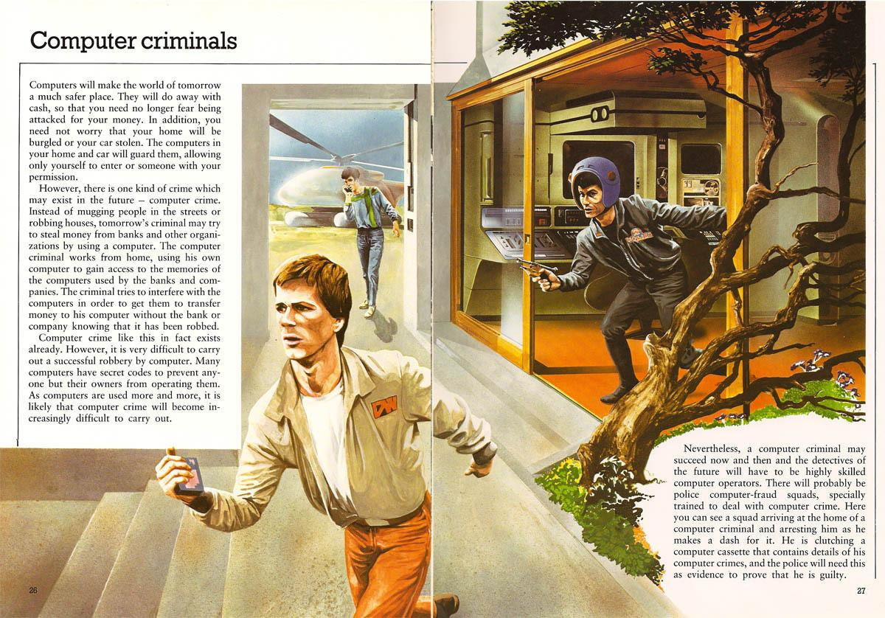
The 1981 book School, Work and Play (World of Tomorrow)

Slide 8
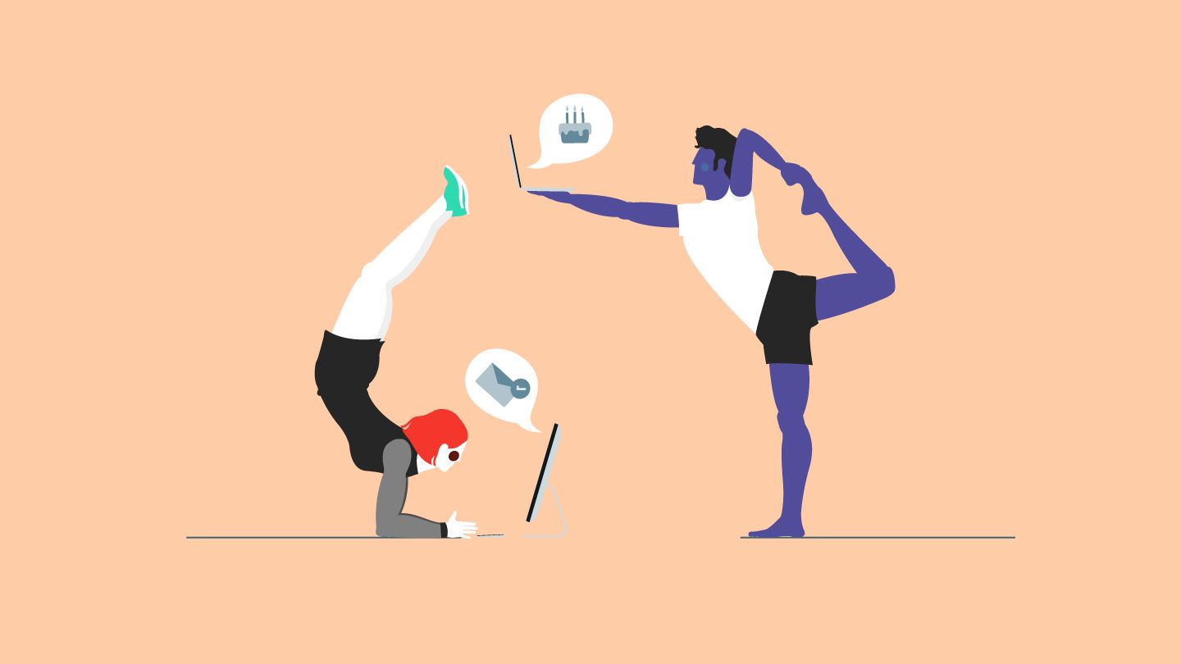

Slide 9
Today
All about me, myself and LYRASIS
How did I get here?
How did any of us get here?
Why are we here?
Privacy
The Fundamentals
Incentives & Players
The industry & how trackers work
What can we do?
Security
Who is after us & who do we worry about?
Why does this matter?
What are the incentives?
Passwords?

Slide 10
I’m Blake! I’m a “librarian” - I have an MLS!
I’m an LJ Mover & Shaker (2001)
Library Director
Teacher
Programmer at a .com startup
Web Librarian
Records Manager
Business Owner / Sysadmin / Support
LISNews, LISHost & LISWire
Senior Systems Administrator
In the past decade I’ve done this ~40 times.
@blakesterz & @lisnews
blake.carver@lyrasis.org

Slide 11
About LYRASIS
80 years of deep history with information professionals
Non-profit
Community focused
Devoted to serving members
1000+ members strong
80+ vendor partners
Bringing together collections-holding organizations across fields, including archives, libraries and museums
1000+
Members
$500m
Services Provided
Millions
of Dollars Saved

Slide 12
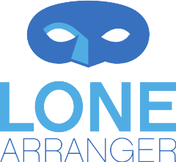
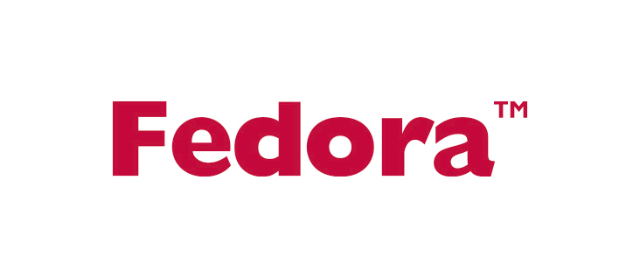
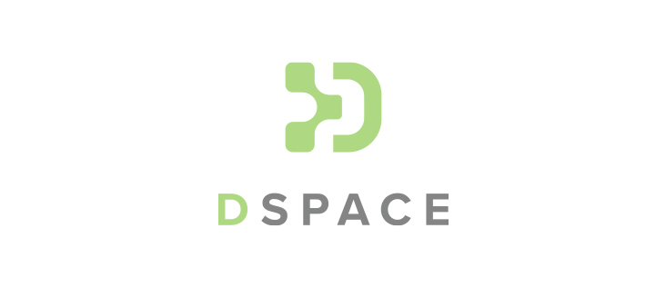
Digital Technology Services: Hosting Services

Slide 13
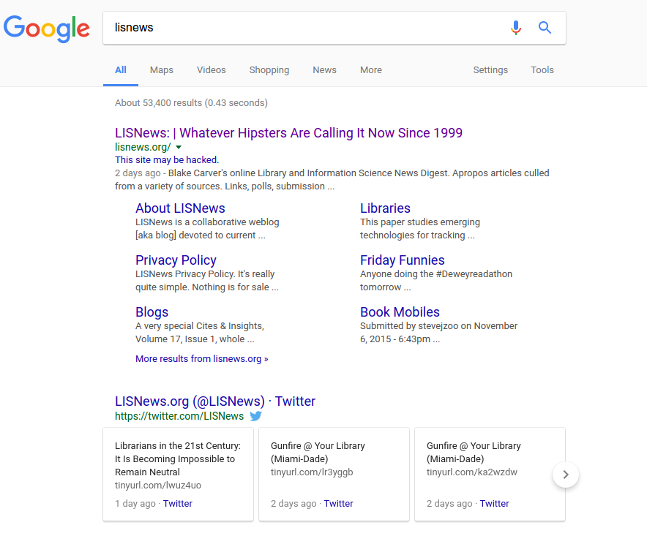

Slide 14
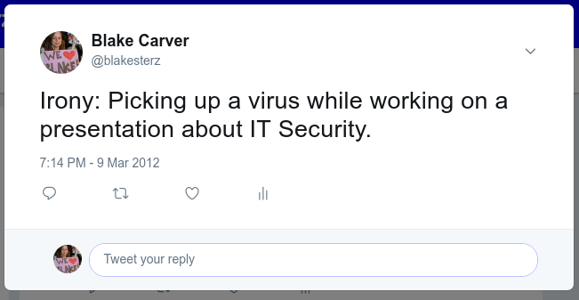

Slide 15
Before We Start - My Assumptions
You won’t be here every day or catch everything the first time
You’re interested in or working in IT
You’re willing to invest time (and money?)
You’re working in a library
You have little to no experience with itsec
You have little to no security in place now
You’re going to be doing some training
Your staff/coworkers
Your friends/family
Your patrons/users/customers
Your boss
Your board
Your self

Slide 16
Everything you need to know
Passwords: L E N G T H & Unique
Paranoia: Think Before You Click
Backups: Frequent and Automatic
Patches: Set to Auto
Upskill: Regular training
Protect: Review all settings
Notes:
The “6 Ps of IT Security”

Slide 17
We are all targets
We all have something of value

Slide 18
List O’ Libraries In The News
The Kokomo-Howard Public Library
Northampton Area Public Library
Wilmer, Texas
The Bartlett Public Library District
Contra Costa library system
Volusia library
Pittsburg Unified School District
Denver Public
Onondaga County library
Spartanburg County
Brownsburg Public Library
Hardin County Schools
Daviess County Public Library
Bartlett Public Library
St. Louis Public Library
Butler County
Baltimore County Public Schools
Tillamook County

Slide 19
“Security & Privacy can be two different things: They can be both a feeling & a reality ”
Bruce Schneier – TedxPSU
Notes:
They are different, you can feel secure if you’re not, and you can be secure even if you don’t feel it.
Look this talk up, it’s GREAT

Slide 20
Understanding…
Information / IT / Data
Privacy

Slide 21
When it comes to Privacy...
Librarians are different.
Privacy
Notes:
Privacy is a relative term. That is, the things that I consider important to my privacy, someone else might not care about. As librarians we usually key in on Confidentiality Threats. We want our patrons records safe. We also don't share that information with ANYONE else. In general, we are fierce about protecting our patrons’ privacy. This is something that has always set us apart from everyone else. Amazon won't do it. Google won't do it. Do I even need to say Facebook won't do it? People who come into the library or use our web sites don't worry about what's going to happen with their information (or at least they shouldn't need worry about it). They should know we are doing our best to guard their privacy. Keeping all our IT resources secure should be a large part of guarding that privacy.

Slide 22
Privacy Vs. Data Privacy
The rules of privacy are being defined and redefined today.
So much of what we do is for sale now.
Things that used to be ephemeral are now permanent(ish).

Slide 23
https://www.linuxjournal.com/content/privacy-mine-right-individual-persons-not-data

Slide 24
Threats To Privacy?
The government threat
The criminal threat
The corporate threat

Slide 25
Privacy is about control...your loss of control over that information is the issue. We may not mind sharing our personal lives and thoughts, but we want to control how, where and with whom. A privacy failure is a control failure.
https://www.schneier.com/blog/archives/2010/04/privacy_and_con.html

Slide 27
Privacy is Getting Better!
But it’s Getting Worse Faster

Slide 28
Why?
Devices: There’s an exponential proliferation of devices.
Data: With all those devices, comes an avalanche of data.
People: There just aren’t enough focused on privacy.
Surveillance is the business of the Internet

Slide 29
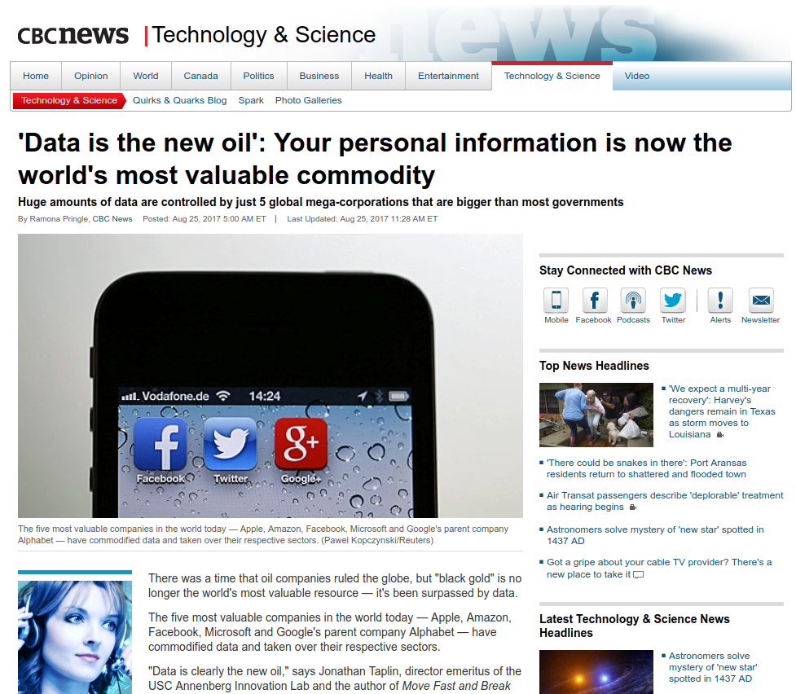

Slide 30
Privacy Policies
They can be changed whenever the company pleases.
They are not an agreement between you and the company.
They are theirs, not yours.
https://www.linuxjournal.com/content/privacy-still-personal

Slide 31
We don’t know how our information is used, stored or shared and for how long.
We don’t know who has access
We don’t know if it’s safe

Slide 32
Personal information is the currency of the entire Internet economy
Notes:
Personal information is the currency of the underground economy. It's
literally what cybercriminals trade in. Hackers who obtain this data
can sell it to a variety of buyers, including identity thieves,
organized crime rings, spammers and botnet operators, who use the data
to make even more money.
A name or email address is worth anywhere from fractions of a cent to
$1 per record, depending on the quality and freshness of the data,
information security experts say.
That may not sound like a windfall, but when you multiply it by
millions of records, it quickly adds up. Take the Zappos breach as an
example: If hackers in fact obtained data on 24 million customers,
even if they sell only 5 million email addresses at five cents a
pop—cha-ching—they've just made $250,000 off of one hack.
Botnet operators make even more money. Say you own a botnet that
consists of 100,000 computers. You may rent it out to spammers for
$1,000 per hour, says Stu Sjouwerman, founder and CEO of KnowB4, a
provider of Internet security
training based in Clearwater,
Fla. If you rent or buy the 24 million records from Zappos' so that
you can then send malware to those email addresses, even if only 20
percent of recipients get infected with your malware that takes
control of their computer, you've still grown your botnet by about 5
million computers with very little work, he adds.
"Now you can charge $5,000 an hour instead of $1,000 per hour for 5
million bots that start sending spam," says Sjouwerman. "These guys
make money hand over fist." Of course, their illegal activity also
means criminal charges, jail time and financial restitution.
http://www.cio.com/article/698820/Are_You_at_Risk_What_Cybercriminals_Do_With_Your_Personal_Data_
Print Article Close Window
From: www.cio.com
Are You at Risk? What Cybercriminals Do With Your Personal Data
– Meridith Levinson, CIO

Slide 33
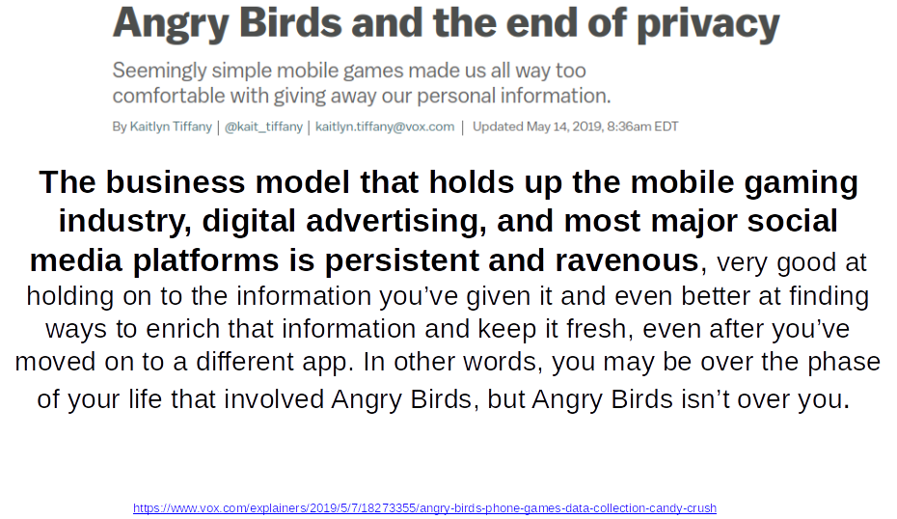

Slide 34
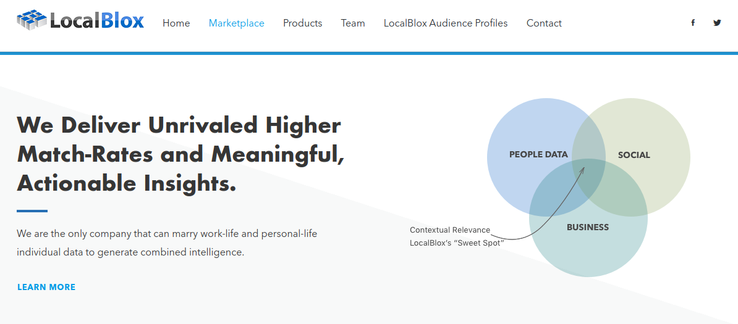

Slide 35
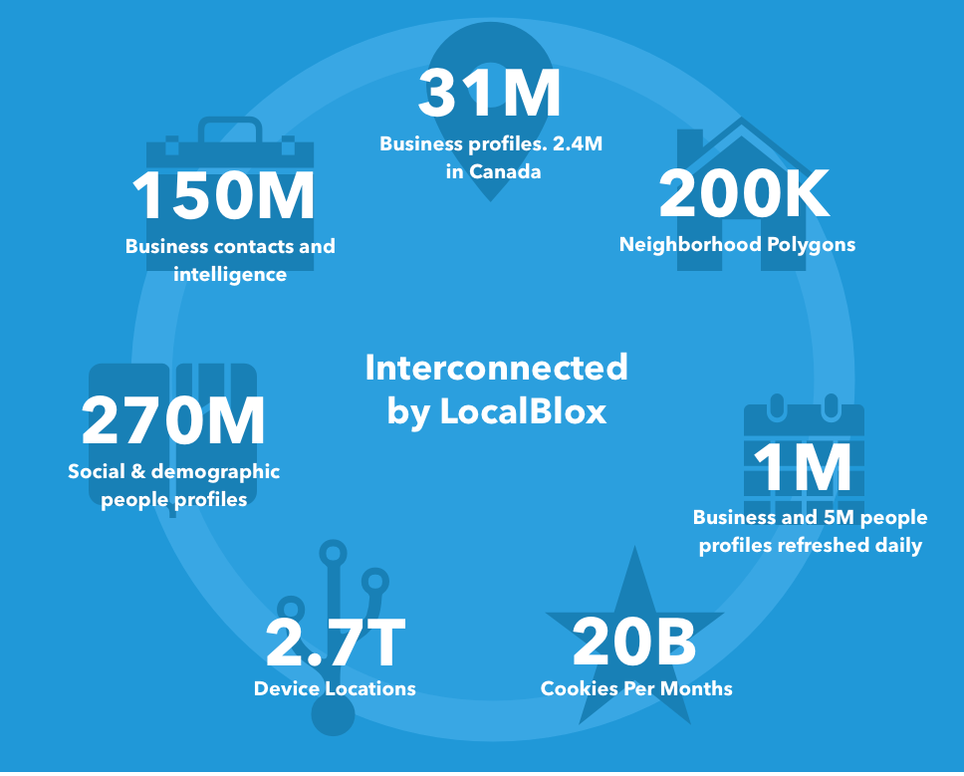

Slide 36
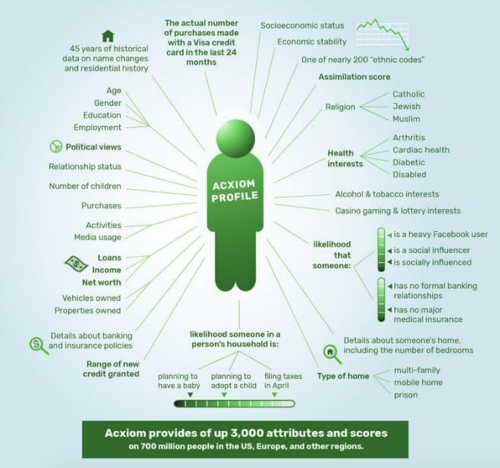

Slide 37
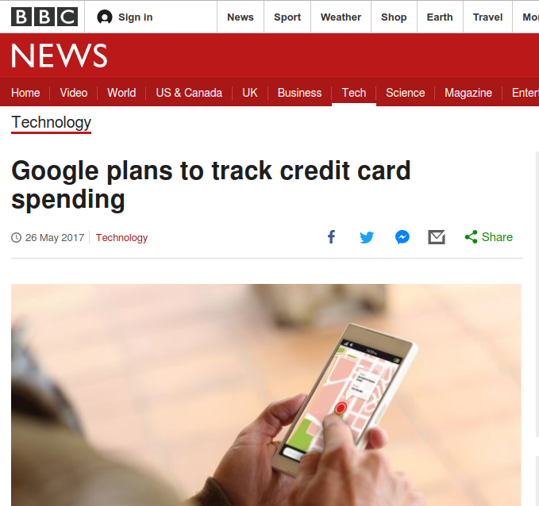

Slide 38
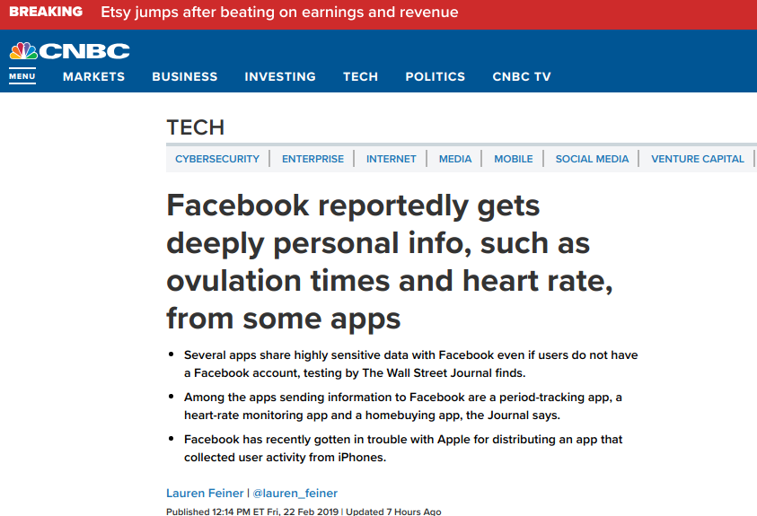

Slide 39
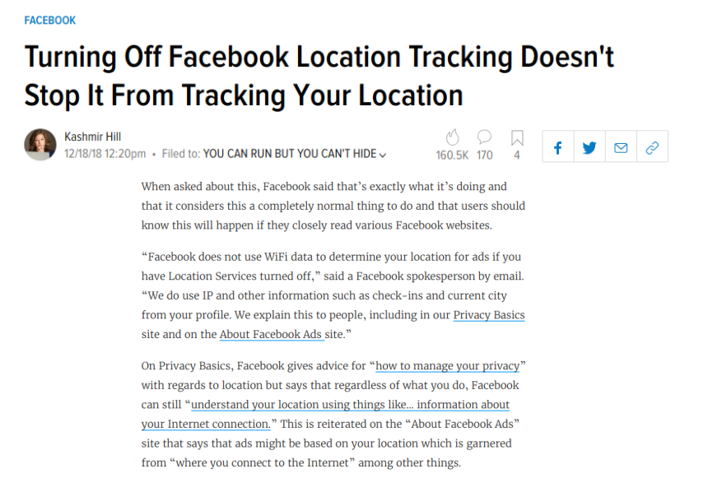

Slide 40
...your data is collected in ways you cannot reasonably prevent, no matter how carefully you or anyone you know behaves.
https://fivethirtyeight.com/features/you-cant-opt-out-of-sharing-your-data-even-if-you-didnt-opt-in/

Slide 41
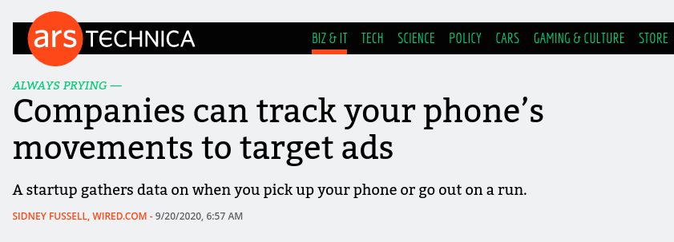
“We see Apple's announcements, consumers getting more conscious of privacy, and the death of the cookie,” says Abhishek Sen, cofounder of NumberEight, a “contextual intelligence” startup in the UK that infers user behavior from sensors in their smartphone.
Sen describes NumberEight’s chief product as “context prediction software.” The tool helps apps infer user activity based on data from a smartphone’s sensors: whether they’re running or seated, near a park or museum, driving or riding a train.

Slide 43
How Does This Work?
Browsing history, app usage, purchases, and geolocation data, data about our clicks, impressions, taps, and movement goes into sprawling behavioral profiles, which can reveal political affiliation, religious belief, sexual identity and activity, race and ethnicity, education level, income bracket, purchasing habits, and physical and mental health.

Slide 44
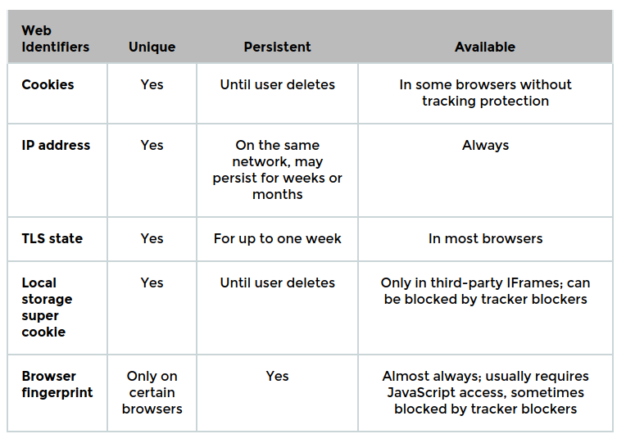

Slide 45
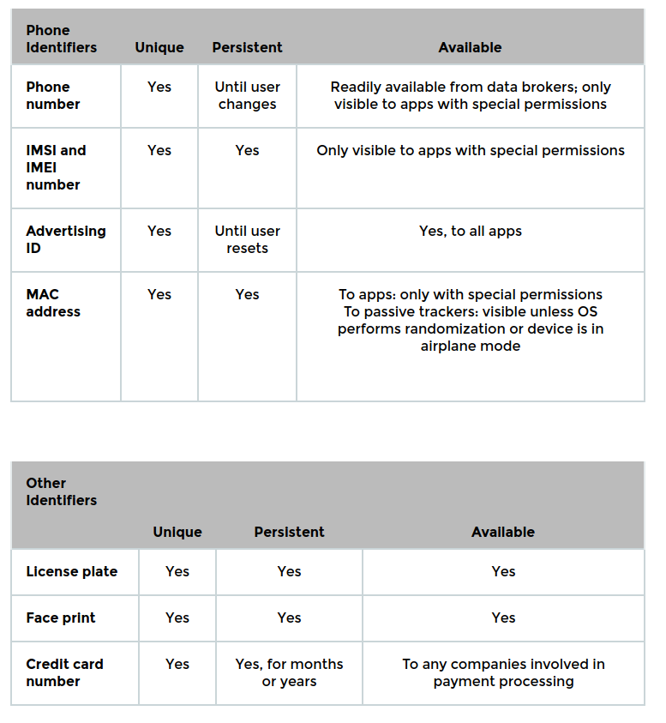

Slide 46
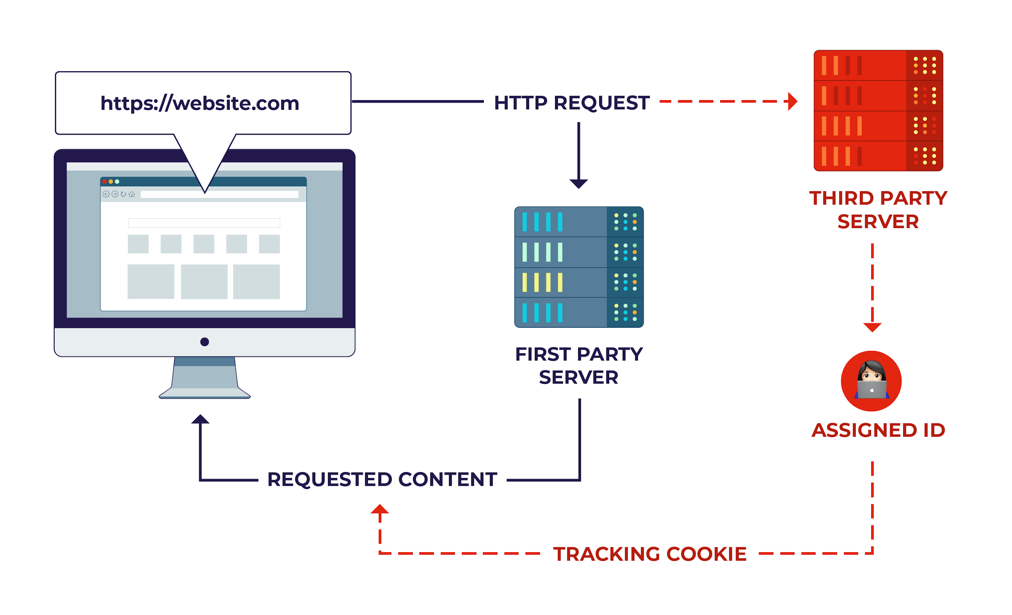
Identifiers
Cookies, Cookie Syncing, headers, TLS, Fonts, Plugins/Extensions, IP Address, JavaScript, Fingerprinting, Iframes, Local Storage
(Mobile) Advertising IDs, Phone Number, IMSI and IMEI, MAC addresses, BlueTooth

Slide 47
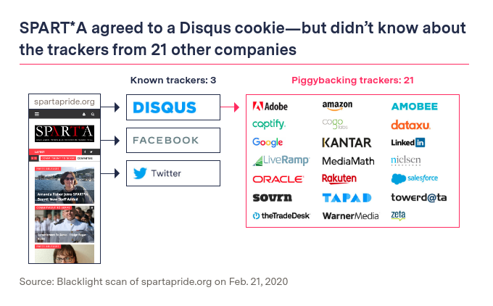
https://themarkup.org/blacklight/2020/09/22/blacklight-tracking-advertisers-digital-privacy-sensitive-websites

Slide 48
Trackers
Buy / Sell / Trade / Beg / Borrow / Steal
Sellers - Real-time bidding, ad exchanges, demand side platforms, shadow bidding, data brokers (Buyers and sellers)
Buyers - Targeted advertising, Political campaigns and interest groups, Debt collectors, bounty hunters, and fraud investigators, Cities, law enforcement, intelligence agencies

Slide 49
What I learned: The card data business is booming for advertisers, for aiding investors and for helping retailers and banks encourage more spending. And there are many ways a card swipe can be exploited that don’t always require a transaction being “sold” or “shared” in a way that fully identifies you. Data can be aggregated, anonymized, hashed or pseudonymized (given a new name), or used to target you without ever technically changing hands.
1) The bank
2) The card network
3) The store
4) Point-of-sale systems and retailer banks
5) Mobile wallets
6) Financial apps
https://www.washingtonpost.com/technology/2019/08/26/spy-your-wallet-credit-cards-have-privacy-problem/

Slide 50
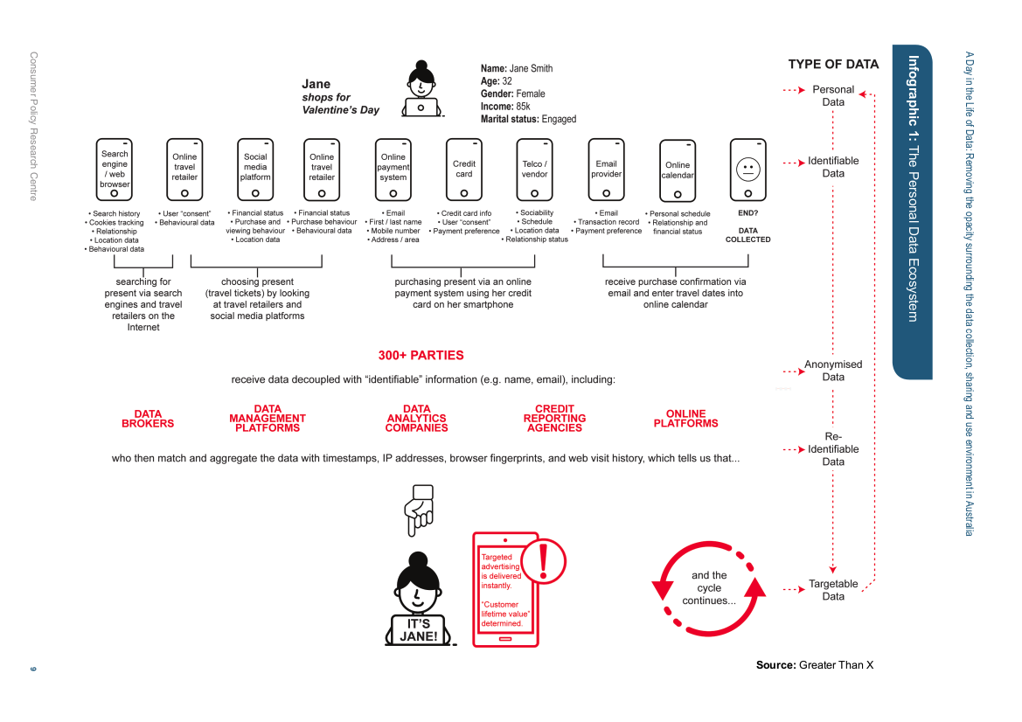

Slide 51
What can we do?
Opt-Out?

Slide 52
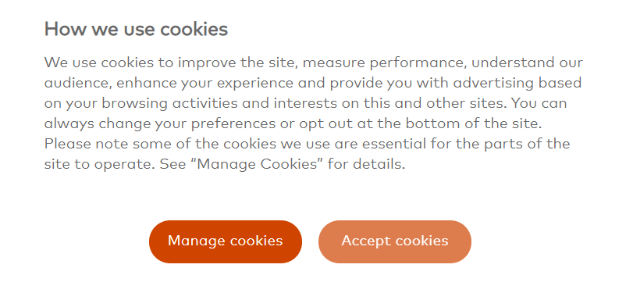
On Reuters, There are 647 different partners, each with its own privacy policy that you are somehow expected to read.
NOBODY is going to read all of those.
Remember that these vendors provide the same services to multiple websites, and as they are uniquely identifying your browser and devices, they can analyze and cross reference you and build surprisingly accurate models of you, as this post from Privacy International outlines.
In summary:
There are hundreds of entities processing your data whenever you visit a website
Largely, you have little say of what constitutes ‘essential cookies’ for the functionality of the websites.
There is a vibrant ecosystem of data vendors who collect, analyze, mine and cross-reference your data
These organizations potentially deal with each other.
Among these vendors are some very familiar names - Adobe, Amazon, Google, Huawei, Oracle, Salesforce
http://www.conradakunga.com/blog/what-do-you-actually-agree-to-when-you-accept-all-cookies/

Slide 53
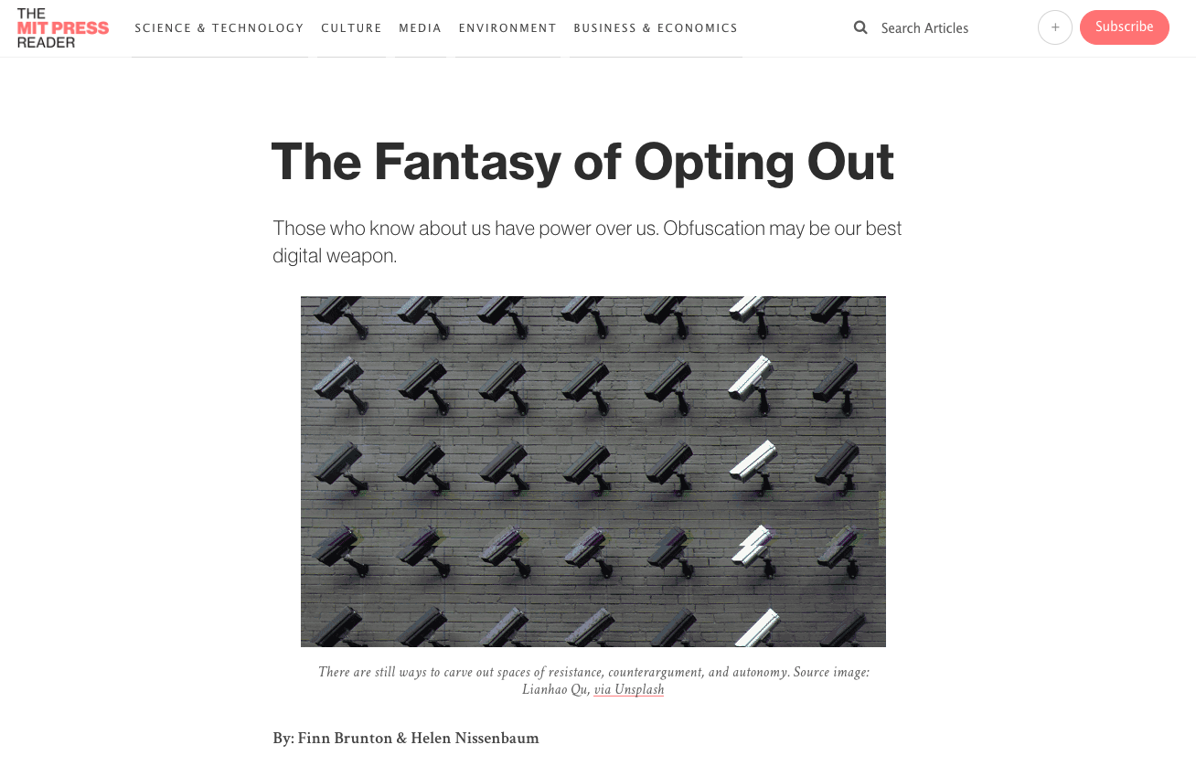
https://thereader.mitpress.mit.edu/the-fantasy-of-opting-out/

Slide 54
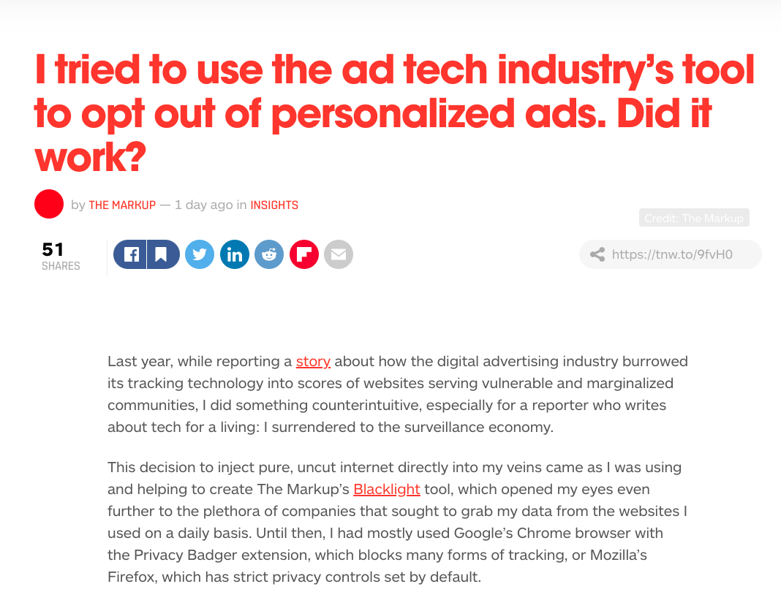

Slide 55
“If you need Exhibit A for why you shouldn’t let the ad industry regulate itself,” Cyphers added, “this is it.”
https://thenextweb.com/insights/2021/03/28/i-tried-to-use-the-ad-tech-industrys-tool-to-opt-out-of-personalized-ads-did-it-work-syndication/

Slide 56
What can we do?
Opt-Out / Log Out
Decentralization & Self-hosting
Open-Source
Encryption
Awareness & Education

Slide 57
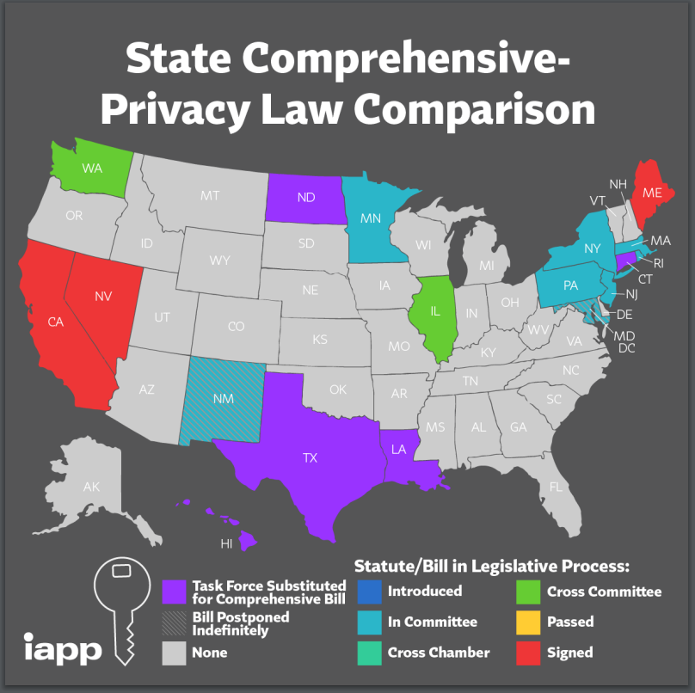

Slide 58
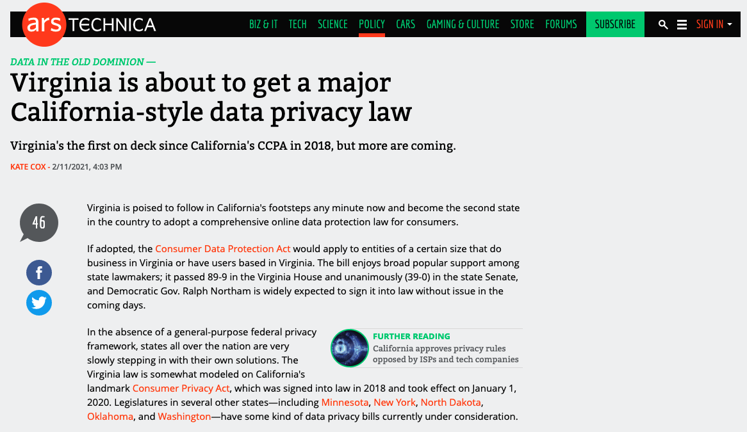

Slide 59
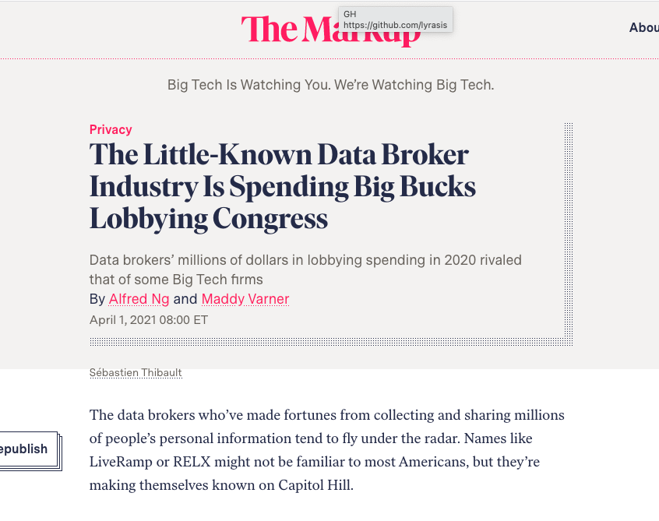
https://themarkup.org/privacy/2021/04/01/the-little-known-data-broker-industry-is-spending-big-bucks-lobbying-congress

Slide 61
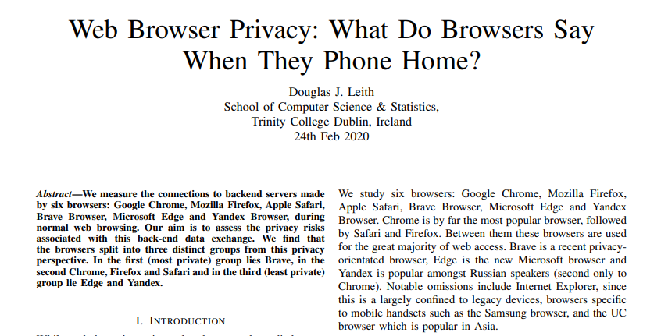
From a privacy perspective Microsoft Edge and Yandex are qualitatively different from the other browsers studied. Both send persistent identifiers than can be used to link requests (and associated IP address/location) to back end servers. Edge also sends the hardware UUID of the device to Microsoft and Yandex similarly transmits a hashed hardware identifier to back end servers. As far as we can tell this behaviour cannot be disabled by users. In addition to the search autocomplete functionality that shares details of web pages visited, both transmit web page information to servers that appear unrelated to search autocomplete.
For Brave with its default settings we did not find any use of identifiers allowing tracking of IP address over time, and no sharing of the details of web pages visited with backend servers. Chrome, Firefox and Safari all share details of web pages visited with backend servers.

Slide 62
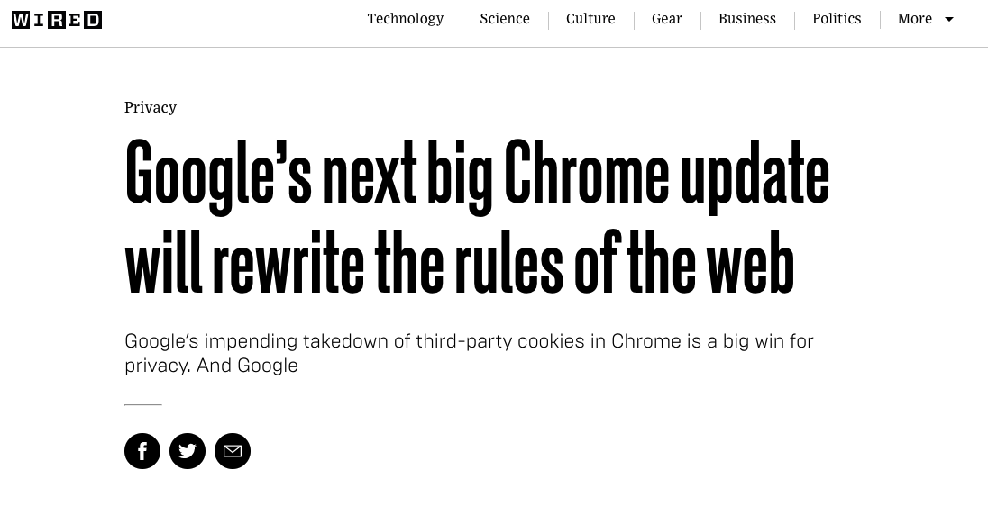
Google will start trialling FloC in March – but will only use websites that have tracking enabled or are already serving display advertising. The company also says it is against its ad policies to serve personalised ads based on sensitive categories. FLoC groups that reveal people’s race, sexual orientation and other categories will be blocked or, if that’s not possible, Google says it will change its algorithm to “reduce the correlation”.
https://www.wired.co.uk/article/google-chrome-cookies-third-party-ads

Slide 63
Practical Privacy
Browsers - Brave, FireFox, Safari
Browser Privacy Plugins
Privacy Badger – uBlock Origin - uMatrix(?)
Use a VPN or Tor
httpS
Linux
DuckDuckGo
Uninstall Apps
Check your settings
Pi-hole
Change DNS Provider
Don’t use Gmail?

Slide 64
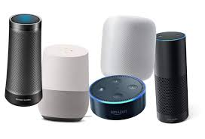

Slide 65
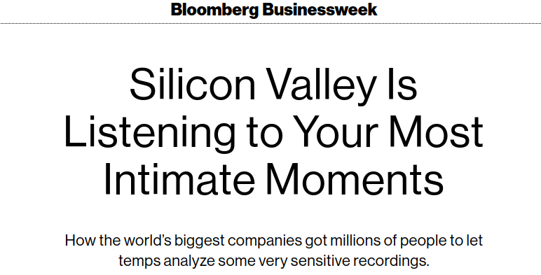
The recordings she and her co-workers were listening to were often intense, awkward, or intensely awkward. Lonely sounding people confessing intimate secrets and fears: a boy expressing a desire to rape; men hitting on Alexa like a crude version of Joaquin Phoenix in Her. And as the transcription program grew along with Alexa’s popularity, so did the private information revealed in the recordings. Other contractors recall hearing kids share their home address and phone number, a man trying to order sex toys, a dinner party guest wondering aloud whether Amazon was snooping on them at that very instant. “There’s no frickin’ way they knew they were being listened to,” Slatis says. “These people didn’t agree to this.” She quit in 2016.

Slide 66
ACCORDING TO THE TWO U.S. information-security employees, data is at risk because Amazon has a poor grasp of what data it has, where it is stored and who has access to it.
“If you wanted to do a 'right to be forgotten,' it would be next to impossible for Amazon to identify all of the places where your data resides within their system,” said the first former U.S.-based employee. The right to be forgotten, or right to have data erased, is a key tool for citizens under several privacy regimes, including in Europe and California.
The second U.S.-based information-security professional confirmed Amazon's shaky understanding of what reams of personal information it holds. “Amazon has grown so fast, it doesn't know what it owns … They don't know where their data is at, so they don’t know if they are protecting it correctly,” the person said.
https://www.politico.eu/article/data-at-risk-amazon-security-threat/

Slide 67
Libraries and Patron Data - Usual Suspects
Integrated Library Systems
Database backups
Print management systems
Server logs
Reference chat/desk logs
Public computer/wireless traffic logs
Interlibrary Loan requests
Anything else with PII
Security camera footage
Card reader logs
Meeting room reservations
Authentication system logs
Library programs
Attendance logs
Feedback responses
Vendor & other app data
Paper forms
Staff email
Library Data and You - A Brief Primer - Becky Yoose

Slide 68
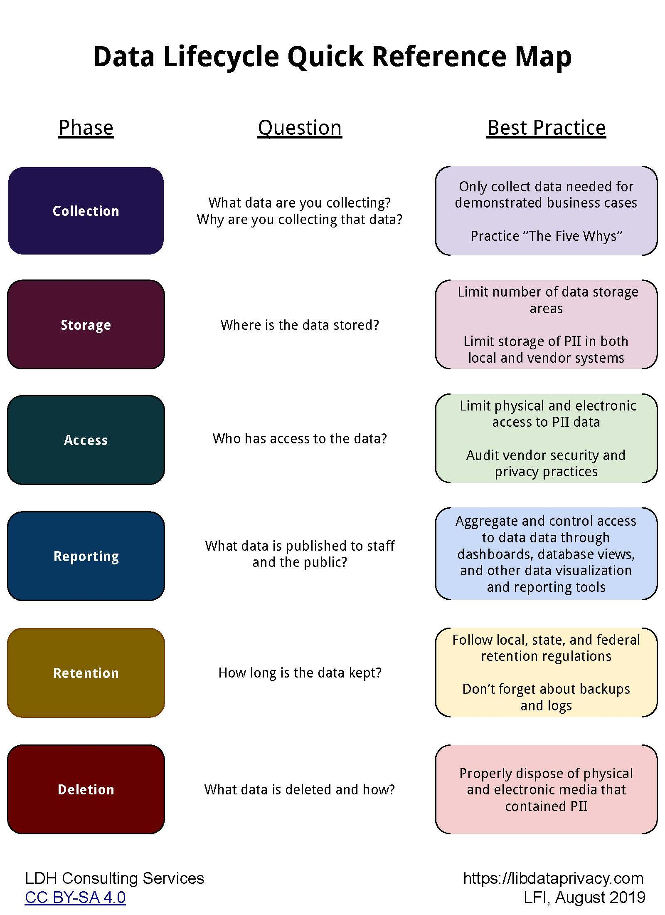
Starting a Privacy Audit
ALA Resources
EFF’s How to Assess Vendor’s Data Security
LFI presentation by Becky Yoose (https://vimeo.com/357367133)
LFI Presentation by Erin Berman (https://vimeo.com/353126702)
From LFI’s excellent slide deck:
Privacy & Security in Public Libraries

Slide 69
A Practical Guide to Performing a Library User Data Risk Assessment in Library-Built Systems
Libraries collect data about the people they serve every day. While some data collection is necessary to provide services, responsible data management is essential to protect the privacy of our users and uphold our professional values. One of the ways to ensure responsible data management is to perform a Data Risk Assessment.
A Data Risk Assessment is a process of identifying data the library collects about users, understanding how it manages that data, identifying the risks associated with that data, and then selecting an appropriate risk mitigation strategy.
https://osf.io/v2c3m/

Slide 70
We don’t want to collect and save EVERYTHING.
Collect & communicate with transparency.
Give people a choice.

Slide 71
Load third-party scripts only when needed
Don’t run Google Analytics
Remove social widgets
No email tracking
Do not log or ask PII data when it’s not needed

Slide 72
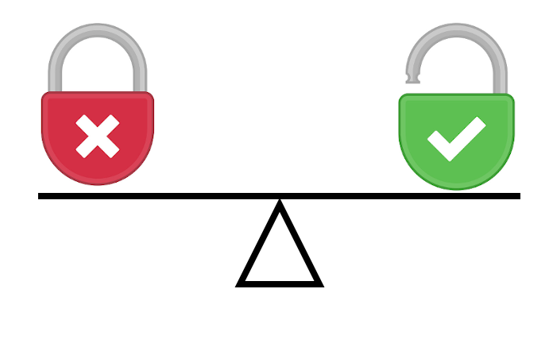
We need to find balance between…
private / secure / hard to use open / harvested / easy

Slide 73
“I don’t think the fix to privacy is something that can be done by an individual alone, in the same way I can’t solve the pollution problem by recycling on my own,”
Daniel Gillmor of the American Civil Liberties Union
https://www.bloomberg.com/news/features/2019-08-08/i-tried-hiding-from-silicon-valley-in-a-pile-of-privacy-gadgets

Slide 74
None of this means Google, Facebook and the rest are evil. But let’s focus on three things
Accept that privacy online entails trade-offs
Keep in mind that the widespread creation and spread of data is inherent to computers and the Internet
We all both benefit from the spread of data BUT let’s also be away of implications
Awareness & Education
https://stratechery.com/2019/privacy-fundamentalism/

Slide 75
Privacy is the new competitive battleground
It’s not clear how soon the technology will become ubiquitous, but it is clear that privacy is quickly emerging as the next competitive battleground. Newly passed regulations like CPRA codify the measures companies need to take, but it’s consumer expectations that will drive long-term shifts within the companies themselves.
For those ahead of the curve, there will be significant cost savings and growth — especially as customers start to shift their loyalty toward those businesses that respect and protect their privacy. For everyone else, it will be a major wake-up call as consumers demand to take back their data.
https://techcrunch.com/2020/12/16/privacy-is-the-new-competitive-battleground/

Slide 76
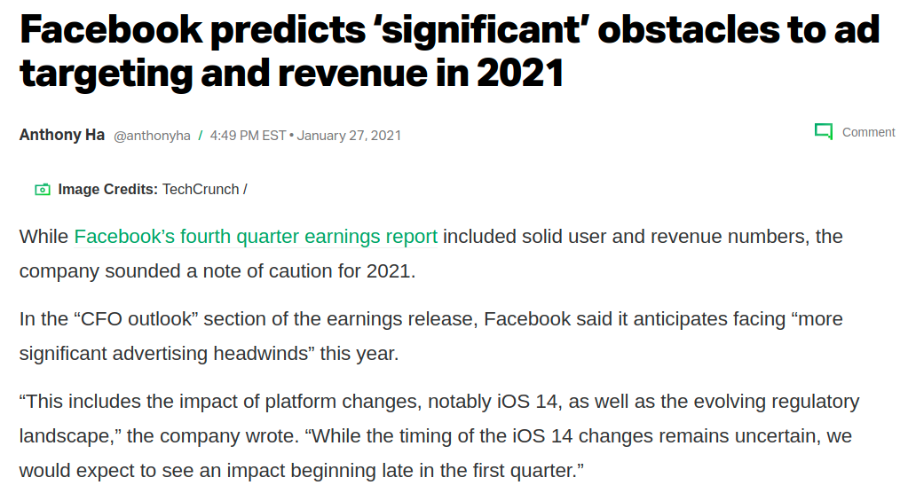
https://techcrunch.com/2021/01/27/facebook-q4-earnings-2/

Slide 77
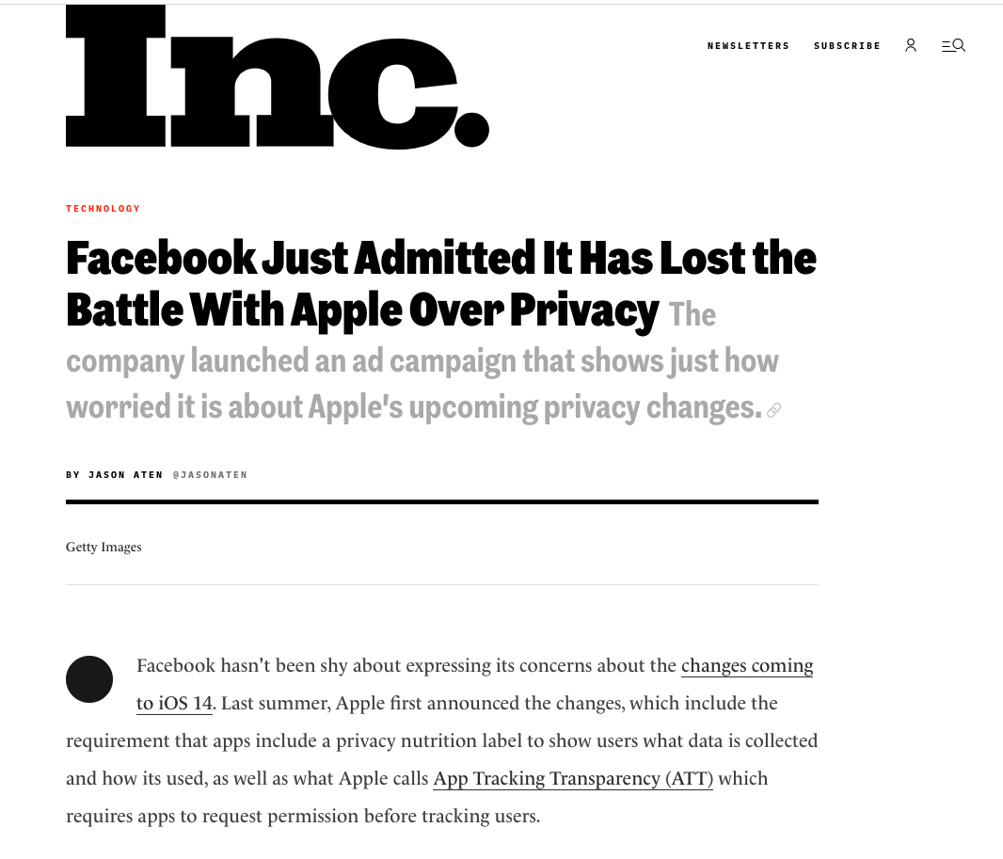

Slide 78
Security

Slide 79
● ● ● ● ● ● ● ●
Security
Cyber Security?
IT Security?
Safety?
Information Security?
Information Literacy?
The Digital Divide?
ITSec

Slide 81
Security
Privacy

Slide 82
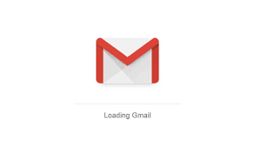
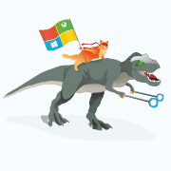
Security and privacy are sometimes mutually exclusive
To get the best security you may have to sacrifice some privacy, and vice versa
Windows 10
Windows Defender
Gmail

Slide 83
If vs. When
Somethings are IFs, somethings are WHENs
Perhaps things are Likely and Possible

Slide 84
● ● ● ● ● ● ● ●
Bad Guys?
Hackers?
Crackers?
Attackers?
Threat Actors?
Black Hats

Slide 85
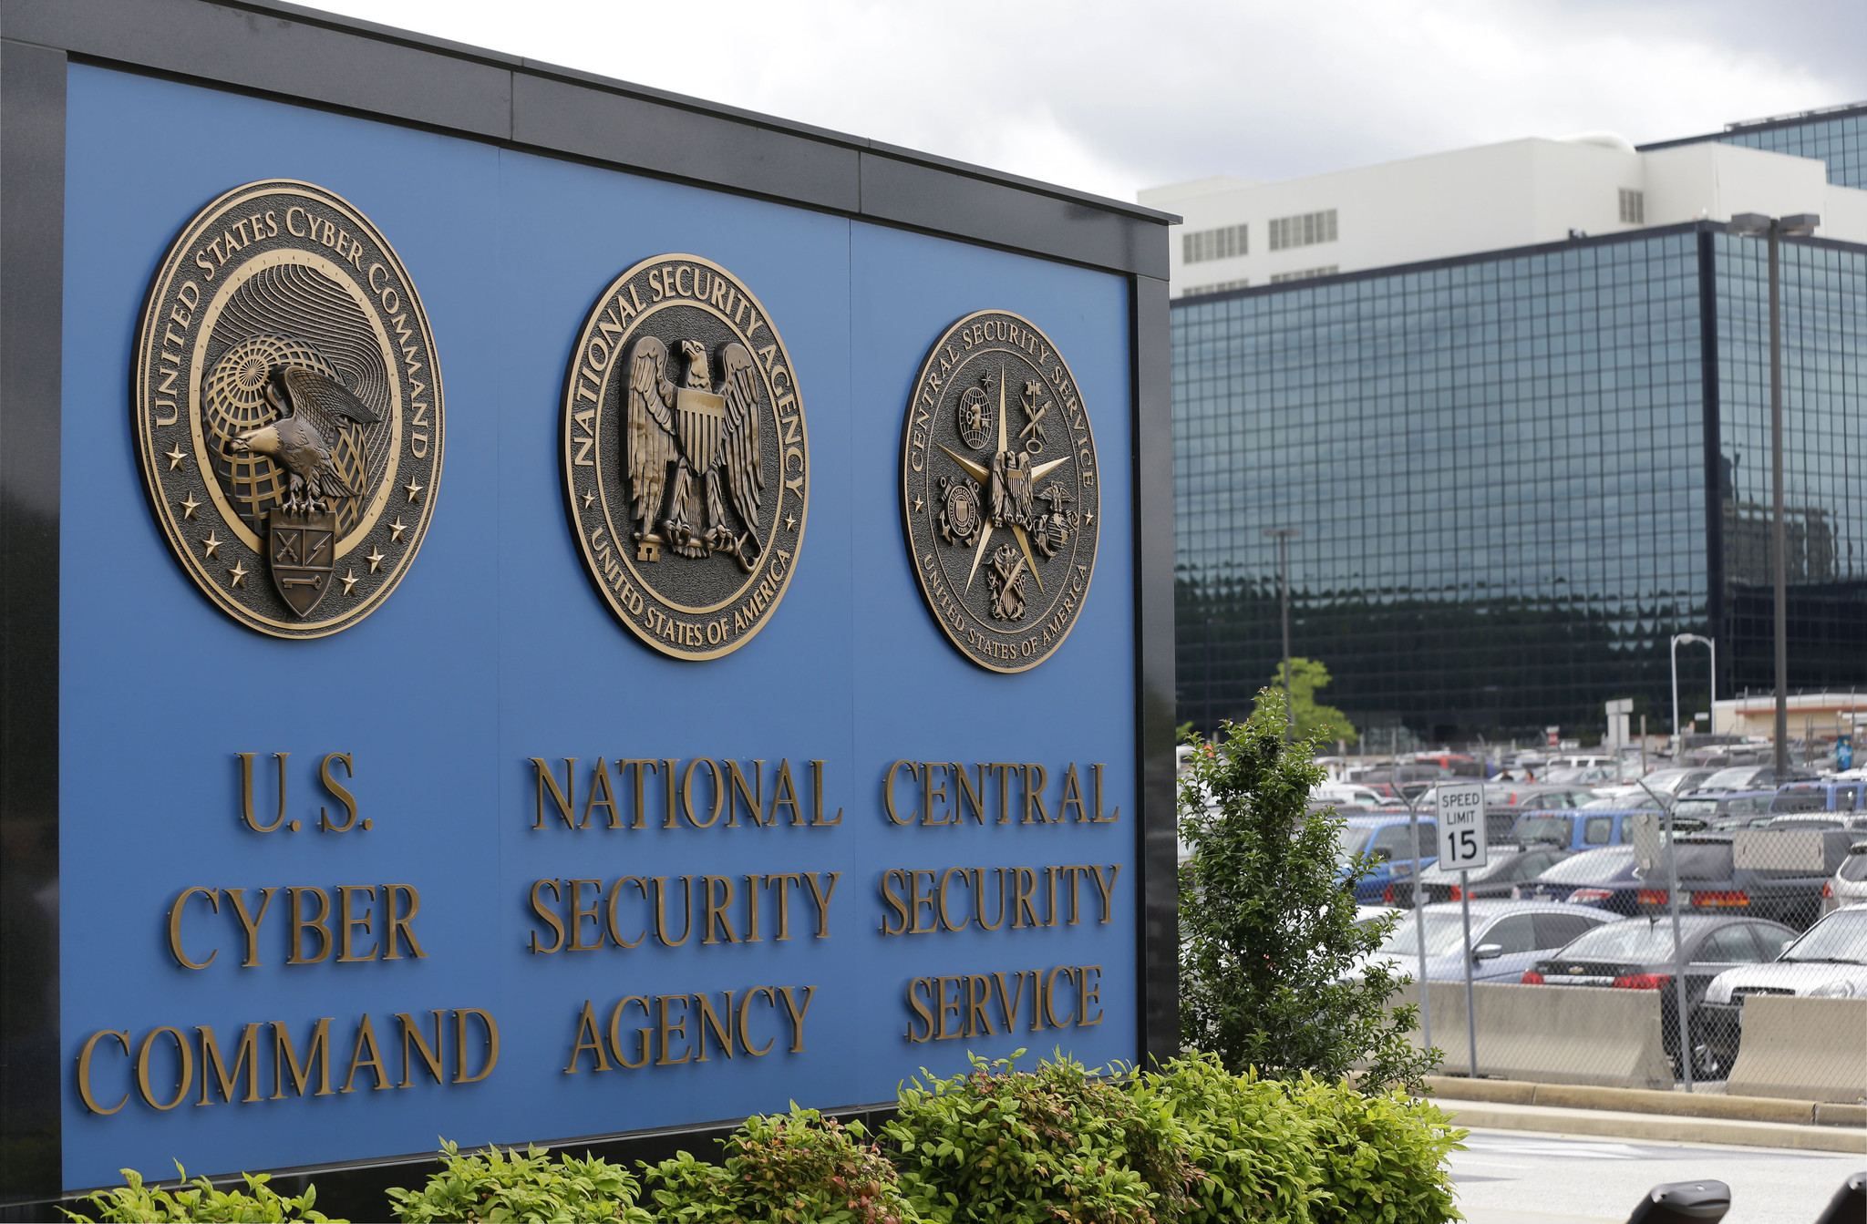

Slide 86
APTs - State Level Actors
Flexible: A big ol’ tool belt of awesome tools
Objective driven: You could just be a step or convenient stop
Stealthy: Super quiet and hard to spot
Patient: Move slow, endless time
Well-resourced and skilled: Smart with endless budgets
Experienced: Established techniques and tools

Slide 87
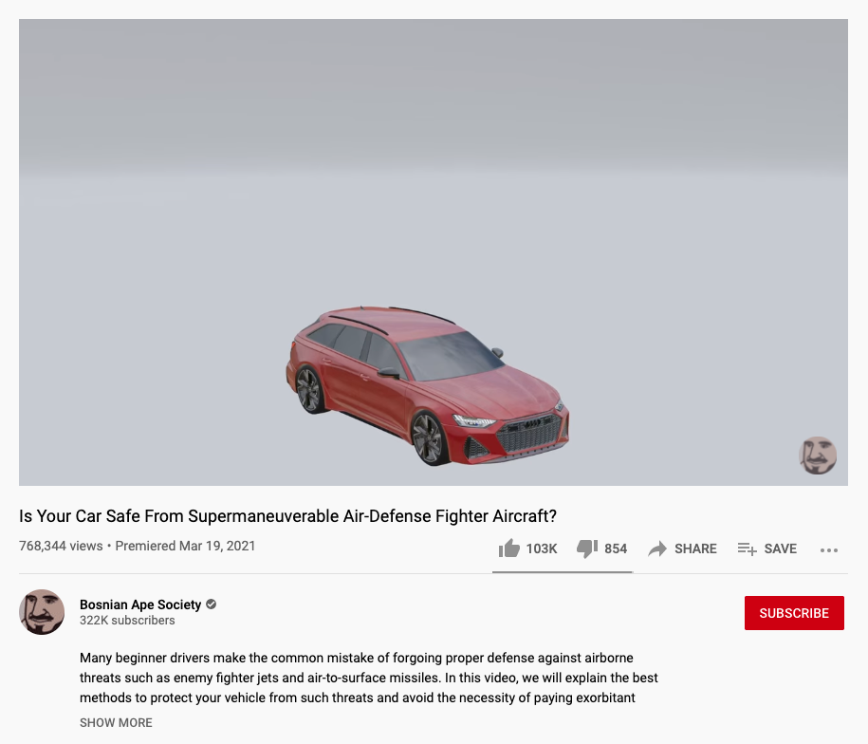

Slide 89
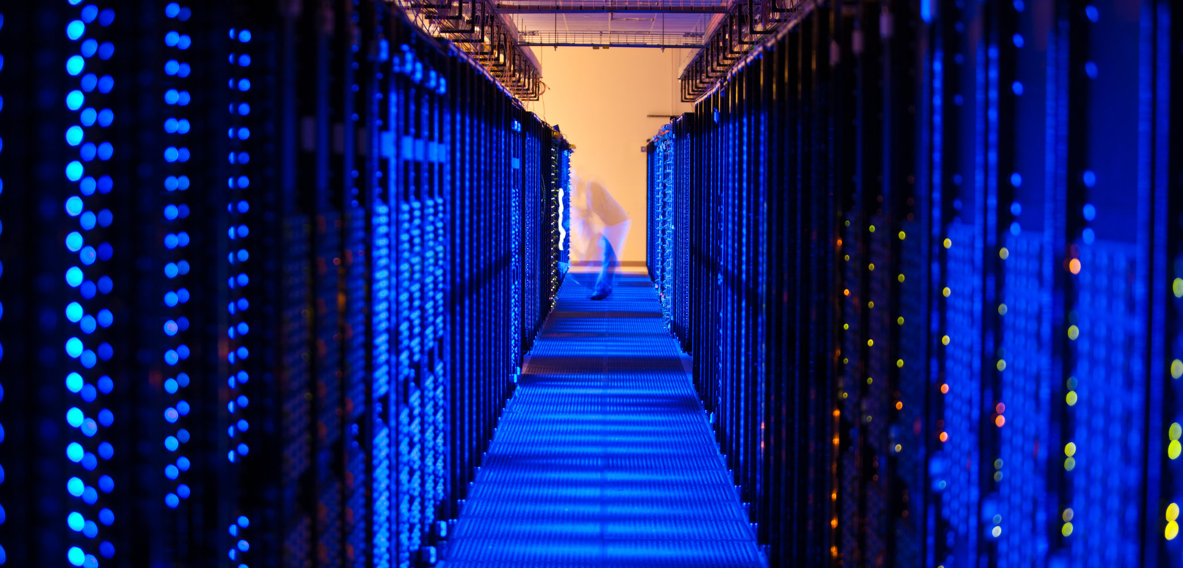
Notes:
NSA etc
There are BIG differences between what we can do, and what an even decent attacker can do.
The attackers have a big advantage over all of. us. They’re automated, dedicated, they have tools and techniques and procedures that give them many advantages . What they do is cheap and easy compared to the work we do.
Allota the attacks you read about are against a single target by a dedicated adversary.
Our threat model can’t cover everything possible. We need to look at what is common and what we have time to defend.
We also want to do things that are big wins, quick wins against all adversaries.

Slide 90
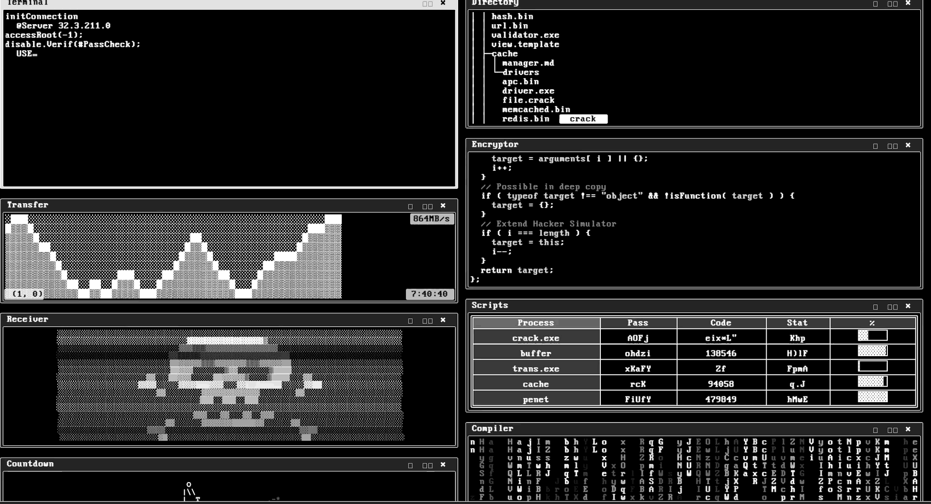

Slide 91
Not APTs - Lower Level Actors
Flexible: Small tool belt of lame tools
Rules driven
Stealthy: Eh, maybe
Patient: Not at all.
Well-resourced and skilled: Dumb and predictable
Experienced: Obvious techniques and tools

Slide 92
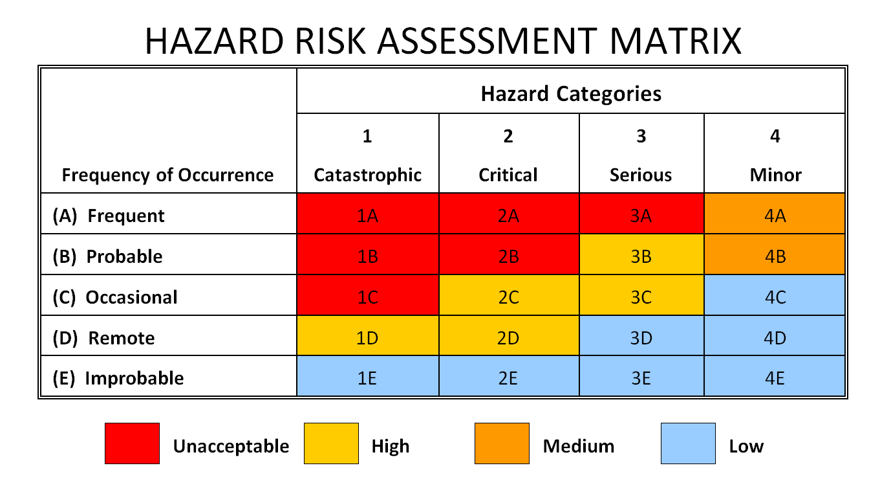

Slide 93
Cybersecurity is both old and new
As you work to make security part of your library conversation, it is critical to keep in mind that:
Cybersecurity is still relatively new.
Cybersecurity is about human conflict.
Cybersecurity evolves fast (and has no boundaries).
Cybersecurity requires asset maintenance.
https://www.microsoft.com/security/blog/2020/10/13/becoming-resilient-by-understanding-cybersecurity-risks-part-1/
Notes:
Cybersecurity is both old and new
As your organization pulls cybersecurity into your existing risk framework and portfolio, it is critical to keep in mind that:
Cybersecurity is still relatively new: Unlike responding to natural disasters or economic downturns with decades of historical data and analysis, cybersecurity is an emerging and rapidly evolving discipline. Our understanding of the risks and how to manage them must evolve with every innovation in technology and every shift in attacker techniques.
Cybersecurity is about human conflict: While managing cyber threats may be relatively new, human conflict has been around as long as there have been humans. Much can be learned by adapting existing knowledge on war, crime, economics, psychology, and sociology. Cybersecurity is also tied to the global economic, social, and political environments and can’t be separated from those.
Cybersecurity evolves fast (and has no boundaries): Once a technology infrastructure is in place, there are few limits on the velocity of scaling an idea or software into a global presence (whether helpful or malicious), mirroring the history of rail and road infrastructures. While infrastructure enables commerce and productivity, it also enables criminal or malicious elements to leverage the same scale and speed in their actions. These bad actors don’t face the many constraints of legitimate useage, including regulations, legality, or morality in the pursuit of their illicit goals. These low barriers to entry on the internet help to increase the volume, speed, and sophistication of cyberattack techniques soon after they are conceived and proven. This puts us in the position of continuously playing catch up to their latest ideas.
Cybersecurity requires asset maintenance: The most important and overlooked aspect of cybersecurity is the need to invest in ‘hygiene’ tasks to ensure consistent application of critically important practices. One aspect that surprises many people is that software ‘ages’ differently than other assets and equipment, silently accumulating security issues with time. Like a brittle metal, these silent issues suddenly become massive failures when attackers find them. This makes it critical for proactive business leadership to proactively support ongoing technology maintenance (despite no previous visible signs of failure).

Slide 94
Security...
The opposite of secure…
Convenient & easy to use.
Security at the expense of usability comes at the expense of security.
https://security.stackexchange.com/questions/6095/xkcd-936-short-complex-password-or-long-dictionary-passphrase/6116#6116

Slide 95
Security...
Isn’t Either / Or.
Isn’t the goal.
Defensibility is our goal.
Thorough understanding…
how, what, and why we’re defending our Cybers.

Slide 96
“In security, you almost never go from making something possible to impossible,” Cappos told ProPublica, “You go from making it easy to making it hard...”
https://www.propublica.org/article/solarwinds-cybersecurity-system

Slide 97
Security is Getting Better…
But it’s Getting Worse Faster
Intro

Slide 98
Why?
Professionals
Intro

Slide 99
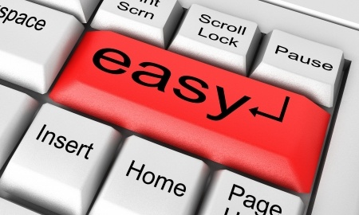
And Everyone Else
Notes:
Professionals, who are good at what they do, and smart and talented.
But then everyone else follows what they do.
99

Slide 100
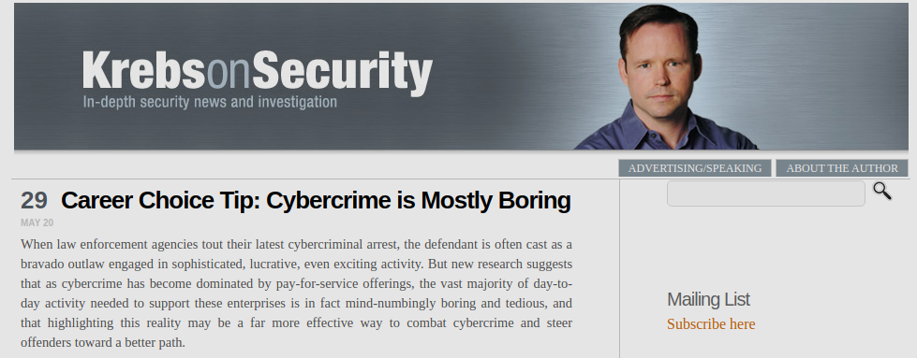

Slide 101
Security is about incentives.
Notes:
Professionals, who are good at what they do, and smart and talented.
But then everyone else follows what they do.
101

Slide 102
As the economics writer Matt Stoller has suggested, cybersecurity is a natural area for a technology company to cut costs because its customers won’t notice unless they are hacked ­– and if they are, they will have already paid for the product. In other words, the risk of a cyberattack can be transferred to the customers. Doesn’t this strategy jeopardize the possibility of long-term, repeat customers? Sure, there’s a danger there –­ but investors are so focused on short-term gains that they’re too often willing to take that risk.
https://www.schneier.com/blog/archives/2021/03/national-security-risks-of-late-stage-capitalism.html

Slide 103
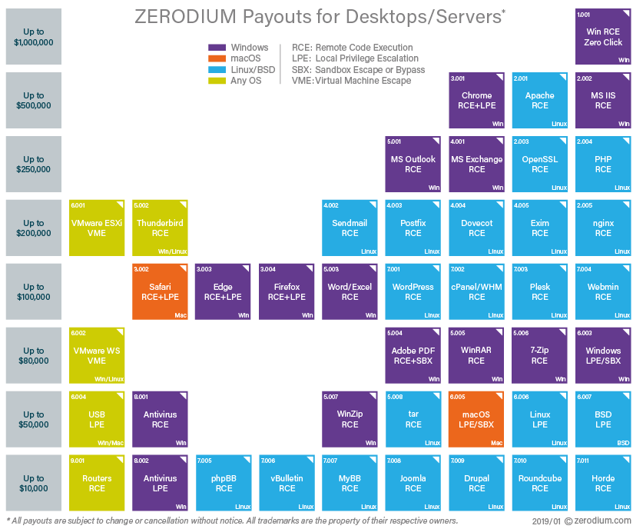

Slide 104
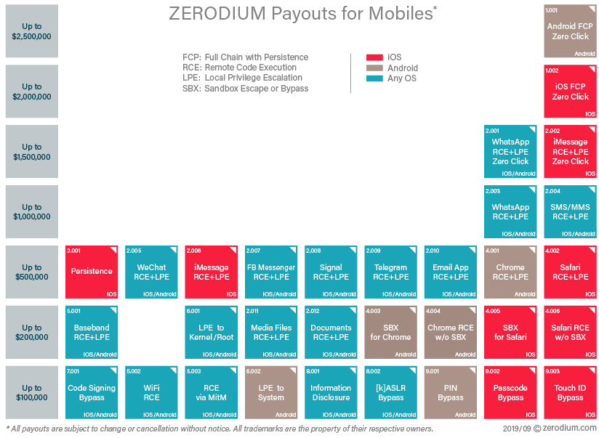

Slide 105
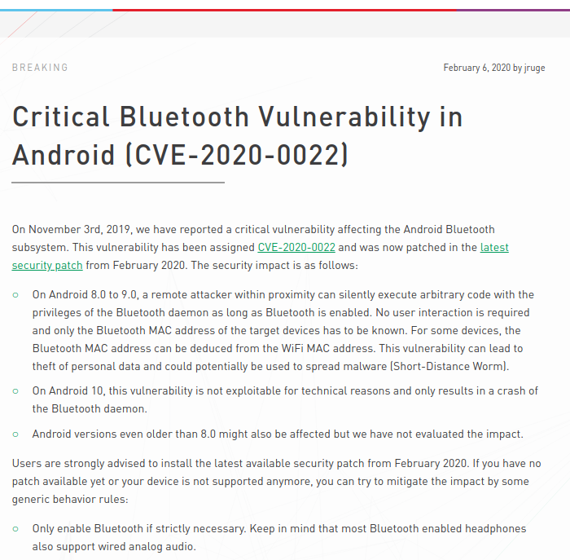

Slide 106
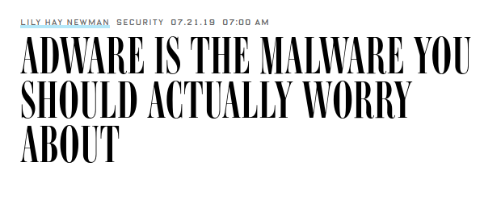
"You’re starting to see actors realizing that just regular adware won’t do these days," Check Point's Hazum says. "If you want the big money you need to invest in infrastructure and research and development."
https://www.wired.com/story/adware-most-common-malware/

Slide 107
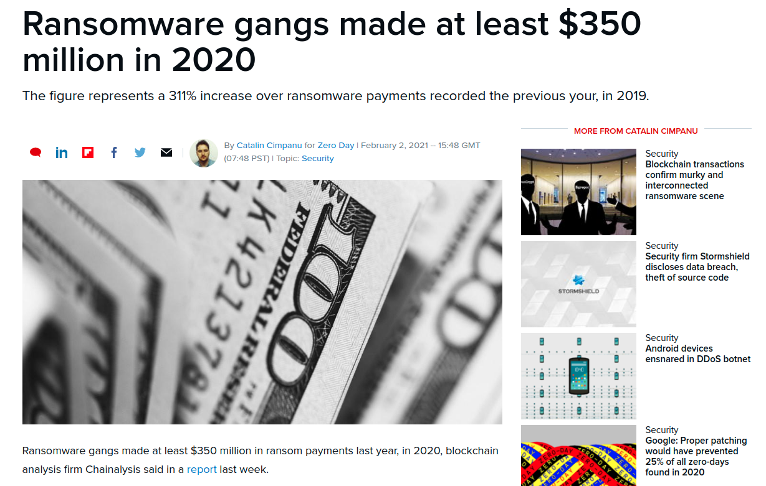

Slide 108
Retail, Finance, Healthcare, and Education
Retail, Finance, Healthcare - Obvious
Education / Libraries?!
1. Piles of treasure!
PII, IP, Espionage, Ransomware, proprietary research data
2. An easier target
Older equipment, crowds, students
3. (Sometimes) Not the Most Protected
Tight budgets and limited technical staffs
Target-rich environment.
Students / Patrons
Large and complex
Less focus and budget on security
4. Lots of Users
5. Perimeter-Focused
6. Lack of Research Visibility for IT Staff
The IT department cannot take measures to secure research data it does not know about.
7. Open Culture
8. Third-Party Vendors
But…. Is edu is more likely to report problems than private sector targets?

Slide 109
Threat Actors’ Most Targeted Industries in 2020: Finance, Manufacturing and Energy
#10 (Down 3 from last year!) Education
Half (50%) of the attacks on education in 2020 were spam or adware; 10% of attacks were ransomware. The education sector ranked as the 10th most attacked in 2020, receiving 4% of all attacks on the top 10 industries. This moves education down from the seventh-most attacked position in 2019, when it received 8% of all attacks.
Although this sector saw a smaller portion of attacks overall, it is also a more vulnerable sector where security budgets are humble, but risks are prolific. Students and staff make for a large attack surface that’s decentralized and harder to control, making schools and universities all the more susceptible to cyberattacks.
https://securityintelligence.com/posts/threat-actors-targeted-industries-2020-finance-manufacturing-energy/

Slide 110
Not much of this crime is new
Automation
Distance
"Technique Propagation"
(“Only the first attacker has to be skilled; everyone else can use his software.”)
Intro

Slide 111
Bad Guys
Skill
Focus
Tools
Time
Training
Highly Incentivized

Slide 112
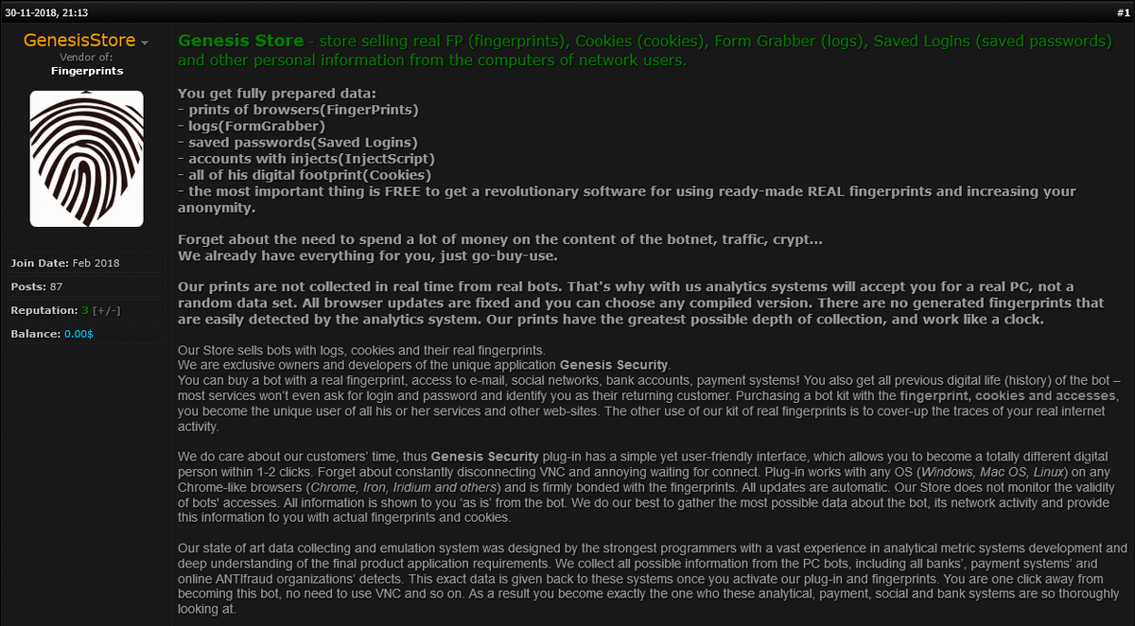

Slide 114
The technology of the internet makes the bad guys vastly more efficient.

Slide 115
It's Safe Behind The Keyboard
Hacking is a really safe crime.
Notes:
Would you rather risk going out and robbing people in real life, or sit behind a keyboard?
115

Slide 116
Who? | Cybercrimials | State-Affiliated Bad Guys (APT) | Nation State Bad Guys | Hacktivists | Bots
Motivation | Economic | Economic / Political | Political | Social / Political | Social / Political / Economic
Driven By | Profit | Profit / Mission | Misson | Profit / Mission | Programming
Sophistication | Low-High | Low-High | High | Medium | Low
Numbers | Allota | Not Many | Fewer | Some | ∞
Targets...

Slide 117
Targeted attacks
Resourceful attackers that target specific individuals and organizations
Boutique hacking
Hand-crafted campaigns targeting a few dozen individuals or organizations
Personalization
Bulk hacking
Automated campaigns targeting many individuals and organizations
Number of Targets

Slide 119
Where Are They Working?
Social Networks
Search Engines
Advertising
Email
Web Sites
Web Servers
Home Computers
Mobile Devices
Notes:
They are everywhere. They are where you are.

Slide 120
https://threatpost.com/silent-librarian-phishing-student-credentials/149249/

Slide 121
https://threatpost.com/silent-librarian-school-research-stealing/160099/

Slide 122
What Are They Using?
Keyloggers
Data Stealers
Ram Scrapers
Bots, Aka Zombies
Banking Trojans
Rats (Remote Access Trojans)
Ransomware
Bugs / Holes / Flaws / CVEs

Slide 123
Top 10 CVEs of 2020
IBM Security X-Force ranked the top 10 CVEs of 2020 based on how frequently threat actors exploited or attempted to exploit them. The ranking is based on both IBM X-Force incident response (IR) and IBM managed security services (MSS) data for 2020. According to our findings, attackers focused on common enterprise applications and open source frameworks that many businesses use within their networks.
CVE-2019-19871: Citrix Application Delivery Controller (ADC)
CVE-2018-20062: NoneCMS ThinkPHP Remote Code Execution
CVE-2006-1547: ActionForm in Apache Software Foundation (SAF) Struts
CVE-2012-0391: ExceptionDelegator component in Apache Struts
CVE-2014-6271: GNU Bash Command Injection
CVE-2019-0708: ‘Bluekeep’ Microsoft Remote Desktop Services Remote Code Execution
CVE-2020-8515: Draytek Vigor Command Injection
CVE-2018-13382 and CVE-2018-13379: Improper Authorization and Path Traversal in Fortinet FortiOS
CVE-2018-11776: Apache Struts Remote Code Execution
CVE-2020-5722: HTTP: Grandstream UCM6200 SQL Injection
https://securityintelligence.com/posts/top-10-cybersecurity-vulnerabilities-2020/

Slide 124
This is the work of a rogue industry, not a roguish teenager
Notes:
http://blog.eset.com/2012/03/06/changing-perceptions-of-malware-threat-images-make-a-difference

Slide 125
https://www.darkreading.com/theedge/how-criminals-job-hunt-on-the-dark-web---/b/d-id/1340265

Slide 126
https://www.zdnet.com/article/this-chart-shows-the-connections-between-cybercrime-groups/

Slide 127
What Are They After?
Databases and business information
PINs
Passwords
Credit Cards
Bank Accounts
Usernames
Contact Lists
Emails
Phone Numbers
Your Hardware...
Notes:
They are after most of the things you’d expect, and some you might not...

Slide 128
http://krebsonsecurity.com/2012/10/the-scrap-value-of-a-hacked-pc-revisited/
Notes:
http://krebsonsecurity.com/2012/10/the-scrap-value-of-a-hacked-pc-revisited/
128

Slide 129
Dark Web Price Index 2020
Credit Card Data
Cloned Mastercard with PIN $15
Online banking logins
minimum $2000 on account $65
Payment processing services
PayPal minimum $100 $198.56
PayPal $1000 – $3000 $320.39
Social Media
Hacked Facebook account $74.5
Hacked Instagram account $55.45
Hacked Twitter account $49
https://news.ycombinator.com/item?id=23818727

Slide 130
https://threatpost.com/rdp-server-access-payment-card-data-in-high-cybercrime-demand/162476/

Slide 131
https://commons.wikimedia.org/wiki/File:Deepweb_graphical_representation.svg

Slide 132
What Happens On The Dark Web? (There’s no map)
• Buying/Selling of Data/Credentials
• Buying/Selling of digital goods
(exploits, malware, ransomware as a service)
• Exfiltration
• Does my library need to monitor the Dark Web?
• Most places can benefit from SOME Dark Web monitoring
– Know what you’re going to do with this stuff
• Some alerts are generally low quality, such as:
– Lists of email addresses, some of which include the org's domain
– Username and password pairs for external things
• Interesting, but probably not actionable
• But if we discover someone selling access to our network, internal user/pass, other access, that’s actionable!
• Dark Web monitoring is one of those things where you shouldn't try to do it yourself
– The legal and regulatory implications of DIY Dark Web monitoring can
be significant
– Weigh these issues carefully before deciding on a strategy

Slide 133
https://www.cnet.com/news/your-hacked-facebook-account-may-be-bankrolling-scam-ad-campaigns/

Slide 134
Next Week
Pick A Podcast and/or a email newsletter or Twitter or OPML
Send me a ranked list of all the things in your library with an IP address
blake.carver@lyrasis.org

Slide 135
https://twitter.com/UK_Daniel_Card/status/1350435222295347200/photo/1
Start Thinking About…
What You Have
What are your defences
What are the threats
Confidence and Likelihood

