Slide 1
Half-Truths, Whole Truths, Fake or Real News
How to be a critical consumer of information
Burlingame Public Library Workshop
May 24, 2017
This work is licensed under a Creative Commons Attribution-NonCommercial 4.0 International License.
Notes:
Elaine

Slide 2
Presenters
Kris Kasianovitz Government Information Librarian
(Stanford Libraries), @govinfogal
Elaine Tai
Adult Services Librarian
(Burlingame Public Library), @480primrose
Notes:
Elaine

Slide 3
Session Goals
Foster critical thinking skills of news and information.
Provide approaches to help you critically evaluate news and information you come across.
Connect you with Library Resources.
Notes:
Kris

Slide 4
Discussion and Exercises (the agenda)
Introductions
What is your go-to news source?
What do you want to gain from this workshop?
Facts, Opinions, and Fake News, OH MY!
Fact-Checking (critical evaluation) Strategies and Tools
Notes:
Kris

Slide 5
What is a Fact?
something that can be proven true (April Brown, PBS NewsHour Coordinating Producer)
a statement, whether it is quantitative or qualitative, that can be proven with evidence (Allison McCartney, PBS Newshour Extra Editor)
a piece of information presented as having objective reality (Merriam-Webster Dictionary, https://www.merriam-webster.com/dictionary/fact )
Source:
PBS NewsHour Student Reporting Labs. (n.d.) Lesson 2.3: Facts vs. Opinions Worksheet A. https://d12grbbaljejv6.cloudfront.net/wp-content/uploads/2016/05/Worksheet-2.3_A.pdf
-Website for Student Reporting Labs Lesson 2.3: https://studentreportinglabs.org/resource/lesson-23-facts-and-opinions/
Notes:
Kris
https://www.americanpressinstitute.org/journalism-essentials/what-is-journalism/elements-journalism/

Slide 6
What is an Opinion?
thoughts on a subject, not necessarily informed by fact, often informed by emotion, (April Brown, PBS NewsHour Coordinating Producer)
a person’s worldview, applied to a specific situation (Allison McCartney, PBS Newshour Extra Editor)
a belief, judgment, or way of thinking about something (Merriam-Webster Dictionary online)
informed opinion: belief, judgment or way of thinking about something based on information (Merriam-Webster Dictionary online)
Source:
PBS NewsHour Student Reporting Labs. (n.d.) Lesson 2.3: Facts vs. Opinions Worksheet A. https://d12grbbaljejv6.cloudfront.net/wp-content/uploads/2016/05/Worksheet-2.3_A.pdf
-Website for Student Reporting Labs Lesson 2.3: https://studentreportinglabs.org/resource/lesson-23-facts-and-opinions/
Notes:
Kris

Slide 7
Exercise: Spot the Facts and Opinions
Article Source: http://news.bbc.co.uk/2/hi/south_asia/4626857.stm
BBC Skillwise Exercise using this article: http://downloads.bbc.co.uk/skillswise/english/en06opin/factsheet/en06opin-l1-f-fact-opinion-and-news.pdf
More on Fact and Opinion from BBC Skillwise http://www.bbc.co.uk/skillswise/topic/fact-or-opinion/resources/l1
Notes:
Kris Could also use http://www.bbc.com/news/health-39292389

Slide 8
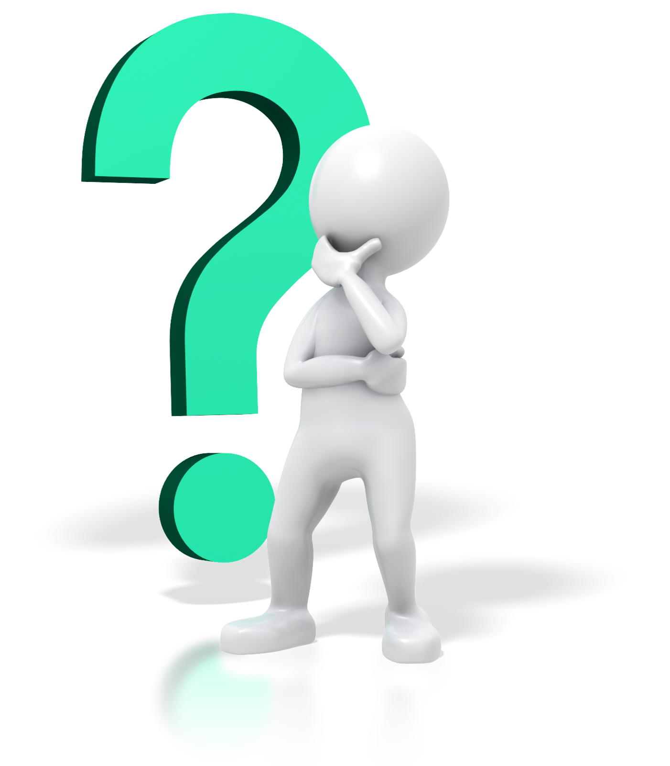
What is Fake News?
HOW DO YOU DEFINE IT?
Image Source: http://www.clipartpanda.com/clipart_images/a-person-thinking-34648739
Notes:
Kris

Slide 9
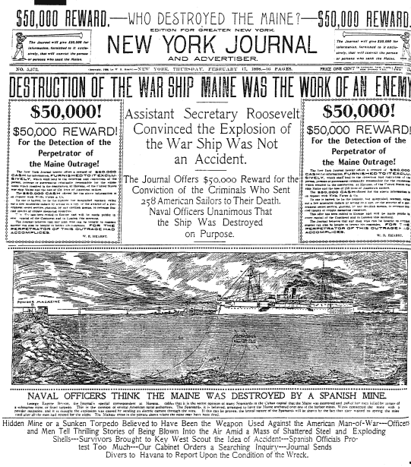
‘Fake News’ is not New: Yellow Journalism
“The use of lurid features and sensationalized news in newspaper publishing to attract readers and increase circulation. The phrase was coined in the 1890’s to describe the tactics employed in furious competition between two New York City newspapers, the World and the Journal.”
-Source:
https://www.britannica.com/topic/yellow-journalism
“Yellow journalism was a style of newspaper reporting that emphasized sensationalism over facts. During its heyday in the late 19th century it was one of many factors that helped push the United States and Spain into war in Cuba and the Philippines, leading to the acquisition of overseas territory by the United States.”
- Source:
Milestones of History in the Foreign Relations of the United States, US Diplomacy and Yellow Journalism 1895-1898.
https://history.state.gov/milestones/1866-1898/yellow-journalism
Notes:
Elaine
Hearst’s treatment - focused on enemy and offered huge reward to readers

Slide 10
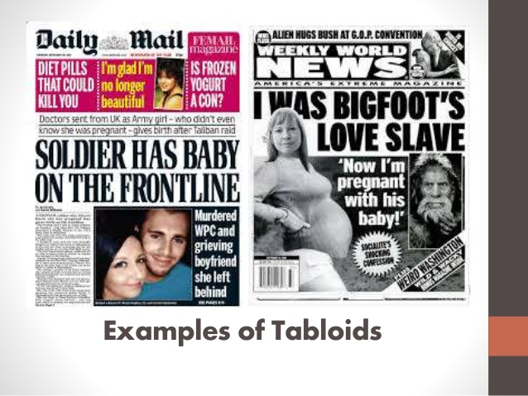
‘Fake News’ is Not New: Tabloids
“The term tabloid is often traced back to Alfred Harmsworth, who used the term in 1896 to describe the size of his British newspaper the Daily Mail. Early tabloid newspapers were recognized by their compact size and oversimplified news content, which made them accessible to non-elite readers.
Currently, the term tabloid applies to all news media—regardless of platform or trendiness—and refers to stylistic and content dimensions of news messages.”
Source: Maria Elizabeth Grabe, Namrata Sharma "Tabloid Journalism". In Oxford Bibliographies in Communication, http://www.oxfordbibliographies.com/view/document/obo-9780199756841/obo-9780199756841-0157.xml
Image Source: https://www.slideshare.net/DezsaRubio/the-different-types-of-newspapers
Notes:
Elaine
-Daily tabloids touch on mainstream media topics while weekly tabloids focus on celebrities, gossip, diets, etc. more
-Wikipedia editors organization decided Daily Mail was not a credible source and planned to delete all uses of it as a source

Slide 11
What is Fake News?
“The printing and dissemination of spurious news is hardly new,
but the term fake news is.
However, when we say that an English word is “new,” we are using a broader meaning of that word than if we were to refer to, say, a musical genre. Fake news appears to have begun seeing general use at the end of the 19th century.”
-Source:
Merriam-Webster.com. (n.d.) How is Fake News Defined? The Real Story of ‘Fake News’. https://www.merriam-webster.com/words-at-play/the-real-story-of-fake-news
Notes:
Kris

Slide 12
What is Fake News?
“Fake news is an inaccurate, sometimes sensationalistic report that is created to gain attention, mislead, deceive or damage a reputation. Unlike misinformation, which is inaccurate because a reporter has confused facts, fake news is created with the intent to manipulate someone or something.
Fake news can spread quickly when it provides disinformation that is aligned with the audience's point of view because such content is not likely to be questioned or discounted.”
-Source:
Rouse, Margaret. (last updated February 2017). TechTarget WhatIs.com. “What Is Fake News?”
http://whatis.techtarget.com/definition/fake-news
Notes:
Kris

Slide 13
What is Fake News?
“Once upon a time (like, three months ago), “fake news” had a precise meaning. It referred to total fabrications — made-up stories about Donald Trump suffering a heart attack or earning the pope's endorsement — and the phrase burst into the political lexicon as Facebook and Google vowed to clean up some of the garbage that had polluted the Internet during the presidential election.
Since then, conservatives — led by President Trump — have hijacked the term and sought to redefine it as, basically, any reporting they don't like. At the extreme end of absurdity, Trump actually asserted on Monday that ‘any negative polls are fake news.’”
-Source:
Callum, Borchers. Washington Post, The Fix. (February 9, 2017?). ‘Fake News’ has now lost all meaning.
https://www.washingtonpost.com/news/the-fix/wp/2017/02/09/fake-news-has-now-lost-all-meaning/
Explore More: https://www.google.com/search?q=define+fake+news&oq=define+fake+news
Notes:
KRis

Slide 14
“Mis- and Dis-information”
Misinformation: information that is not completely true or accurate
Disinformation: false information that is given to people in order to make them believe something or to hide the truth; false information deliberately and often covertly spread (as by the planting of rumors) in order to influence public opinion or obscure the truth. Key: there is intent to deceive
-Sources:
Merriam Webster's Learner’s Dictionary.
http://www.learnersdictionary.com/definition/misinformation
http://www.learnersdictionary.com/definition/disinformation
Merriam-Webster Online. https://www.merriam-webster.com/dictionary/disinformation
Notes:
Kris

Slide 15
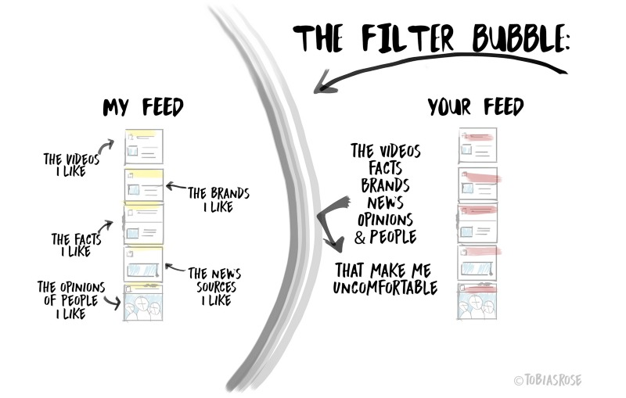
Bias and Information Behavior
Media Bias
Confirmation Bias
The Echo Chamber
Filter Bubbles
Satisficing
Information Overload
Information Avoidance
Repetition theory
Image Source: Tobias Rose-Stockwell, https://medium.com/@tobiasrose/empathy-to-democracy-b7f04ab57eee
Notes:
Elaine
We all have biases. It’s a nature of being raised in any society. It’s important to recognition our own biases and others in consuming information, and how our natural behaviors influence this.
Media bias exists on all ranges, and will always exist.
However it’s then important to consider how much these institutions bring in fact vs opinion, and what they’re leaving out, in terms of how much bias leaks into their presentation of information.
If need - Controversy with WSJ editor for statement on lack of willingness to call false statements lies (so even a neutral stance or attempted neutrality presents a problem in how people consume media, meanwhile we see that they have that tool presented earlier): https://www.facebook.com/theDanRather/posts/10157986074875716
Confirmation bias has to do with how our information intake reinforces our biases
Many of us are aware of the idea of an echo chamber. We surround ourselves with people of like views and so our opinions mirror those of around us and it just reinforces the idea we have the right beliefs.
Filter bubbles are a part of this, and that bubble is made more solid when we consider social media.
This has been a criticism especially with facebook, which would take what we Like and share into consideration with algorithms in showing us either sponsored content or content from friends. It literally shuts out information from those you appear uninterested in. The graphic shows this well.
Satisficing meanwhile means we see what we agree with and are satisfied with that information. We’re less likely to care about finding more information. This keeps us in our bubbles, and keeps the echo chamber idea alive.
Information overload is at a high with all the ways we can consume media now. In terms of information behavior this means we’re also more likely to ignore information that doesn’t agree with our beliefs
Information avoidance has to do with avoiding information we feel doesn’t align with our beliefs, or isn’t what we care about. So it’s easy to say something isn’t a real issue if we’re avoiding consuming information about it altogether.
Repetition theory means the more you hear something, the more you believe it. And again it reinforces beliefs.
This all goes into how we take information in on a daily basis, and we need to keep this in mind when becoming more critical of information

Slide 16
Role of Social Media
Image Source: Tobias Rose-Stockwell, https://medium.com/@tobiasrose/empathy-to-democracy-b7f04ab57eee
Notes:
Elaine
Add something about screen size on which we engage with information? A lot gets hidden; responsive web design.
--Rather than just getting information from say the radio, television, and a newspaper or two, all these mediums are fed through these other means, and for many is how people get info.
-This is concerning in that social media helps spread information rapidly whether or not it’s correct.
--the way we view things either on our cell phones or on the computer screen means we usually see a snippet of an article.
-It’s a quick headline, on twitter it’s 140 characters, it could be a misleading image.
-And there are so many news sources we’re not necessarily checking what that source is.
As a note the rapid use of social media has its positives in this.
-In natural disasters and political activity throughout the world we’re seeing information come immediately about things that are happening
-before there would have been a delay or we might not even have known, e.g. we’re seeing this with the situation in the Philippines right now.

Slide 17
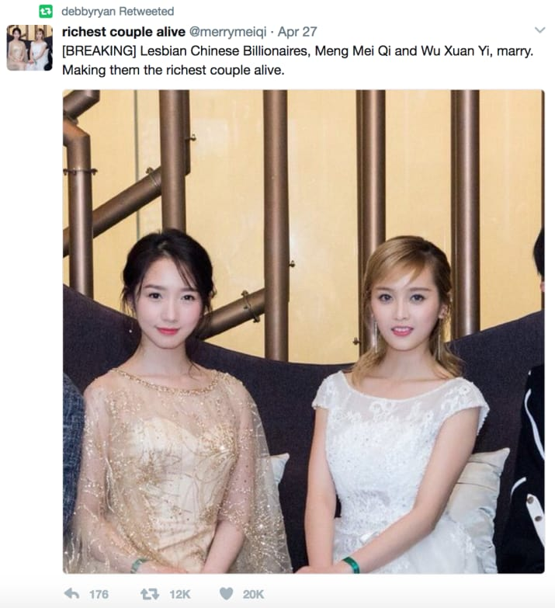
A Good Example
Two K-pop stars jokingly said to be Chinese billionaires who married. Everybody immediately got very excited.
Twitter: @merrymeiqi
"I thought they looked like they were at a wedding with the dresses they were wearing, and the dresses sure looked expensive," Fry said.
She said that she thought people would fact-check first, but added that it "just shows the power of what we want to happen."
-Source:
https://www.buzzfeed.com/kassycho/make-them-billionaires-buy-their-album
Notes:
Elaine

Slide 18
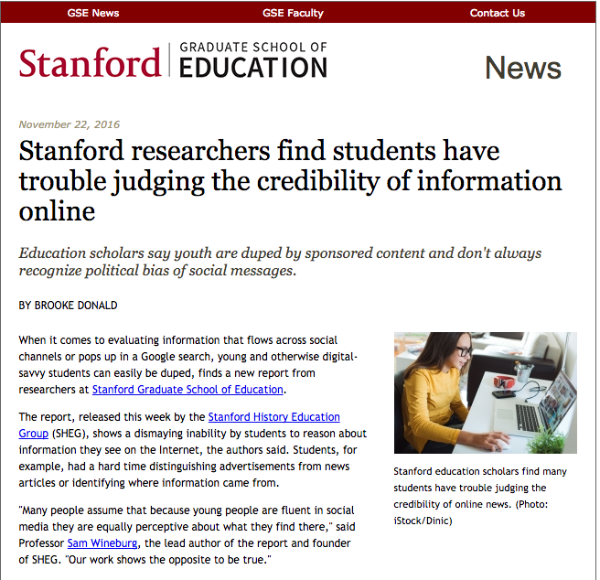
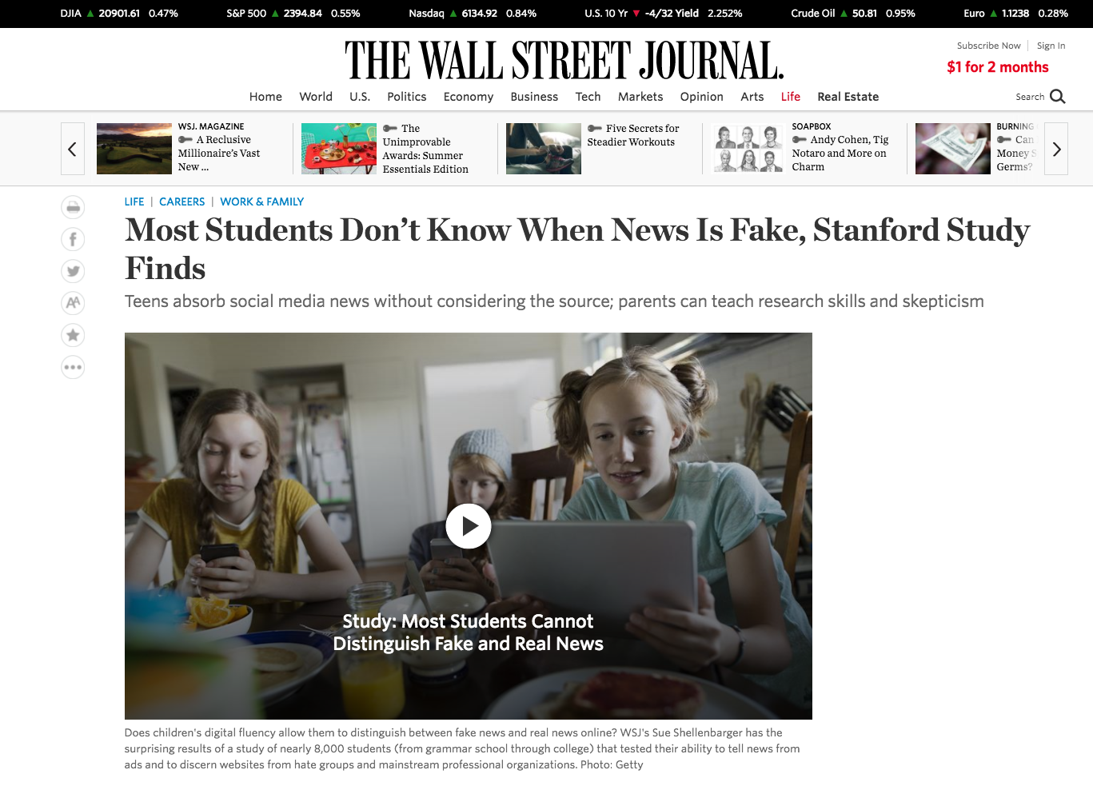
SHEG Study Stanford History Education Group. (November 22, 2016.) Evaluating Information: The Cornerstone of Civic Online Reasoning. Executive Summary. https://sheg.stanford.edu/upload/V3LessonPlans/Executive%20Summary%2011.21.16.pdf
Key Findings:
Students have a hard time distinguishing advertisements from news articles
Students have a hard time identifying where information came from
https://ed.stanford.edu/news/stanford-researchers-find-students-have-trouble-judging-credibility-information-online
https://www.wsj.com/articles/most-students-dont-know-when-news-is-fake-stanford-study-finds-1479752576
Notes:
Kris
Key findings:
N = 7,804
Wanted to identify approaches to teaching necessary skills to distinguish between credible sources and unreliable sources
Study looked news literacy and the ability to judge facebook, twitter, and comments on all these sites
Who wrote the story and is it credible?
Advertisements, paid content, and native advertisements
Recognizing legitimate and dubious sources
Findings:
Students have a hard time distinguishing advertisements from news articles
Students have a hard time identifying where information came from

Slide 19
Navigating the News: Approaches to Critically Evaluate Information
(The Handouts)
How to Spot Fake News, Infographic from International Federation of Library Associations (IFLA). (Based on Factcheck.org How to Spot Fake News, 2016)
https://www.ifla.org/publications/node/11174
Breaking News Consumer’s Handbook, WNYC.org On the Media, September 30, 2013, http://www.wnyc.org/story/breaking-news-consumers-handbook-pdf/
Ten Questions for <fake> News Detection, The News Literacy Project and Checkology.org, http://www.thenewsliteracyproject.org/sites/default/files/GO-TenQuestionsForFakeNewsFINAL.pdf
Notes:
Kris

Slide 20
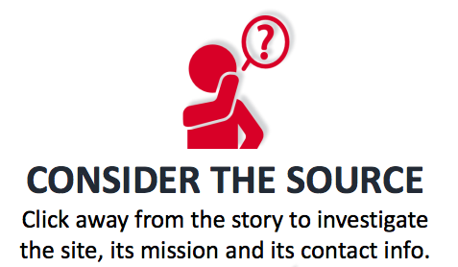
What kind of website is it?
Is this a news, opinion, advocacy, or commerce site?
Check the “About Us” page. How does the site represent itself? Do they provide information about their mission, methods, or reasons why they do what they do?
What do other people say about the website or organization?
Does the website or organization have a name that is similar to another? Does it look similar to another site or organization? Be aware of spoofed urls and website spoofing.

Slide 21
martinlutherking.org
vs.
www.thekingcenter.org/
Notes:
Site on the right is a (now) well documented site run by Neo-nazi group Stormfront. See https://en.wikipedia.org/wiki/Stormfront_(website)#cite_note-55

Slide 22
Notes:
Elaine

Slide 23
Tweet created using TweetFake.com
Notes:
Elaine

Slide 24
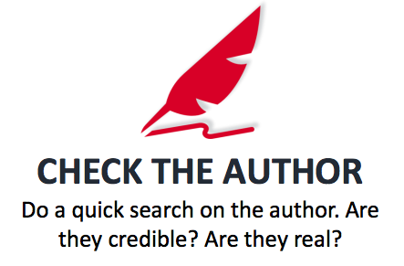
Does the article include a way to contact the author?
What other articles have they written?
Search Google, LinkedIn
Do they have an affiliation? Check the organization or company directory.
Notes:
https://www.washingtonpost.com/news/the-fix/wp/2016/11/14/googles-top-news-link-for-final-election-results-goes-to-a-fake-news-site-with-false-numbers/?tid=a_inl&utm_term=.9581b12ecb24
https://www.washingtonpost.com/news/the-intersect/wp/2016/11/17/facebook-fake-news-writer-i-think-donald-trump-is-in-the-white-house-because-of-me/?utm_term=.dc7b8d0003e3

Slide 25
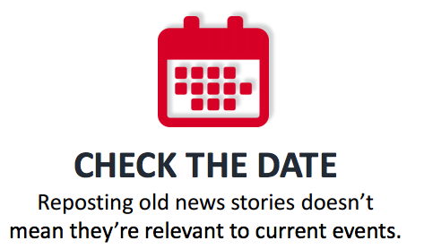
Source: http://kfor.com/2015/06/30/dead-again-why-celebrities-die-over-and-over-online/
Notes:
Urban Legends and dead celebrities that keep coming back. Especially on Facebook, Twitter, etc. it’s easy skim a headline and re-post. Before re-posting, go to the site and check for a date. If there’s no date, search about the topic for more info!

Slide 26
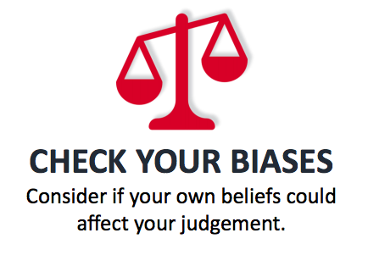
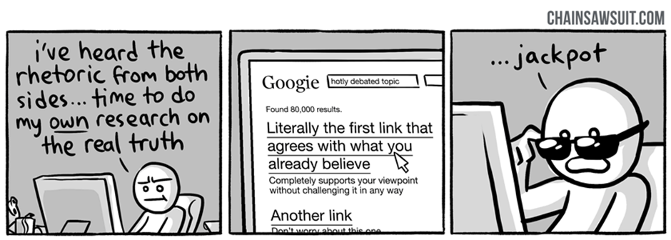
Image Source: http://chainsawsuit.com/comic/archive/2014/09/16/on-research/
Notes:
Elaine
Take into consideration the information behavior we discussed earlier. This comic makes a joke of satisficing. We are likely all guilty of being in our own filter bubbles and preferring echo chambers rather than seeking out differing opinions.

Slide 27
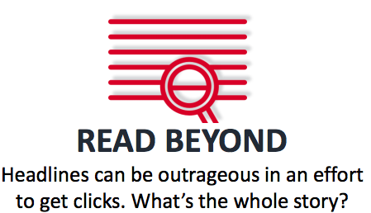
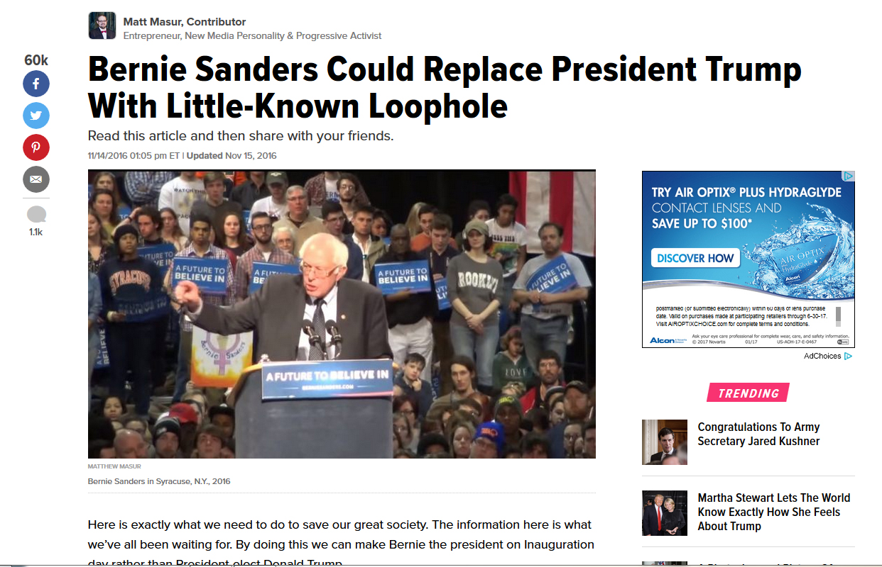
Clickbait, Clickbaity, Clickbaiting
https://www.merriam-webster.com/dictionary/clickbait
Notes:
Elaine
Some articles have sensational headlines, where the content does not quite match the headline, while others have entirely different content. This came out after the election, before inauguration.

Slide 28
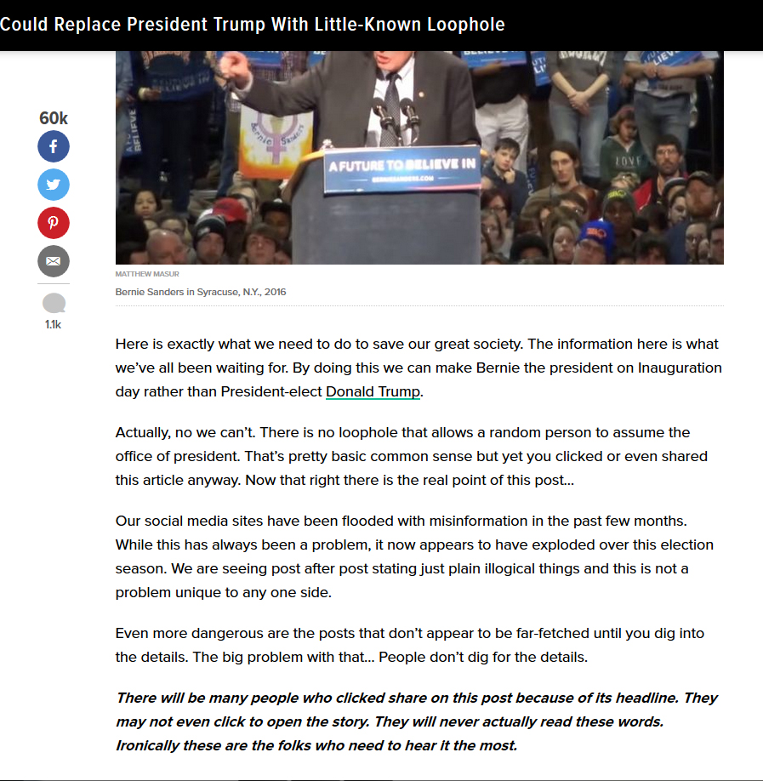
http://www.huffingtonpost.com/entry/bernie-sanders-could-replace-president-trump-with-little_us_5829f25fe4b02b1f5257a6b7
Notes:
Elaine
Clickbait headline - after Trump’s election, and playing on the series of articles that kept appearing even while Hillary had won the nomination
Social Media aids the fast - viral spreading of news, mis-disinformation. With social media you often are just getting a headline, snippet, possibly misused image, and people are quick to repost.

Slide 29
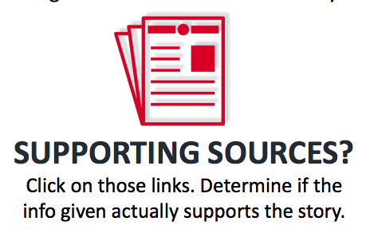
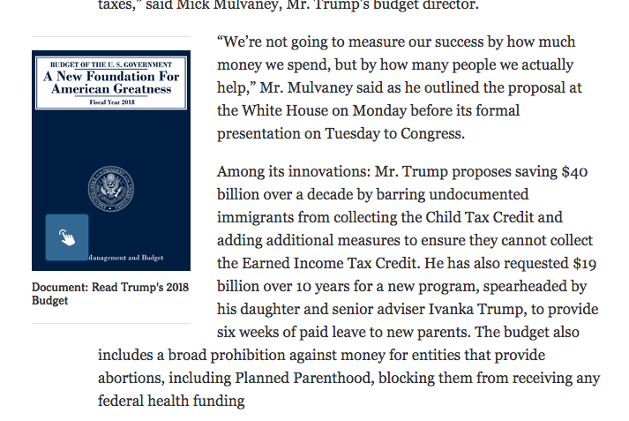
Is there “cited” or linked information in an article?
Does it just link to yet another article from the same site or another site quoting the same information? Does it get you to an actual primary source, study, report, etc.
Nytimes.com example (include the actual documents for you to review)
Trumps Budget Cuts Deeply into Medcaid and Anti-Poverty Efforts
https://www.nytimes.com/2017/05/22/us/politics/trump-budget-cuts.html
Notes:
Kris

Slide 30
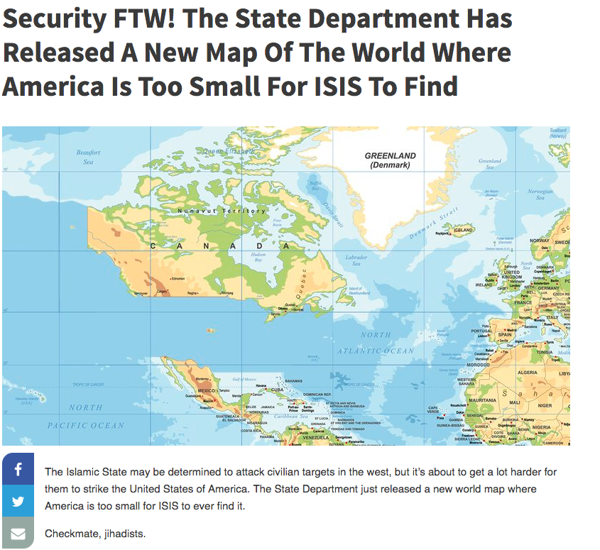
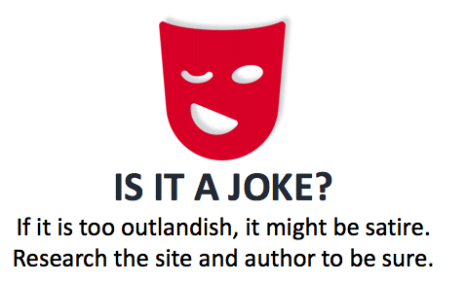
Note: Image source on next slide
Notes:
Elaine

Slide 31
Some Satire Sites to be familiar with:
The Onion
Clickhole
Borowitz Report
Daily Currant
Daily Squib
Reductress
Article Source: http://www.clickhole.com/article/security-ftw-state-department-has-released-new-map-5972
Notes:
Elaine

Slide 32
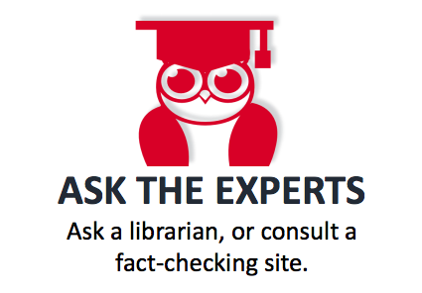
Fact-checking sites:
Snopes: http://www.snopes.com
Politifact: http://www.politifact.com/
FactCheck.org http://factcheck.org/
*AllSides.com: https://www.allsides.com/
Notes:
Kris

Slide 33
Strategies and tools
Refine your Google Searches https://support.google.com/websearch/answer/2466433?hl=en
Add a word like hoax, fake, bias to your search
Google Reverse Image Search https://support.google.com/websearch/answer/1325808?hl=en
Wikipedia List of common misconceptions https://en.wikipedia.org/wiki/List_of_common_misconceptions
Use Whois lookup of domains (to see who owns the domain) https://whois.icann.org/en and https://www.whois.com/whois/

Slide 34
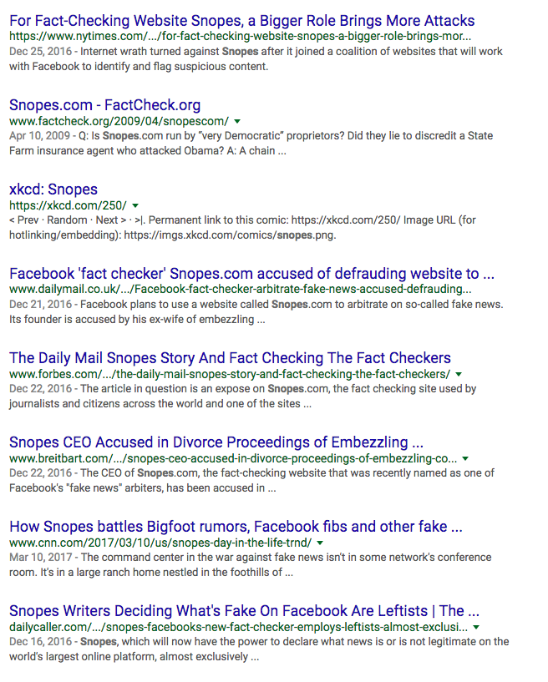
Refine Your Google Searches, a few examples
Exclude words or sites from your search use “-”
-useful for searching about a website without including information directly from it

Slide 35
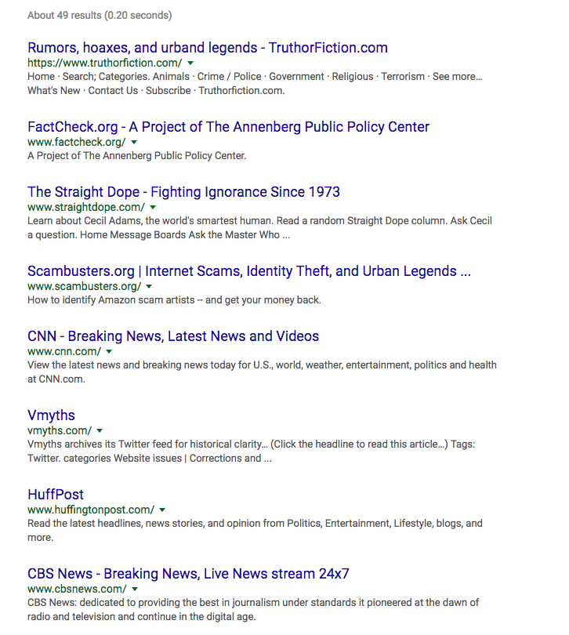
Refine Your Google Searches, a few examples
Include related:
in front of url, to search for related sites

Slide 36
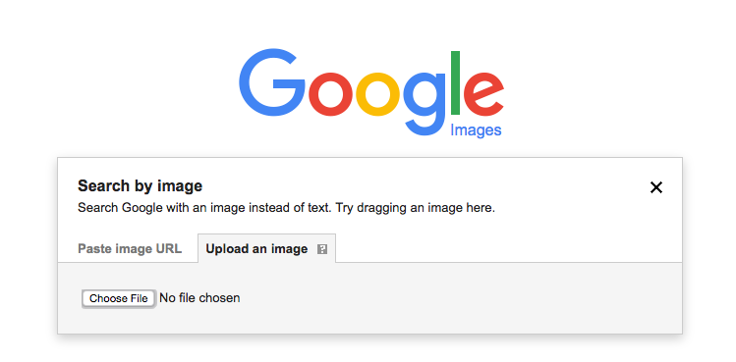
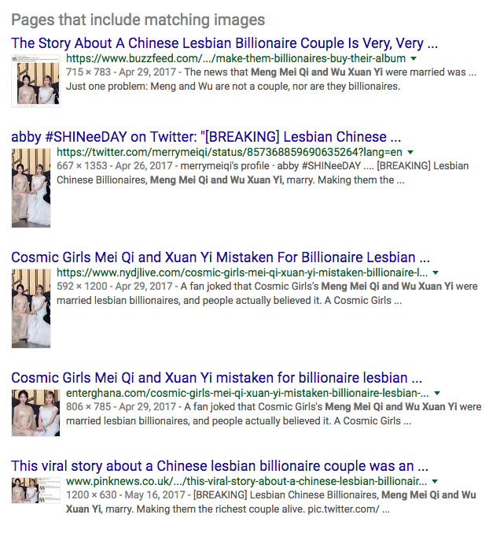
Google Reverse Image Search
-Download image to computer or copy URL of image
-Go to Google Image Search, click the camera in the search box
https://images.google.com/

Slide 37
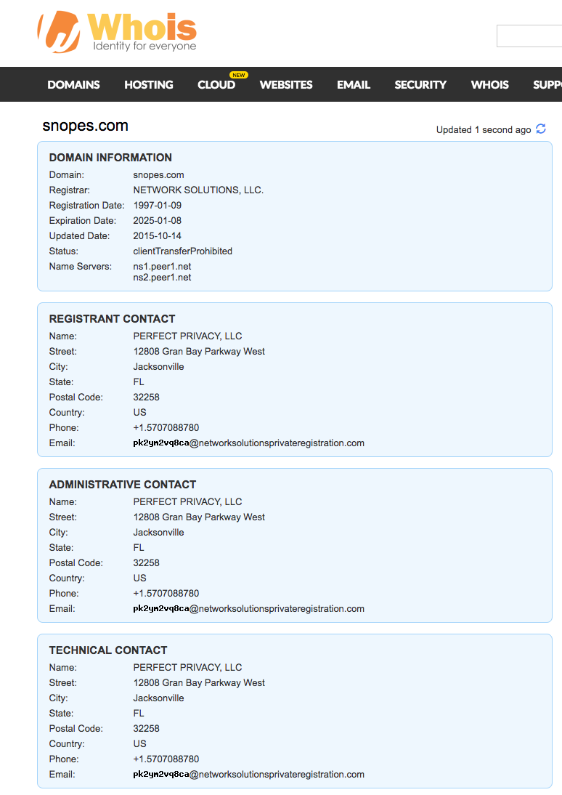
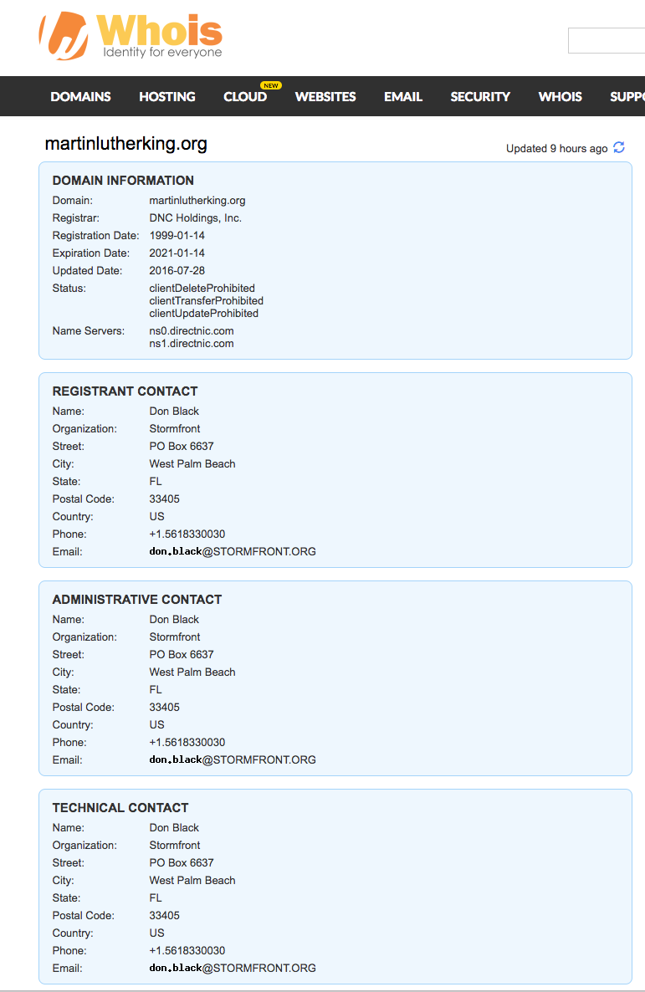
Whois Lookup
https://www.whois.com/whois/

Slide 38
Exercise: Differing Views of the Same News
February 23-24, 2017 Repeal of Obamacare
February 23, Breitbart Blue State Blues
http://www.breitbart.com/big-government/2017/02/23/obamacare-blue-state-blues-way-lose-house-fail-repeal/
February 23, FoxNews Politics
http://www.foxnews.com/politics/2017/02/23/cpac-pence-says-americas-obamacare-nightmare-is-about-to-end.html
February 23, National Review
http://www.nationalreview.com/article/445166/repeal-obamacare-replace-obamacare-republicans-disagree
February 23, NY Times (online)
https://www.nytimes.com/2017/02/23/us/politics/obamacare-affordable-care-act-house-republicans.html
February 24, 2017, VICE.com
https://www.vice.com/en_us/article/obamacare-repeal-is-turning-into-a-big-hot-mess

Slide 39
News Resources @BPL
State, Local, and National Newspapers in print (located in the Reading Room, Main Level)
Full Text Newspapers http://burlingame.org/index.aspx?page=1578#Articles (Access from home, all you need is your PLS Card!)
AtoZ Databases (requires a BPL Card), first link on the list http://burlingame.org/index.aspx?page=1578#Business
Notes:
Elaine

Slide 40
Check out these books
Graves, Lucas. 2017. Deciding What's True: The Rise of Political Fact-Checking in American Journalism. https://doi.org/10.7312/grav17506. https://burlingame.bibliocommons.com/item/show/2533903076_deciding_whats_true
Jackson, Brooks, and Kathleen Hall Jamieson. 2007. UnSpun: finding facts in a world of disinformation. New York: Random House Trade Paperbacks. https://burlingame.bibliocommons.com/item/show/1749342076_unspun
Kovach, Bill, and Tom Rosenstiel. 2010. "Blur: how to know what's true in the age of information overload". New York: Bloomsbury. https://burlingame.bibliocommons.com/item/show/1958256076_blur
Stebbins, Leslie F. 2015. Finding reliable information online: adventures of an information sleuth. Lanham, Md. [etc.]: Rowman & Littlefield. https://burlingame.bibliocommons.com/item/show/1796009091

Slide 41
Check out these library guides
Getting your Info Lit (by Elaine Tai) https://burlingame.bibliocommons.com/list/share/319266177_etai221/838916377_getting_your_info_lit
Real Fake or Somewhere in Between Topic Guide https://burlingame.bibliocommons.com/list/share/417879887_pimalib_stephaniem/897069337_real,_fake_or_somewhere_in_between_evaluating_the_news
Reading the Facts, Fact-Checking Topic Guide https://burlingame.bibliocommons.com/list/share/150468461_mpllibbc/877904717_reading_the_quotfactsquot_fact-checking_organizations

Slide 42
Key Government Information Sources
Statistical Abstract of the United States https://www.census.gov/library/publications/time-series/statistical_abstracts.html
Data.gov https://www.data.gov/ (CA Data Portal https://data.ca.gov/)
Crime and Criminal Justice: FBI Uniform Crime Reporting https://ucr.fbi.gov/ and Bureau of Justice Statistics https://www.bjs.gov/
Economic Indicators: US Census Bureau https://www.census.gov/economic-indicators/
Health: National Center for Health Statistics, FastStats https://www.cdc.gov/nchs/fastats/
Notes:
Difference Between FBI and BJS
FBI - crimes committed
BJS - victims of crimes, incarcerated populations
https://www.bjs.gov/index.cfm?ty=abu

Slide 43
Key Government Information Sources
Immigration: Dept. of Homeland Security Yearbook of Immigration Statistics https://www.dhs.gov/immigration-statistics/yearbook
Labor and Employment: Bureau of Labor Statistics https://www.bls.gov/
Federal Legislation: Congress.gov https://www.congress.gov/
Federal Regulations: (proposed) Regulations.gov https://www.regulations.gov/
(final) Code of Federal Regulations via GPO (Government Publishing Office) https://www.gpo.gov/fdsys/browse/collectionCfr.action?collectionCode=CFR
Laws: United States Code via GPO https://www.gpo.gov/fdsys/browse/collectionUScode.action?collectionCode=USCODE
Population (and more): US Census Bureau https://www.census.gov/data.html

Slide 44
Government Information: Disappearing Docs???
http://eotarchive.cdlib.org/
Notes:
Kris

Slide 45
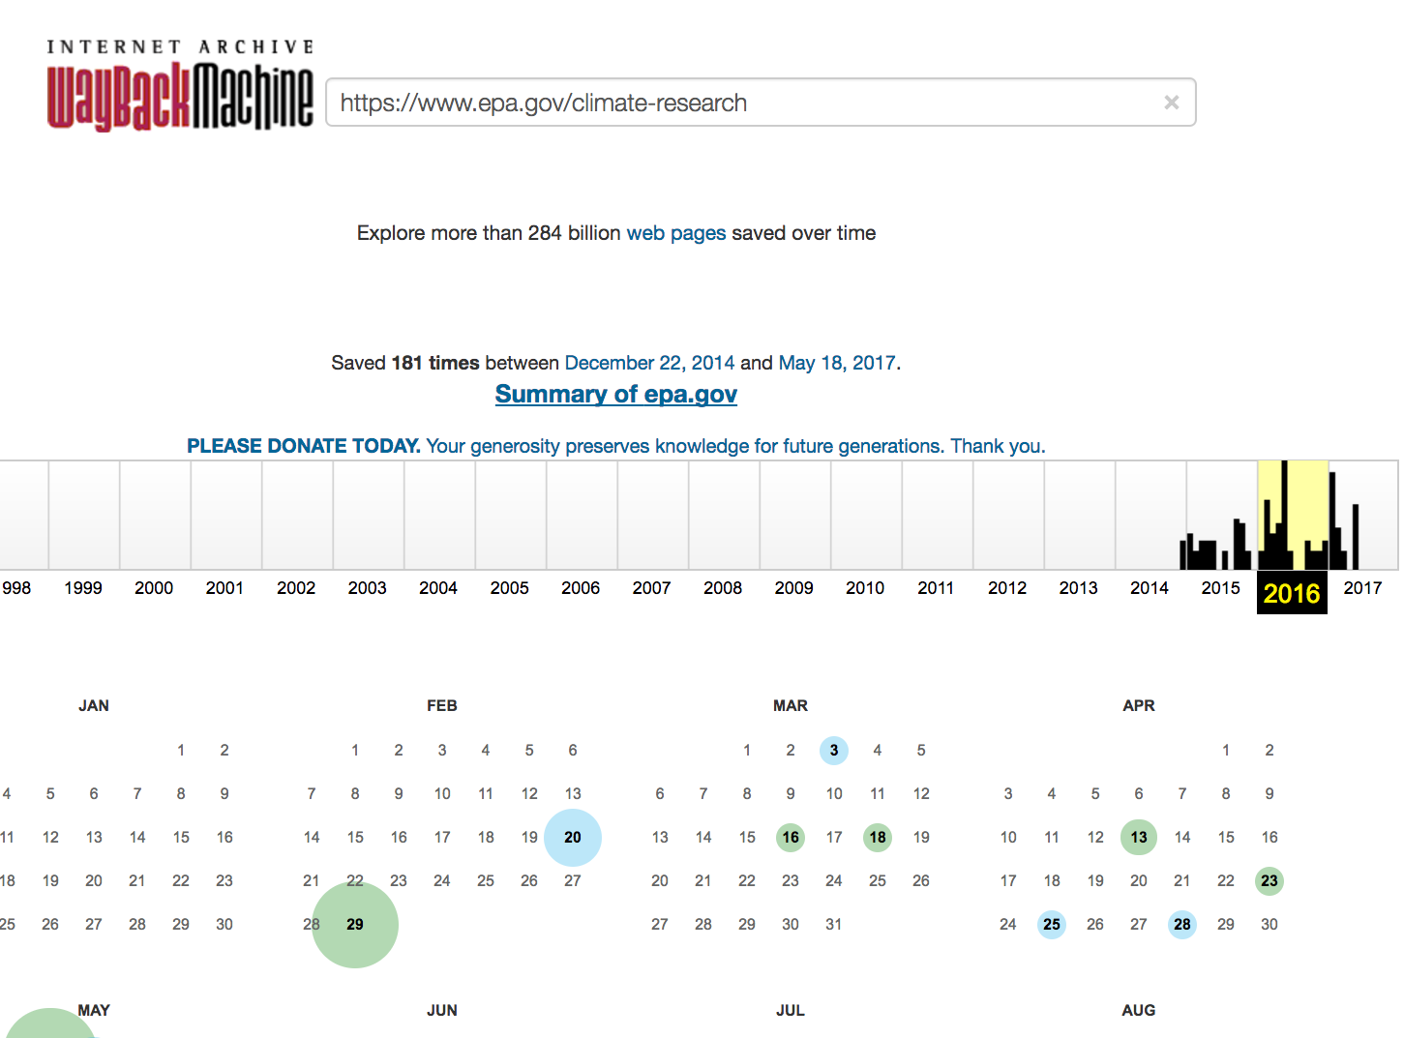
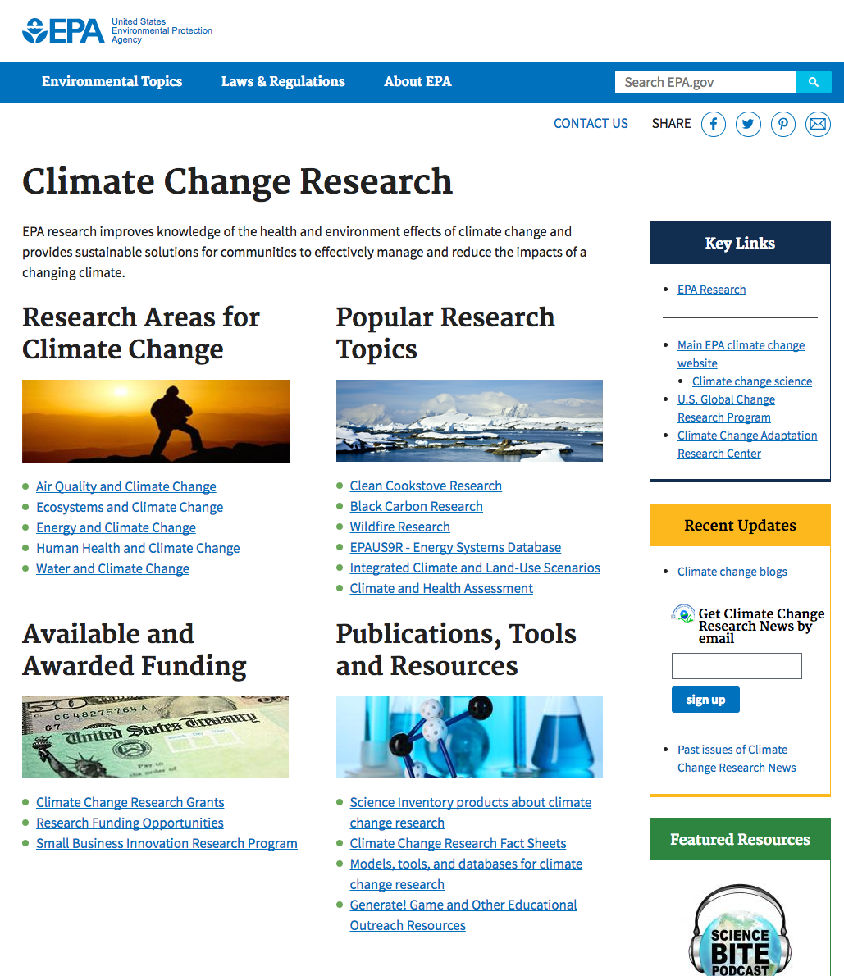
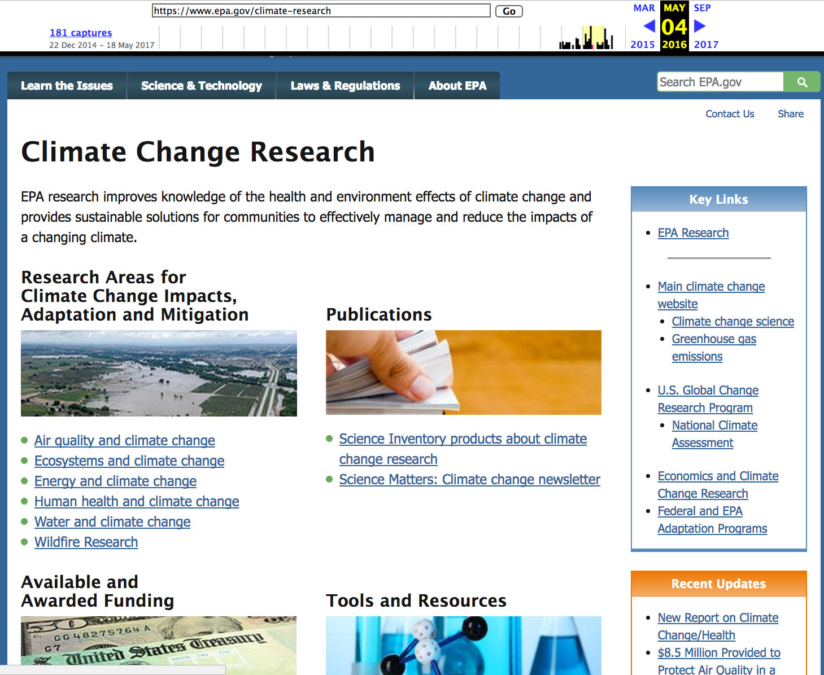
Government Information: Disappearing Docs???
Let’s go WayBack!
EPA Climate Change Research website captures in WayBack Machine, https://web.archive.org/web/20160601000000*/https://www.epa.gov/climate-research
Current Site: https://www.epa.gov/climate-research
May 4, 2016 Snapshot
https://web.archive.org/web/20160504145909/https://www.epa.gov/climate-research
Notes:
Kris

Slide 46
Government Information: Disappearing Docs???
Let’s go WayBack!
“If you see something, save something, 6 ways to save something in the WayBack Machine!”
http://blog.archive.org/2017/01/25/see-something-save-something/
Chrome extension

Slide 47
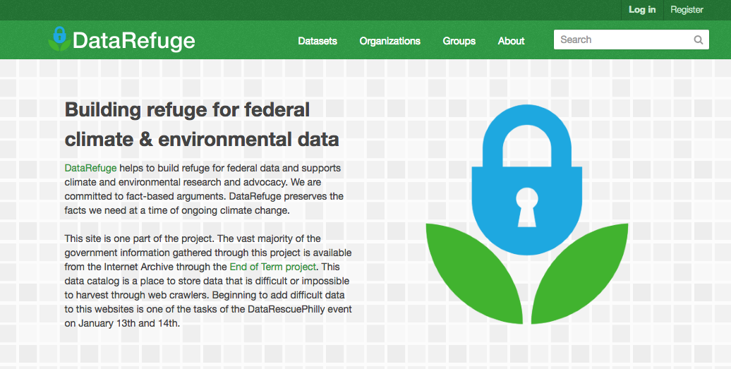
Government Information: Disappearing Data???
https://www.datarefuge.org/
Notes:
Kris

Slide 48
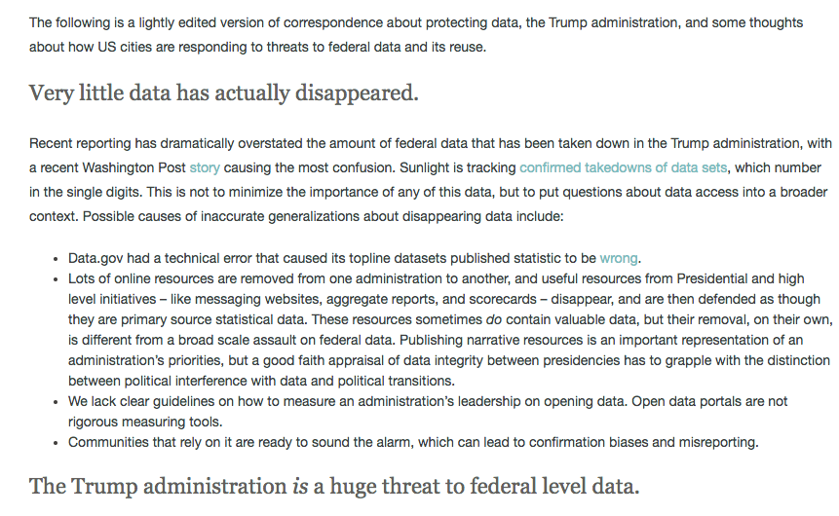
Government Information: Disappearing Data???
https://sunlightfoundation.com/2017/05/23/trump-threats-to-data-and-us-cities/
Notes:
Kris

Slide 49
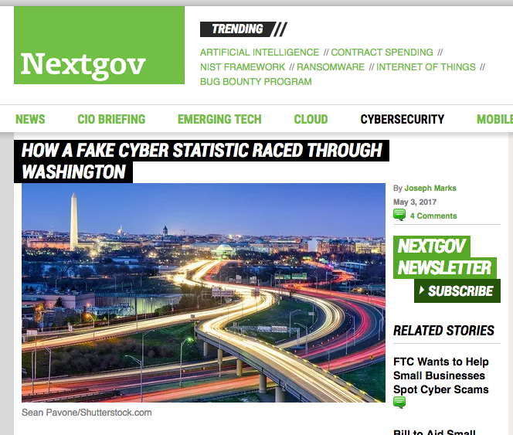
Government (mis-)Information
“The statistic, typically attributed to the National Cyber Security Alliance, is that 60 percent of small businesses that suffer a cyberattack will go out of business within six months.”
“To be clear, there is no public study that has determined how many small businesses are forced to shut their doors following a cyberattack. In fact, there is very little information about the economic impact of data breaches and other cyber incidents on small businesses generally.”
Source: http://www.nextgov.com/cybersecurity/2017/05/how-fake-cyber-statistic-raced-through-washington/137542/?oref=nextgov_today_nl
Notes:
Kris

Slide 50
To Sum Up: Navigating the News as a Critical Consumer of Information
Read beyond the headlines
Find out more about the source and author
Triangulate, look at more than one source, news outlet. Don’t view articles, images, etc. in isolation
Use known and accepted sources for fact-checking
Check your own bias and read outside your filter bubble
Be a little skeptical
Ask a Librarian!
Notes:
Kris

Slide 51
Thank You!
Please fill out a feedback form!
Contact BPL http://www.burlingame.org/index.aspx?page=1113

