Slide 1
All the News NOT Fit to Print
January 18, 2017
jwasterlain@santaclaraca.gov

Slide 2
What we are covering tonight
What is “fake news”
Why do people make fake news
What are the dangers it poses
How does it spreads
Tech interventions
Spotting fake news
Fighting back

Slide 3
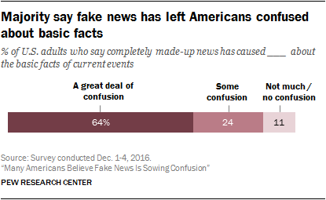
Why are we talking about this?
88% of Americans believe fake news is causing at least some confusion
The term is getting used frequently without much context
The story will ramp up as other countries have new elections

Slide 4
What is “fake news”

Slide 5
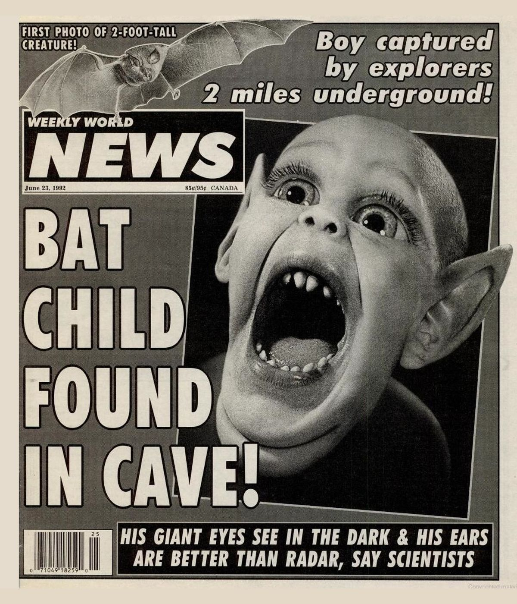
If only it was this simple…

Slide 6
Types of fake news
Fake news/hoax: fully fabricated but meant to be believed
Bad news: not entirely inaccurate, but misleading, deceptive, or out of context
Biased news: true, but interpreted in a highly partisan manner
Satire: meant as humor
Clickbait: vague or inflammatory headline with little connection to content

Slide 7
Why do people make fake news?

Slide 8
$$$ (Also to mislead people, but mostly money)

Slide 9
What are the dangers of fake news?

Slide 10
What are the effects of fake news?
Misinformation
Misremembered information
Distrust of all information
Allows people to discredit real information
Real life actions and consequences stemming from fictional information

Slide 11
How does fake news spread

Slide 12
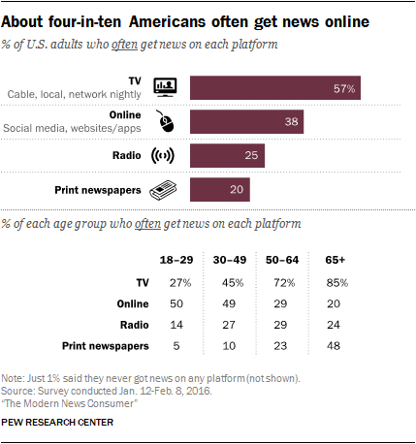
How do you get your news?
Most people get their news from television
Online is the second most popular way
Print newspapers are WAY down on popularity, particularly with younger generations

Slide 13
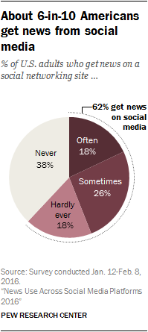
Do you get news through social media?
62% of adults get news on social media

Slide 14
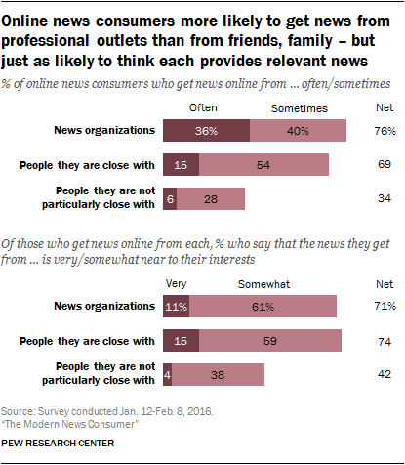
Where do you get your online news?
News orgs are still the main source
But who you are connected to online may highly affect the news you consume

Slide 15
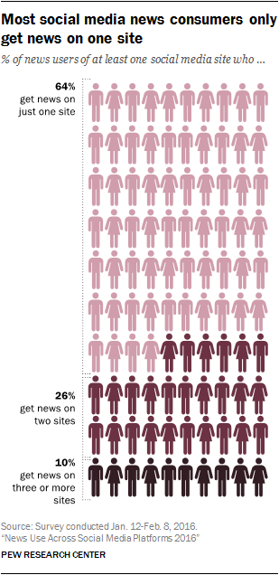
How many places do you get news from?
Most get news from just one source.
Source refers to a social media site, not a particular news source.

Slide 16
Fake news thrives in these conditions
Less authoritative sources
More social/share based environment
Fewer platforms visited

Slide 17
Sharing your feelings
Fake news plays on our emotions
Articles get shared fast because we are outraged and want others to be outraged too

Slide 18
Technology is unlikely to save us
You are smarter than an algorithm!

Slide 19
What social media companies are doing
Building algorithms to discover fake news
Making it easier to flag content
Including third party fact checking
Blocking known fake news sites from using their advertising products

Slide 20
How to spot fake news

Slide 21
Check the source news organization
Is it a trusted source?
Is it a “real” source (ie. SJ Mercury vs. SJ Chronicle)
Does the URL look right for the organization?
Is there an “about us” section?
Does the website look legit?

Slide 22
What’s the difference?
abcnews.go.com
abcnews.com.co

Slide 23
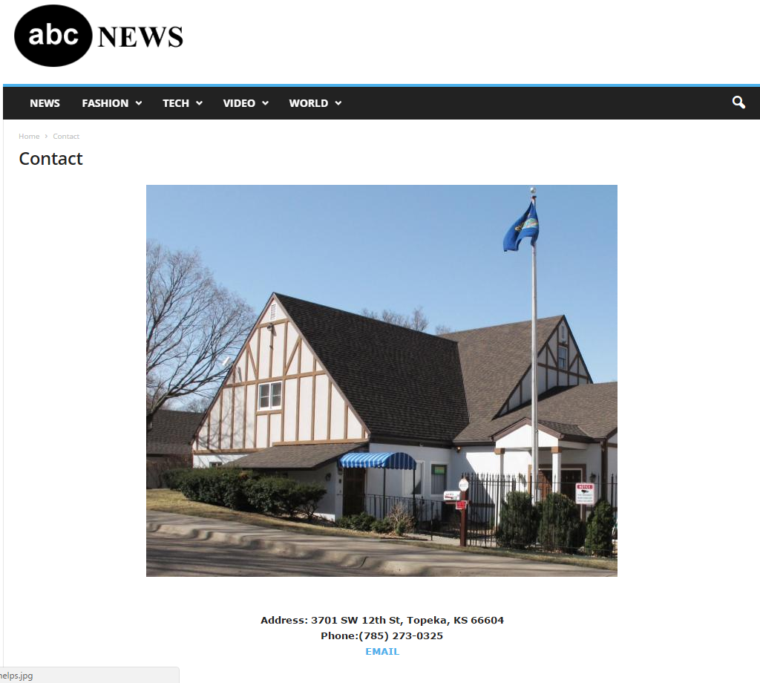

Slide 24
Check the author
Do they exist online beside this article?
Have they written anything else?
Does the content of their other articles look suspect?
Have they contributed information to other legitimate organizations?

Slide 25
Read beyond the headline
Headlines can be misleading or totally disconnected from the story
Clickbait is headline-driven but rarely real news
Don’t share before reading the whole article

Slide 26
When was it written?
Not all “news” is new
Old stories get recirculated to stoke emotion or dredge up previous controversies
This is particularly an issue with pictures (do a reverse image search to see if its been used before)

Slide 27
Check the content
ALL CAPS AND UNNECESSARY PUNCTUATION IS A WARNING SIGN!!!
Fact or opinion?
Links to other official sources?
Do the sources back up the story? Do they exist?
Verify quotes by searching them in Google.

Slide 28
Is it satire?
This one is hard if you don’t share the site’s sense of humor or irony
Know your major satire sites (Onion, Clickhole, McSweeney’s)

Slide 29
Who else is reporting the story?
Big stories get carried on many sites
How credible are the other sites covering the story?
Search sites that you normally wouldn’t to see if the story is similar

Slide 30
How does the article make you feel?
Fake news stories are “button pushers”
Super angry? Read it again, critically.

Slide 31
Does this play into your political beliefs?
Confirmation bias is a real, powerful thing
We all have biases. Be aware of them.
Find the article from a neutral or opposing side and see if it matches up.

Slide 32
Use fact checkers
Factcheck.org
Politifact.com
Snopes.com

Slide 33
You expect us to do all this?
Umm… no, probably not.

Slide 34
How to fight against fake news

Slide 35
Do your part!
Be critical of what you read and careful about what you share
In doubt, use a fact checker or some of the strategies above
Flag content that might be fake (if possible)

Slide 36
Support legitimate journalism
If you can, buy a subscription to a local or national paper you think does good work.
Promote fact-driven reporting with verifiable info
Share articles from quality sources and drive up their traffic

Slide 37
Thank you for coming
If you would like a list of resources, please give me your email on the way out

