Slide 1
Cupertino Library’s
Teen Hack-a-thon

Slide 2
WHAT THE HACK?
“The teens are hacking in the library?!?!”
- a concerned relative

Slide 3
What a Hackathon is NOT

Slide 4
What a Hackathon IS
CODE
EXPLORE
PROBLEM SOLVE
CREATE
COLLABORATE
COMMUNITY

Slide 5
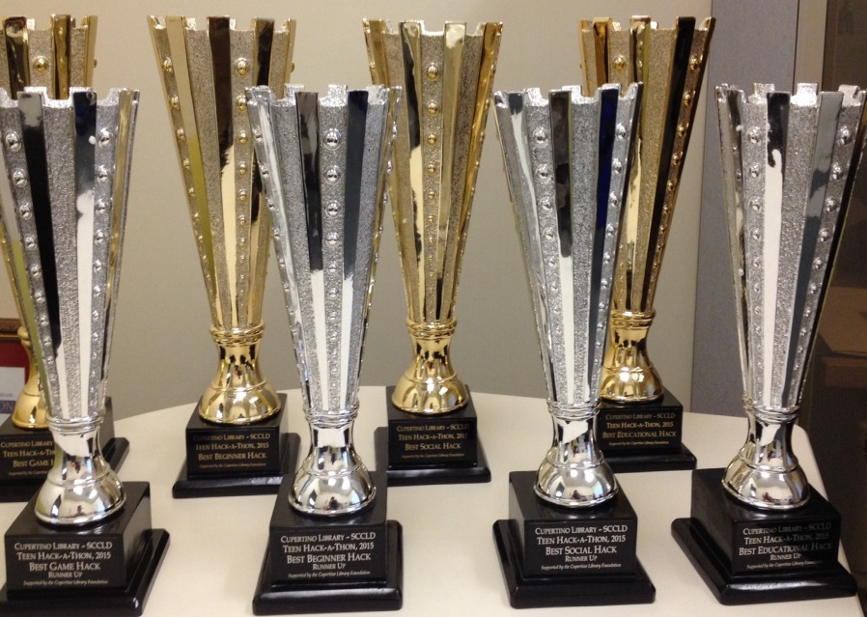
INCENTIVES

Slide 6
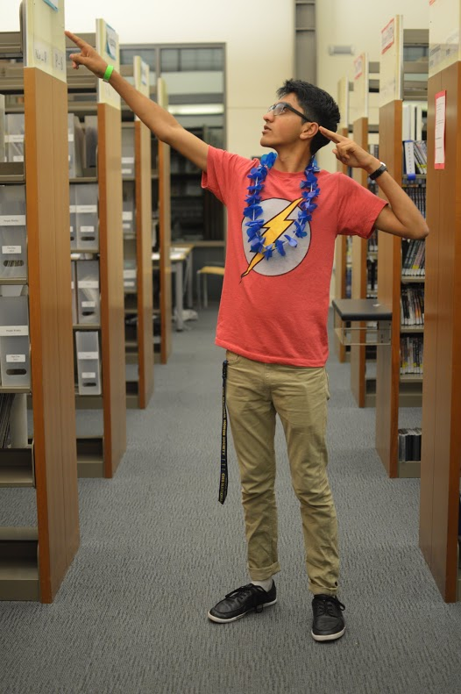
GOALS
Connect teenagers to the library
Attract non-library users
Address teen needs (see Prompt)
Foster STEAM learning skills
Provide platform to collaborate & create
Promote Teen Summer Reading
HAVE FUN

Slide 7
Cupertino Library’s Teen Advisory Board

Slide 8
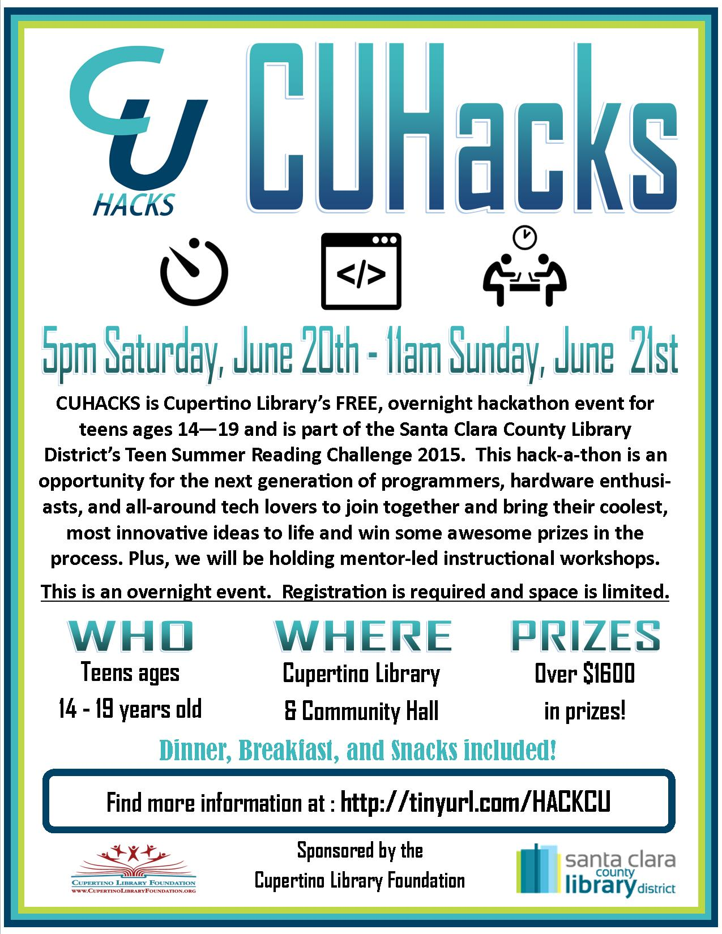

Slide 9
CU HACKS TIMELINE
5 PM Doors Open
6:30 PM Opening Ceremony
7:00 PM Hacking Begins
Web dev. and iOS Workshops
9:00 PM Dinner, Robotics Demo
10 PM – 1AM Advanced Coding Workshops
5 AM Project Submission Opens
6:30 AM Judging Starts
7 AM End Hack, Breakfast
9 AM Final Pitches, Judging
10 AM AWARDS Ceremony
11 AM Cleanup Starts, BYE!!

Slide 10
Financial Supporters
http://cupertinolibraryfoundation.org/

Slide 11
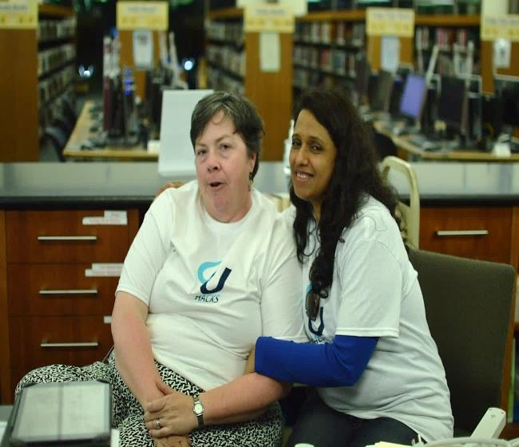
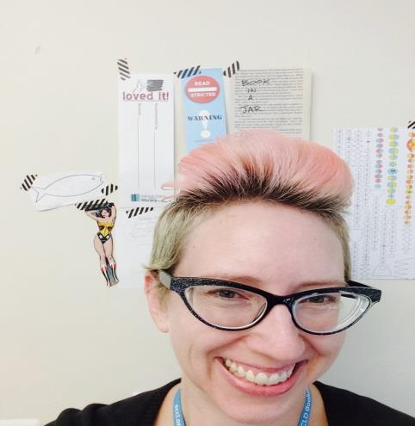
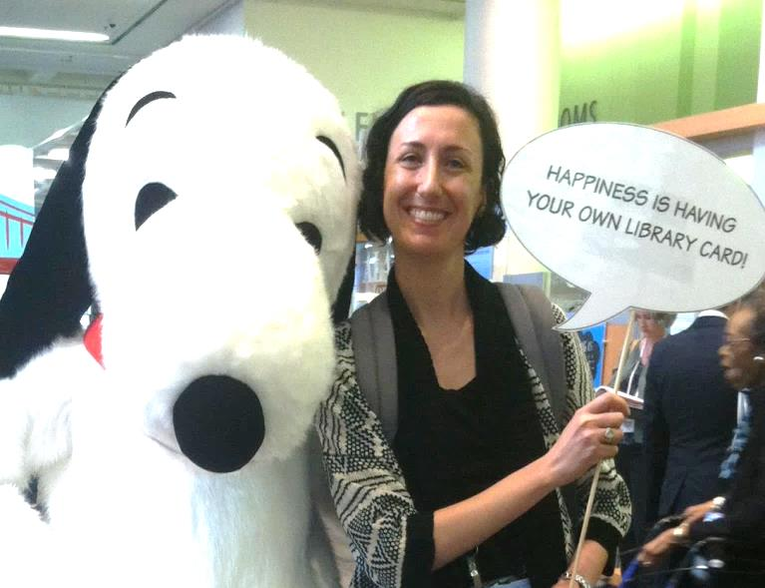
STAFF
Over 31 staff members
Structure staff schedules
Address liability issues
Supervise volunteers
Work in 4 – 8 hour shifts
Manage Registration & Check-Out
Crowd Control
Sign up teens for Summer Reading

Slide 12
Community Partners

Slide 13
Tech Supporters
Lockitron

Slide 14
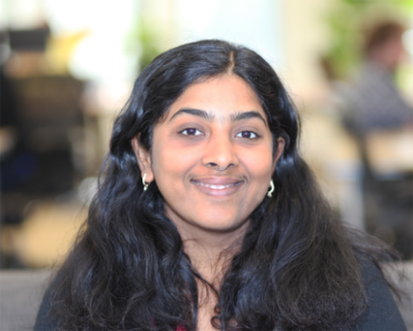
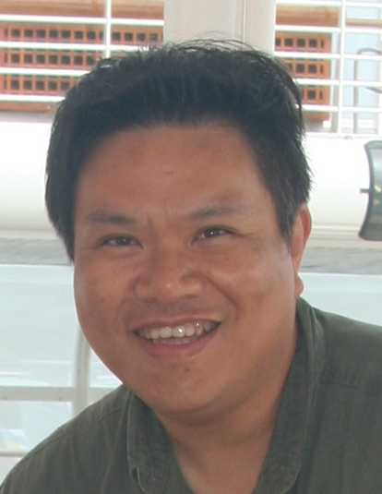
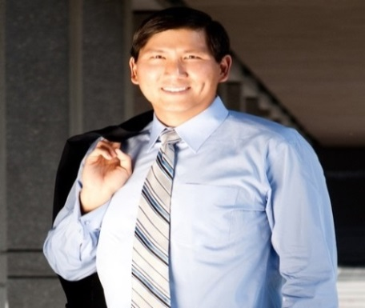
JUDGES
Shobana Radhakrishnan
Vice President of Engineering - Mindflash Technologies Inc
Jerry Liu
Research Manager
HP Labs
Darcy Paul
Cupertino City Council
Jon Howe
Principal Engineer - Video Clarity

Slide 15
CU HACKS RULES
Eligibility: teens ages 14 – 19
Liability waivers signed by parent/guardian
Teams consist of 1 – 4 people
Create a working application in 12 hours
Hardware and software hacks accepted
No prewritten code
Film a 90 second video demonstrating your app
Select one category to submit your project
RUBY
C++
JAVA

Slide 16
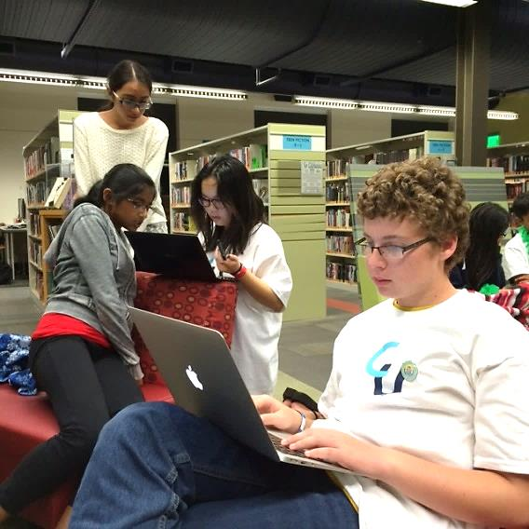
PROMPT
Hackers,
Bring your coding experience and innovative ideas together to develop an application that assists local teenagers in their everyday lives. Think about the average day-in-the-life of a Cupertino teenager. What would help fellow teens with the following:
Family obligations
School
Homework
Test preparation
Group projects
Stress reduction
Music recitals
Health
Hanging out with friends
…….and much more.

Slide 17
CATEGORIES
PROMPT
SOCIAL
HACK
1ST HACK
GAME
HACK
EDU.
HACK

Slide 18
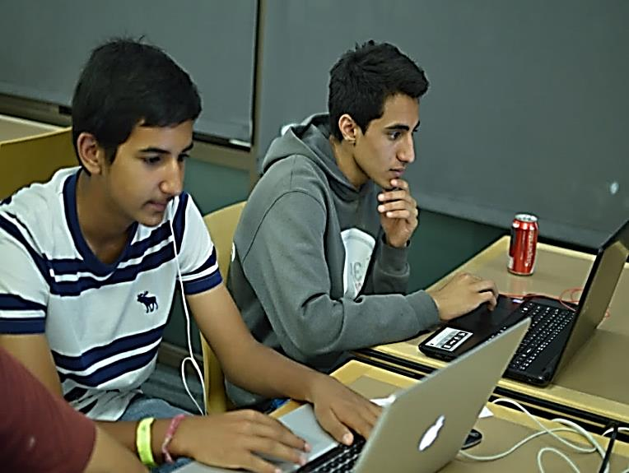
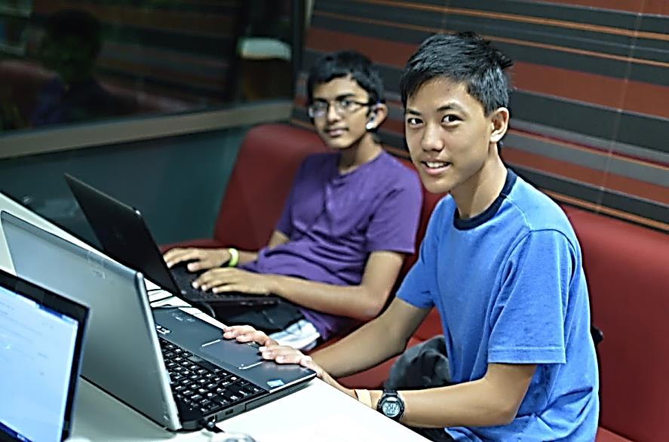
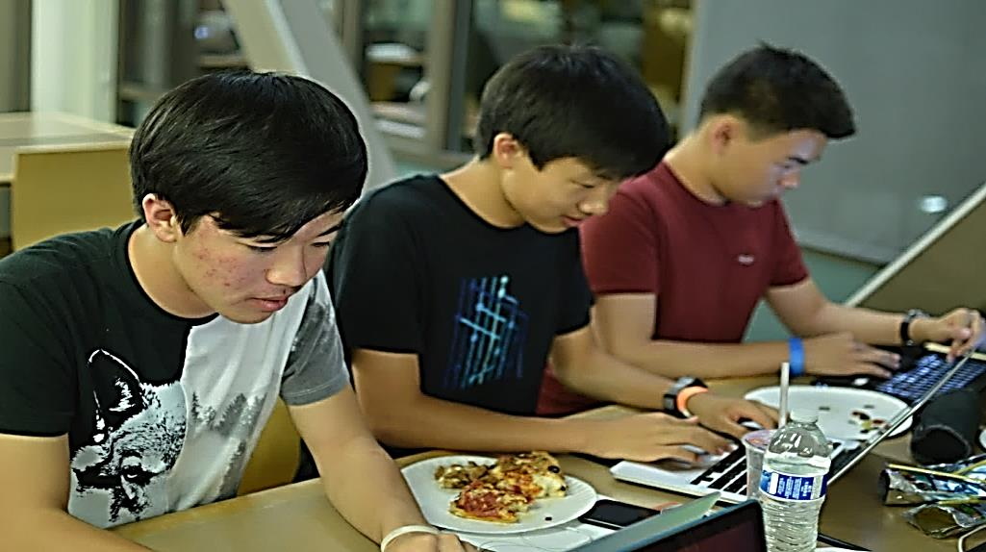
SCORING CRITERIA
Originality
Technical Difficulty
Potential Positive Impact
User Experience

Slide 19
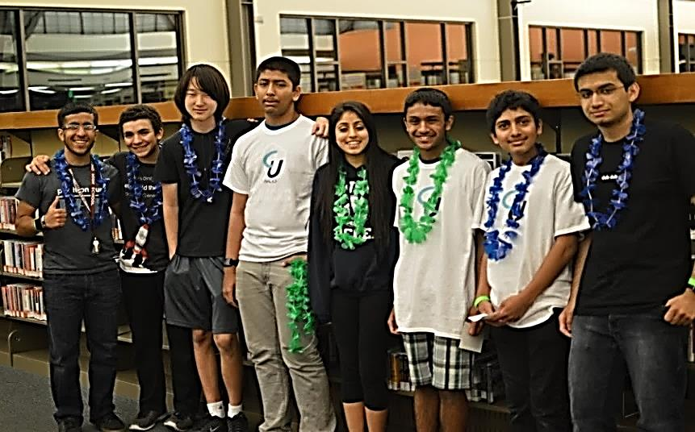
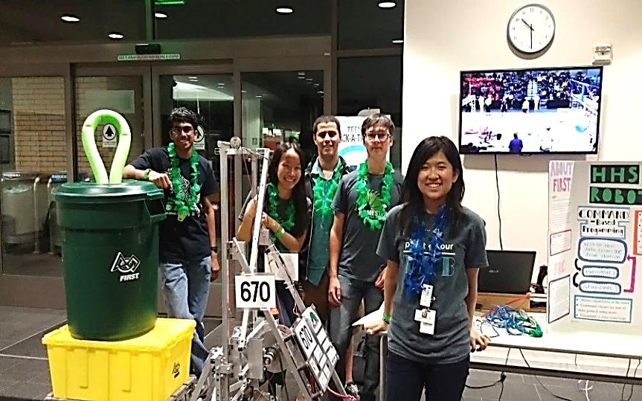
INSTRUCTIONAL WORKSHOPS
TINOVATION
iOS Development Workshop
Web Development Workshop
Coding for Beginners
Software 1 – on – 1 Assistance
Homestead Robotics
Robot Demonstrations
Engineering troubleshooting
Hardware 1 – on – 1 Assistance
Notes:
One of the coolest facets of a hack-a-thon are the learning workshops.

Slide 20
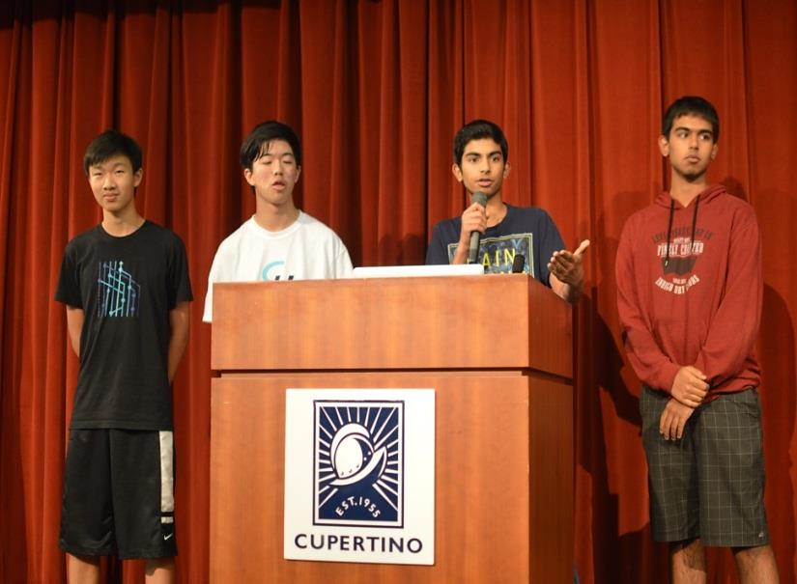
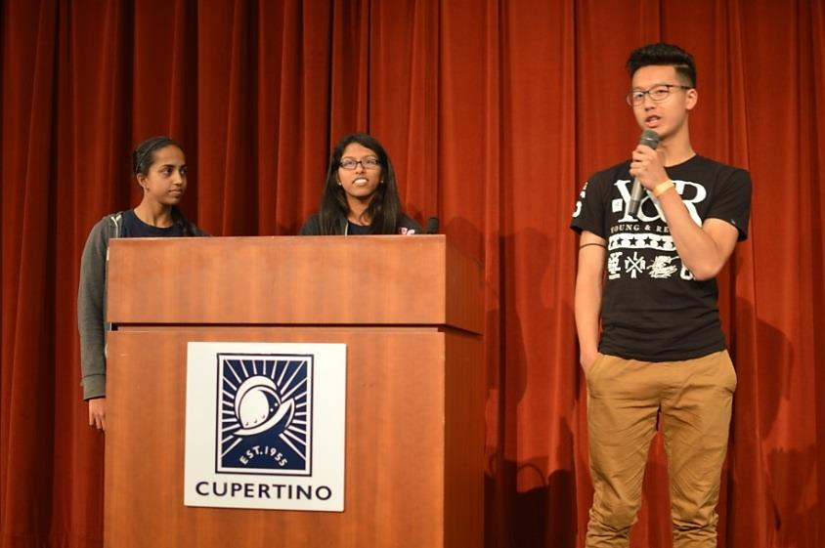
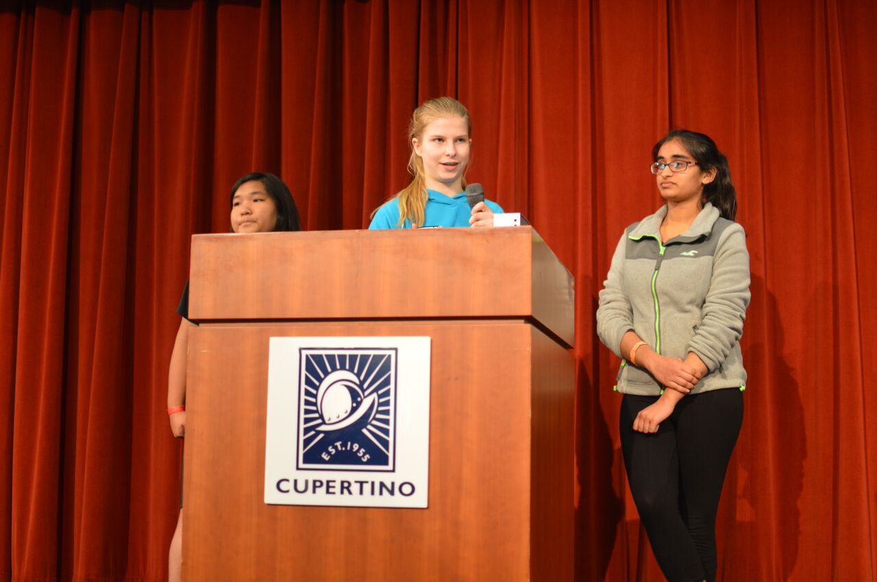
FINAL PITCHES
Top 2 teams from each category
2 minutes
SELL YOUR PROJECT!!!

Slide 21
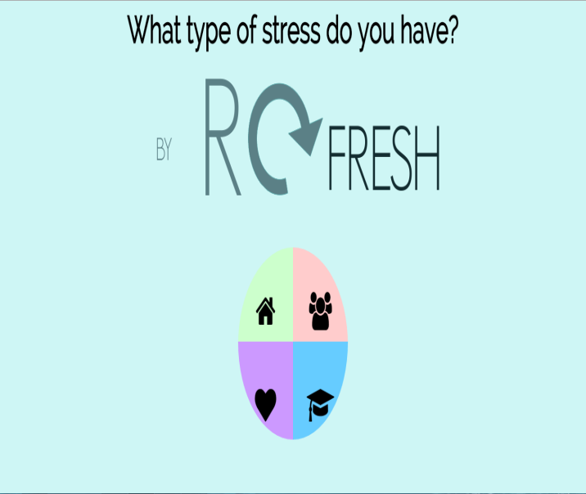
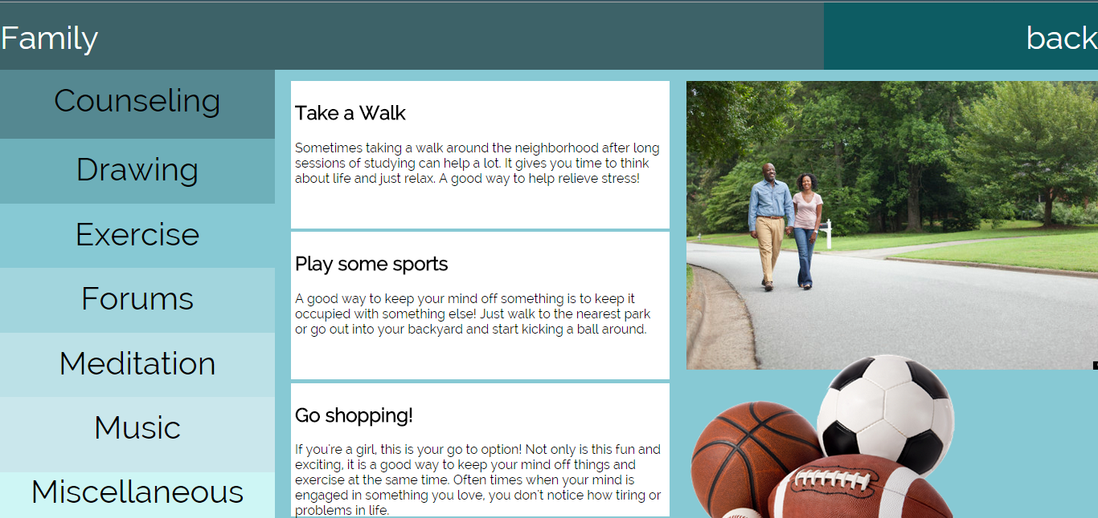
BEGINNER HACK

Slide 22
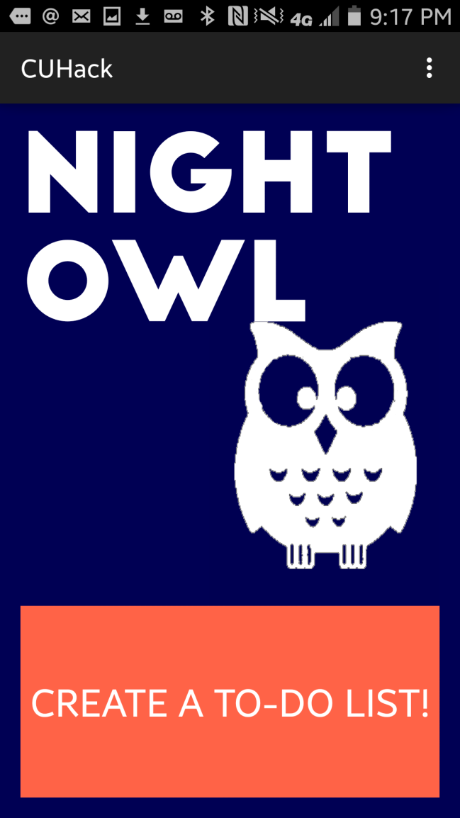
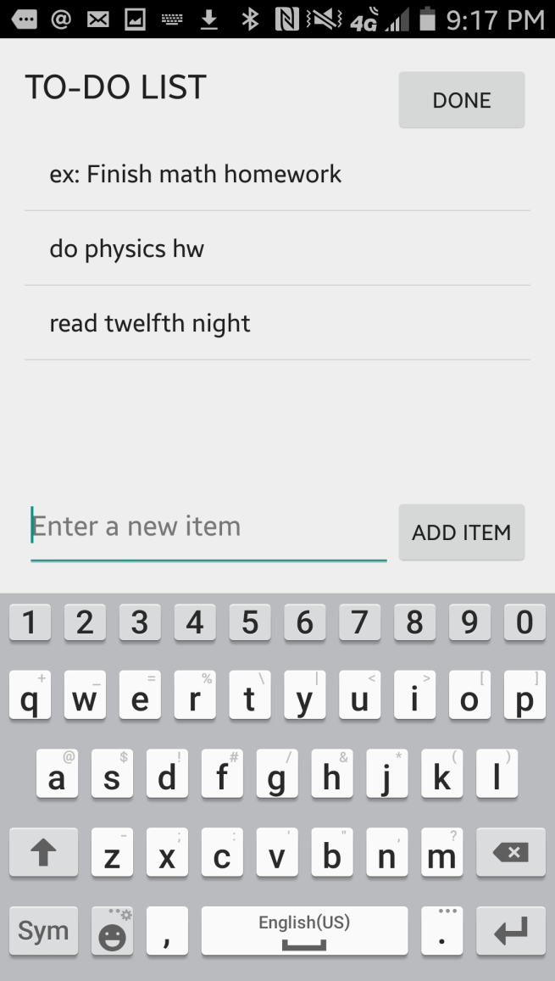
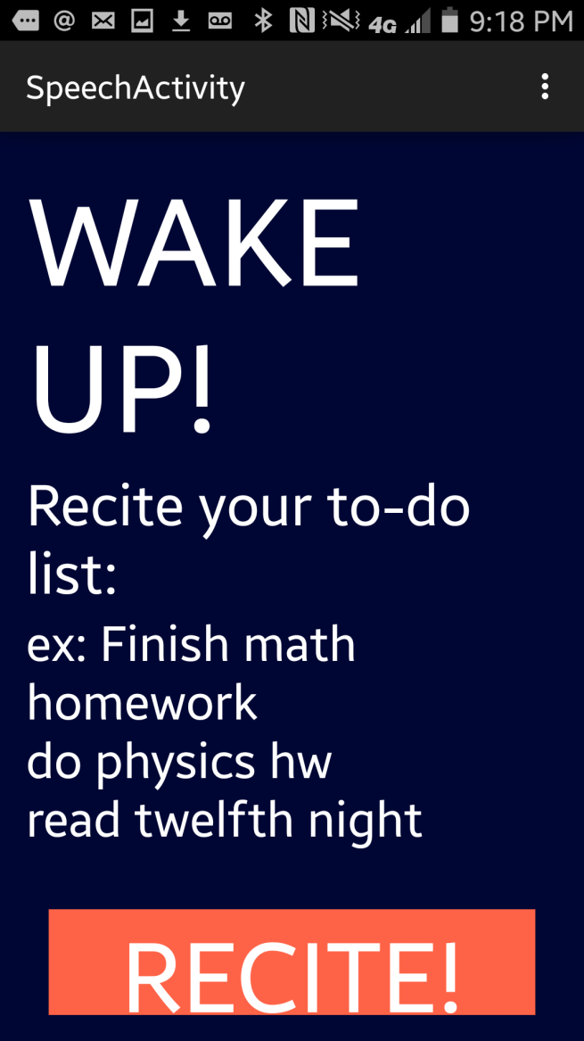
EDUCATIONAL HACK

Slide 23
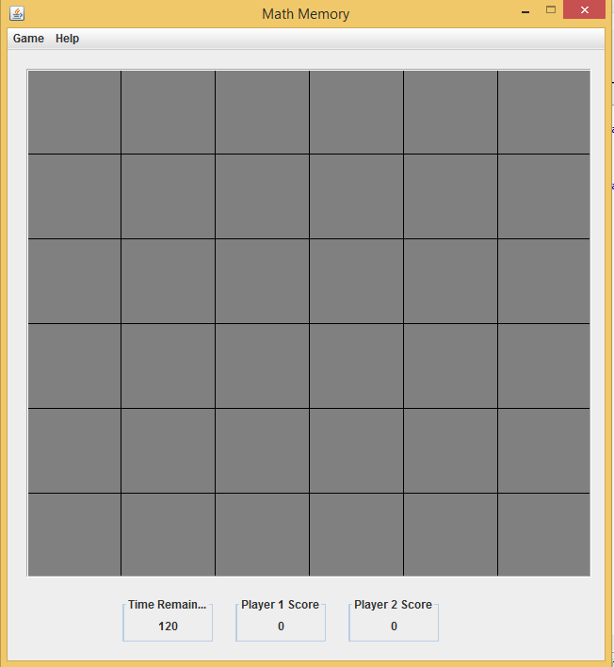
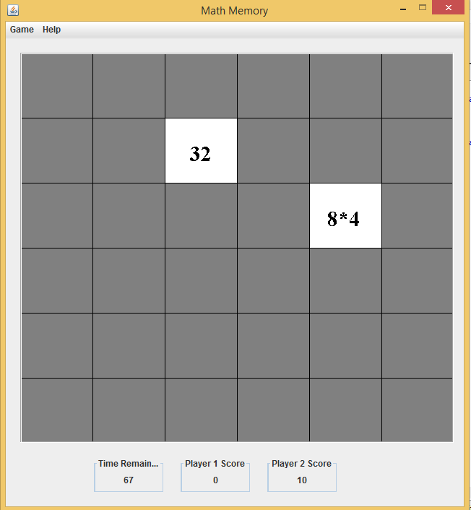
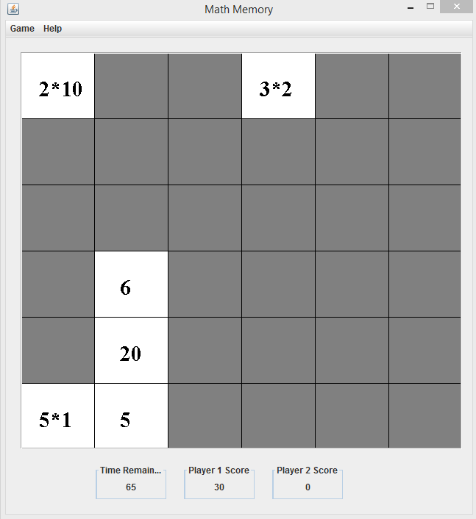
GAME HACK

Slide 24
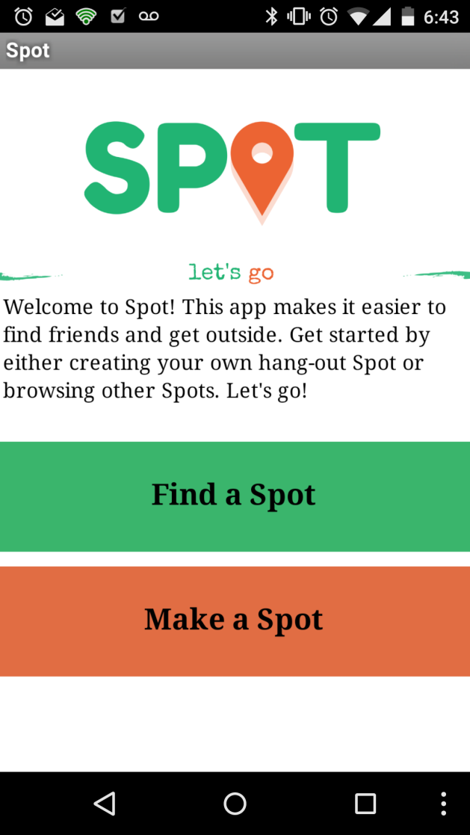
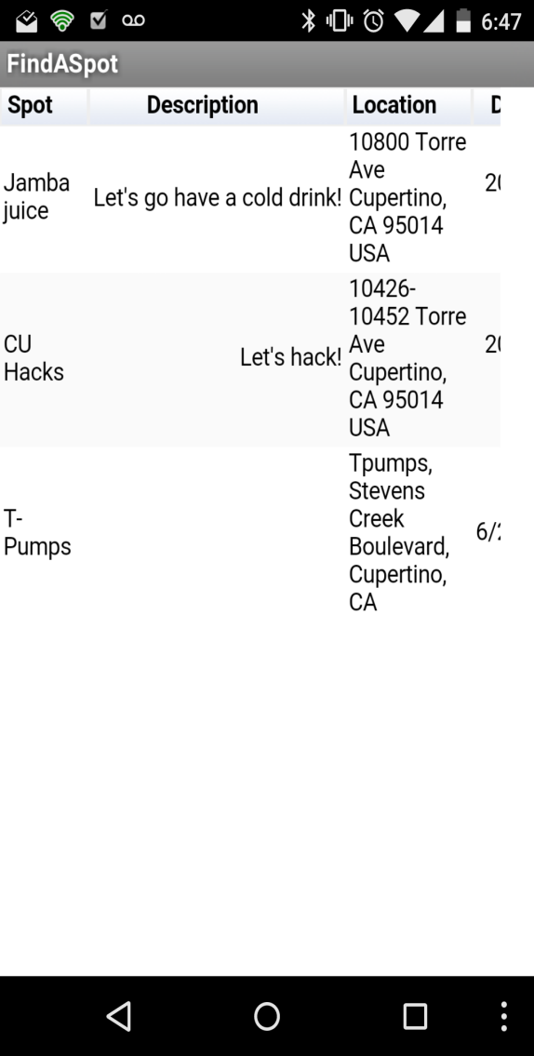
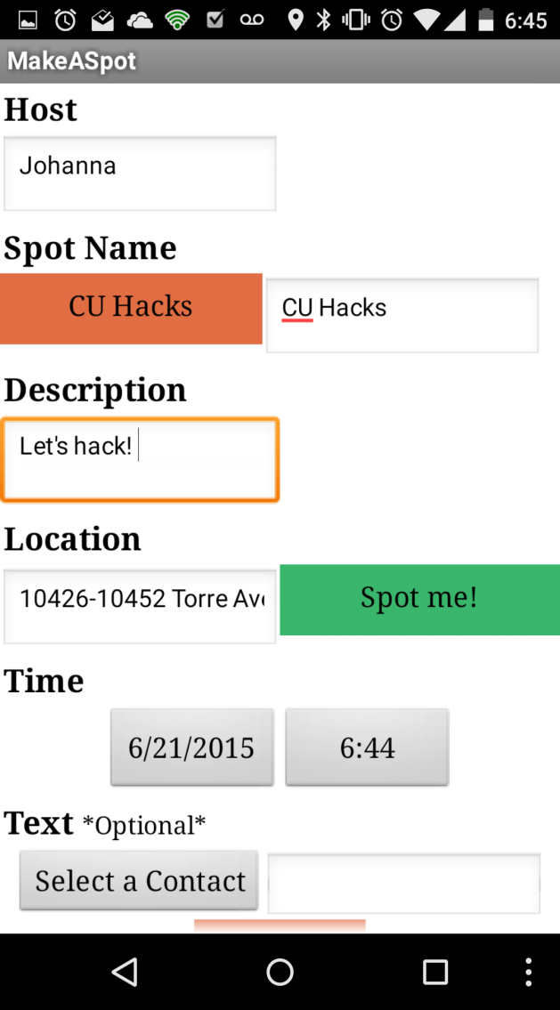
SOCIAL HACK

Slide 25
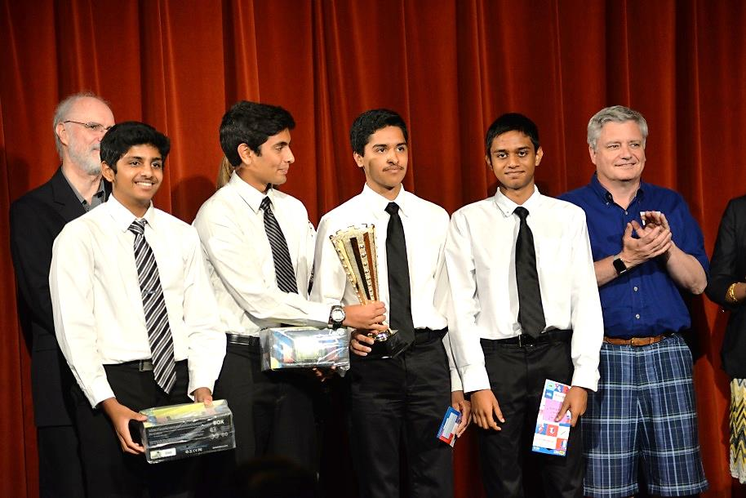
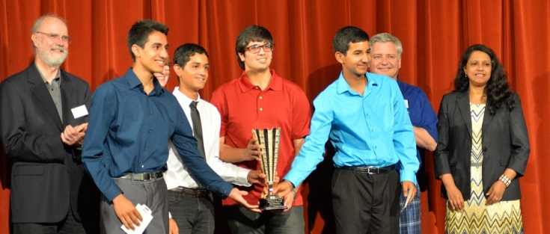
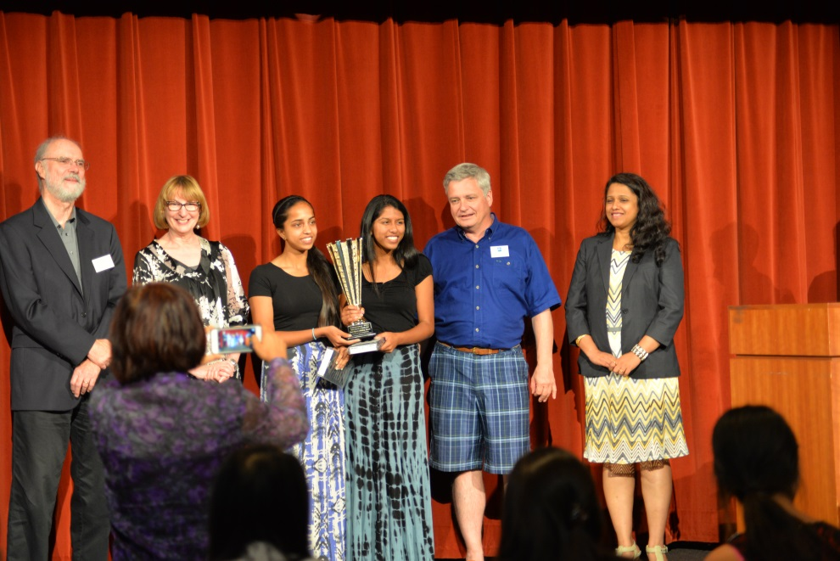
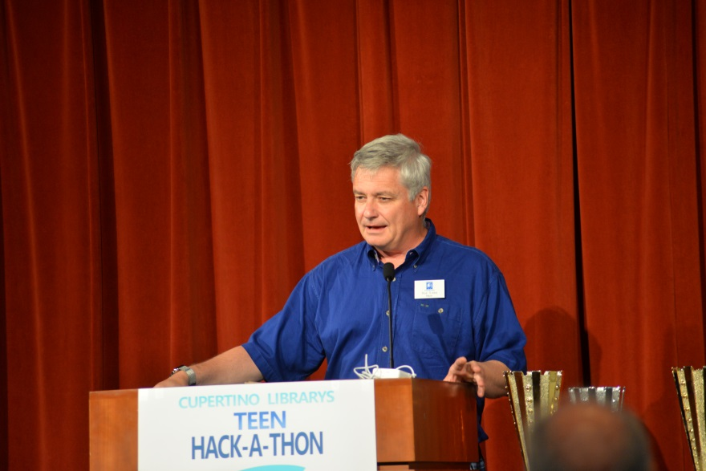
AWARDS CELEBRATION

Slide 26
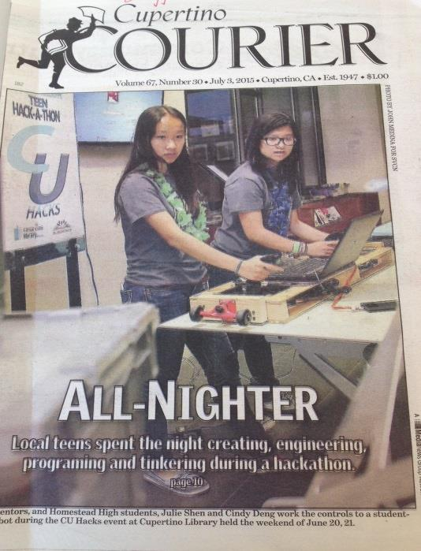
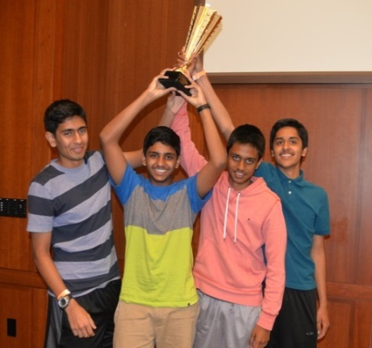
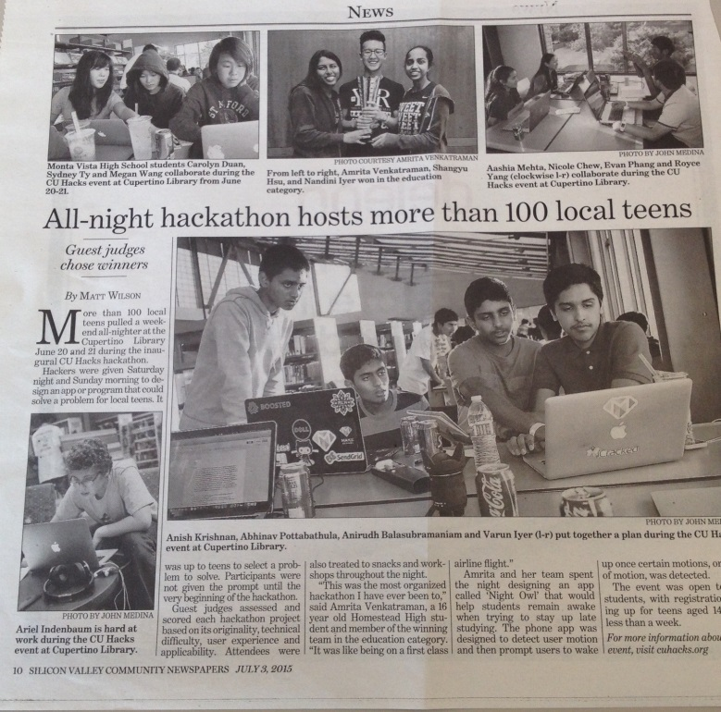
THE RESULTS
113 teen participants
30 teen mentors
14 community partnerships
6 coding workshops
2 robot demonstrations
55 pizzas
576 cans of soda
31 projects submitted
8 top finalists
$1600 in prizes
18 hours running time

Slide 27
Matt Lorenzo
Teen Services Librarian
Cupertino Library
mlorenzo@sccl.org

