Slide 1

b
Notes:
The Mix at SFPL is a Digital Media Learning Lab that meets Teens where they are and offers them the sorts of offerings that will attract youth ages 13 – 18 into the library…

Slide 2
b
The Mix at SFPL Goals
Programs should live up to these values
Programs should help youth
EQUITY
FULL PARTICIPATION
Social Connection
Become better consumers of media
Have hands on building experiences
When educational opportunity is available and accessible to all young people, it elevates the world in which we all live
Learning environments, communities, and civic life thrive when all members actively engage and contribute.
Learning is meaningful when it is part of valued social relationships and shared practice, culture, and identity.
Connect w/ mentors, peers + library staff
Celebrate local culture + diversity
open - mindedness
respect
collaboration
Notes:
It is less than a month until The Mix at SFPL opens, and we will welcome Teens into our exciting new Digital Media Learning Lab and library collections. This is an opportunity for all SFPL staff to gain access to training on new technologies and to explore new programming opportunities. You have already heard me talk about how The Mix seeks to meet Teens where they are and offer them the sorts of offerings that will attract youth ages 13 – 18 into the library…

Slide 3
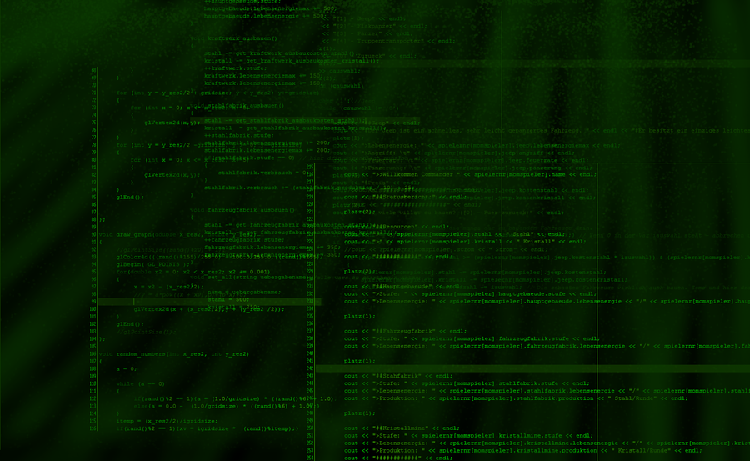

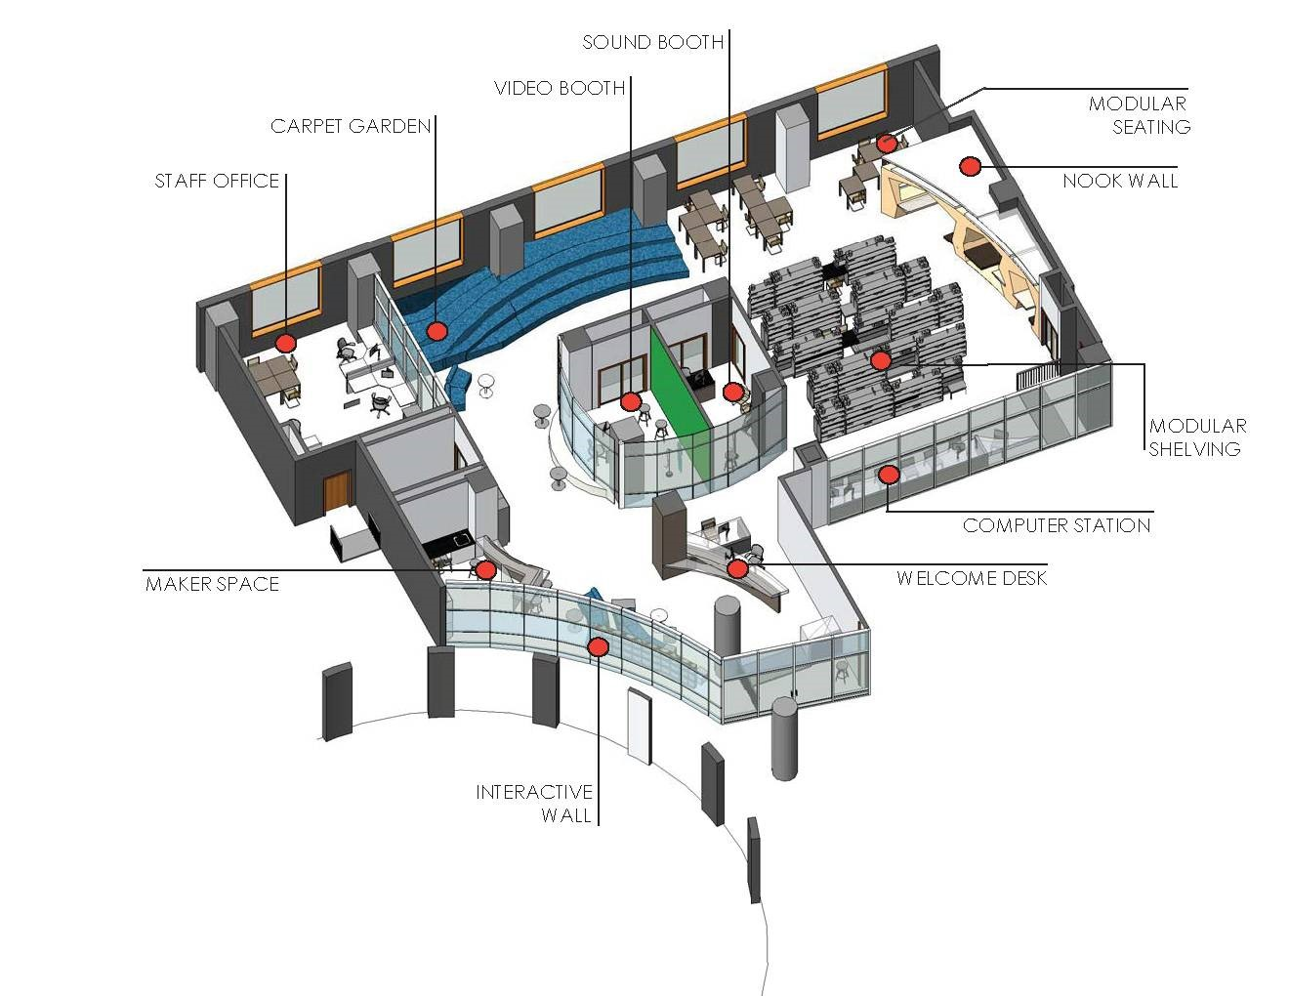
Programs and Partnerships
Support
Learning
Notes:
Everything we are designing for the Mix is in support a type of learning that integrates personal interest, peer relationships, and achievement in academic, civic, or career-relevant areas.

Slide 4

Leslie Knope does not have access to librarians who support her 21st Century Literacy Goals in a Connected Learning Environment.
Notes:
It can be hard for us to remember that not everyone thinks of the public library as an awesome and supportive place to hang out and explore your interests. This age of 13 – 18 can be the age during which people become alienated from the library because traditional service models to not serve many teens in a way that sets them up for success.

Slide 5
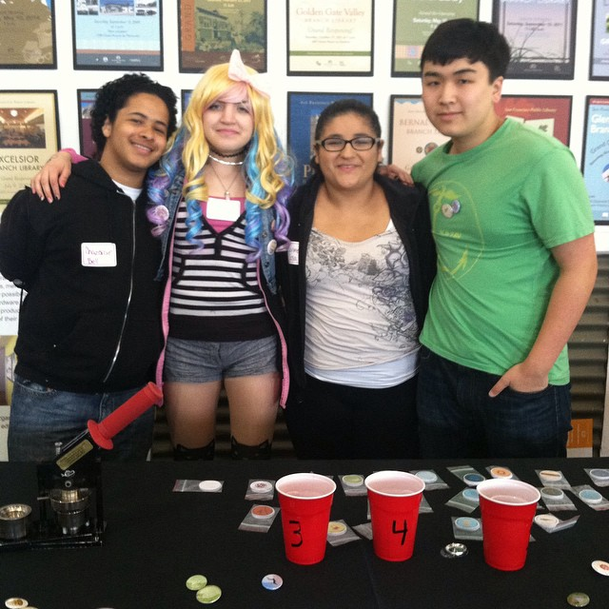
Which 21st Century Literacies excite teens the most?
Which of these literacies are a good library fit?
What activities will encourage these
literacy skills?
Notes:
First we worked with Teens through our BAY to determine what sorts of activities we should offer in the Mix. We took their suggestions and developed a slate of programs that appeal to teens and match our institutional goals and values.

Slide 6

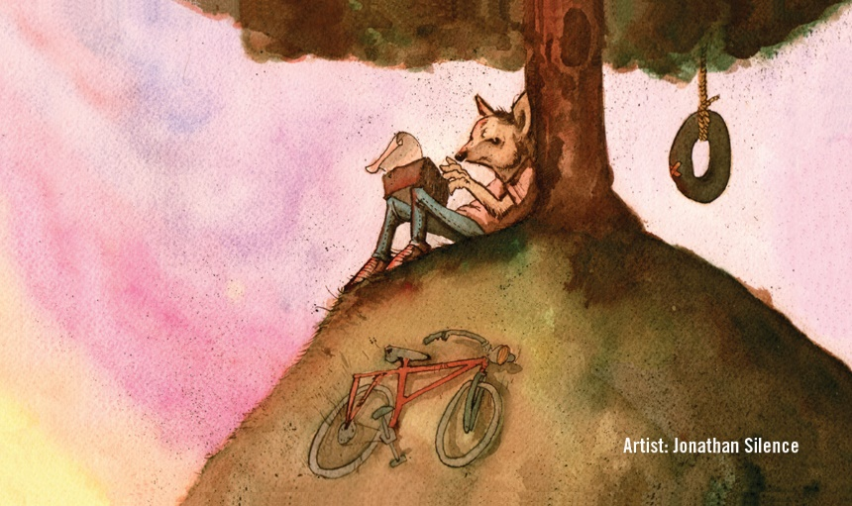



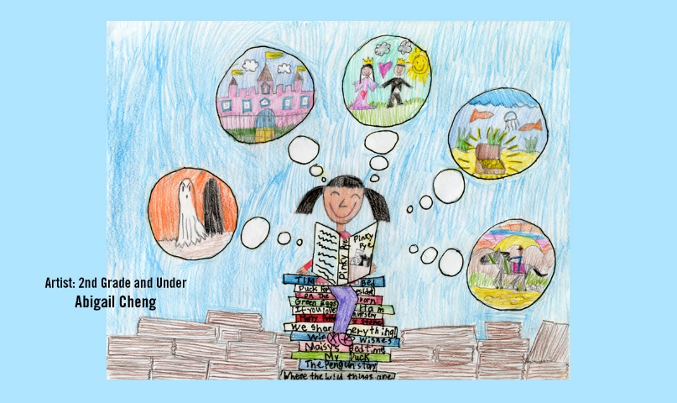
Collaboration
Self- Direction
ICT Literacy
Real World Innovation & Problem Solving
Media Literacy
Leadership
Notes:
The Mix reimagines SFPL’s teen library space as a supportive environment for developing 21st Century Literacies. Now I am going to walk you through specific examples of these 21st Century Literacies, and how the slate of programs we have been offering since The mix opened in June supports them.

Slide 7

Collaboration

Slide 8
Collaboration
Informal Collaboration
Shared responsibility
Substantive Decision
Making
Interdependent Learning
Notes:
The opportunities for developing skills in collaboration will include these elements.

Slide 9
The Mix for Collaboration
CA Academy of Sciences TechTeens
Girls Who Code
Board of Advising Youth
Big Screen Gaming
BAVC Video Production
Audio Studio with Blue Bear School of Music
Notes:
The opportunities for developing skills in collaboration include these elements. Examples of programs that cultivate these skills.

Slide 10
Real World Innovation & Problem Solving

Slide 11
Real World Innovation & Problem Solving
Active Inquiry
Design Thinking
Real World Issues and Challenges
Acting on Personal Ideas
Notes:
The opportunities for developing skills in Real World Innovation and Problem Solving will include these elements.

Slide 12
The Mix for Real World Innovation and Problem Solving
Youth Advocacy Day
3D Design Studio
Board of Advising Youth
Where Do You Belong?
Youth Speaks
TeenTechSF Civic Hackathon
Notes:
Examples of programs that cultivate these skills.

Slide 13
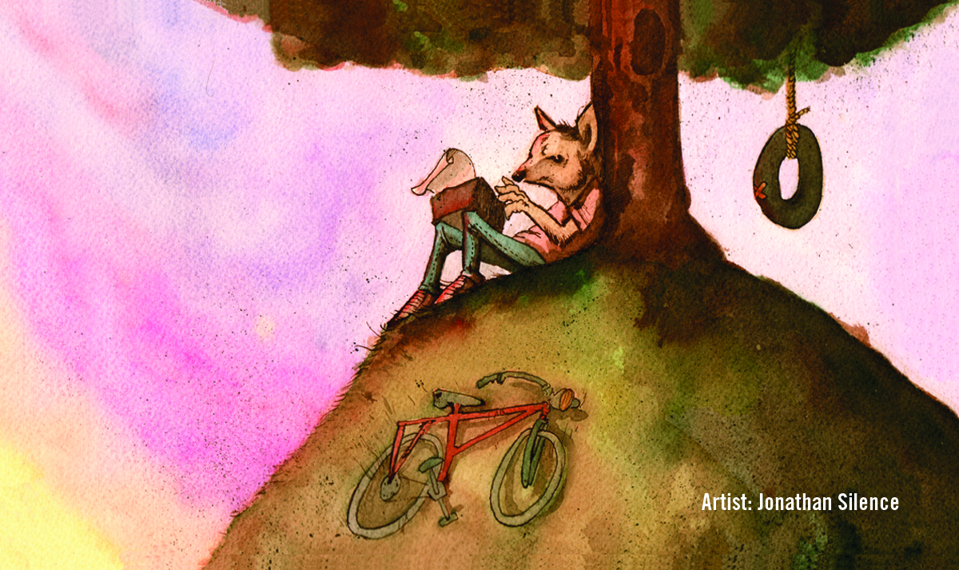
Self- Direction
Notes:
Self-directed learning is perhaps the most traditional library service model, which The Mix will expand through new equipment and technology.

Slide 14

Self- Direction
Advance Skill Levels at one’s own pace
Learning as a Lifelong Process
Define and Complete Tasks Without Direct Oversight
Set Own Goals for
Success Criteria
Notes:
The opportunities for developing skills in self-direction will include these elements.

Slide 15
The Mix for Self-Direction
Sewing and Crafting
Print Collection
Audio and Video Open Studio
LittleBits Arduino Coding Kit
Maker/Tinker Open Studio
T-shirt Printing with Silhouette Cameo
Notes:
Examples of programs that cultivate these skills.

Slide 16

Media Literacy

Slide 17
Media Literacy
Discover how messages are constructed and for what purpose
Explore how media can influence beliefs and behaviors
Evaluate information critically and competently
Learn media creation tools and conventions
Notes:
The opportunities for developing skills in Media Literacy will include these elements.

Slide 18
The Mix for Media Literacy
Youth Speaks
BAVC Video Production
WritersCorps
Blue Bear and BUMP Records
Print and Digital Collection
themixatsfpl.org
Notes:
Examples of programs that cultivate these skills.

Slide 19

Leadership

Slide 20

Leadership
Groups Achieving a Common Goal
Demonstrate Integrity
Work Positively and Ethically
Inspire Others
Notes:
The opportunities for developing leadership skills include these elements.

Slide 21
The Mix for Leadership
BAVC Intermediate Filmmaking
Board of Advising Youth
Youth Speaks
Teen-Led Clubs
Community Leadership
Mentoring Relationships
Notes:
Programs that cultivate these skills.

Slide 22

ICT Literacy
Notes:
Information and Communication Technology

Slide 23

ICT Literacy
Research, Communicate, and Create in New Ways
Tools to Function in a Knowledge Economy
Equal Access and Use of Information Technologies
Increase Social Networks for Disconnected Teens
Notes:
The opportunities for developing skills in Information and Communication Technology will include these elements.

Slide 24
The Mix for ICT
eCommunity and Social Networking
Fast Internet Connections
Diverse Operating Systems
Distance Learning
Broadcast Media Technologies
Interactive Wall Exhibits
Notes:
Examples of programs that cultivate these skills.

Slide 25
‘Start Stop Continue’ Feedback
What meaningful activity did you start in The Mix?
What will you stop doing?
What will bring you back?
Notes:
Evaluation begins as the programs roll out! We ask Teens for their feedback on 1. Whether they were able to explore interests that they walked in the door with 2. Whether they discovered something new 3. Whether they will stop doing something -- program was a flop, or something negative is being given up (nutritional health anyone?)

Slide 26
Follow and share with us! #themixatsfpl
Our New Teen Website Showcases Teen’s Creations
Instagram
Soundcloud
Pictures by the youth and of the youth during different mix programming. Simply post and use #themixatsfpl
The home for the youth’s audio creations. Teens simply upload their content and share with us.
YouTube
Twitter
The home for the youth’s video creations
Tweets from Mix Staff on SFPL’s main twitter account will showcase youth creations to a wider audience

Slide 27
Thank You!!!
Questions?
Contact themix@sfpl.org

