Slide 1
The SoundSwell project was supported in part the Institute of Museum and Library Services under the provisions of the Library Services and Technology Act, administered in California by the State Librarian.
Notes:
Introduce self
SoundSwell was funded by an LSTA Eureka grant for the proof of concept phase
Created through a partnership formed by The Santa Cruz Public Libraries and Santa Cruz Rehearsal Studios

Slide 2
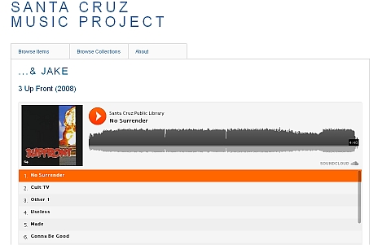
What is SoundSwell?
Downloadable Database
Discovery & Access Tool
Historical Archive
Notes:
A streaming database of local music that library cardholders can download for free.
Only discovery tool for local music
Establishes a historical archive of local music that people can listen to for years to come.
It expands access to local music in a way that compensates and respects the art of the musician.
We pay a 2 year licensing fee for each album, and after the contracts ends, those albums go into the archive where they can be streamed, but not downloaded.

Slide 3
Start with Why
Notes:
It’s always a good idea to start with WHY.
Eureka Leadership Institute fellow for 2012.
Library Journal article about the Iowa City Local Music project- wondering if something similar would be a good fit for my community.
But I wasn’t really connected to the local music scene in Santa Cruz and I had some real reservations about pursuing such a huge project with no community support.

Slide 4
Community Connections
Notes:
And then….something amazing happened.
Part of my job as the virtual services librarian is to monitor the library’s social networks. As I was wondering about the question of community support and interest, I received messages from a community member on both Facebook and Twitter!
This person had also seen an article about the Iowa City Music project in a civilian news source, Boing Boing, and suggested that we should do it and Santa Cruz AND that she was willing to help.
So, I figured if one person in Santa Cruz thought this was a good idea, there had to be others. We arranged to have a phone conversation, and it turned out that this person was deeply entrenched in the local music scene, and she owned a record label and the Santa Cruz Rehearsal Studios.

Slide 5
Looking Outward
Notes:
At this point, I thought the planets had aligned, and that the project merited serious consideration. So I thought it was time to look outward and do a little more investigation into the local music scene and the community in order to determine how this project could have the greatest impact.
Community assessment focused on music –interesting findings

Slide 6
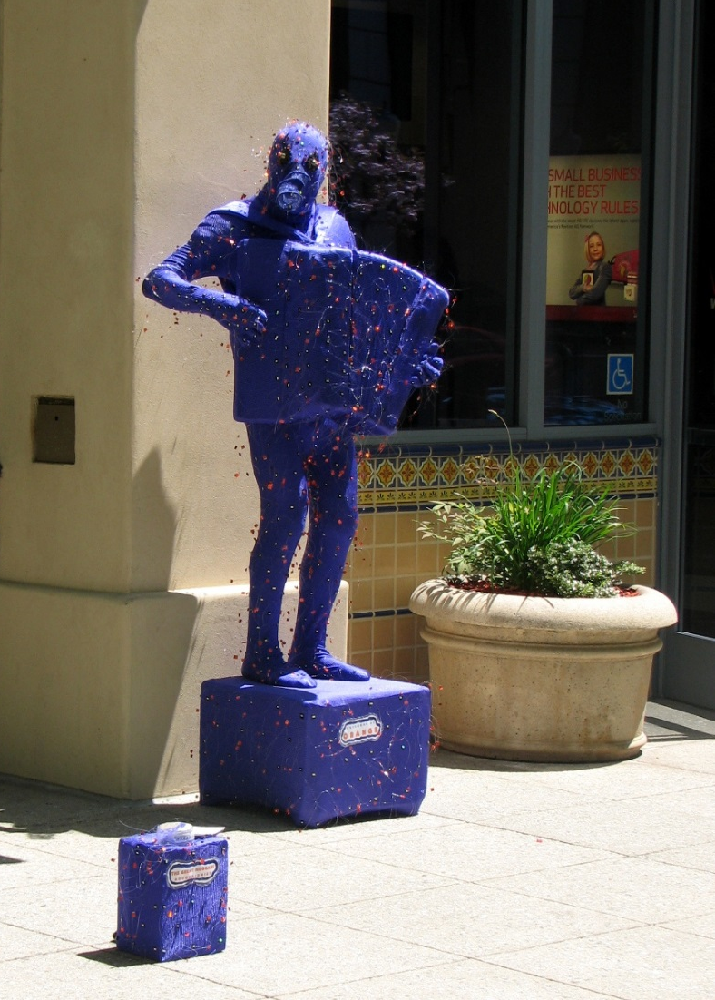
Santa Cruz!
Arts Identity
Active Music Scene
Variety of Genres
The Great Morgani photo courtesy of Sara Stasi
Notes:
What I found was that Santa Cruz is a unique community with an artistic flair. We have a vibrant music scene filled with a large variety and number of active musical artists in many genres.

Slide 7
Santa Cruz Arts Master Plan
Visual Arts Bias
Event Based Musical Promotions
Musical Genre Bias
Notes:
Santa Cruz is trying to promote its artistic flair in terms of economic development by establishing a new identity as an arts destination. But a look at the arts master plan reveals that the visual arts have overshadowed the musical arts in terms of institutional support, which is events based and biased toward certain genres like jazz and classical.

Slide 8
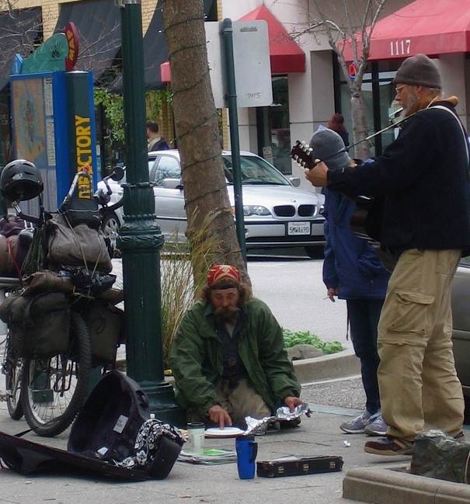
Music Community Faces Challenges
Need a Discovery Tool
Compensation & Copyright
Small Venue Activity
Large Event Competition
Photo by Earth Worm
Notes:
So, the musical community in Santa Cruz faces some real challenges.
First of all, Music lovers don’t have a lot of options for discovering local music beyond a chance encounter at a restaurant or bar. iTunes and most subscription services don’t have geographically based discovery tools and take a big chunk out of that 99 cent download fee. And When it comes to large scale local events, our musicians are often competing with out of the area performers.

Slide 9
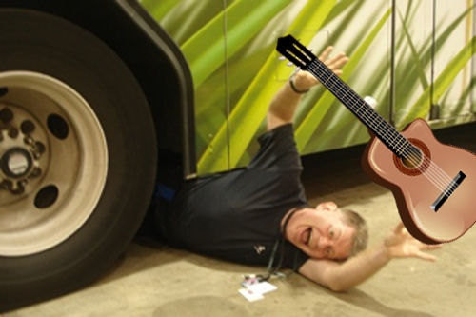
Why are we throwing musicians under the bus?
Notes:
So, when it comes to planning and institutional support, musicians in Santa Cruz are really getting thrown under the bus-- To the detriment of musicians and the community as a whole.

Slide 10
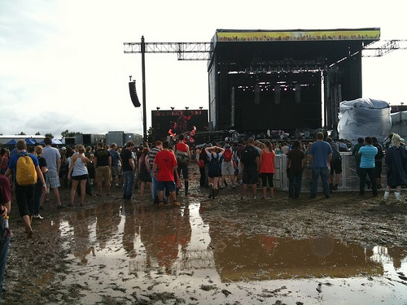
SoundSwell
Weather-Resistant!
Free
Easy
Value
Notes:
SoundSwell is both an alternative and compliment to event based local music discovery and promotion.
It’s a free, year-round, weather-resistant, one-stop location to discover the music of Santa Cruz.
By helping musicians to grow their fan base locally, SoundSwell can really have a big impact on small venue attendance, and stimulate economic development in the musical arts.
Communicates the value of local music on an institutional level
Library=government

Slide 11
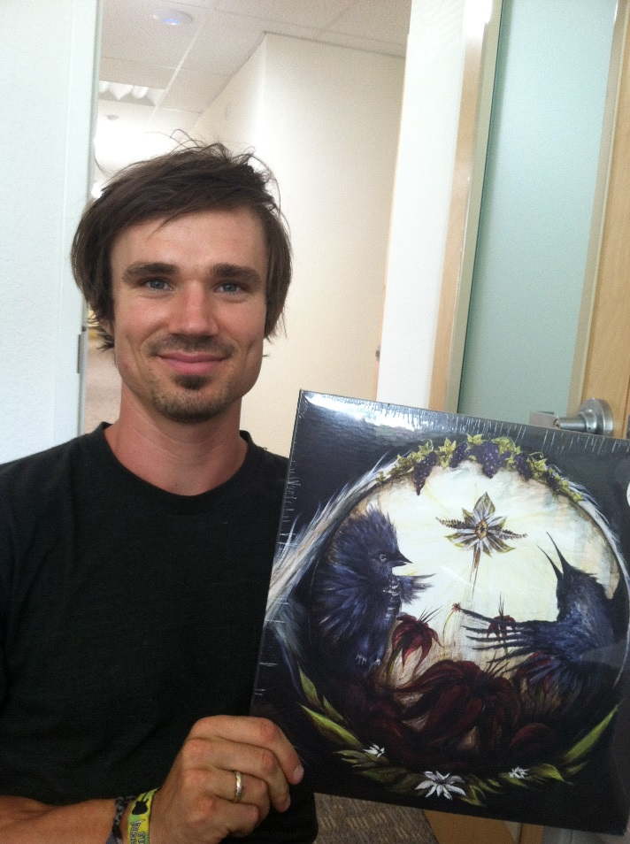
SoundSwell Builds Community
“It’s so exciting that you’re doing this project because it really brings the listeners and the musical and artistic community together”
--Beaumont Bradbury of New World Ape
Notes:
Most importantly- Soundswell builds community. This quote from Beau Bradbury of New World Ape says it better than I ever could. He says…

Slide 12
Music Brings People Together
The Library
Musicians
Arts Community
Listeners
The Media
Notes:
And SoundSwell definitely does bring the musical community and its listeners together.
And it has also positioned the library as a real player in local arts and music.
Connections we’ve made with musicians, the media, and fans has created a new set of relationships for the library.

Slide 13
Building SoundSwell
Notes:
Now lets switch gears a bit and talk about How we did it.
For the proof of concept phase, Project activities break down into 3 areas
Securing content
Building the database
Data entry

Slide 14
Securing Content
License Agreement
Selection Criteria
At least 1 Santa Cruzan
Band Claims Santa Cruz Identity
Commercially Produced CD
Getting the Word Out
Meeting with Musicians
Follow Up and Paperwork
Notes:
The biggest part of securing content = relationship building
Created a license agreement
Selection criteria for inclusion in the database. This turned out to be more complicated than I imagined – even defining local music proved challenging. And I learned a lot about what it means in the local music scene to have a strong geographic identity, and how important that is to the integrity of a project like this.
But that lesson really developed my ability to build these relationships.
It made it easier to Develop talking points and written form letters to describe the project to local musicians.
Finally, we spent a lot of time talking with musicians in person, by phone, and by email, securing agreements and accepting submissions.

Slide 15
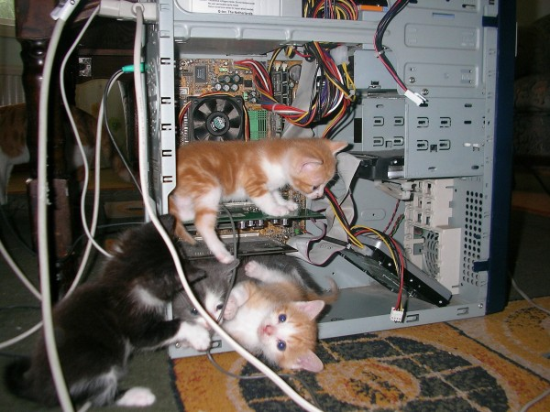
Building the Database & Data Entry
Omeka (Open Source)
Ripping & Scanning
SoundCloud
Photo by The Unreal Sephiroth
Notes:
We used Omeka, which is an open source digital exhibition software used by archives and museums and libraries
It uses Dublin Core
Allows you to curate collections of a variety of digital objects.
And it was a good choice because we already had an Omeka database server built!
Even with a server already built, there was a lot to do:
Ripping CDs for archive and streaming
Scanning everything for the archive
Omeka’s Sound Cloud plug-in
Data Entry
Using SoundCloud = Double Data Entry
Couldn’t use for file downloads due to need for authentication = more work adding zip files

Slide 16
Challenges
Language
Cataloging & Data Entry
Storage
Notes:
We had some challenges.

Slide 17
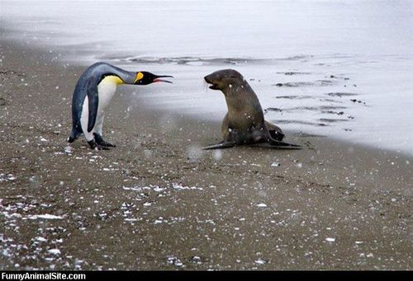
The Language Challenge
Notes:
I speak “librarian” not musician, and I had to learn to talk to musicians in a way that sounded compelling to them.
one place where librarian speak and musician speak came together was when we talked about the historical archive aspect of the project. Every musician values the opportunity to become a part of the historical record of local music in SC.

Slide 18
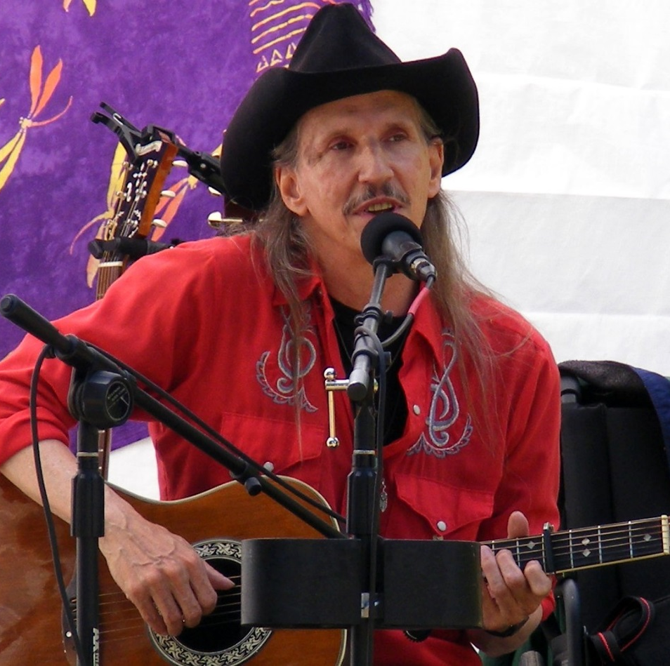
“Thank you for including me in the SoundSwell project. I am proud to be a part of the local music of Santa Cruz and now part of the library. I performed frequently in Santa Cruz for twenty years, and now physical limitations keep my opportunities to occasional. I'm glad there is another way to get my music out to the community.”
Yours Truly,
Billy "Hawk" Epstein
Notes:
For example, Local Musician Billy Hawk Epstein emailed me to thank me for including him in the project. Active for more than 20 years in the local music scene, his health problems prevent him from playing public shows. He is so grateful to have a way to get his music out to the community.

Slide 19
Cataloging & Data Entry Nightmare
No Authority Files
Pseudonyms
Consistency
SoundCloud Data
Zip Files Galore
Notes:
Cataloging was a complete nightmare.
There are no authority files for these musicians
Some of them change pseudonyms as often as their socks.
The problem is the cataloging of the physical CD’s and maintaining consistency between the Marc Record and Dublin Core
Data Entry was also pretty tedious and time consuming
Using soundcloud required us to do a duplicate entry of metadata
Authentication at download = soundcloud not handling downloads = more work

Slide 20
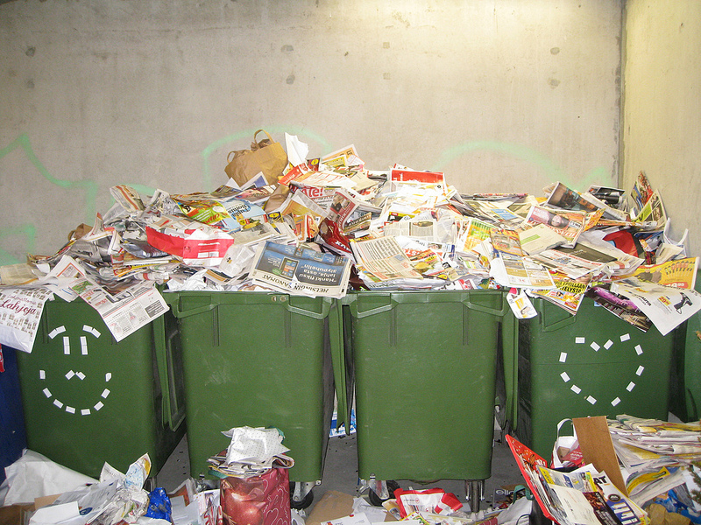
Storage Problems
Photo by Matti Mattila
Notes:
Finally, we had some storage problems
We were working with huge files
Storage became a problem just as we were about to go live
Needed short term fix and long term solution – which we are still working on

Slide 21
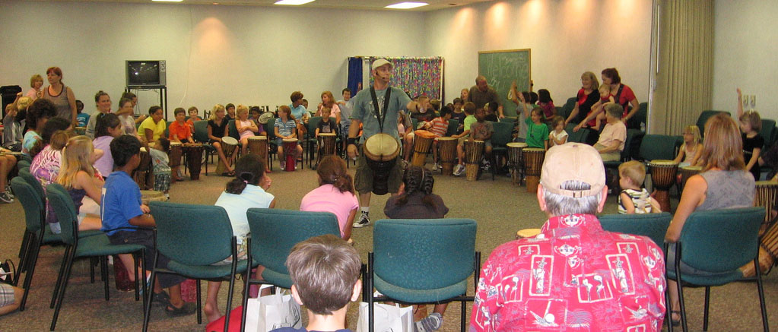
Music Brings People Together
Drum circle led by Giving Tree Music. Photo courtesy of Clearwater Public Library System, FL.
Notes:
These challenges are worth it because everybody enjoys music. It’s part of our shared and individual identities, and it brings people together. Preserving and making that available to our communities is extremely valuable, and reinforces the hyper-local role of libraries as creators, curators, and disseminators of uniquely local content and culture.

Slide 22
Notes:
Short, Medium, and long term
Short Term Plans
Work on expanding the collection incrementally by adding musicians and making the collection more robust and complete.
Plan for 2 year cycles of core collection overturn, including:
negotiating new license agreements with musicians
Organizing music from expired agreements into the archive collection
Medium - Slowly work on expanding the archive collection to bring in newspaper articles, video clips, and other digitized objects; creating a band archive page as we move forward – and possibly even going back in time and adding musicians from the past.
Long Term Possibilities
This project lends itself to the Discover & Go model, where libraries pay into a centralized IT framework and add to the network by negotiating with musicians in their respective communities for the benefit of the entire network. The San Francisco Bay Area would be a fantastic test bed for this type of network.

Slide 23
Let’s Take a Look
Notes:
Demo

Slide 24
Thank You!
SCMUSIC.SANTACRUZPL.ORG
Diane Cowen
Virtual Services Librarian,
Santa Cruz Public Libraries
email: cowend@santacruzpl.org
Twitter: @groovacious

