Slide 1
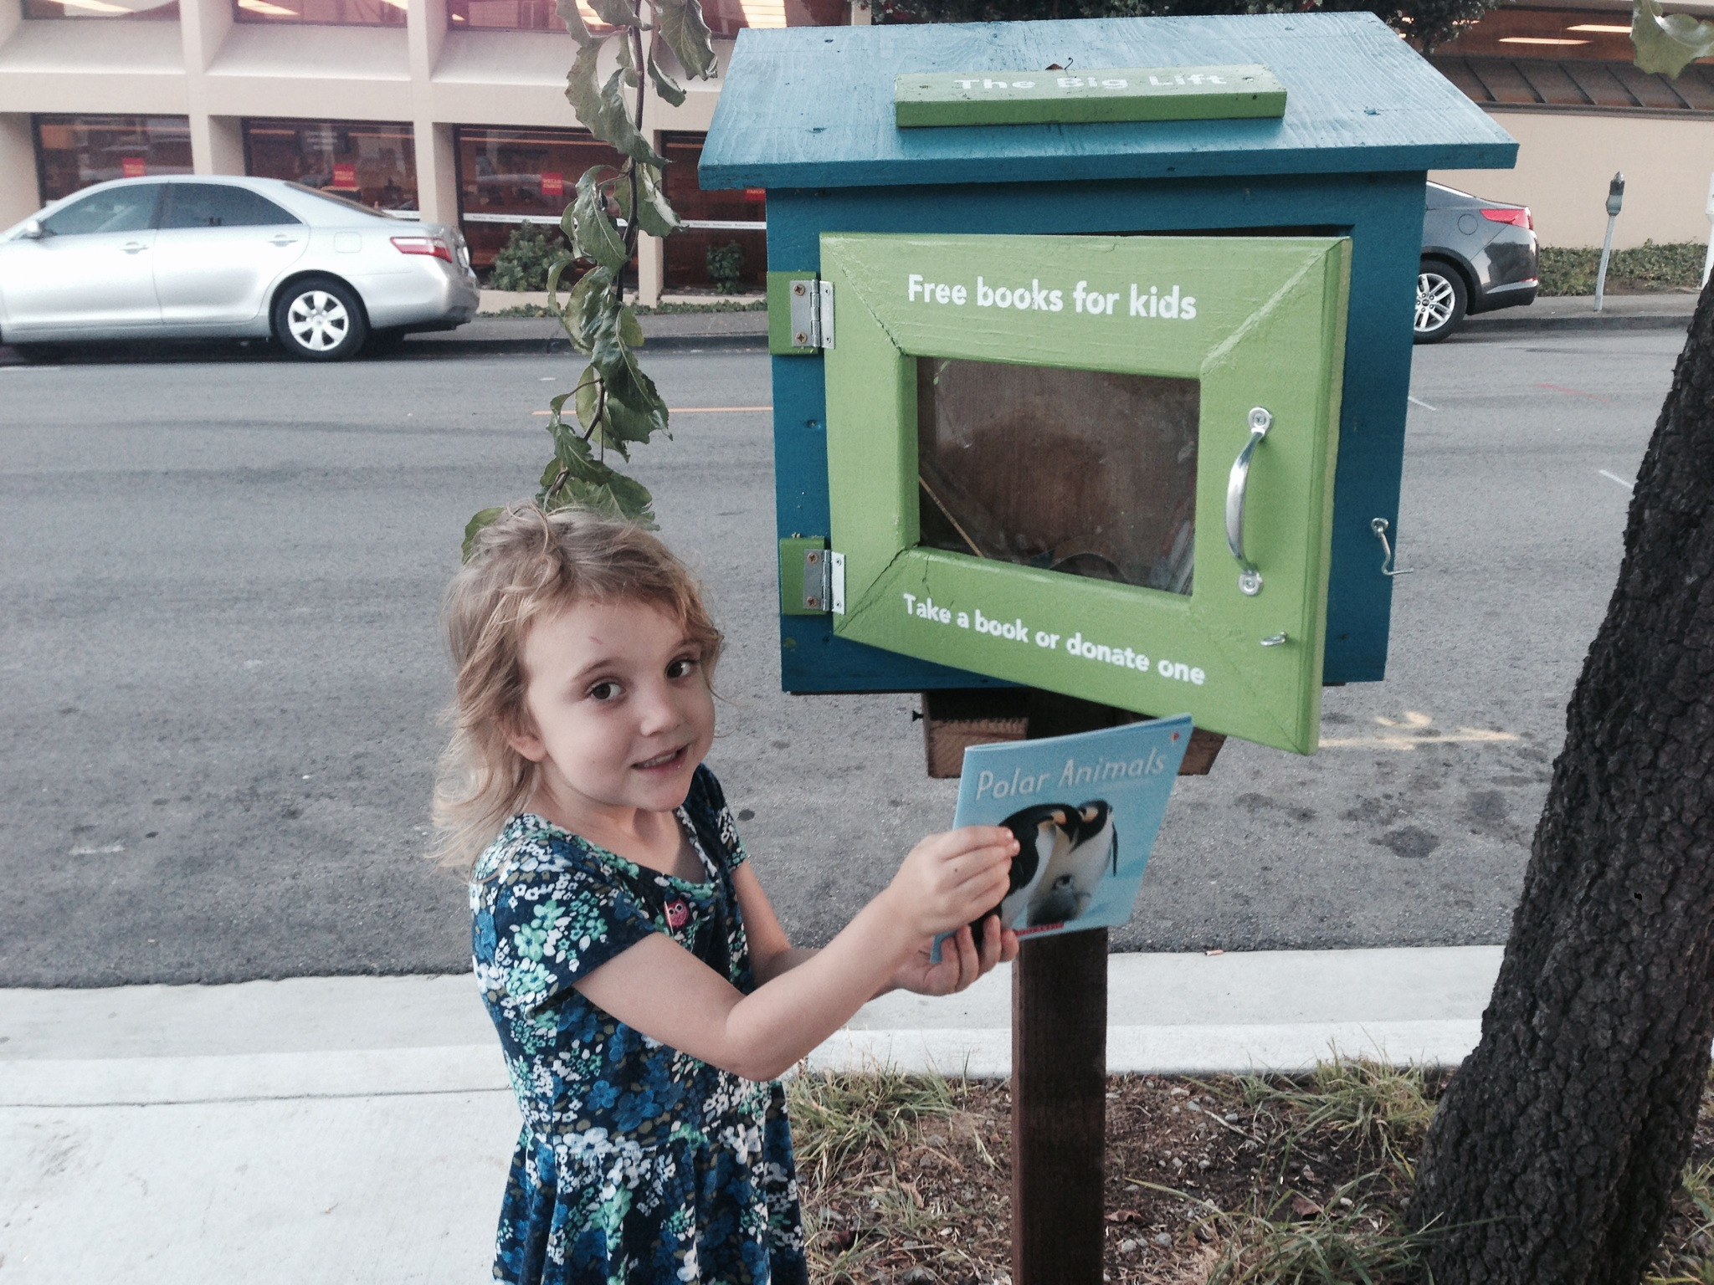
Big Lift Little Libraries

Slide 2
Overview of The Big Lift Strategic Plan
The Big Lift Plan
Overall Goal: Go from 58% reading at grade level by 3rd grade to 80%
Overall Goal: Go from 58% reading at grade level by 3rd grade to 80% by 2020
Make a big system policy change
Provide quality preschool for 3- & 4-year-olds
Sustain progress through
Greater readiness
Goal: Increase % of children ready for kindergarten from 50% to 80%
-Strategy #1: Develop the case for preschool
-Strategy #2: Create a quality preschool model & rollout plan
-Strategy #3 Develop a plan to improve the transition to kindergarten
Better attendance
Goal: Reduce chronic absence by 50%
-Strategy #1: Engage school districts annually
-Strategy #2: Share best practices & recommend system changes
Inspiring summers
Goal: 80% of kids reading below level attend a quality program
-Strategy #1: Make the case for quality summer programs
-Strategy #2: Build a network of program providers to improve quality & access
Family engagement
Goal: integrate family engagement principles county-wide
-Strategy #1 Develop engagement principles
-Strategy #2: Convene groups who support families to inform and engage them
-Strategy #3: Work with preschool model team to incorporate principles.
Notes:
The Big Lift is an effort of the Peninsula Partnership Leadership Council focused on increasing countywide reading proficiency of 3rd grade students from 58% to 80% by 2020.
The approach is to create systems response to a systems problem --- that is:
42% of county 3rd graders, 3000 children, are not reading proficiently
60%+ for Latino, African American, and Pacific Islander children
Source: Dataquest
Those behind tend to stay behind:
88% of dropouts could not read proficiently by 3rd grade
Source: Bureau of Labor Statistics’ National Longitudinal Study of Youth

Slide 3
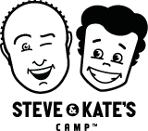
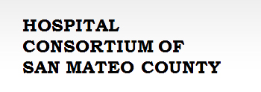
The Big Lift Collaborative
Notes:
252 organizations involved in the Big Lift in SMC
Organizers saw a current challenge of visibility and engagement of these organizations and individuals. You can’t just turn around and start universal preK.

Slide 4
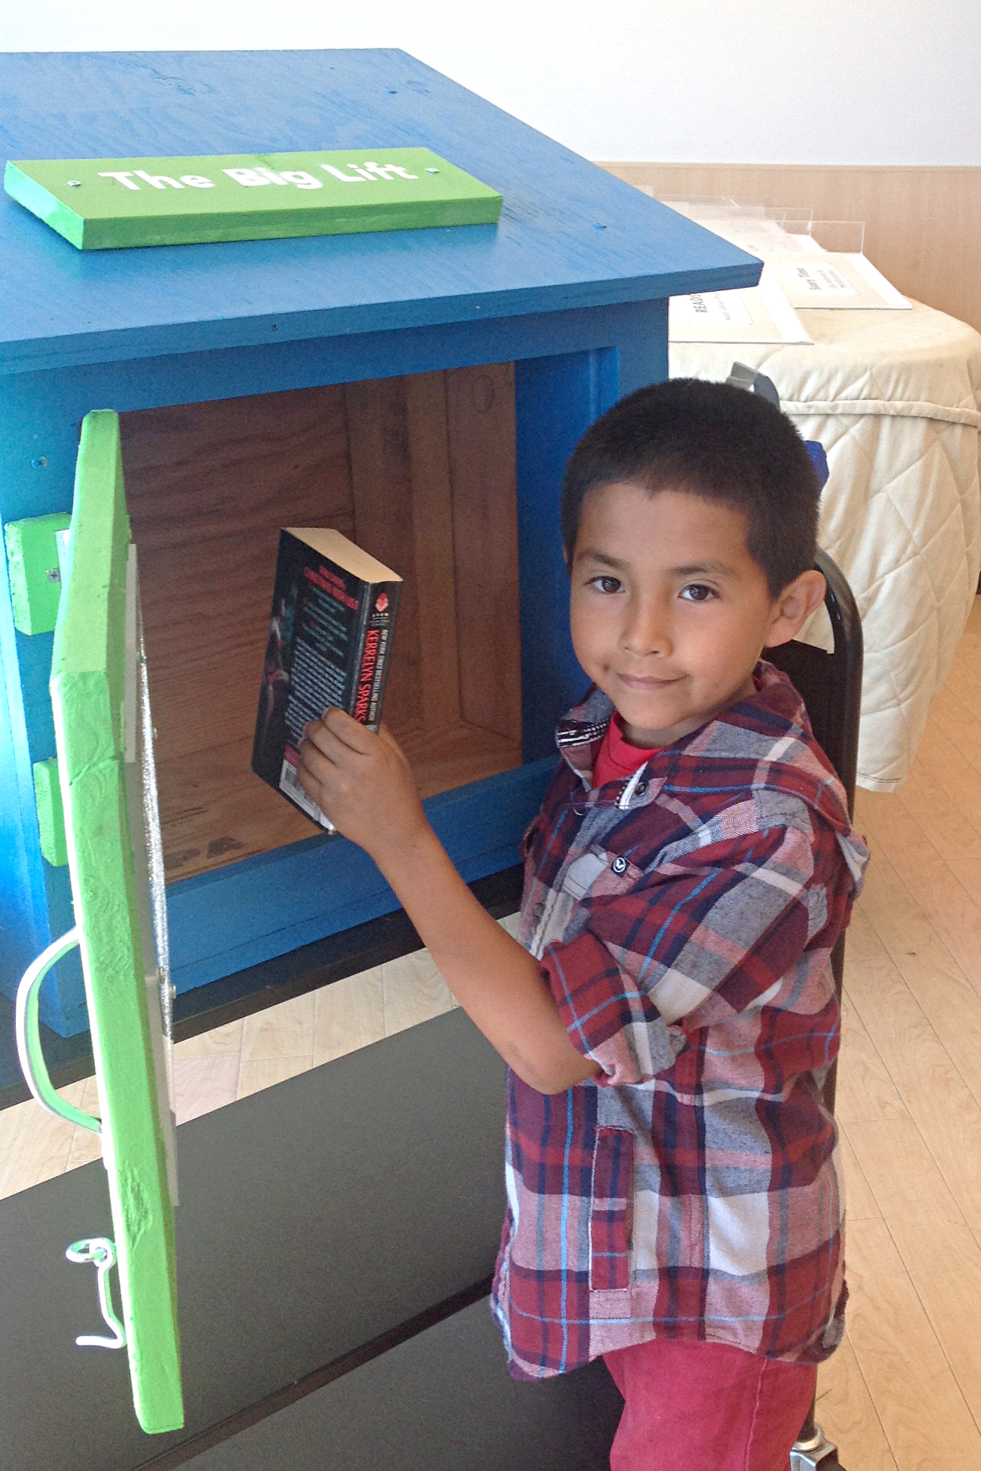
Encourage a culture of reading in San Mateo County,
Increase access to books for children and families at the point of need,
Involve all of the county in The Big Lift, and
Create resident support for The Big Lift initiative.
Notes:
What are the goals of the project.

Slide 5
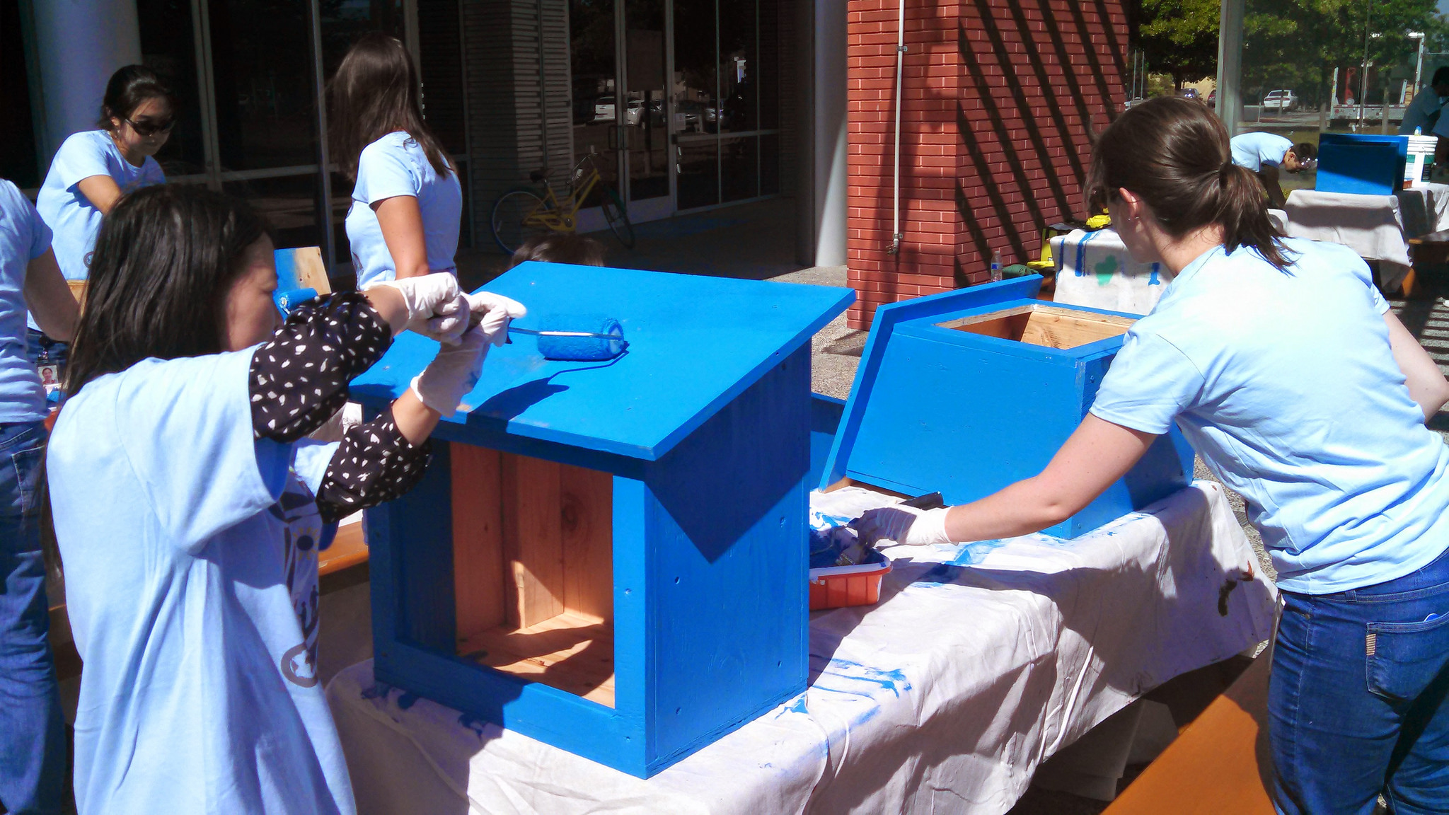

Slide 6
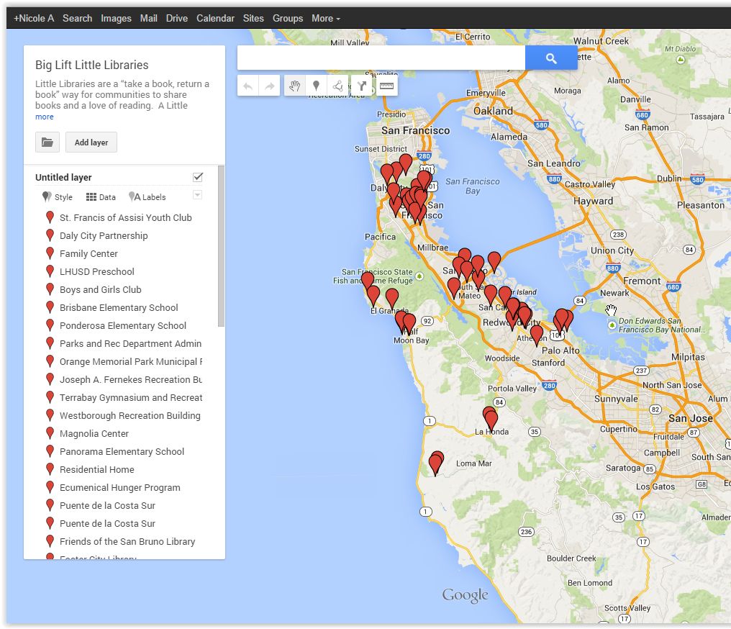
Notes:
Schools, Preschools

Slide 7
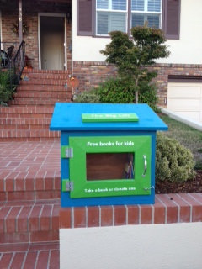
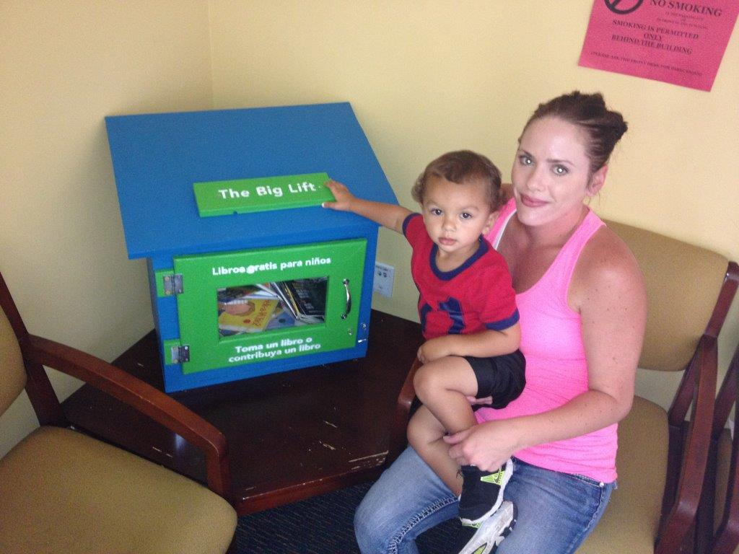

Slide 8
Thank you!
http://www.smcl.org/en/content/big-lift-little-libraries
Nicole Pasini
Library Services Manager, Community Libraries
pasini@smcl.org

