Slide 1
Jenn Laredo -- Los Gatos Public Library
Future of Libraries 10.0: Libraries Fostering Communities
October 14, 2014

Slide 2
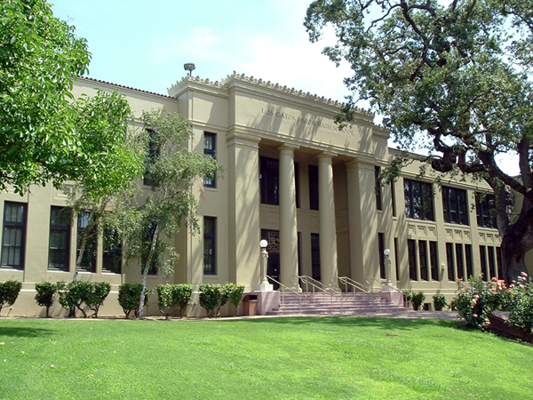
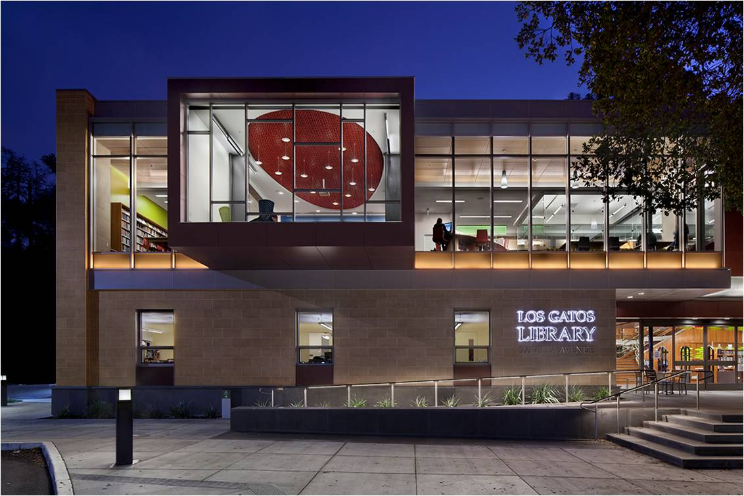

Slide 3
Los Gatos Library Teen Room

Slide 4
Developmental Assets for Adolescents
Family life provides high levels of love and support.
Young person feels safe at home, school, and in the neighborhood.
Young person reads for pleasure three or more hours per week.
Young person perceives that adults in the community value youth.
Young person accepts and takes personal responsibility.
School provides clear rules and consequences.
Young person receives support from three or more nonparent adults.

Slide 5
Wouldn’t it be great if…..

Slide 6
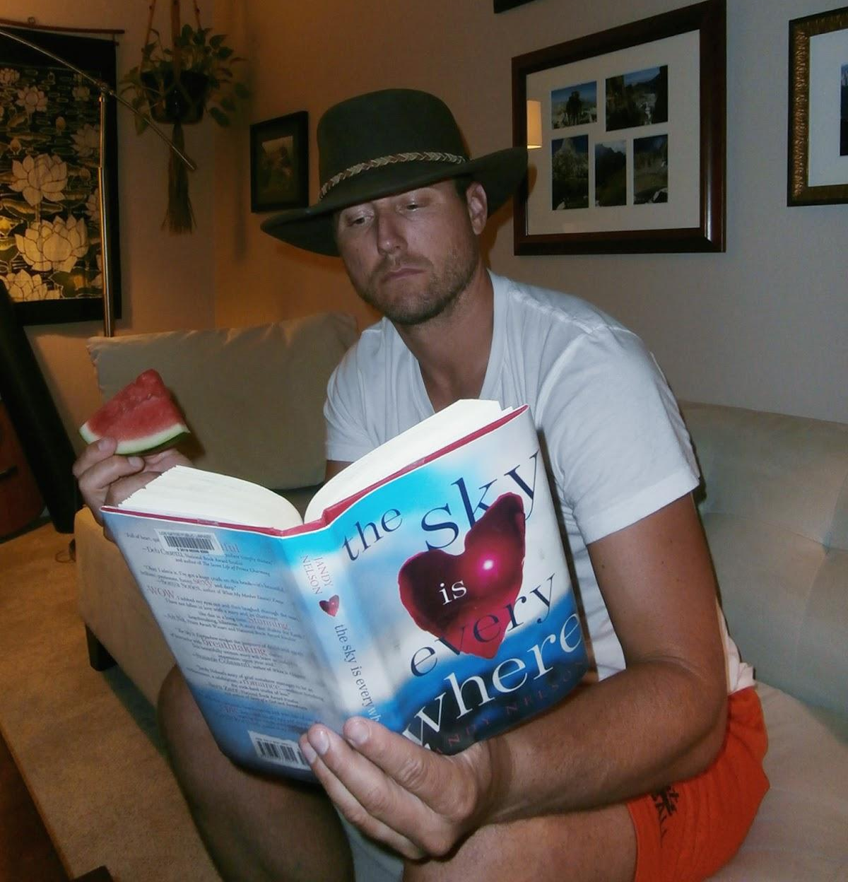
Andy, a.k.a. Mr. Holland
football coach
Heidi’s neighbor
LGHS English Teacher
new Jandy Nelson fan

Slide 7
grown ups
+
teen novels
+
social media
__________________
Reverse Required Reading

Slide 8
Describe the book in a sentence.
Did you like it?
How was it different than you expected?
If someone likes this book, they would also like…. (could be books, mags, music, TV shows, movie, anything really.)

Slide 9
Los Gatos Town Employees

Slide 10
You have been hand-selected….
Because of your significant place in our community….
This unique program pairing local, well-known community members with one of our most popular teen novels….
If you choose to accept this honor…..
We would love for you to help us make this a true community event.
Please let me know if you are interested.

Slide 11
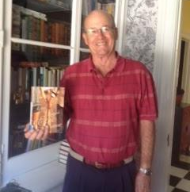
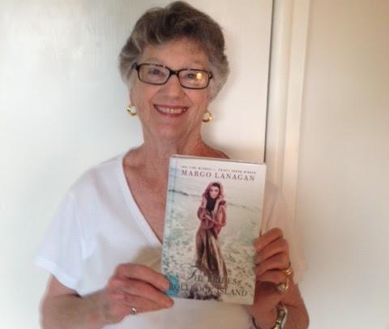
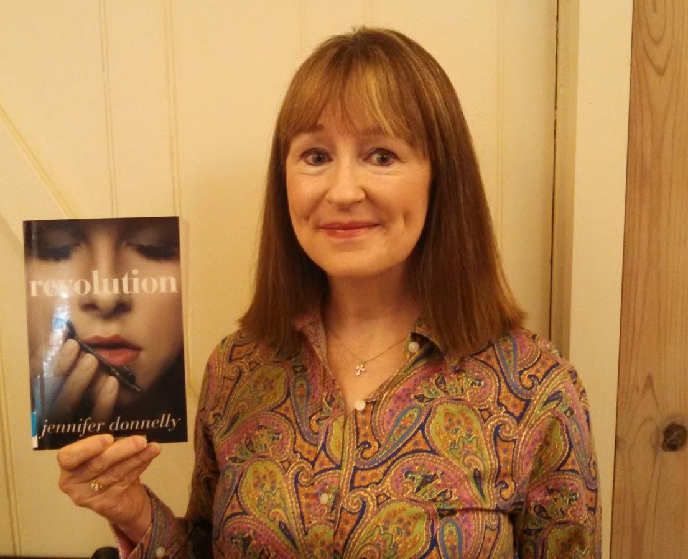
Los Gatos Library Board Members

Slide 12
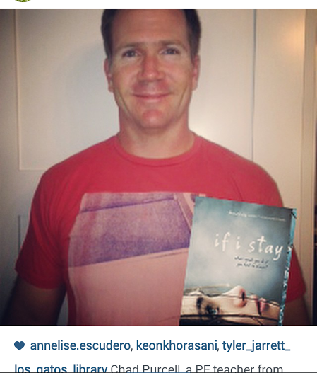
Local Teachers

Slide 14
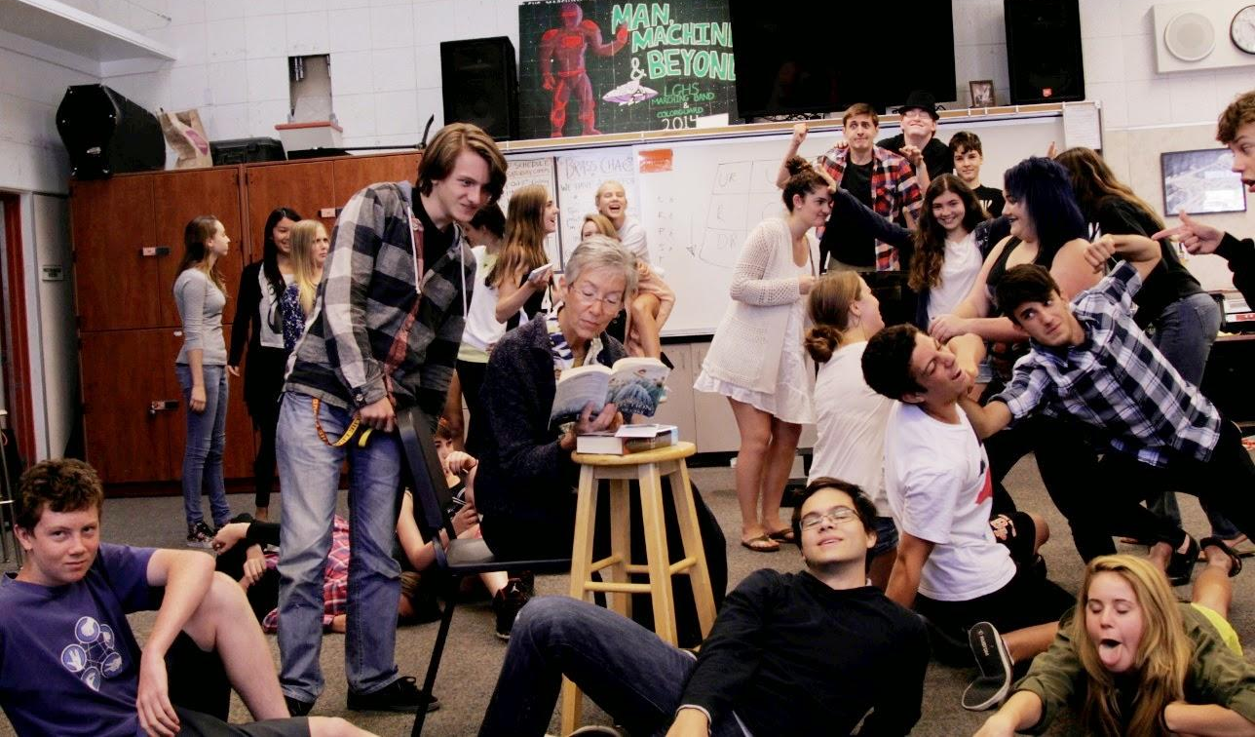

Slide 15
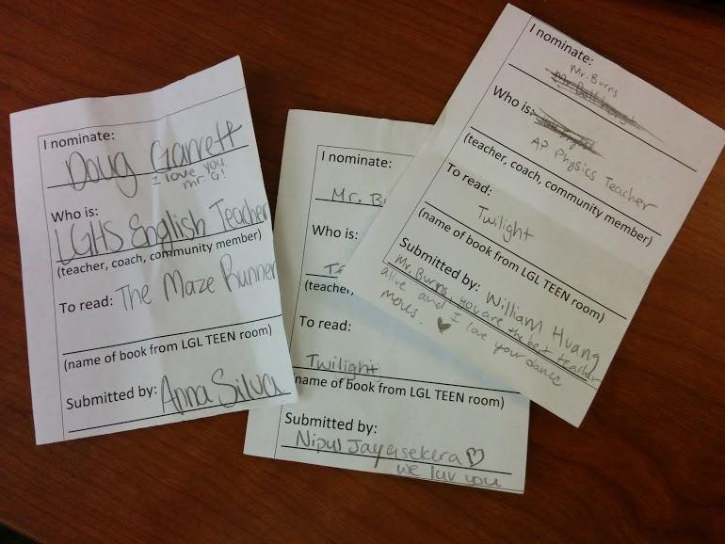

Slide 16
about three months in
29 adults asked to read
18 adults who said “YES!”
13 adults completed assignments to date
40 Instagram followers
50+ nominations
loads of goodwill generated

Slide 17
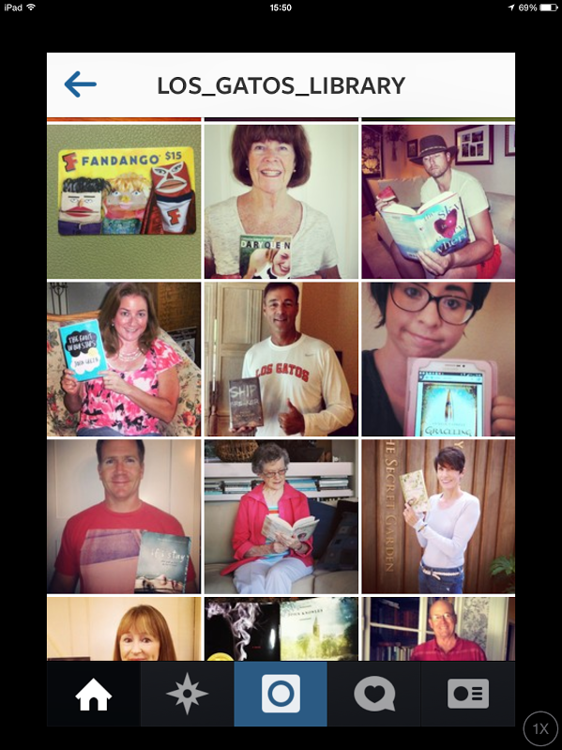
los_gatos_library

Slide 18
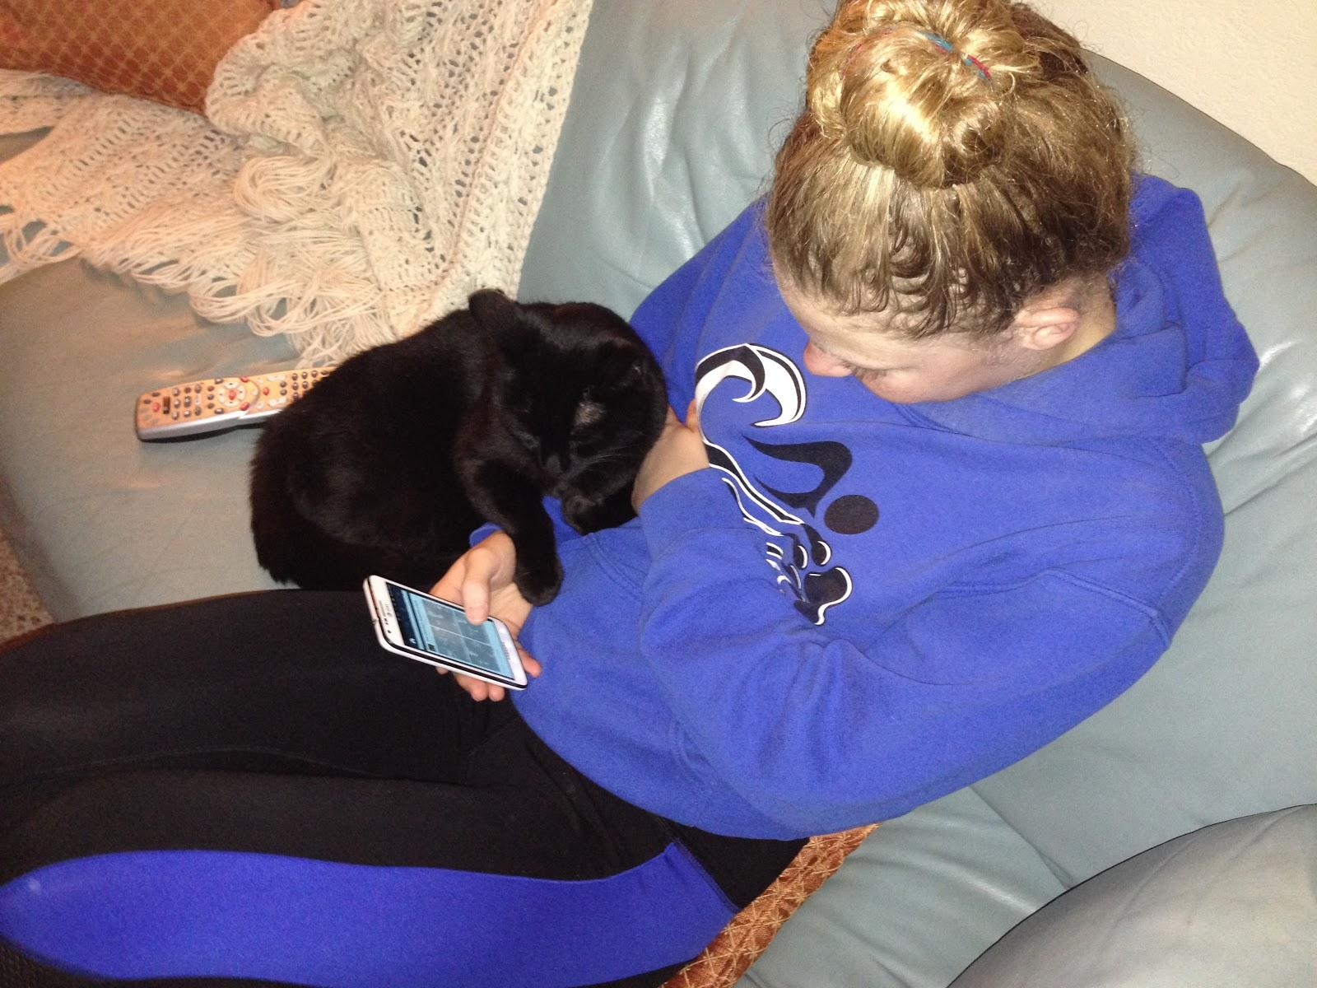

Slide 19
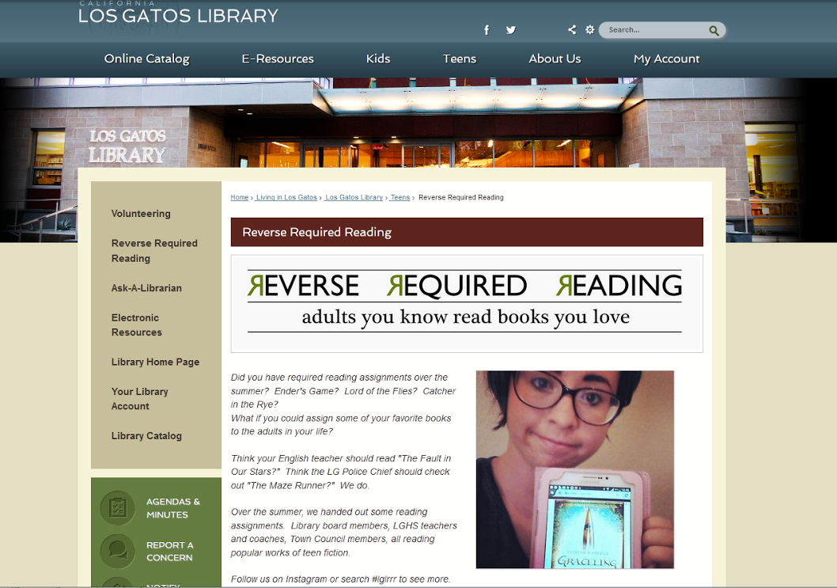

Slide 20
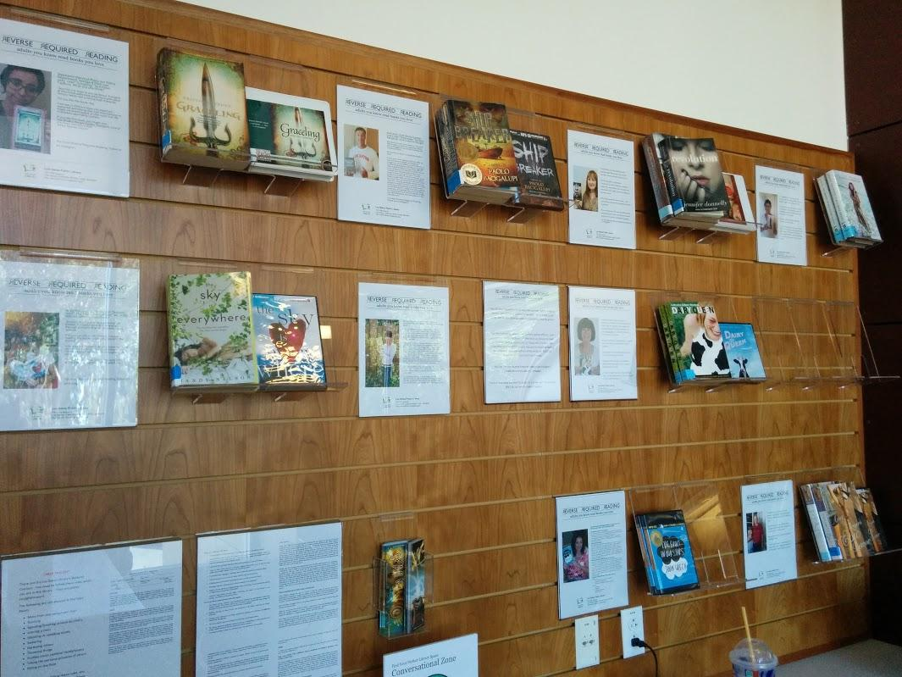

Slide 22
community member & other community members
teen & lib staff
one RRR
nomination
teen & community member
lib staff & community member

Slide 23
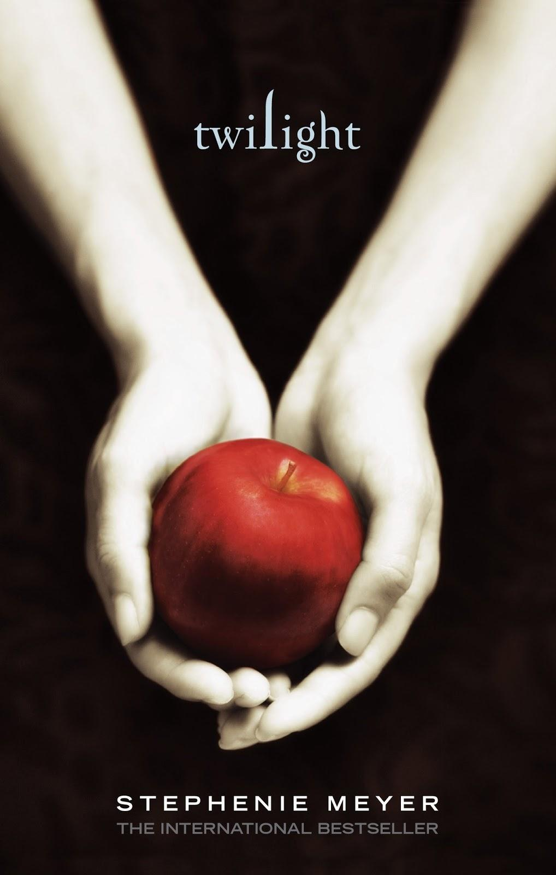
YA Lit
>

Slide 24
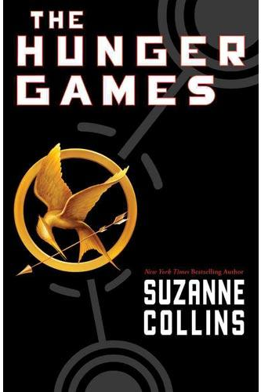

Slide 25
How was the book different than you expected?
I didn’t expect the book to cover as many serious issues as it did
I did not expect to encounter such mature references that were made throughout the novel.
I loved that the characters were intelligent and articulate – that they made literary references
Am I allowed to say it was much better than I expected?? I thought it was well­-written and the characters and themes well­ developed.
I was surprised at how well written it was. I loved this book for it’s emotional depth.

Slide 27
Lessons Learned
Be open to a variety of success markers
Store up some responses before you start
Think about the photos
Think about “reports” and who will read them, and where

Slide 28
Things to try next….
Way to nominate parents
Photo nominations?
Book groups
Work in local businesses
Incorporate volunteers

Slide 29
jlaredo@losgatosca.gov
our RRR webpage: http://www.losgatosca.gov/2162/Reverse-Required-Reading
(includes a link to our draft social media policy!)
our Instagram page: http://instagram.com/los_gatos_library

