Slide 1
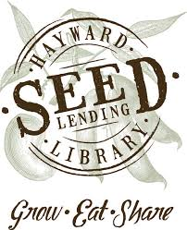
What Does It Take? Building and Maintaining a Seed Lending Library
Lindsey Vien & Sally Thomas
Hayward Public Library
The Future of Libraries - October 14, 2014
San Francisco Public Library

Slide 2
Roots: Farm City Book-to-Action, 2011
Notes:
The roots of the Hayward Seed Lending Library started back in 2011, when we launched our first Book-to-Action series with Novella Carpenter’s fantastic book Farm City: The Education of an Urban Farmer.

Slide 3
Novella Carpenter Shares Oakland-Based Story
Notes:
We hosted the author at a standing-room only event.

Slide 4
Great Community Interest in Urban Farming
Video: http://youtu.be/tOkDOYR5Pb4
Notes:
The community response showed an intense interest in not only Novella Carpenter’s story, but also in urban farming.

Slide 5
Partnership with Ochoa Middle School, Project EAT & Others
Notes:
The Book-to-Action program model brought us out in the community, partnering with Project EAT, an initiative that brought school gardens and nutrition education into Hayward Unified School District. Students from Ochoa Middle School made a presentation about their garden at the event.

Slide 6
Community Garden Work Day
http://booktoaction.library.ca.gov
Notes:
We worked with the students to organize community members to participate in a community garden work day in their school garden. (Learn more about Book to Action at BtoA website.)

Slide 7
Rebecca Newburn & Richmond Grows Seed Lending Library – launched 2010
http://www.richmondgrowsseeds.org/
Notes:
The Richmond Grows Seed Lending Library got us started in 2012 by giving us a few big grocery bags full of a variety of their surplus seeds. The library that helped and inspired us the most is Richmond Grows in Richmond, California – not far from Hayward! Richmond Grows is, I believe, the first seed library in a public library and they were started by a Transition Initiative group, Richmond Rivets, when they approached the library with their seed saving enthusiasm and know-how and asked about a partnership. They have an excellent educational and supportive web site that gives the basics about everything from what kinds of seeds to start with to general guidelines for saving. Keep in mind that in the Richmond model, the library is the host and that the Rivets maintain the seed library with volunteers and donations. Highly recommended. Pictured here is Rebecca Newburn – she’s a math teacher by day, and a seed lending library advocate at all other times. She has had a national influence, and has been extremely supportive of us. If you are interested, she will be leading an Advanced Seed Saving class next Tuesday night at the Richmond Library. I will be attending, along with several Hayward Seed Lending Library volunteers.

Slide 8
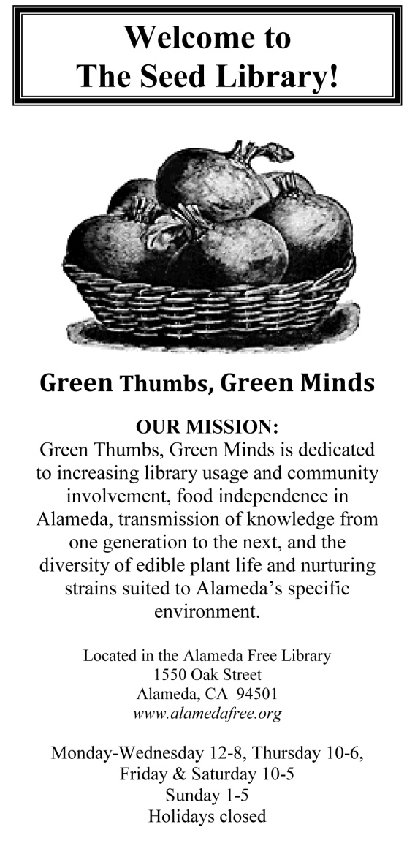
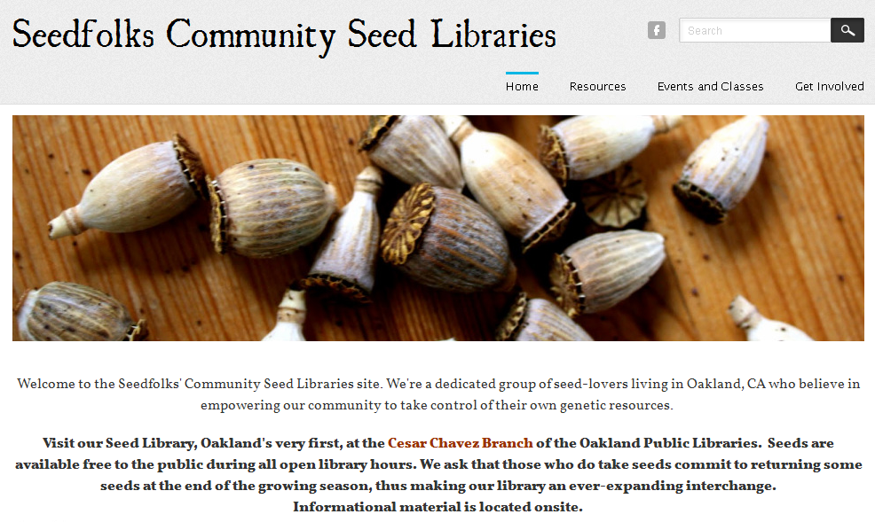
Growing Movement in Public Libraries – Near and Far
JUST A FEW EXAMPLES
Near:
Oakland
Alameda
Far:
La Crosse, WI
Notes:
Culture of sharing resources among seed lending libraries. Very supportive. La Crosse Public Library – Wisconsin’s first seed lending library, influenced greatly by Richmond Grows Library. Other Seed Lending Libraries in the Bay Area include Alameda Free Library’s “Green Thumbs, Green Minds.” And Oakland Public Library’s “Seedfolks Community Seed Libraries” at its Cesar Chavez Branch.

Slide 9
Seed Lending Library Social Network - http://seedlibraries.org/
Notes:
Sowing a Culture of Interdependence: “Share resources, build connections, co-create networks.”

Slide 10
Seed Lending Library Social Network – Member Map

Slide 11
The Seed Library Start-up Tool Kit – Downloadable Resources on DropBox

Slide 12
http://seedlibraries.weebly.com/

Slide 13
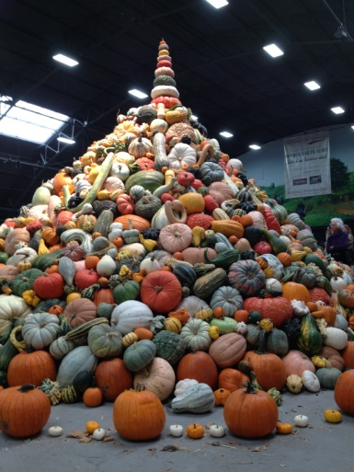
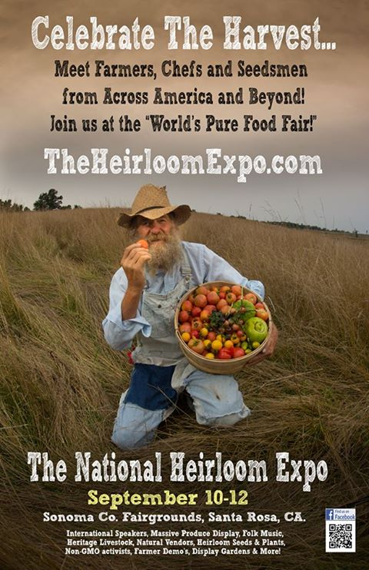
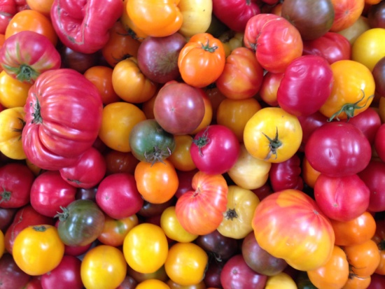
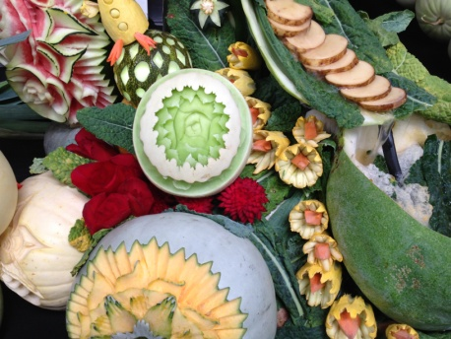
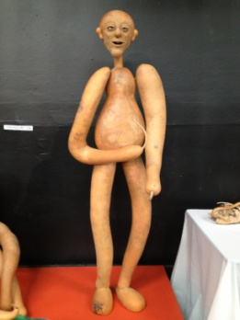
Seed Summit @ National Heirloom Expo Sonoma County – September 2013
Notes:
Rebecca Newburn has convened a “Seed Summit” – an opportunity for Seed Lending Libraries to connect and share information and discuss challenges at the National Heirloom Expo in Sonoma. This year’s Seed Summit meeting took place last month.

Slide 14
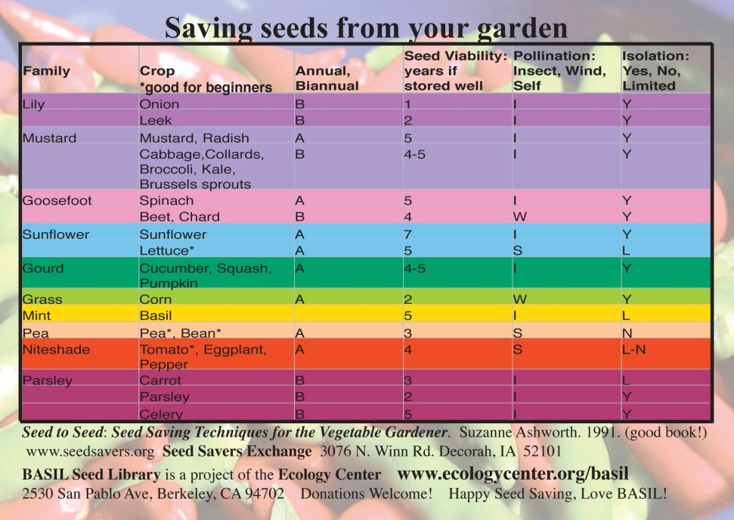
Bay Area Interchange Seed Exchange – Berkeley, California
Notes:
Culture of sharing resources with experienced community centers like BASIL.

Slide 15
Recycling Hayward Public Library’s Old Card Catalog
Notes:
Our library director Sean Reinhart had the brilliant idea to recycle an old card catalog, which had been in storage for years. It was a perfect repurposing project.

Slide 16
Volunteers: Essential Ingredient
Nancie & Gail: Alameda County Master Gardeners

Slide 17
We Did It! Hayward Seed Lending Library

Slide 18
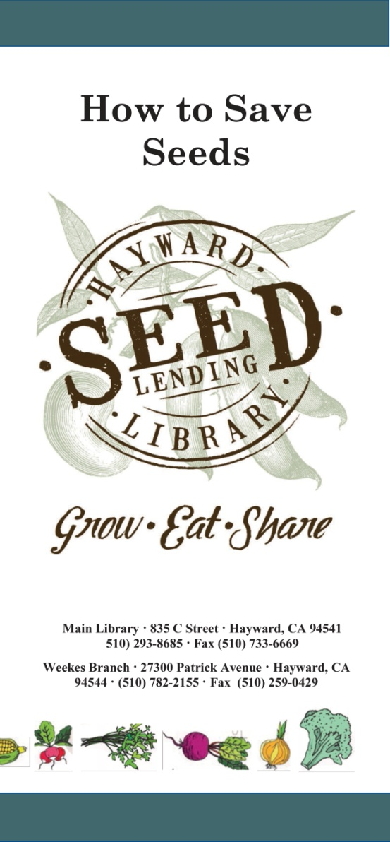
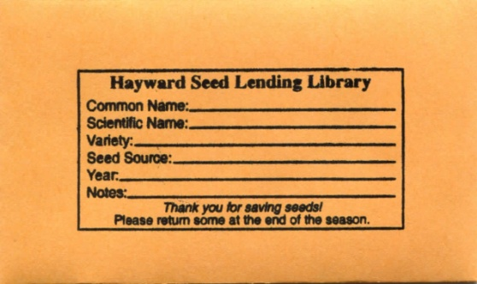
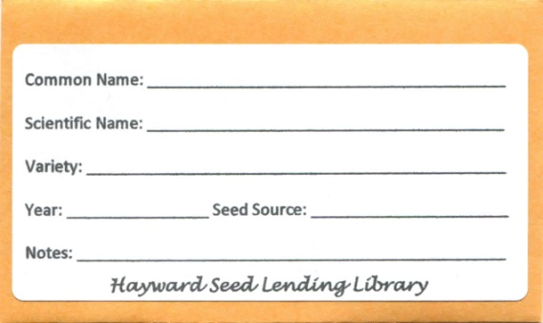
“Getting Started” Brochures & More

Slide 19
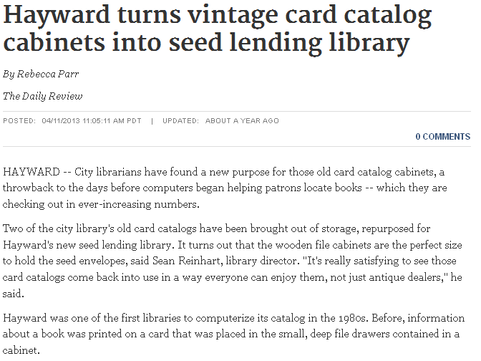
“Seed Read” – Variety of Events & Press Announce Resource to Community

Slide 20
Hayward Seed Lending Library Launch: “Seed Read” April 2013

Slide 21
Skype Conversation with Janisse Ray, April 2013

Slide 22
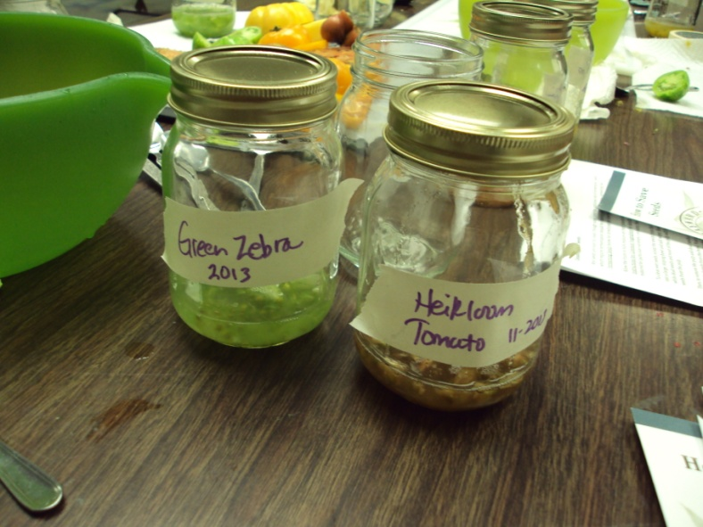
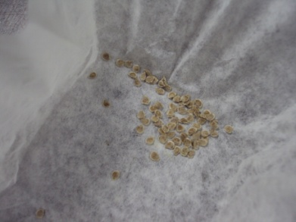
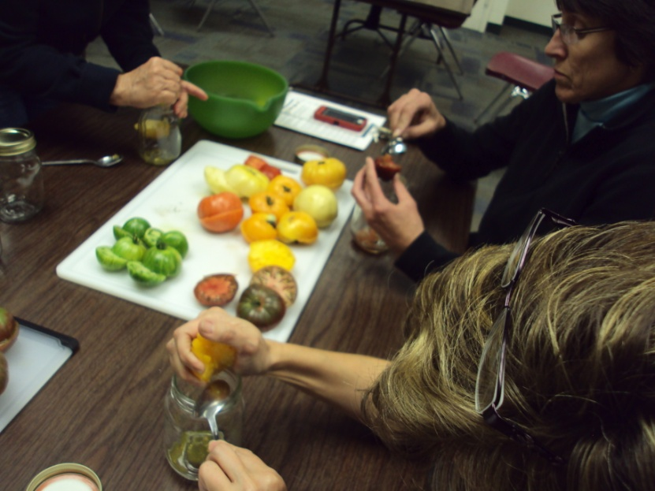
Ongoing Workshops
“Wet” Seed Saving Workshop, Nov. 2013

Slide 23
Sustaining Volunteer Involvement

Slide 24
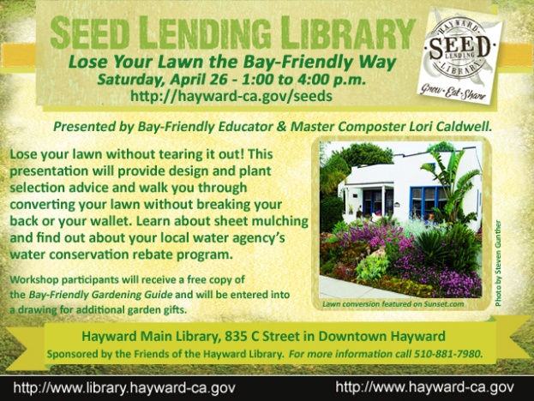
Bay Friendly: Lose Your Lawn Workshop – April 2014

Slide 25
Seed Savers & Gardeners’ Club – Launch May 2014

Slide 26
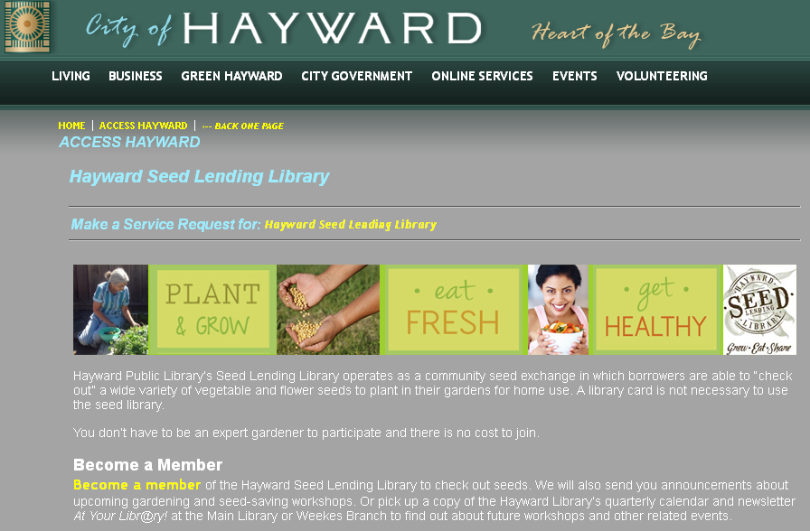
“Access Hayward”: CRM Page Website & Ongoing Press
http://hayward-ca.gov/seeds
Tri-City Voice free weekly paper

Slide 27
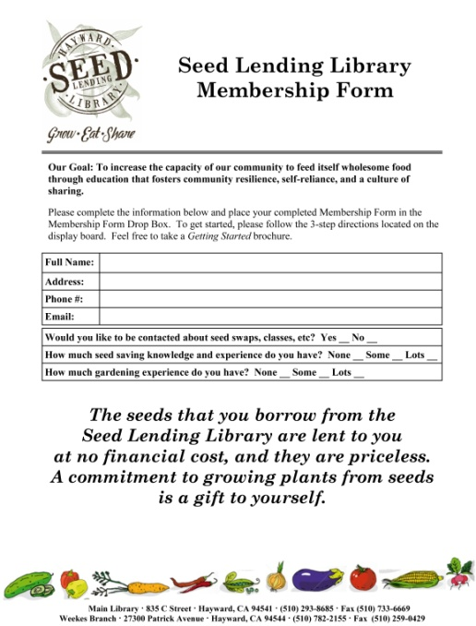
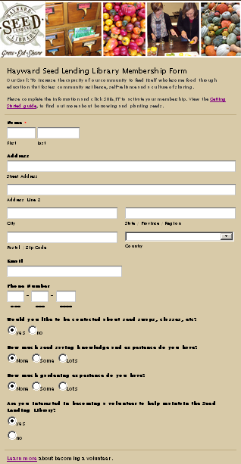
Developing Infrastucture – Started with Paper membership for
Started with paper-based membership form in 2013. Upgraded to online membership form in 2014, using Wufoo.

Slide 28
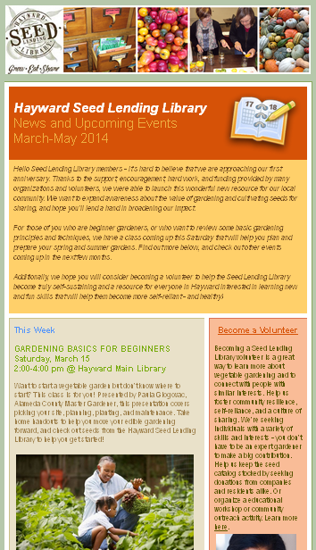
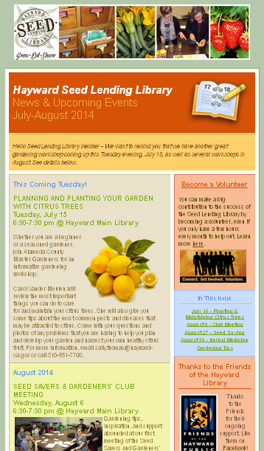
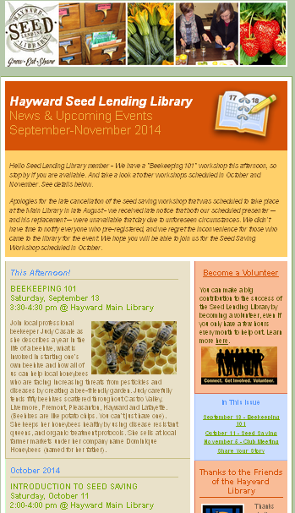
Using Constant Contact

Slide 29
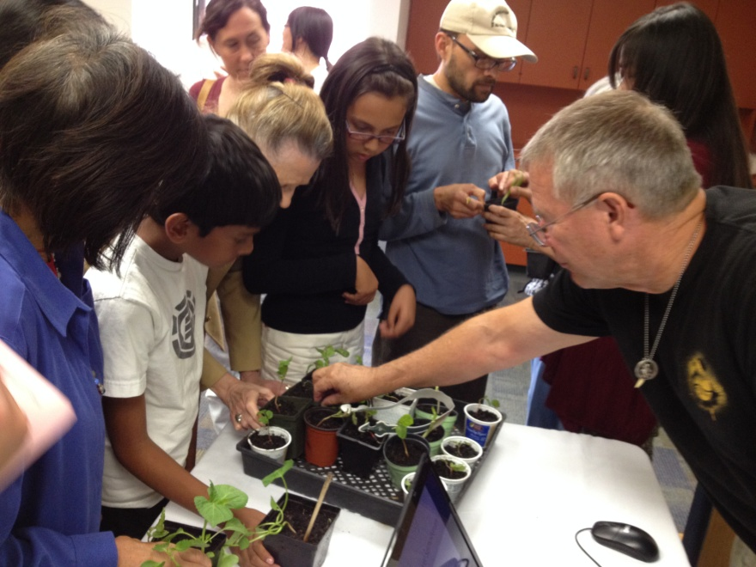
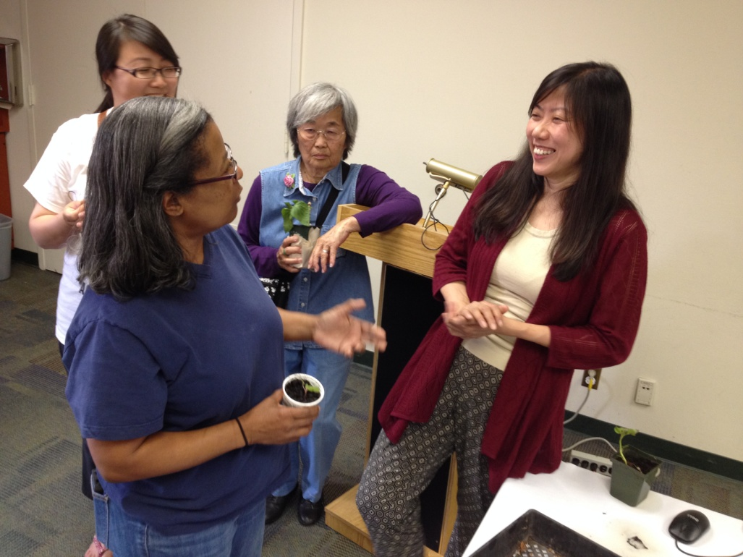
Growing Plants from Seeds Volunteer Presenter: Cheryl Tan – June 2014

Slide 30
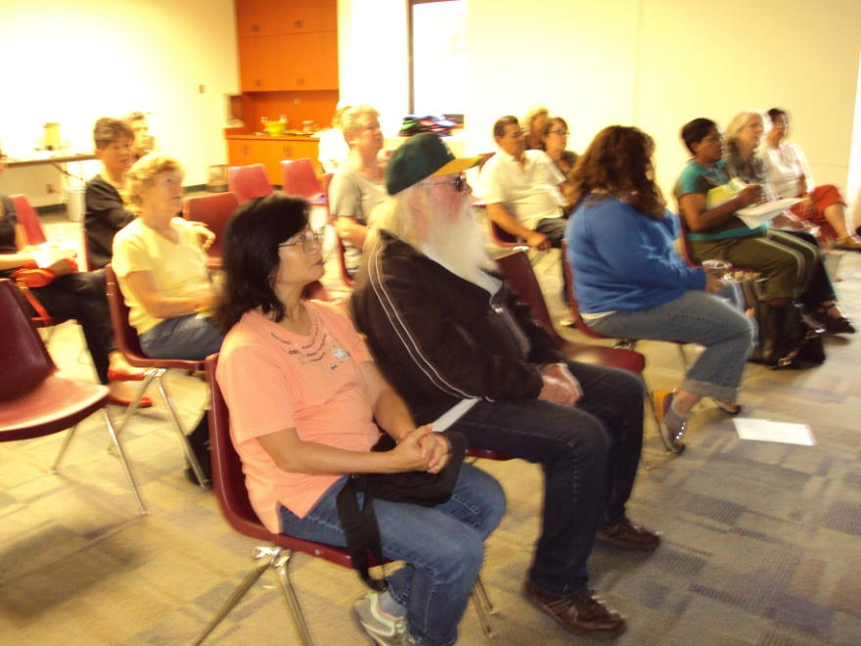
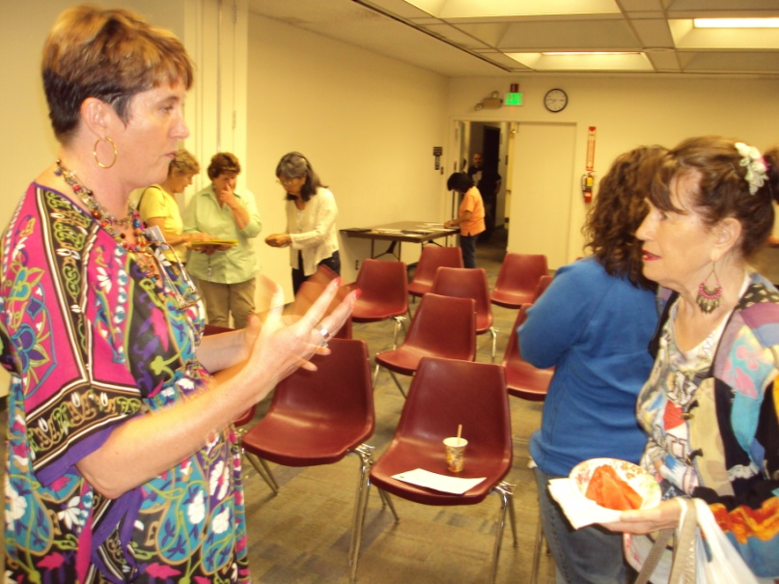
Planning & Planting Citrus Trees Alameda County Master Gardeners, July 2014

Slide 31
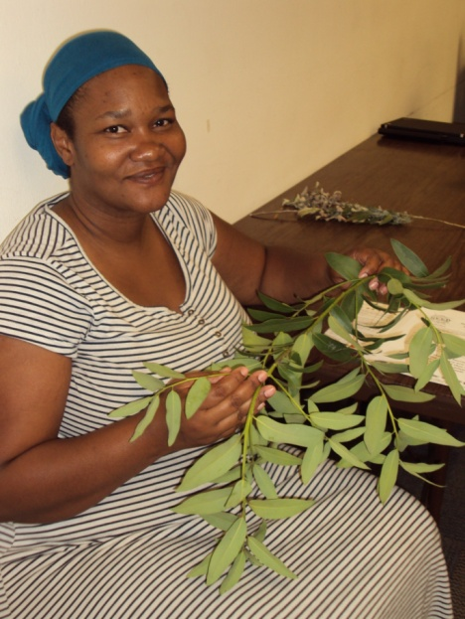
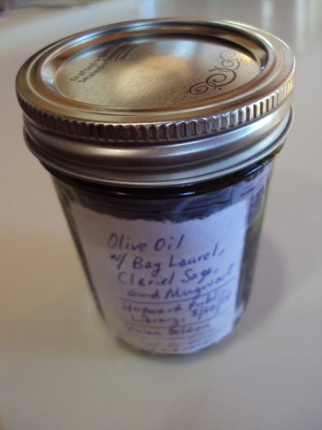
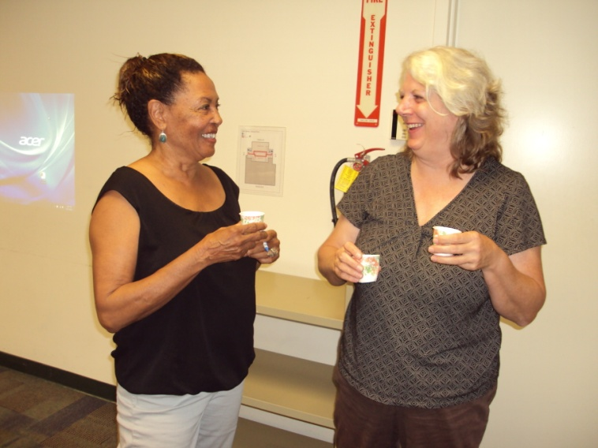
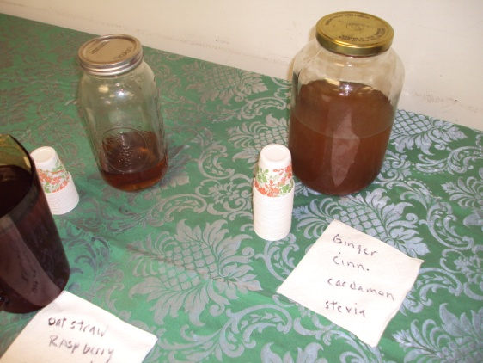
Intro to herbal medicine & Teas Volunteer Presenter, Aug. 2014

Slide 32
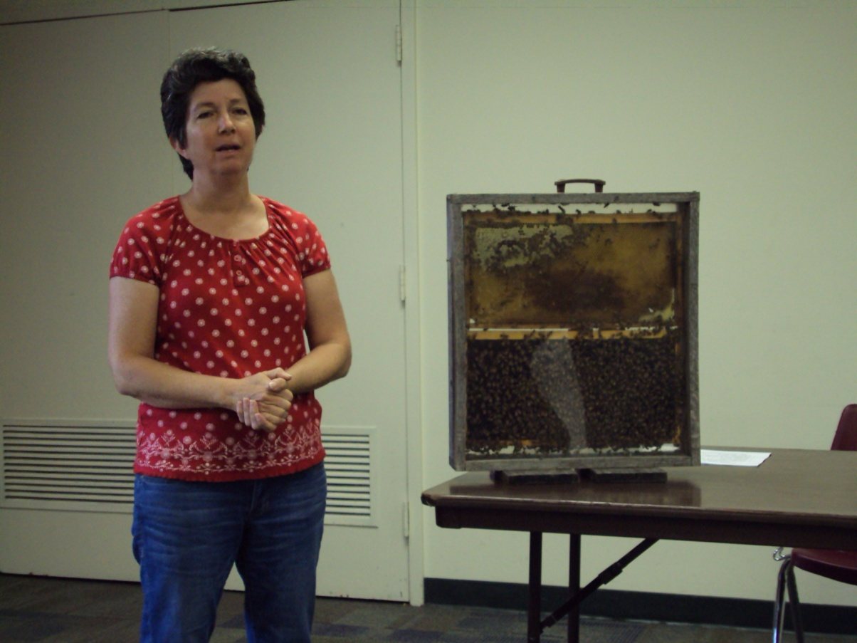
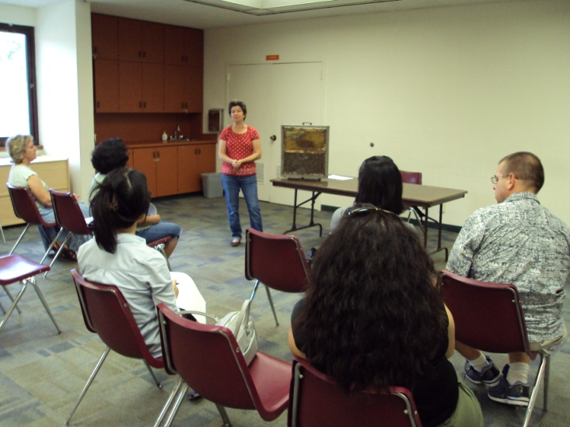
Beekeeping 101 Workshop, Sept. 2014

Slide 33
Why Save Seeds?
Notes:
The importance of the term heirloom seed. The seeds we collect and save are seeds that have been in families for generations and communities for generations, seeds that have traveled far and wide in the pockets of immigrants, seeds from our ancestors that have come down to us—and now we can share them. They are seeds that grow true to themselves over and over again and best of all seeds that are free to borrow, books, and return and share... Just like favorite books. So yes!!, a Seed Library, and we’d like to share with you the path of our research and how it took us kind of in a faraway circle and then right into our own back yard.

Slide 34
Heirloom vs. Hybrid
Notes:
Let’s start with the basics. An heirloom plant (or open-pollinated) is one that breeds true from seed, meaning that the seeds from the parent plant will grow off-spring with the same characteristics. Heirloom varieties at open-pollinated varieties with a long history of being cultivated and saved within a family or group.
A Hybrid variety does not breed true from seed; hybrid seed is produced by crossing 2 different parent varieties of the same species. Hybrids do not remain true in generations after the initial cross and cannot be saved from generation to generation unchanged.
Genetic modification is direct human manipulation of an organism’s genetic make-up resulting in genetically modified organisms or GMOs. Today, most conventional soybeans, corn, and cotton have been genetically modified to exhibit traits that repel pests or withstand the application of herbicides.

Slide 35
Plant Species are Threatened with Extinction
Notes:
We are dependent on plants for everything from food to fiber and shelter. It is estimated that 60,000 to 100,000 plant species today are threatened with extinction and that 75% of our crop genetic diversity has been lost in the last 100 years. When a plant variety disappears, its potential to aid us in the future is lost forever. Without deliberate efforts to save seed varieties before they disappear, the global community may be vulnerable to calamity. Now that we have told you the “why” we will take about the “how”.

Slide 36
Seed Savers Exchange
Notes:
Seed Savers Exchange is one of the largest non-governmental seed banks in the United States. They are a national leader in the heirloom seed movement and a strong advocate for the protection of the earth’s rare genetic food stocks. Seed Savers has been instrumental to the creation of the seed libraries across the country. They have been very generous in sharing their resources and expertise.

Slide 37
Choosing Heirloom Plants
Start out with seeds that are easy to grow and easy to save.
Learn about cross pollination for each species you have and the recommended distance between plants
Some plants are biennials.
Dry seed saving vs. wet seed saving
Keep track of FAMILY, genus, and species for the seeds you have.

Slide 38
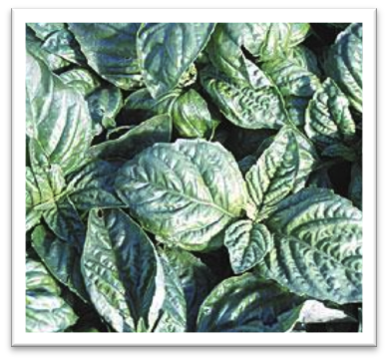
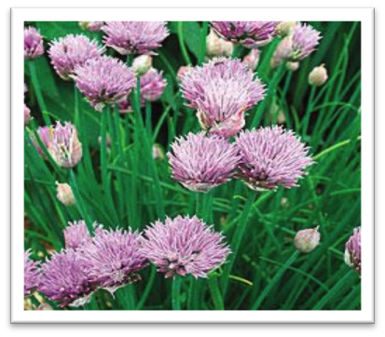
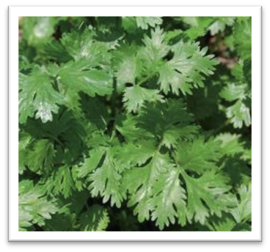
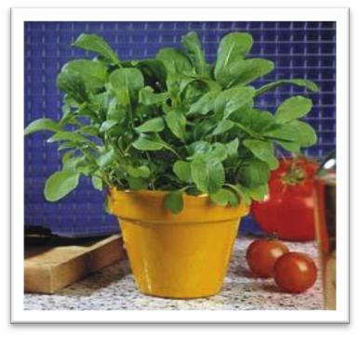
“Easy” Seeds: Self-Pollinating
Herbs
Basil, Purple Opal
Basil, Lettuce Leaf
Chives
Arugula
Cilantro
Notes:
The seeds that are considered “easy” are species that can be planted near any other plant because they self-pollinate and will not cross pollinate. The seeds you plant will stay true to themselves and you will get the same plants again and again. They are also easy because they flower in an obvious way and the seeds can be harvested and dried quite easily. The key is to start with and stick to these types of seeds until you can provide good education about more difficult seeds, or tap into experienced gardeners who will make the extra effort with more complicated seeds.

Slide 39
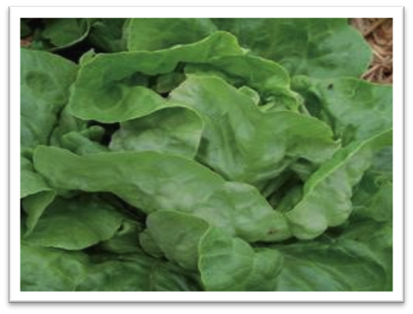
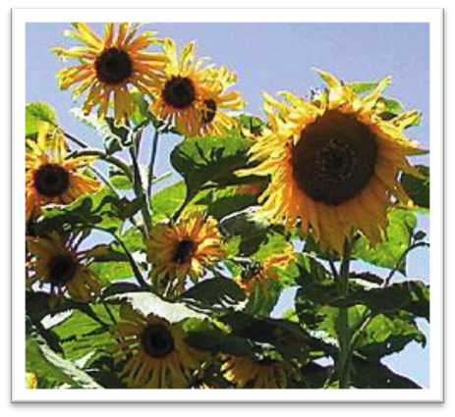
Easy Seeds to Cultivate: Lettuce & Sunflowers
Lettuce (Self-Pollinate)
Basil, Purple Opal
Ella Kropf
Sunflowers (Cross-Pollinate)
Arikara
Notes:
Lettuce is great to grow for seed. You can eat all the lettuce you want, but let one section bolt—it will shoot up and flower. The seeds of course will be in the flower. Sunflowers are also a fun plant to grow and the seed is easy go save and a good draw for birds and other wildlife. It does cross pollinate so needs be grown somewhat isolated from other varieties.

Slide 40
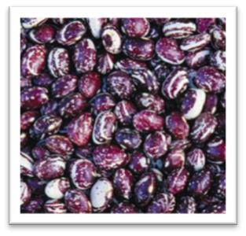
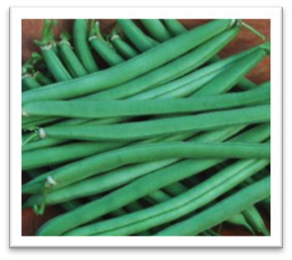
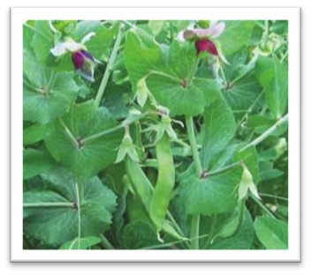
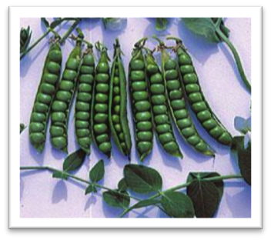
More “Easy” Seeds: Beans & Peas
Beans
Tiger’s Eye
Good Mother Stollard
Provider
Peas
Dwarf Gray Sugar
Green Arrow
Notes:
All legumes are in the easy class as well, and are great to start out with. Beans and peas are easy to grow and the seeds easy to harvest. . You’ll notice that you can grow both green eating beans and beans to dry for cooking. Most common beans do not cross pollinate, but it’s best to grow them at opposite sides of the garden.
Our beans were popular and of all the seeds, we got a lot seeds back!

Slide 41
Get Your Peeps Together! Community Support & Connections
Notes:
On the Richmond Grows web site they have section titled Get Your Peeps Together, meaning get your people together. The truth is that our ability to start a seed library came from many other sustainability movements that were already happening in our community, some that we were aware of or already connected with. La Crosse has a unique local foods movement to begin with, with many farmers markets and CSA’s and even a fresh food to school program called Grow Your Brain. For the past several years, I have been involved with Coulee Partners for Sustainability, a group that, advises local government on issues, holds education classes, and sponsor a huge annual Earth Fair. Our library has been involved in the EF for several years and this led us meet and work with other groups, including the Hillview Urban Agriculture Center, a group of citizens who have worked for the past several years to built an urban greenhouse. That project is coming to reality with a spring groundbreaking and it will be located 3 blocks from our library. We look forward to partnering with them on some very exciting projects.

Slide 42
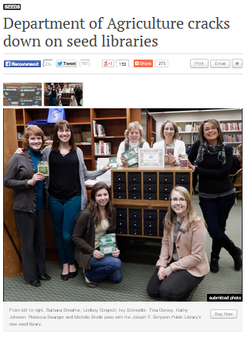
2014: Emerging Legal Challenges
July: Pennsylvania Department of Agriculture informs the Simpson Seed Lending Library that its seed sharing activity is in violation of the Pennsylvania Seed Act of 2004

