Slide 1


Slide 2


Slide 3


Slide 4


Slide 5


Slide 6


Slide 7

Photo by srgpicker - Creative Commons Attribution License https://www.flickr.com/photos/91485322@N00
Created with Haiku Deck

Slide 8

Photo by 3 Sverige - Creative Commons Attribution License https://www.flickr.com/photos/29474957@N06
Created with Haiku Deck

Slide 9
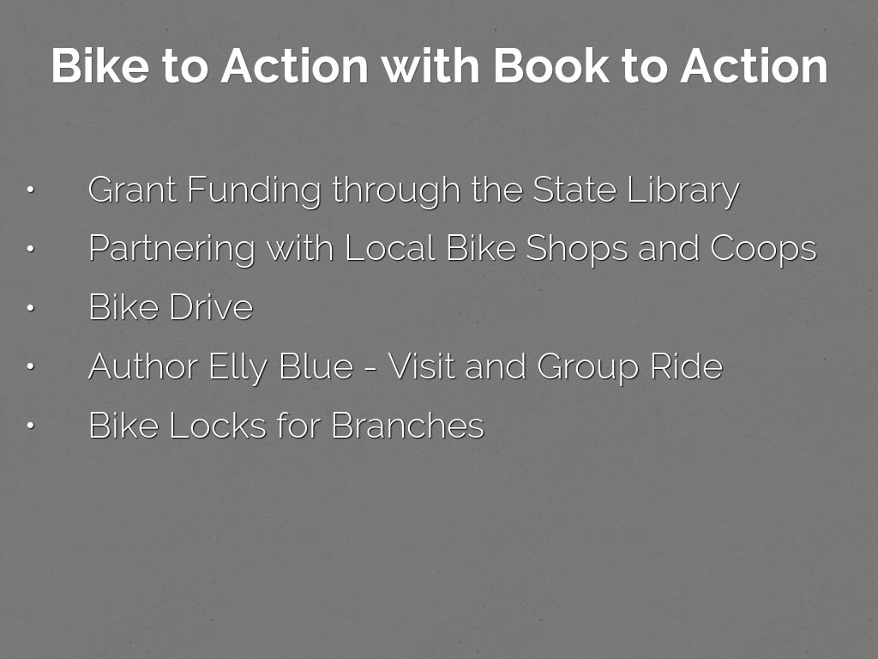

Slide 10
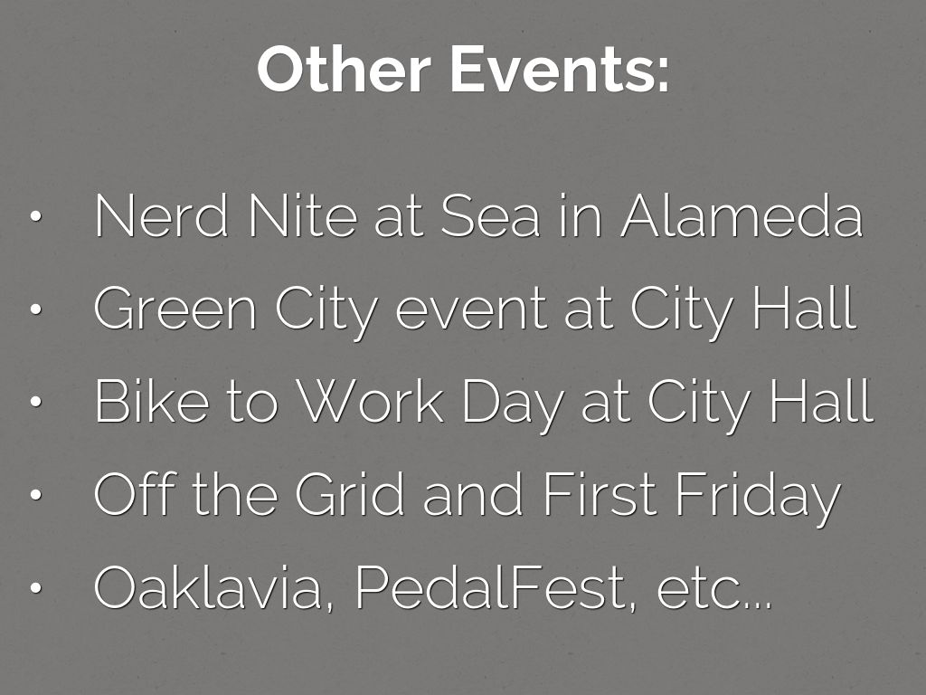

Slide 11

Photo by Nietnagel - Creative Commons Attribution-NonCommercial-ShareAlike License https://www.flickr.com/photos/13382424@N00
Created with Haiku Deck

Slide 12


