Slide 1
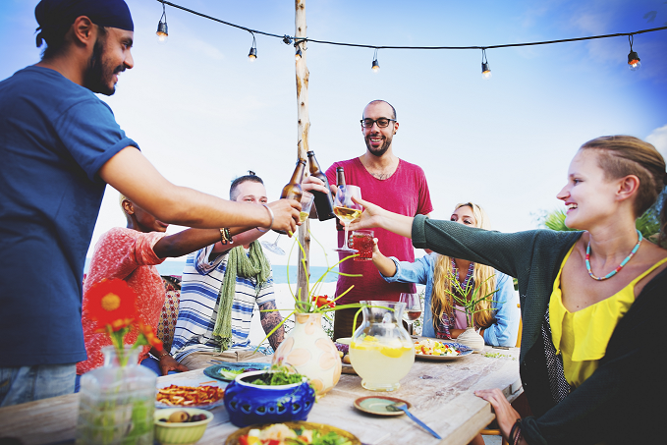
San Jose Public Library
Evolution of a Library Game Show
Outreach
to the
20s-30s
Notes:
San Jose Public Library has Non-Library Users!
A significant number are young professionals in the 20s and 30s.
Our strategic priority is to boost awareness of library services and programs.

Slide 2
Reaching Non-Library Users
The Idea: Develop a program for them and they will come to our branches to see we’re cool!
Conduct Surveys, interviews, focus groups
Develop a Program that interests them based off of results from surveys and interviews
Promote the program using memes, sidewalk chalk art, create a cool video, use Meetup.com, Facebook, Twitter
Watch them come into the libraries!
Notes:
Thursday Night Insight Upcycle Craft was presented in iterations
1 day of planning and promotion
1 week of planning and promotion
4 weeks of planning and promotion
We expected a large turnout based off of the 1 week, but we were wrong.

Slide 3
Reaching Non-Library Users
The Idea: Develop a program for them and they will come to our branches to see we’re cool!
Conduct Surveys, interviews, focus groups
Develop a Program that interests them based off of results from surveys and interviews
Promote the program using memes, create a cool video, use Meetup.com, Facebook, Twitter
Watch them come into the libraries!
Notes:
We needed to go back to the drawing board and really empathize with demographic.
Empathizing meant understanding their event planning is last minute and heavily influenced by the plans of their friends.

Slide 4
Shift Focus
Get them into the library
Go Where They Are
Notes:
We needed to the shift focus from getting them into the library to going where they are.
Researched events and venues in downtown San Jose determined Trivia Night as the perfect match for the library.
Our first outreach site was Trials Pub.

Slide 5
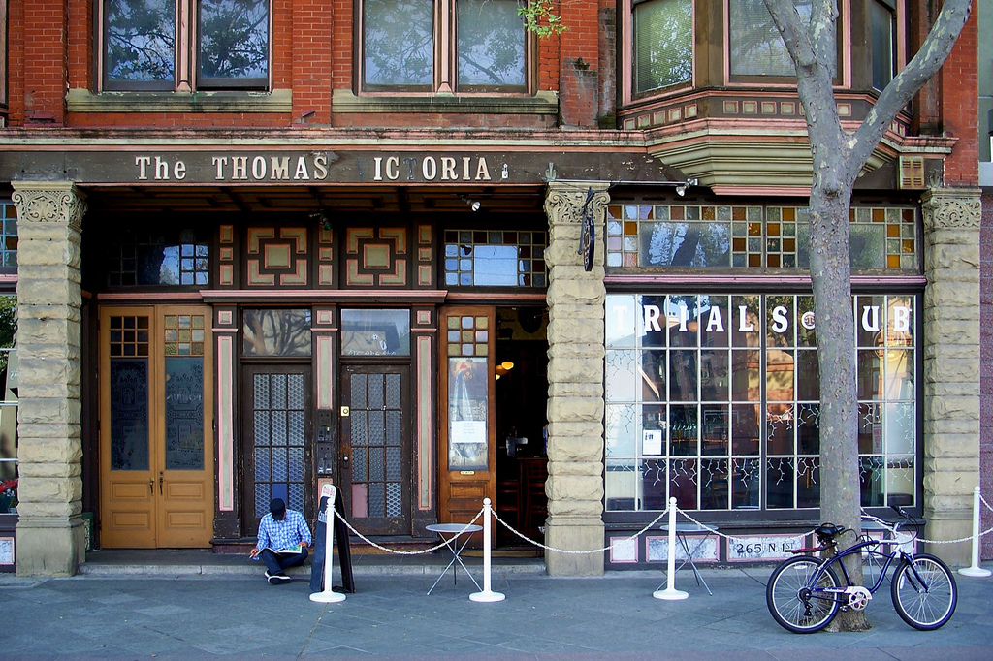
The Location:
TRIALS PUB
Notes:
Trials has a weekly Trivia Night that consists of 20 fill in the blank questions
Lucky for us we had Library staff that knew some of the Trials Pub staff
Those connections provided the foundation to pitch Ask A Librarian Trivia Night

Slide 6
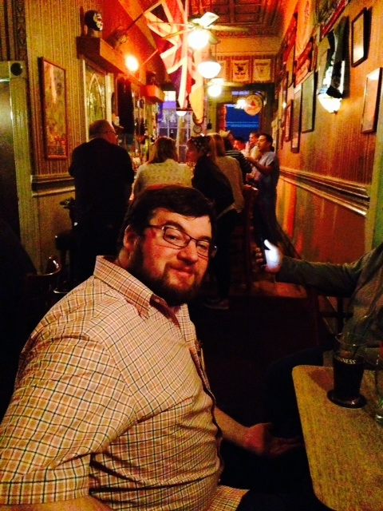
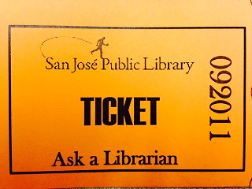
The Prototype:
Ask a Librarian
Notes:
Ask A Librarian Trivia Night
Trivia Night participants can receive assistance from the Library Team on 1 question
BUT they must answer a yes/no survey question about their library usage or knowledge.

Slide 7
Trials Trivia Ticket
Have you downloaded a library eBook or eAudiobook from the library to your tablet or smartphone?
□ □ □ Yes, it’s 2015. Need I say more?
□ □ □ No way, I roll old school. It’s all about the ink and paper.
Notes:
Ask A Librarian Ticket Example
These answers are not dry, but maintain the fun and relaxed atmosphere of the trivia night.

Slide 8
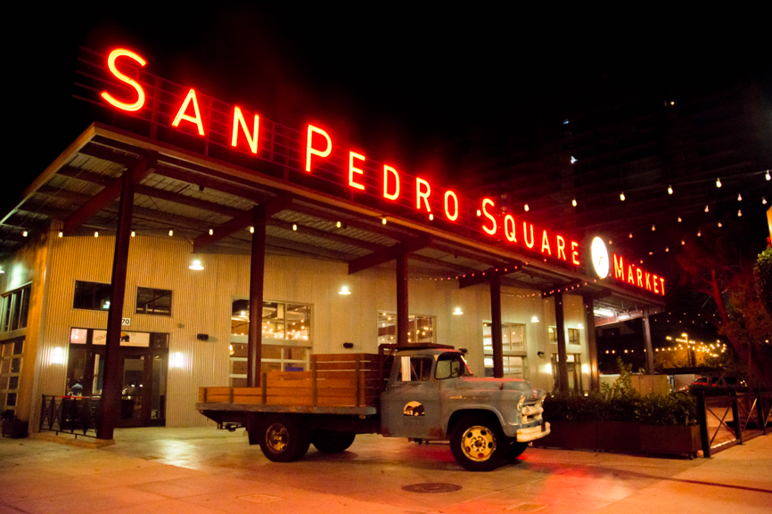
The Location:
San Pedro Square Market
Notes:
Our next outreach site is San Pedro Square Market
San Pedro Square Market has over 20 vendors for eating and drinking and is hot spot for live music.
The Library already had a partnership with SPSM through its monthly music and movement events.
This is the original site of SJPL's library game show...

Slide 9
Notes:
Do You Know What WHAT?! A game show that combines trivia and head to head stunts.
SJPL's method address the strategic priority to boost awareness of library services and programs
to the 20s and 30s.

Slide 10
DID YOU KNOW?
We’re Signing People Up for Library Cards!
Get Yours Today!
Notes:
Similar to advertising in a movie theater we promote our library services during our staging set up time of the game show.
We have an outreach laptop to issue library cards to access library electronic resources immediately.

Slide 11
DID YOU KNOW?
There’s an App for that!
Check the catalog and renew your materials from the SJPL app!
Search for “SJPL” on the App store
Notes:
They can checkout are inventory quickly using the app

Slide 12
DID YOU KNOW?
When you donate books to the library you are helping earn funding for library programming
Notes:
Based on our interviews we had found this demographic is philanthropic
Let's move along to the crowd favorite the Stunts!

Slide 13
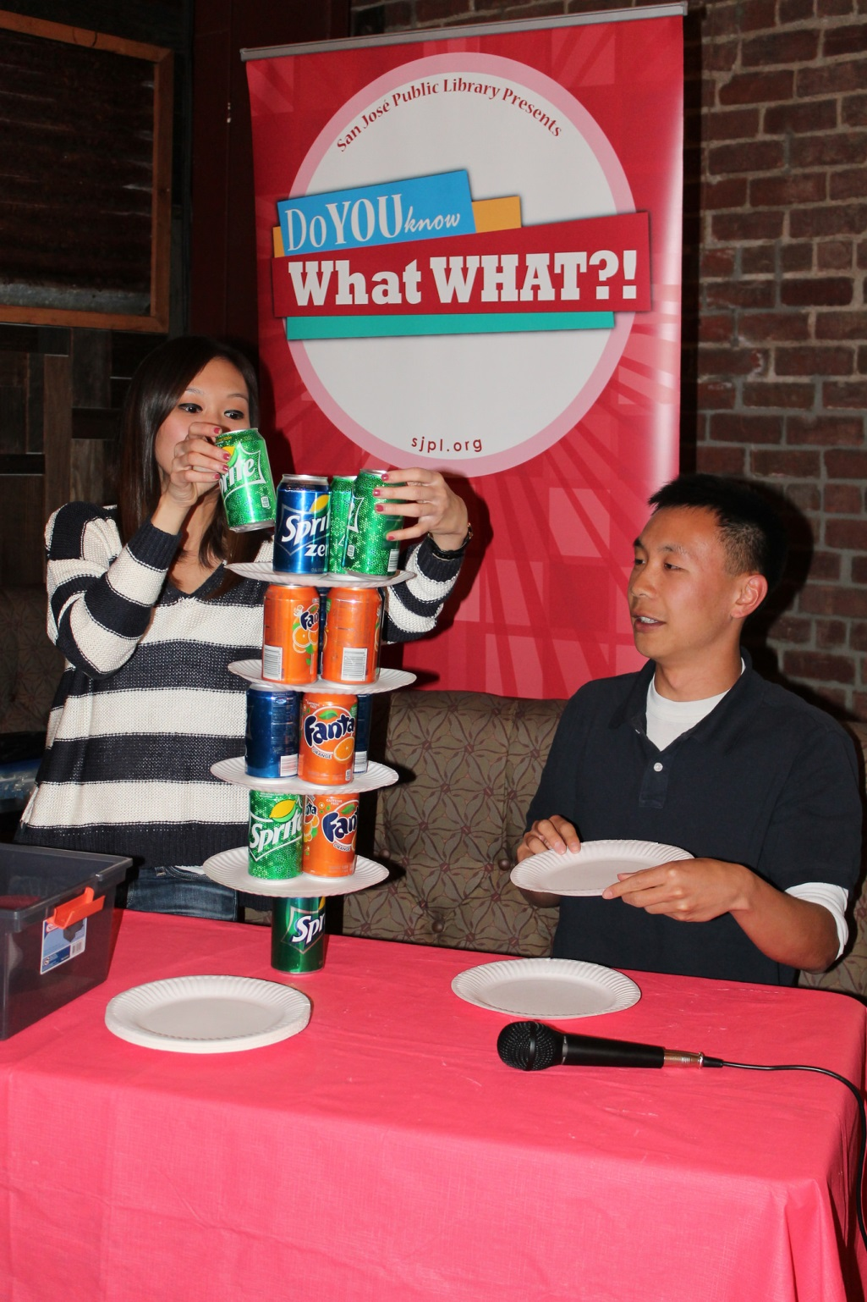
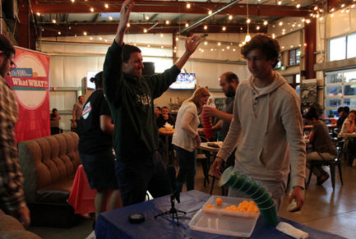
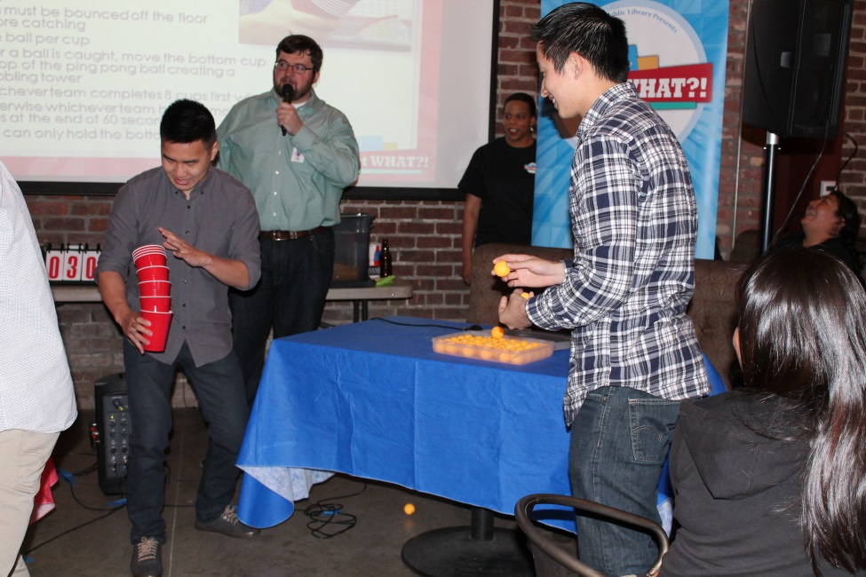
Notes:
Let's move along to the crowd favorite the stunts!
The Candelier the object is to create a reverse pyramid of 15 cans and 4 paper plates.
The next favorite head to head stunt is called Tilt A Cup
This involves bouncing a ping-pong ball on the floor and the having the partner catch the bounced ball with 8 cups that are already stacked.
The cup with the caught ball is then placed at the bottom of the stack and the catcher can only hold the bottom cup.
This process is repeated until all balls are caught and the result is a wobbly tower.
Whoever catches them all first wins.

Slide 14
What does the library service “Mango” do?
Deliver delicious fruit
Teach you over 60 languages for free
Prevent the NSA from knowing what books you check out
Streams Caribbean Music through your smart phone
Notes:
Most of you are already familiar with basic trivia questions but I want to show you examples of the Library Trivia QuestionsApproximately 10% of the trivia questions are "Library Trivia Questions" again we promote our electronic services that we believe would be relevant to them.

Slide 15
What age groups can participate in Summer Reading?
Under 6
Under 12
Under 18
Breathing
Notes:
In this Library Trivia Question we're promoting one of our biggest program which is summer reading and again the answers are fun.

Slide 16
PYRAMID OF KNOWLEDGE
Notes:
The final game to determine the winner is the pyramid of knowledge round.
Similar to the game taboo its a word or phrase guessing game.
one of the partners in the team must be the clue provider and the teammate must be the guesser.
This last round provides the losing team the opportunity to quickly gain points and potentially win the game.
So that's the game show from beginning to end.

Slide 17
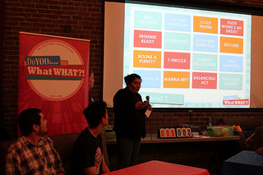
Notes:
The game show of January 2015 is not the same game show of today.
You'll notice in this image the 1st round has 16 categories.

Slide 18
Round 1
TRIVIA
SWEET SURPRISE
TRIVIA
COLOSSAL COLLECTION
RELICS
FAMOUS LAST WORDS
TRIVIA
STUNT
GAMBLING MAN
SHAKY FOUNDATION
TRIVIA
TRIVIA
STUNT
TRIVIA
QUOTABLE QUOTES
SURPRISING LATE COMERS
Round one!
Notes:
We quickly learned the participation time of the contestants needed to reduced to 8 categories because the contestants still wanted time to eat and drink:-)
LEARNING OPPORTUNITIES
labeling equipment - ex. the wireless microphone power cord was accidently switched with the wireless buzzer system power cord.
legible slides- Our first slides were the wrong color and font size to be seen from 30 ft away
scheduling- the 1st game show was the same day as a Sharks hockey game. The proximity of SPSM affected parking of the game show staff and the participation level of the game show.

Slide 19
Survey Types
Notes:
ADDITIONAL LEARNING OPPORTUNITY
Survey BurnOut or Survey Fatigue Table Trivia is great, but if you ask too many library-esque usage, attitude, knowledge questions, the participation reduces.
One question similar to Trials Trivia Night Question is best.
In addition to SPSM we wanted to present the game show in another location.

Slide 20
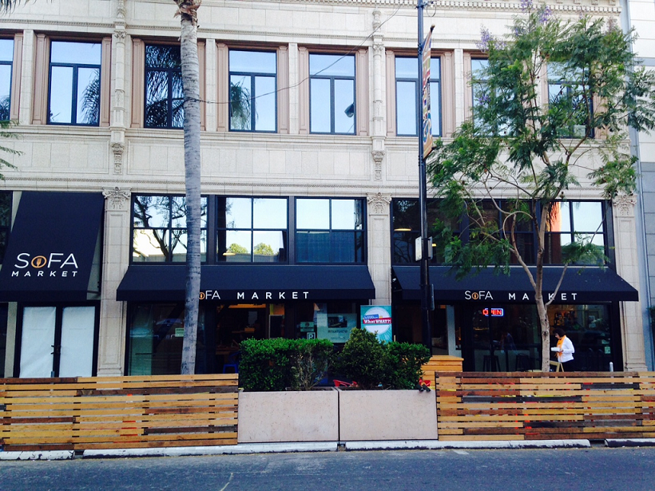
The location:
SoFA Market
Notes:
We communicated our desire to present the gameshow at a second site with the San Jose Downtown Association.
They connected us with South First Market.
South First Market is similar to SPSM but about 1/10th the size.

Slide 21
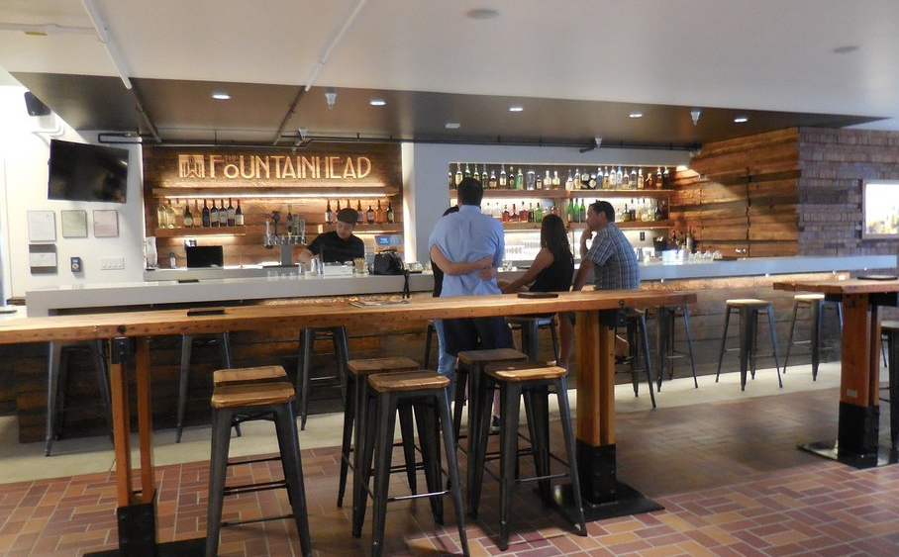
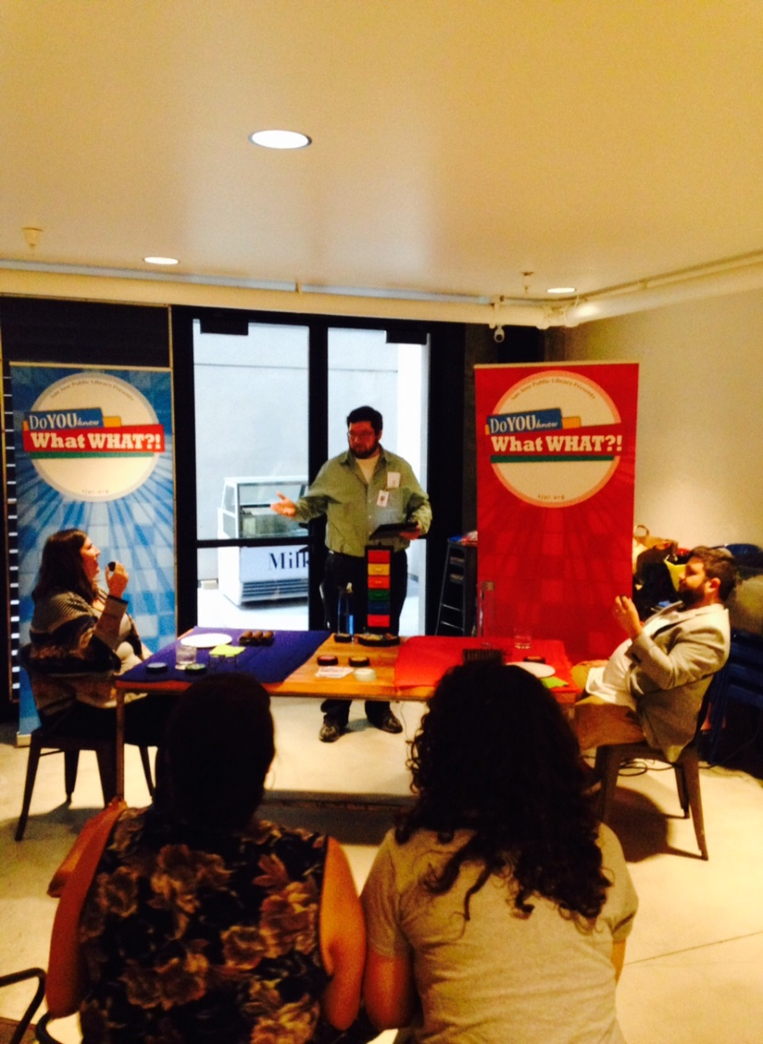
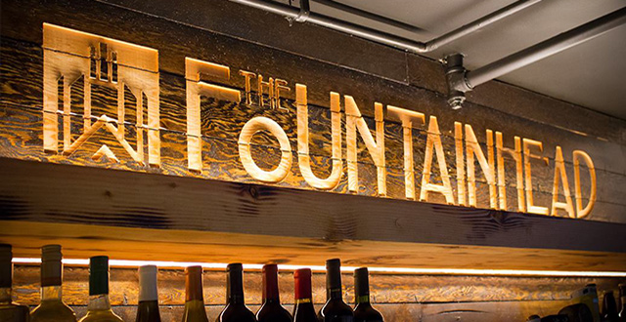
The Fountainhead
Notes:
Due to the smaller size we prototyped the SoFA Market location with 1 week of planning and promotion to determine our needs for the significantly smaller space.
We changed the types of stunts and determined that we needed to add an audio system, and use a hand-held projector
The Who's first Buzzer system enabled us the flexibility to have multiple teams and changed the scoring system.

Slide 22
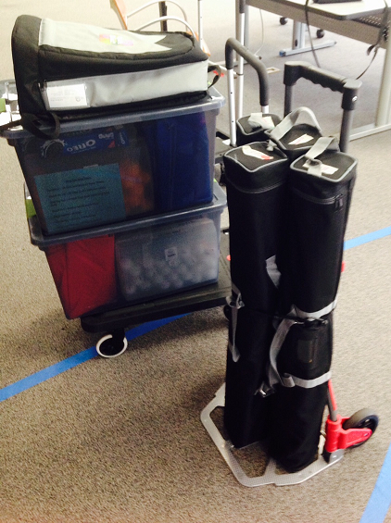
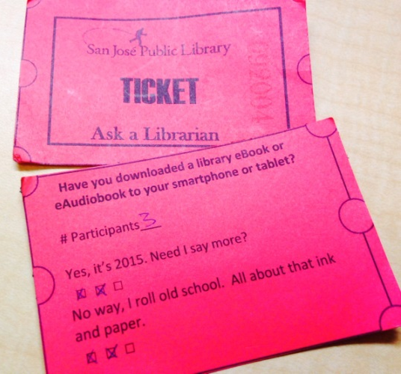
SUPPLIES & LOGISTICS
STAFFING
AUDIO / VISUAL
STORAGE
TRANSPORTATION
Notes:
If you're looking at starting your own library game show outreach program. Here are some Supplies and Logistics to keep in mind.
Staffing- 6 staff members are needed ( host, slide turner, 2 stunt set up, score keeper, and library sign-up/extra help)
Audio - Visual- Understand what equipment and electrical outlets provided by the venue and then determine what you will need.
Storage- Identify a space at your library location to store all of the stunts, staging, and equipment for the game show.
Transportation- have a plan for transporting the materials and understand the equipment you need for transporting the materials from the library to the venue to your car or public transportation depending on your situation.

Slide 23
Venues & Partnerships
Does your organization already have a partnership or connection with a potential venue?
Do any of your staff members have connections with the owners or staff you wish to partner with?
Have a proposal that is open and fair for the library or business to end the partnership and determine an agreed upon deadline for continuation or review.
Keep open lines of communication before, during, and after events to maintain a healthy relationship.
Notes:
Your Library Network is critical to securing a venue.
Here are some questions to ask and communication rules to keep in mind.

Slide 24
Game Show Takeaways
Seek Partnerships within Library Network
Prototype to find out what’s working
Try, Try, Again !
Notes:
Game Show Takeaways

Slide 25
Questions or Comments?
Contact e-mail
nancy.donnell@sjlibrary.org

