Slide 1
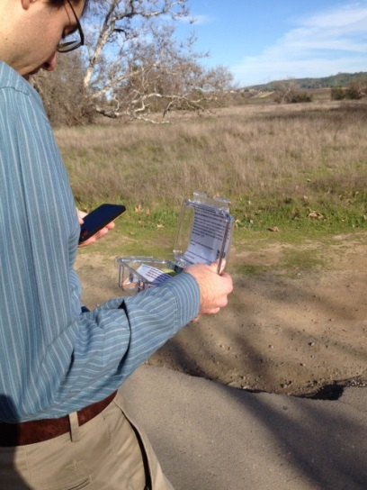
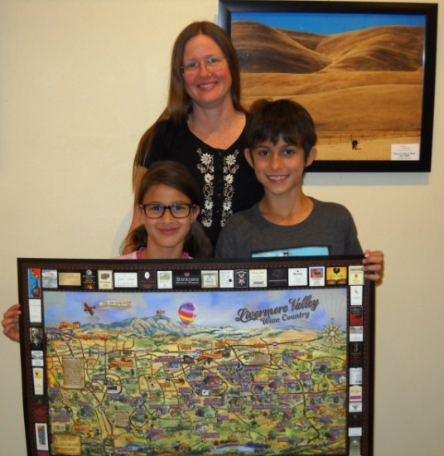
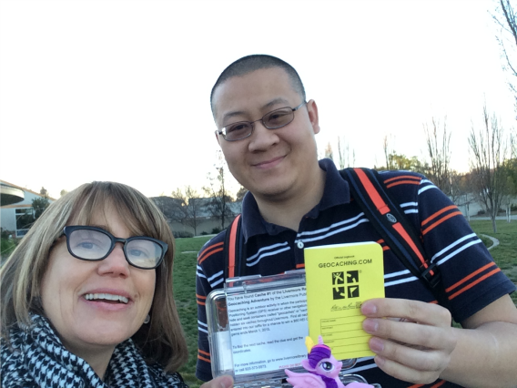
Livermore Public Library Geocaching Adventure

Slide 2
So… what is geocaching?
At it’s core, it’s a modern day treasure hunt – it’s a game!
A geocacher uses GPS coordinates and then attempts to find the geocache hidden at that location
Geocache = fancy word for a container
The coordinates usually will not lead you to the exact spot. Once you arrive in the area, you’re playing hide and seek with a box!
When you find the geocache, you sign the log book and if you brought something to trade you swap it out with something in the box

Slide 3
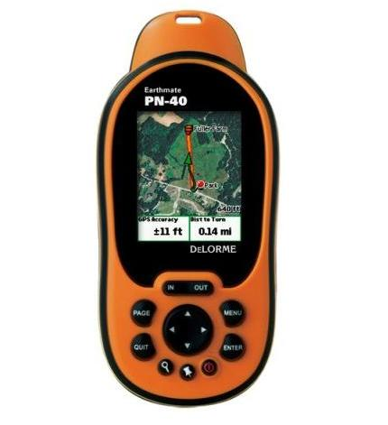
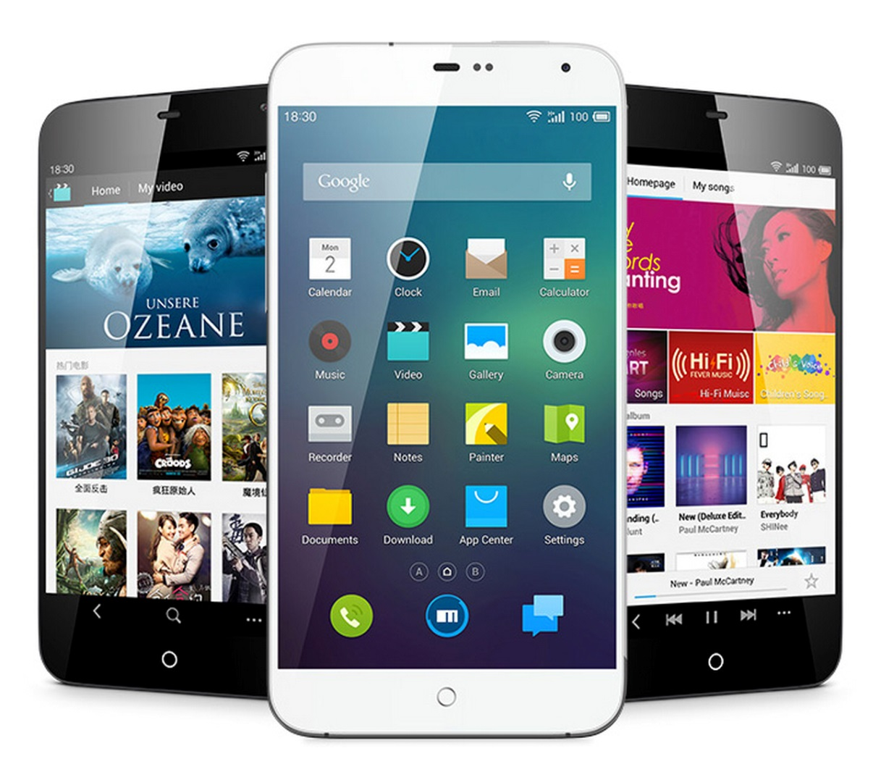
What do I need to start?

Slide 4
Livermore Public Library’s Geocaching Adventure – Hunt for the Golden Chalice
We hid six geocaches around Livermore
This was a Multicache! We included clues too, to give it elements of a Puzzle Cache.
The first location’s coordinates was released on February 1st on the library’s website.
This was slightly themed around Livermore Reads Together.
Participants were asked to create an account and log their progress on the library’s page to be entered into a raffle.

Slide 5
For our adventure…
You will need to create an account on the library’s geocaching page.
Enter the coordinates of each cache as you find them into your GPS device, or smart phone.
Smart phones come preloaded with map apps. If you enter the cache’s coordinates into Google Maps, the app will show you the cache’s location relative to yours.
When you find a cache, sign in to your account on the webpage and log which number cache you found and a brief description of where.
When you log all six, you are automatically entered into the raffle!

Slide 6
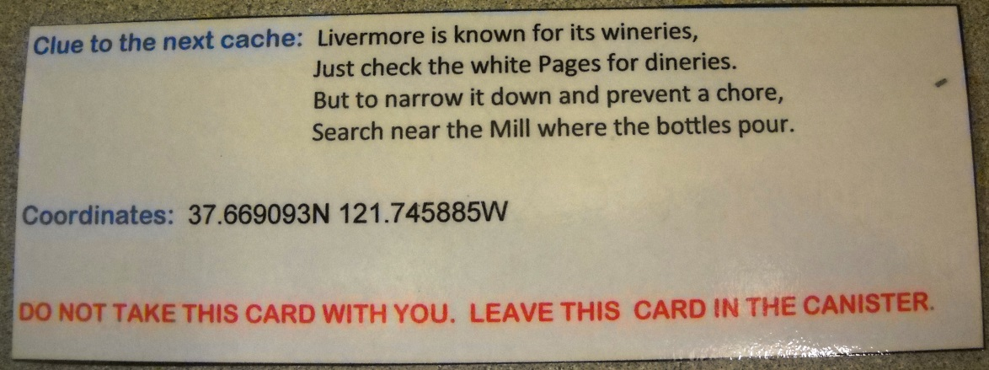
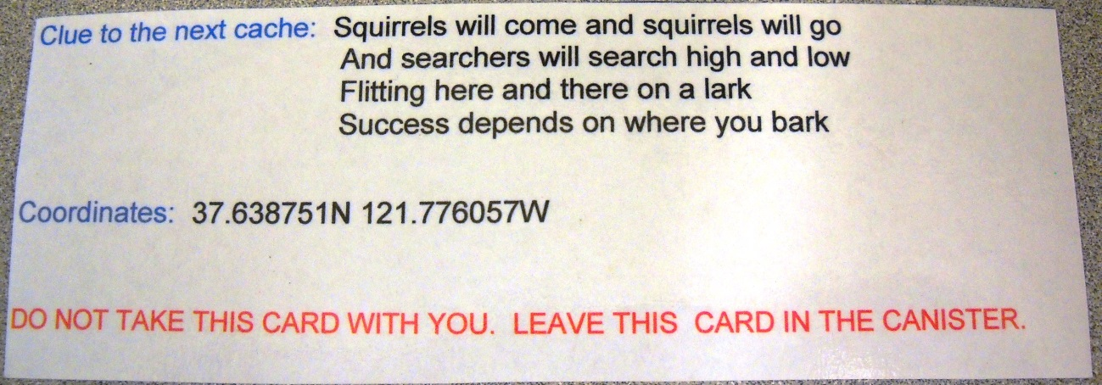
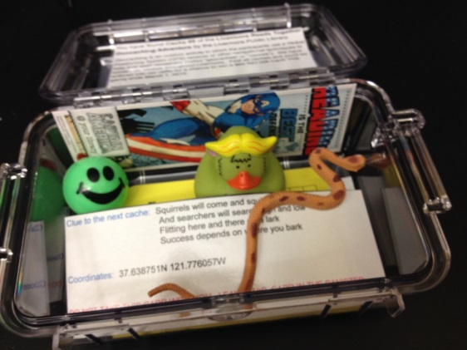

Slide 8
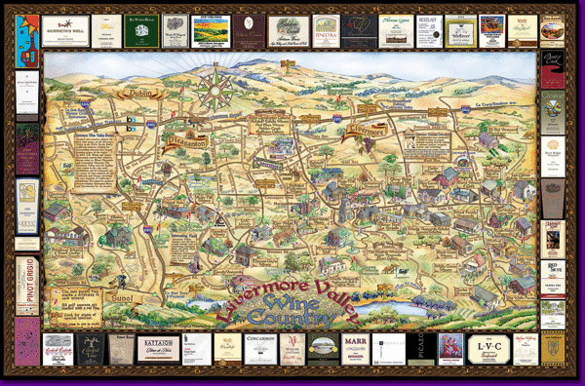
A raffle!?
Grand prize is a $60 REI gift card.
Other prizes include:
Livermore Valley Wine Country Wine Map
A DVD copy of Pixar’s Ratatouille

Slide 10
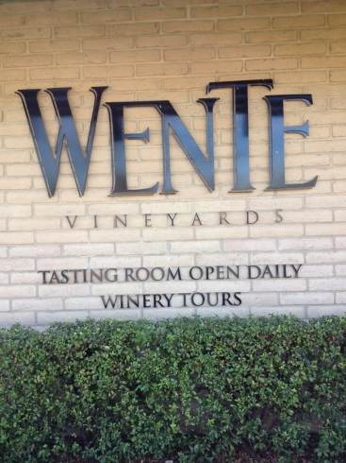
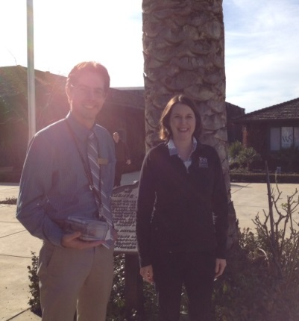
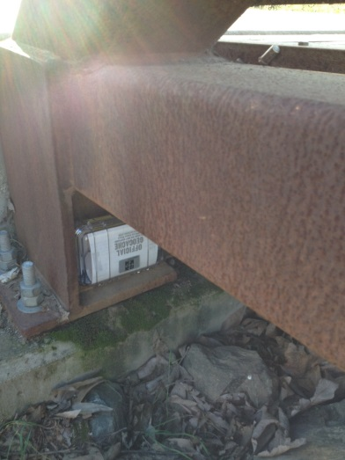
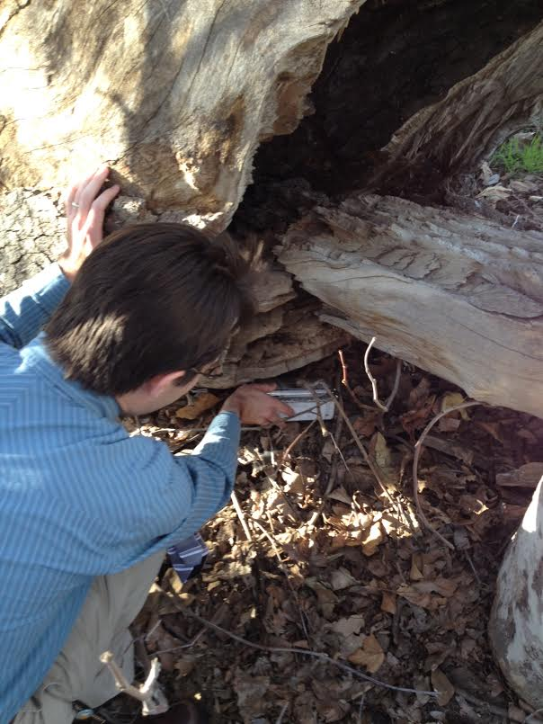
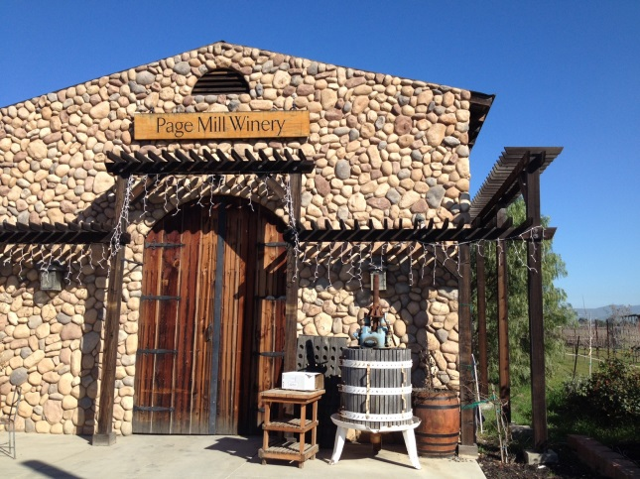
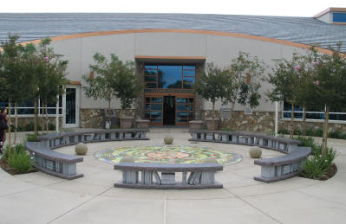
Community Partnerships
Casse-Croute Bakery
Wente Vineyards
Sycamore Grove Park
Page Mill Winery
Livermore Civic Center Library

Slide 11
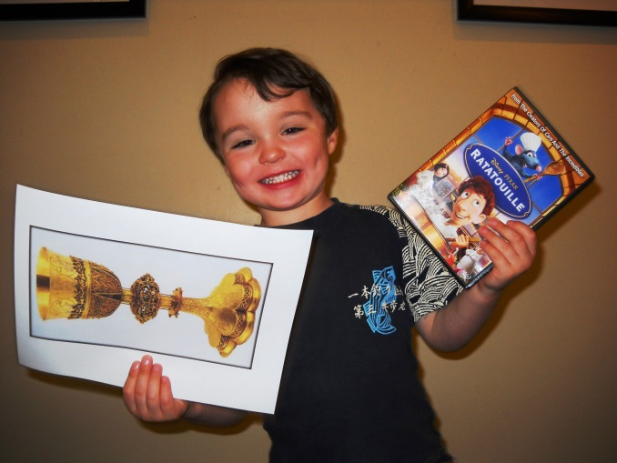
Program ran from February 1, 2015 to February 28, 2015
83 people registered (31 youth and 52 adults)
34 participants successfully completed the game, and eight won the raffle.
Nick Blaschak found the golden chalice, and won a Ratatouille dvd

Slide 12
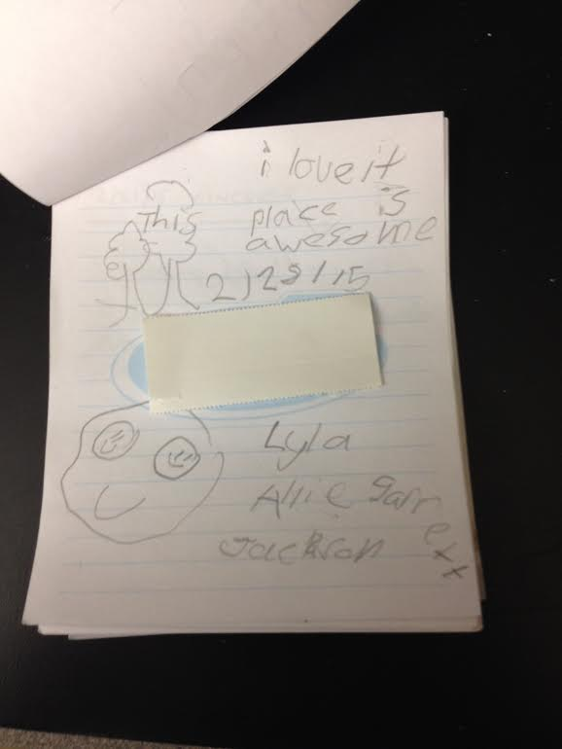

Slide 13
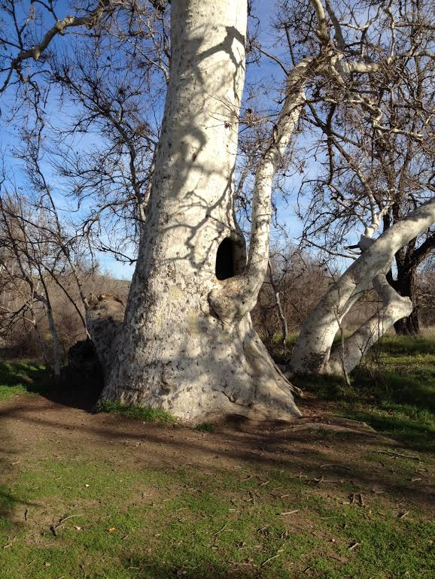
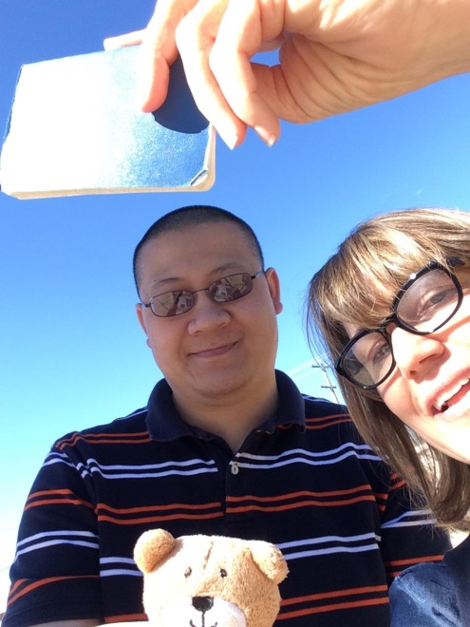
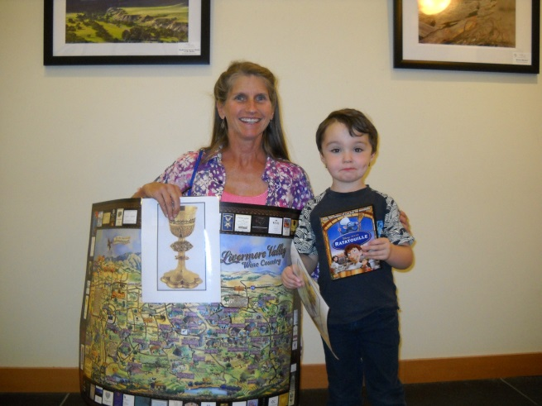

Slide 14
Comments from participants
“Had fun geocaching with my daughter and her family. Even my 2 year old granddaughter found a cache at Wente.”
-Dennis Uhlich
“We had so much fun finding the caches. It was a great way to spend quality time with the family. The Library staff did a terrific job organizing this event. TFTC [Thanks For The Cache].”
-Donna Davis
“What a great event! We really enjoyed geocaching!”
-Jill Pauli
“We had lots of fun! The geocache game was great for our whole family and the movie and storytellers were great too!”
-Cindy Blaschak
“We were just climbing through this tree last month…My son will now always talk about it as the tree with the treasure inside!”
-Geocaching game participant after finding the final cache
“Owner came out and congratulated us on the find!”
-Geocaching game participant after locating the cache at Casse Croute Bakery
“Daddy read me and my sister the hint and we knew where the cache would be. We found it!”
-From a child participating in the geocaching game

Slide 15
Thank you
Paul Sevilla, Librarian II
Livermore Public Library Civic Center
prsevilla@livermore.lib.ca.us
925-373-5573
Or ask Nathan!

