Slide 1
#bookfacefriday

Slide 2
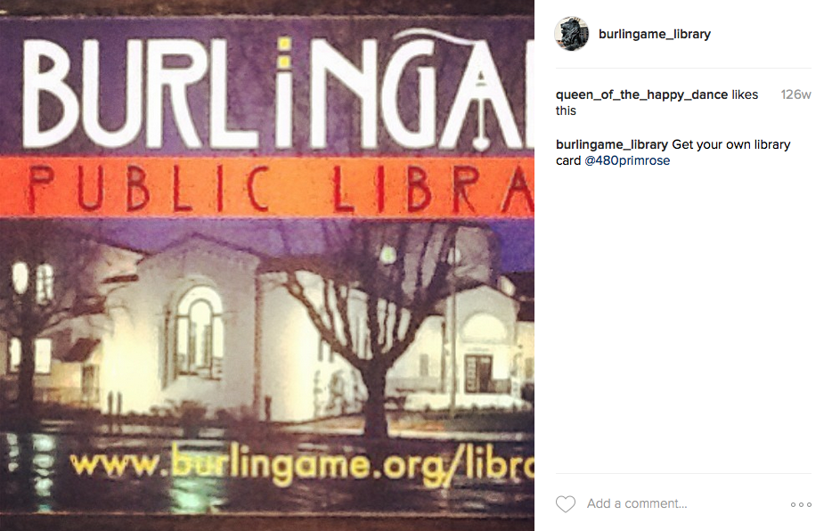
First post was on April 30, 2014
Account started with the goal to:
Increase the library’s presence on social media

Slide 3
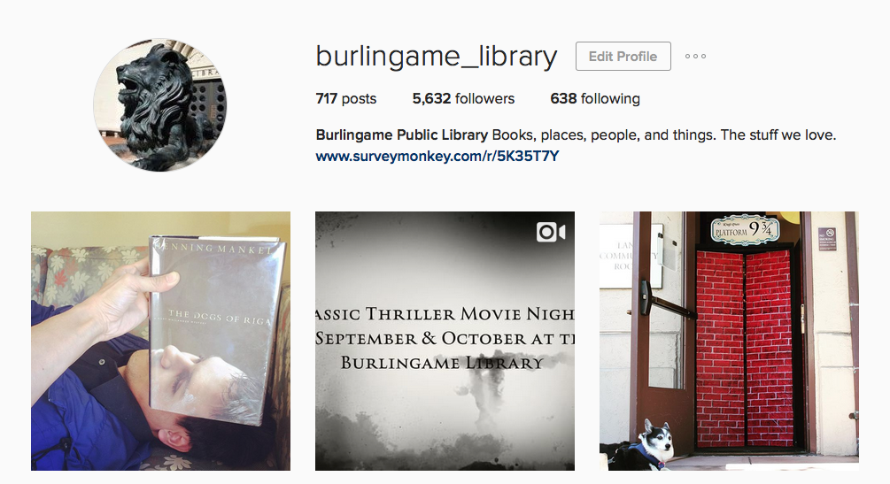

Slide 4
Started by the New York Public Library in August 2014
Asked IG users to post bookfaces on Fridays
@nypl would repost their favorites on Fridays

Slide 5
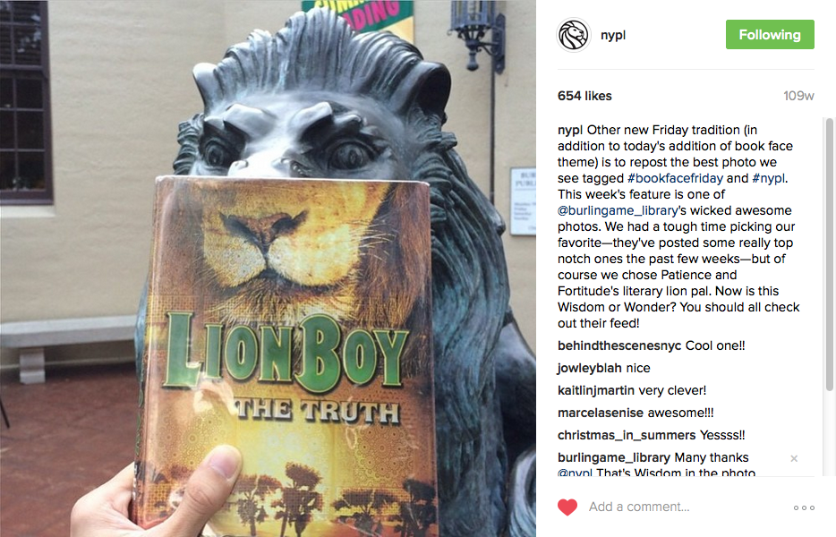

Slide 6
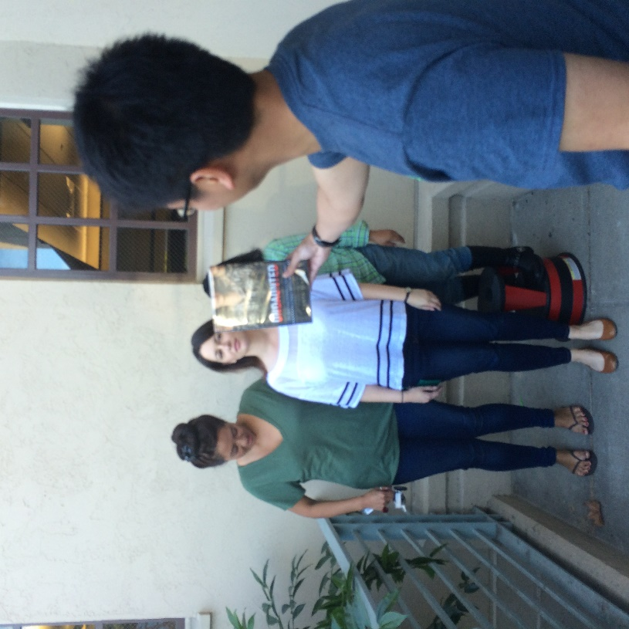
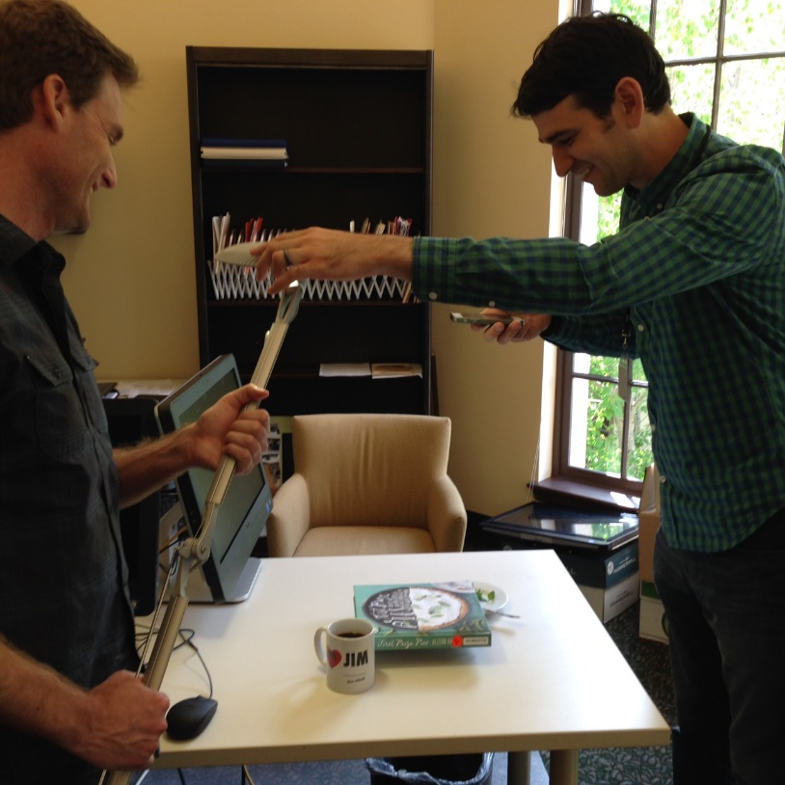
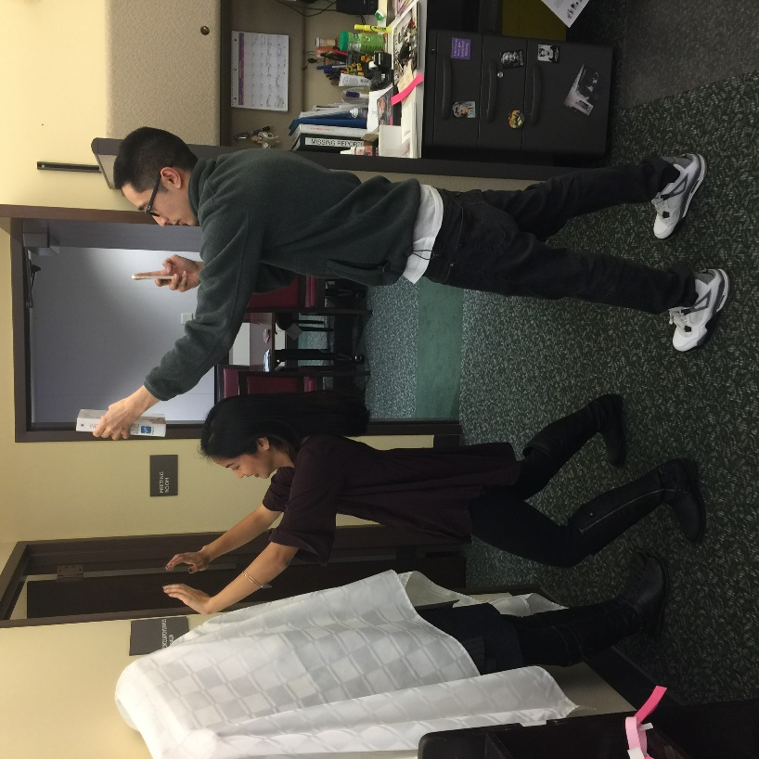
What is a #bookface?

Slide 7
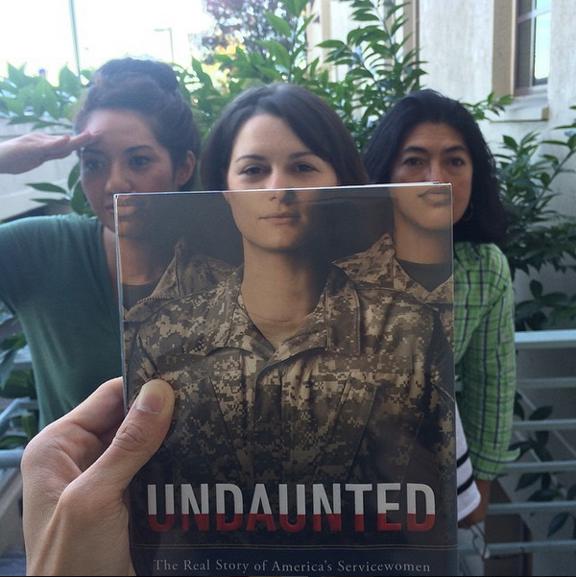
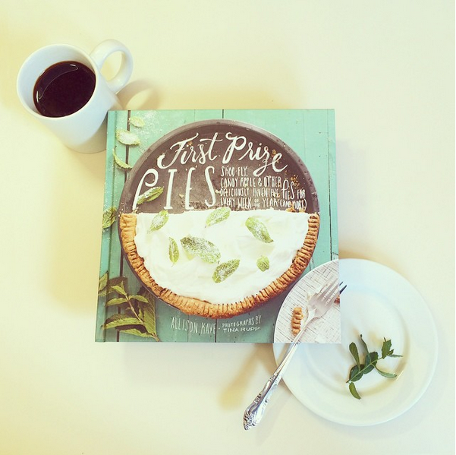
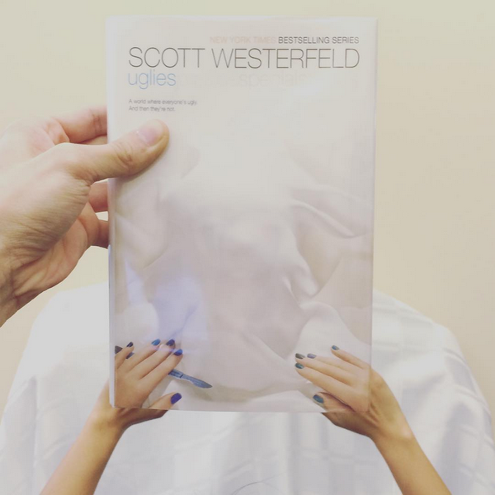
What is a #bookface?

Slide 8
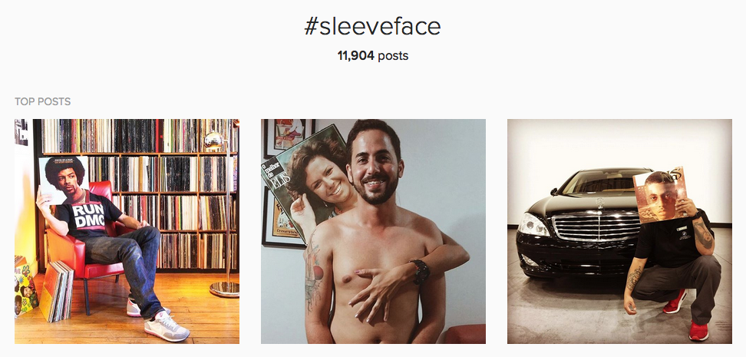
Actually did not start with books…

Slide 9
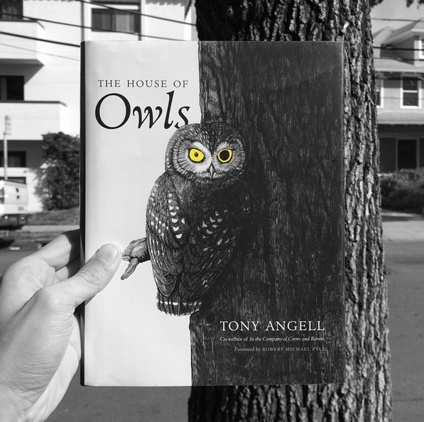
Helpful Tips on #bookface
Use Instagram filters to help make the images more seamless
After taking a shot, utilize further editing tools to make them unique
Utilize the burst function on your smartphone

Slide 10
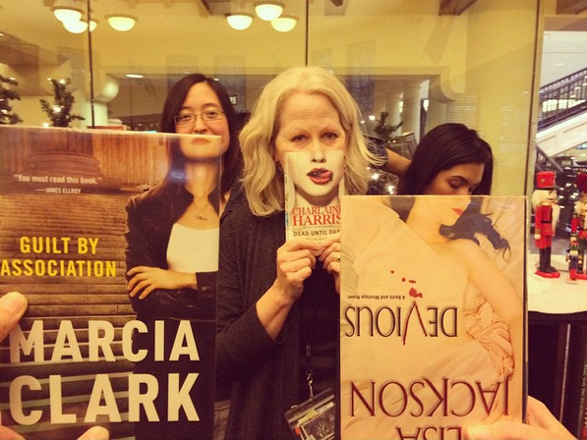
Helpful Tips on #bookface
Ask coworkers to help out when you need perspective
Taking the shots yourself limits your #bookface range
Push the limits!

Slide 11
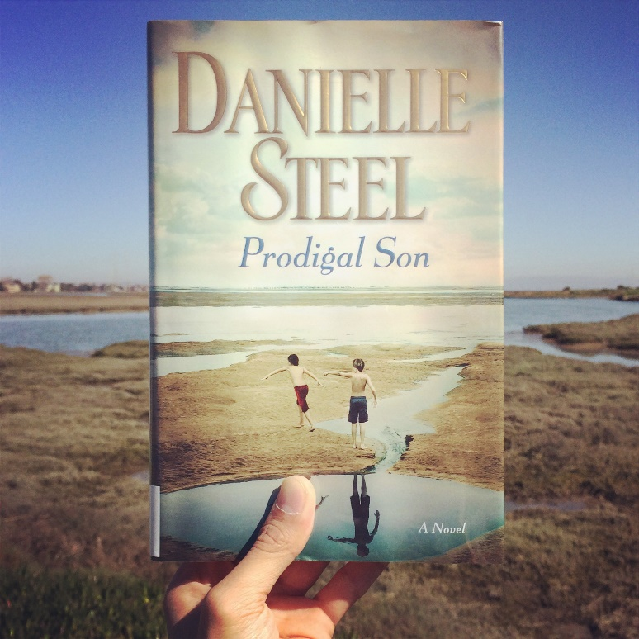
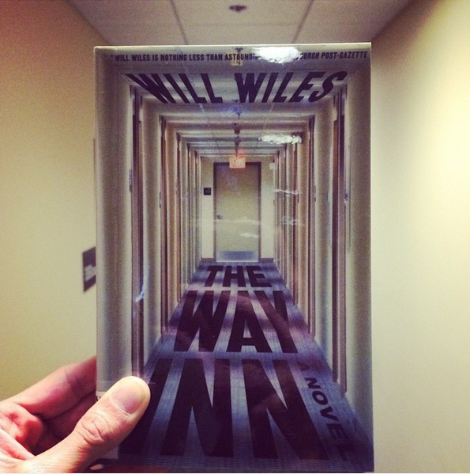
Change it up!

Slide 12
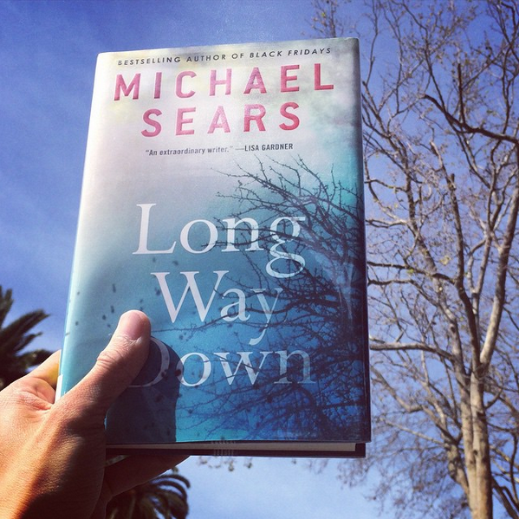
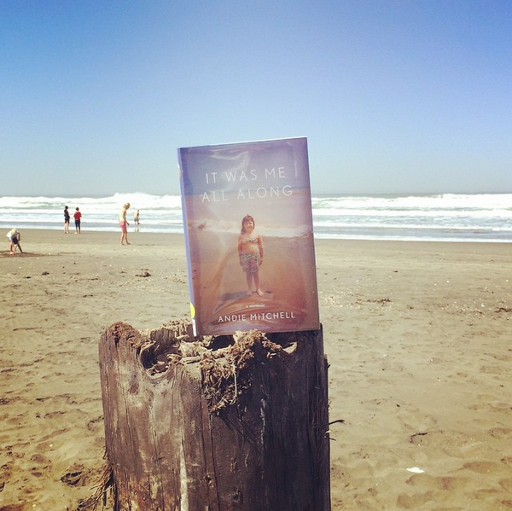
Change it up!

Slide 13
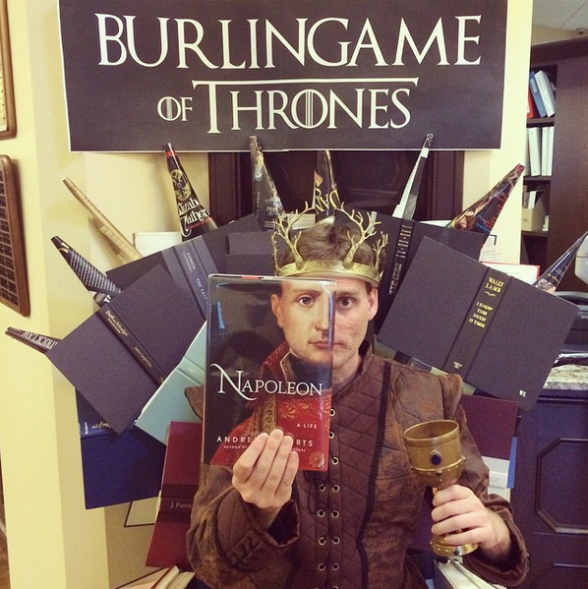
Start your own hashtag to engage your patrons
Showcase new book releases
Highlight library staff

Slide 14
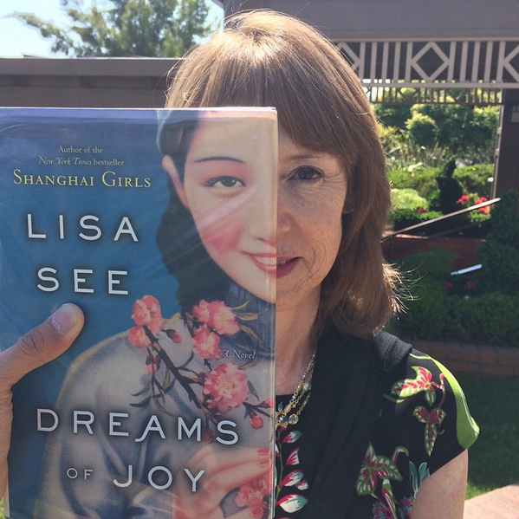
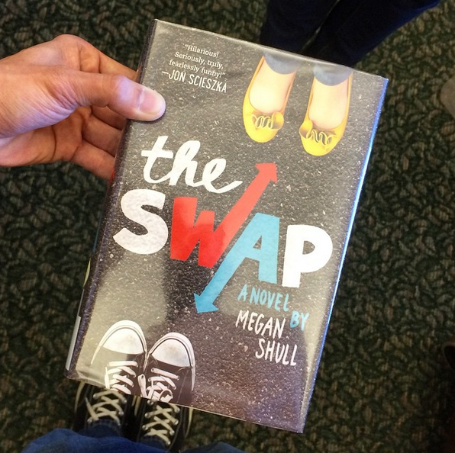
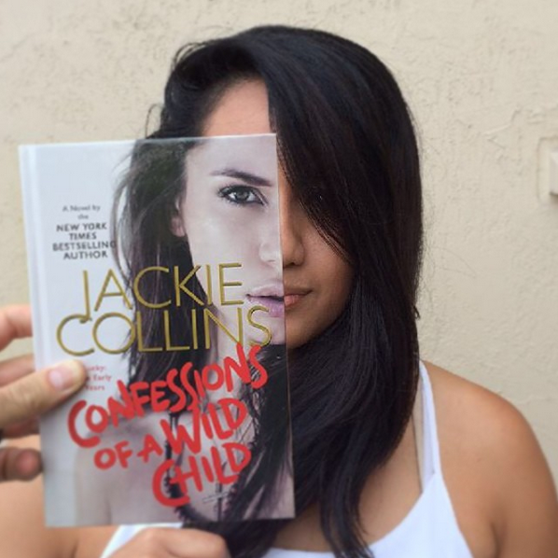
Connecting with Authors

Slide 15
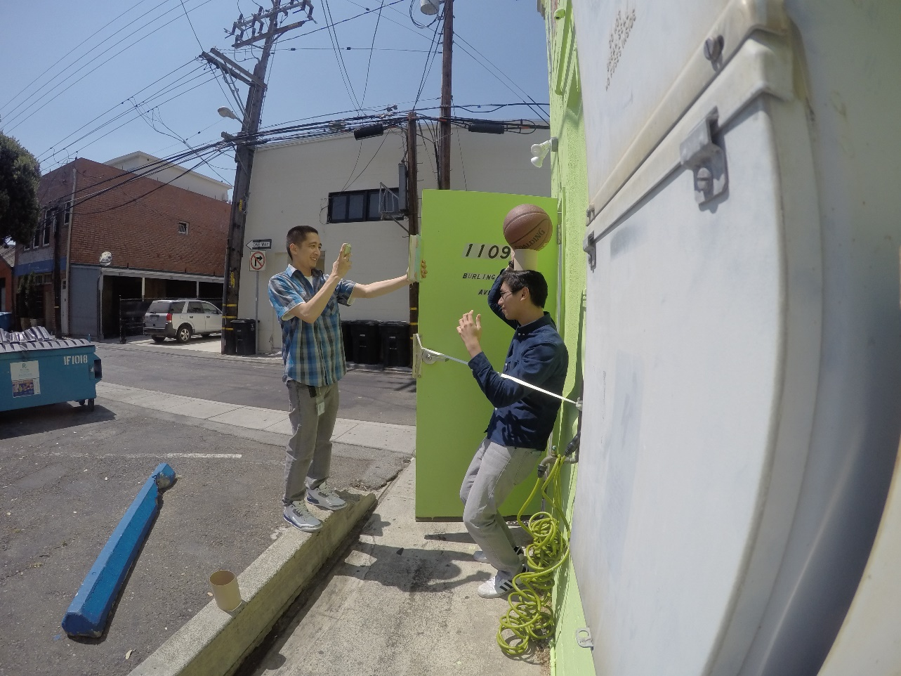
Challenges
Finding the books
Taking the time to create content
Getting buy in from library staff

Slide 16
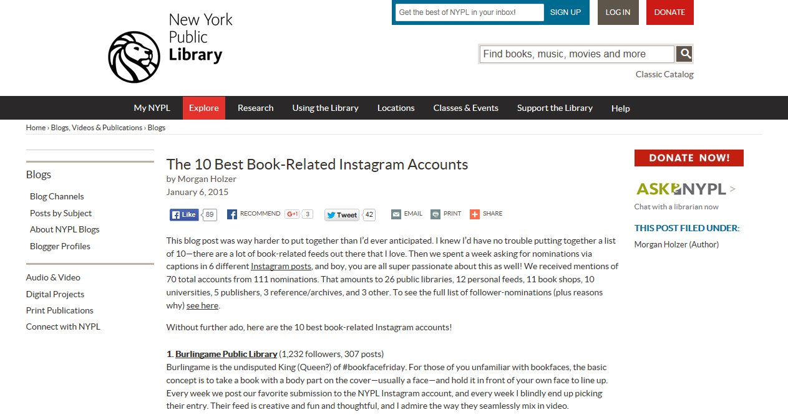

Slide 17
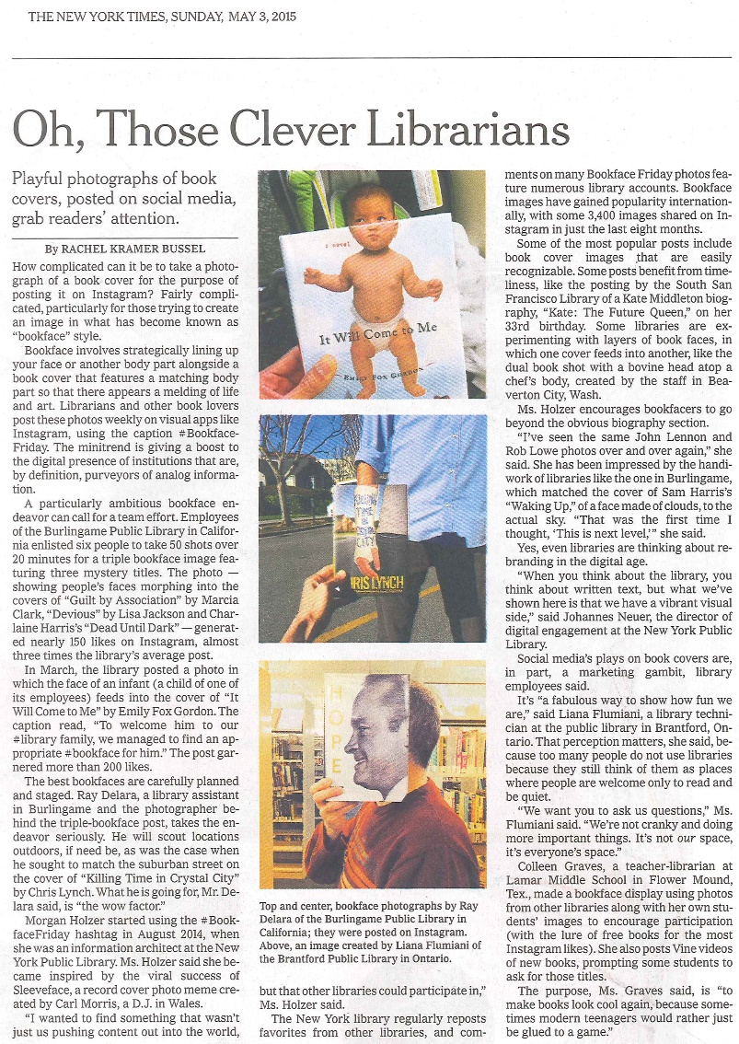
Published May 3rd, 2015
Focused on the rise of libraries utilizing social media to reach their communities
Reach is much larger than expected

Slide 18
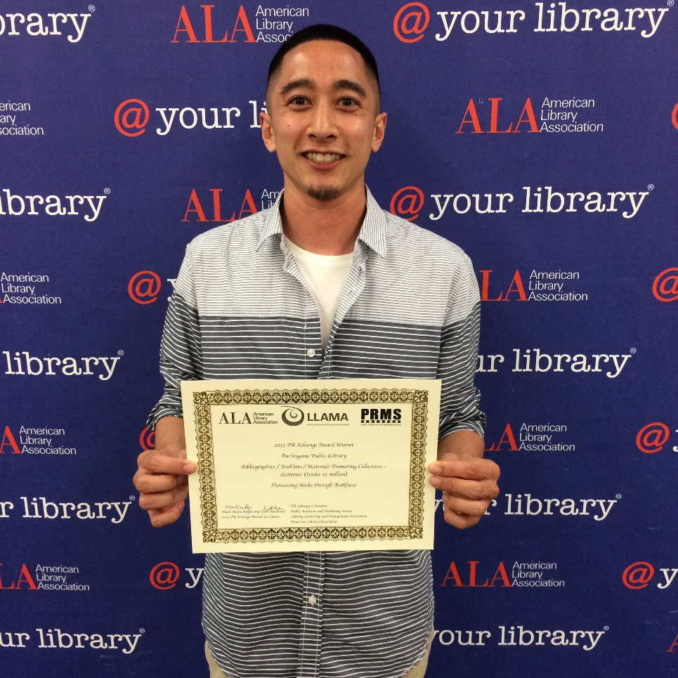
During ALA 2015, the Burlingame Library was awarded a PRExcellence Award
Electronic materials promoting collections
Showcasing Books through #Bookfaces

Slide 19
