Slide 1

WHAT DO I DO NOW?
Handling Challenging Situations
with
Mentally Ill and Homeless Library Users
Spring 2012
Staff Development Workshop
of the
Pacific Library Partnership
Presented by:
Leah Esguerra, LMFT
Kathleen Lee, Health & Safety Associate
Karen Strauss, Assistant Chief of Main
San Francisco Public Library

Slide 2
What We’ll Cover
Background on local homelessness
San Francisco Public Library’s story of partnering with experts and education
Hear from someone who has lived both sides of the story
How to better handle challenging situations

Slide 3
Bay Area Population
COUNTY | OVERALL COUNT (2010) | HOMELESS COUNT (2011) | HOMELESSNESS
Alameda | 1,510,271 | 4,178 | 2.8%
Contra Costa | 1,049,025 | 4,274 | 4.1%
Monterey | 415,057 | 2,507 | 6%
San Francisco | 805,235 | 6,455 | 8%
San Mateo | 718,451 | 2,149 | 3%
Santa Clara | 1,781,642 | 7,045 | 4%

Slide 4
Homelessness in San Francisco
History
Barbary Coast
Great Depression
Summer of Love
AIDS and crack epidemics
Shelters
Since 2004
Care-not-Cash
Project Homeless Connect
Adapted from a presentation in 2007 to SFPL staff
by Rajesh Parekh, MD, and Rann Parker, Directors,
SF Homeless Outreach Team

Slide 5
*Local
Project Homeless Connect Events
Berkeley
Contra Costa County
Monterey County
Oakland/Alameda County
San Francisco City & County
San Jose
San Mateo County
*Past and/or present

Slide 6
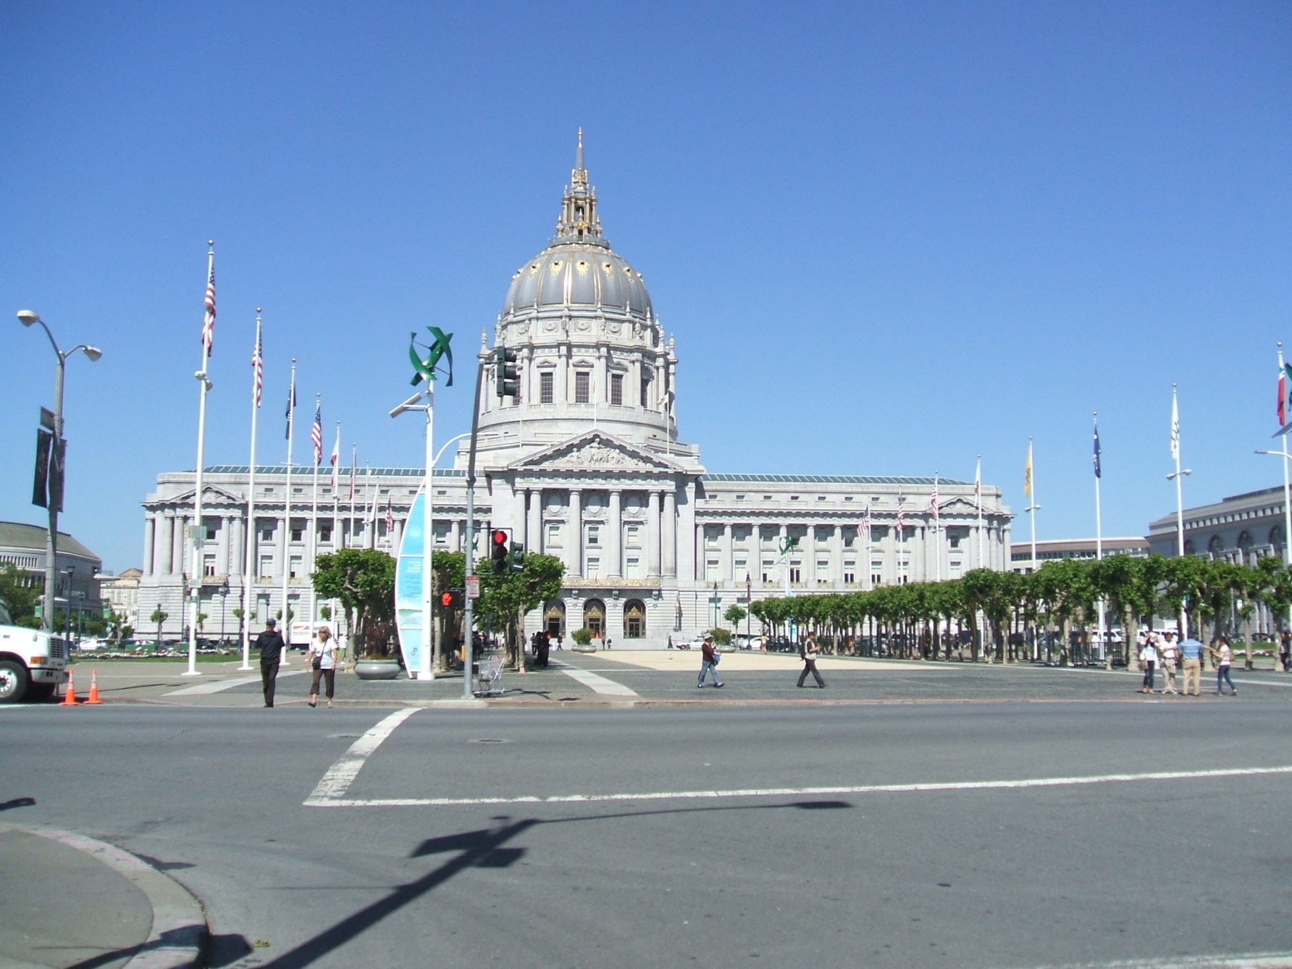

Slide 7
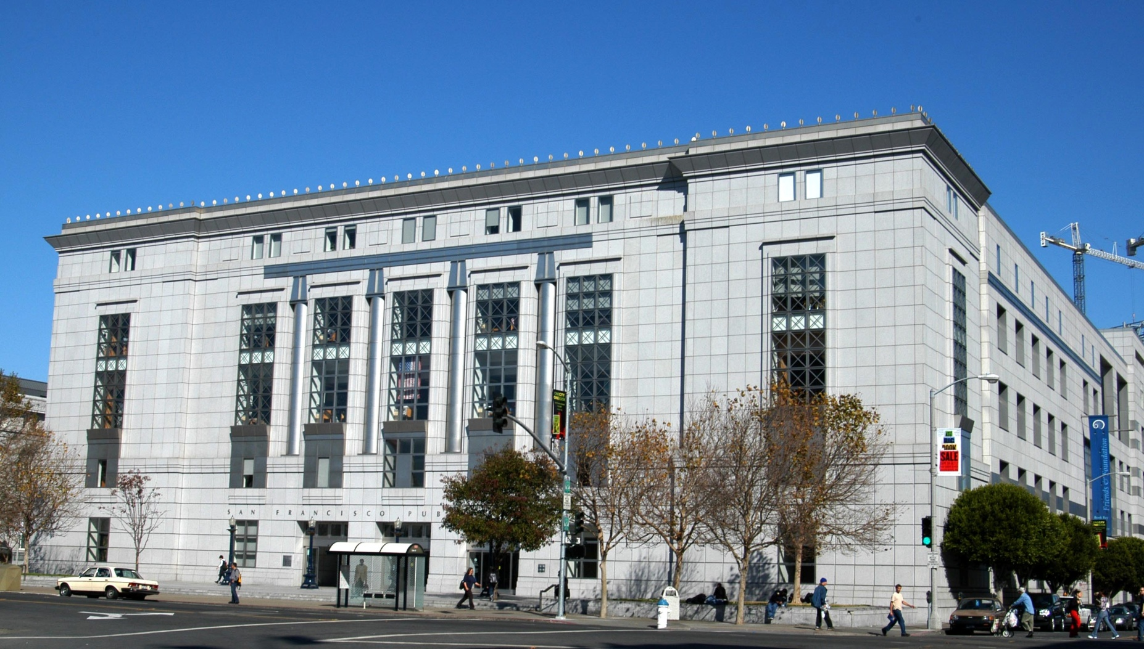

Slide 8
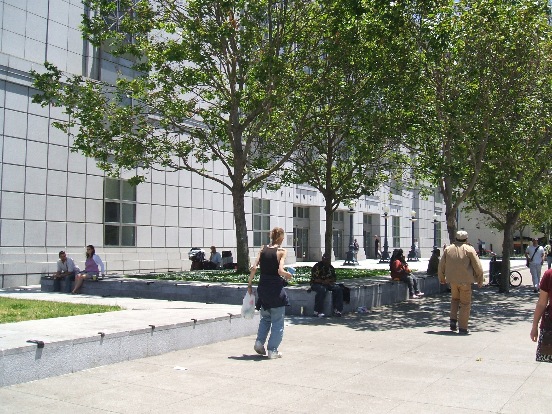

Slide 9
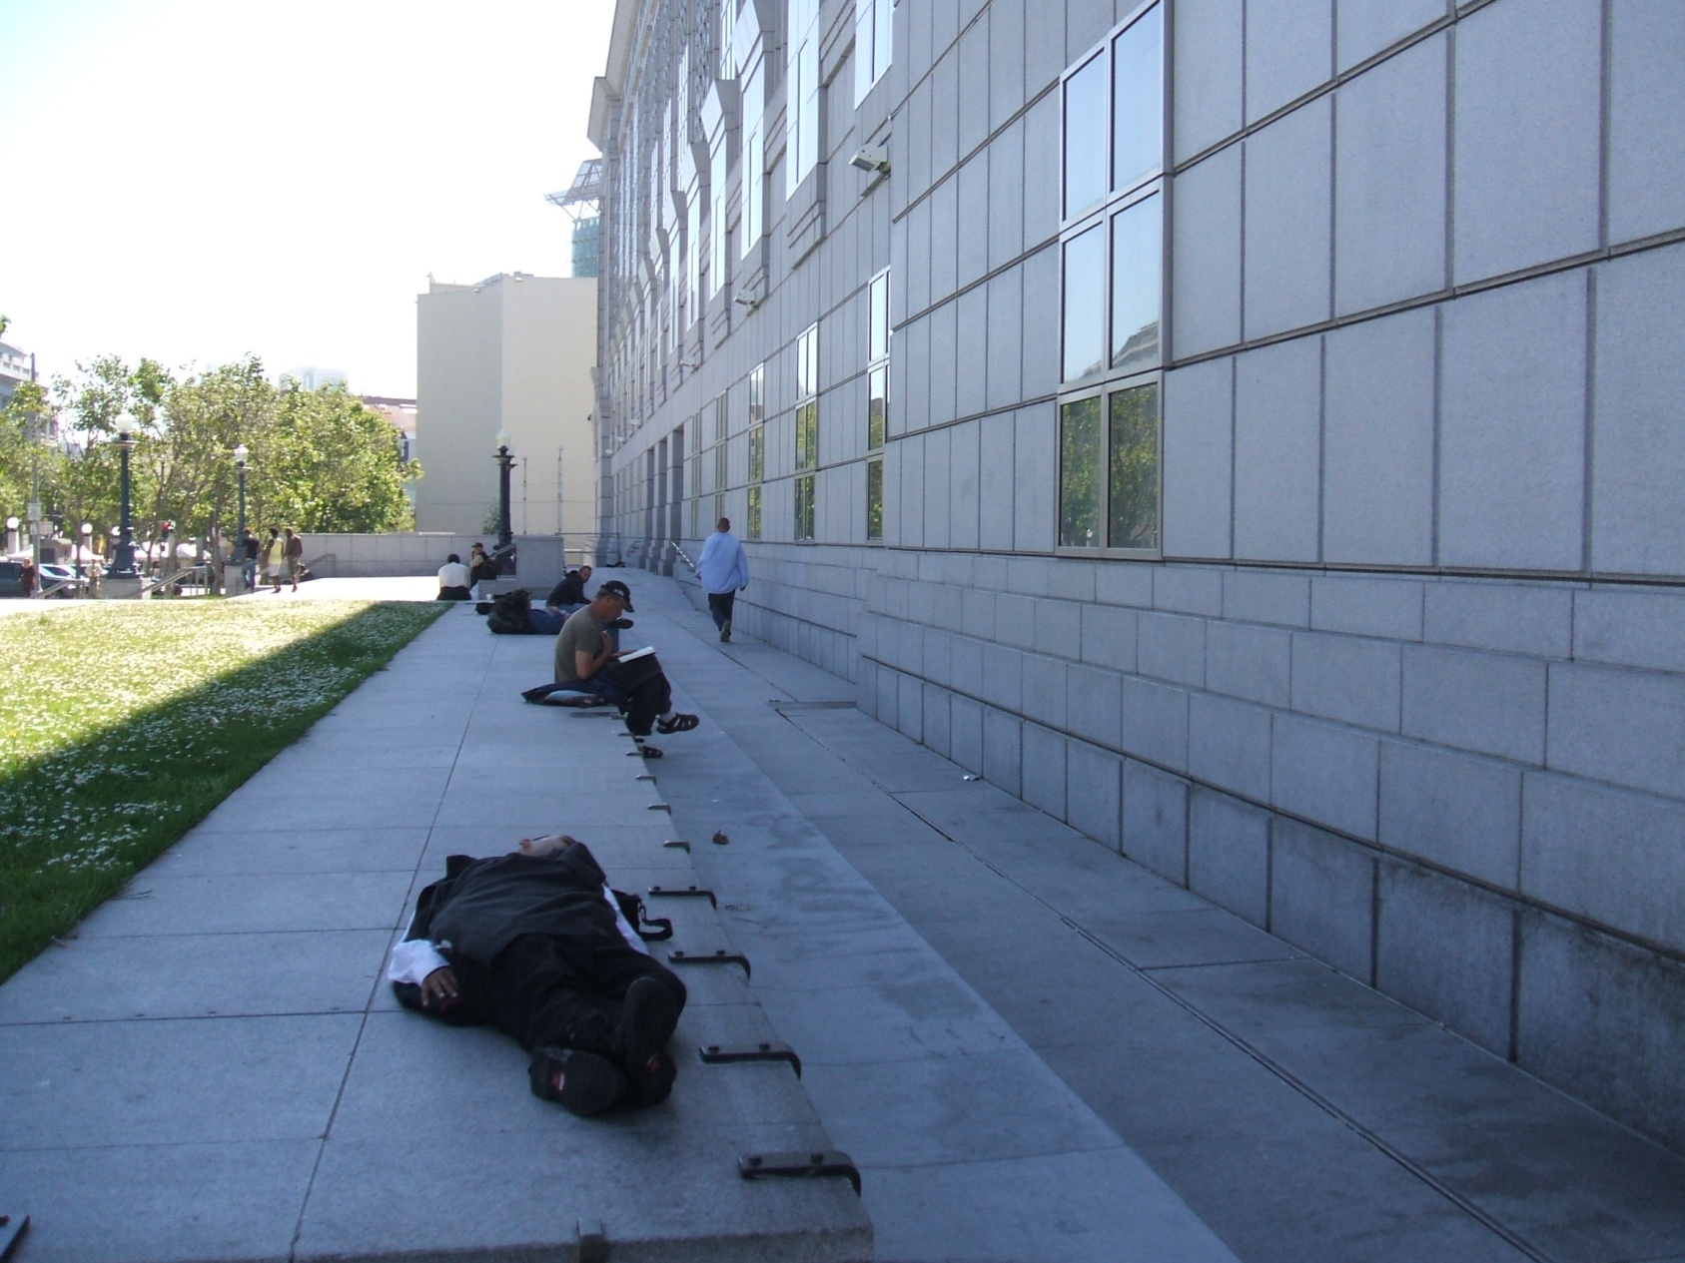
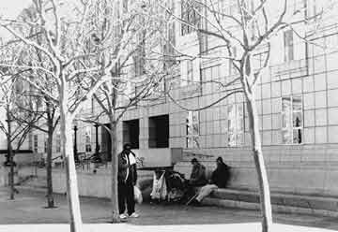

Slide 10
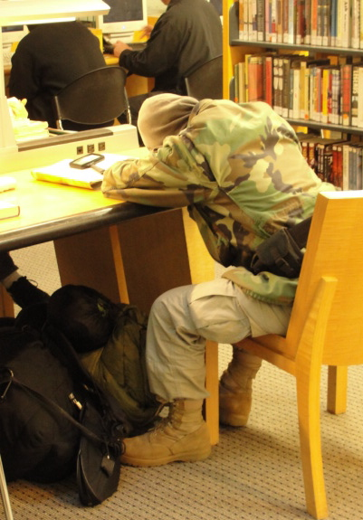
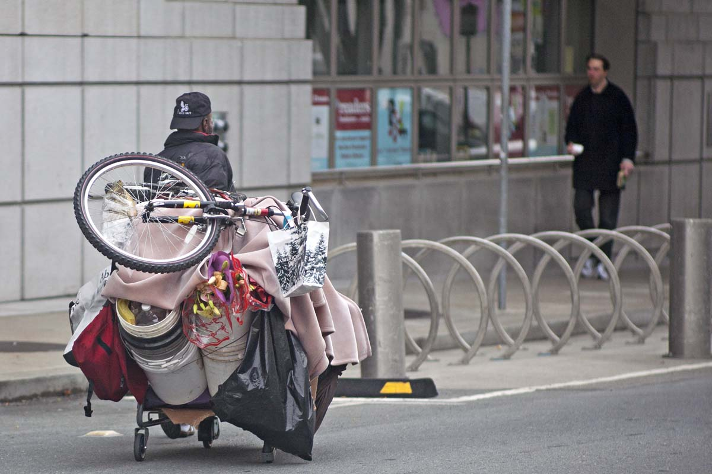

Slide 11
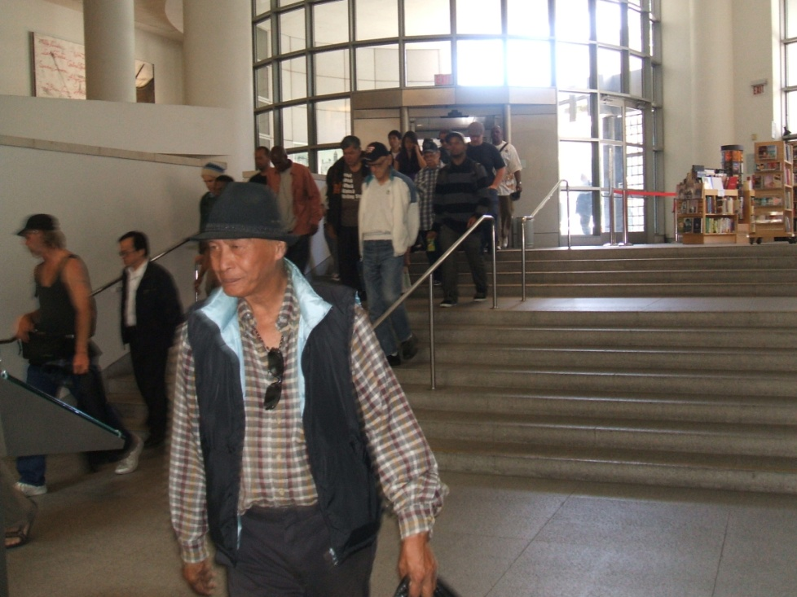
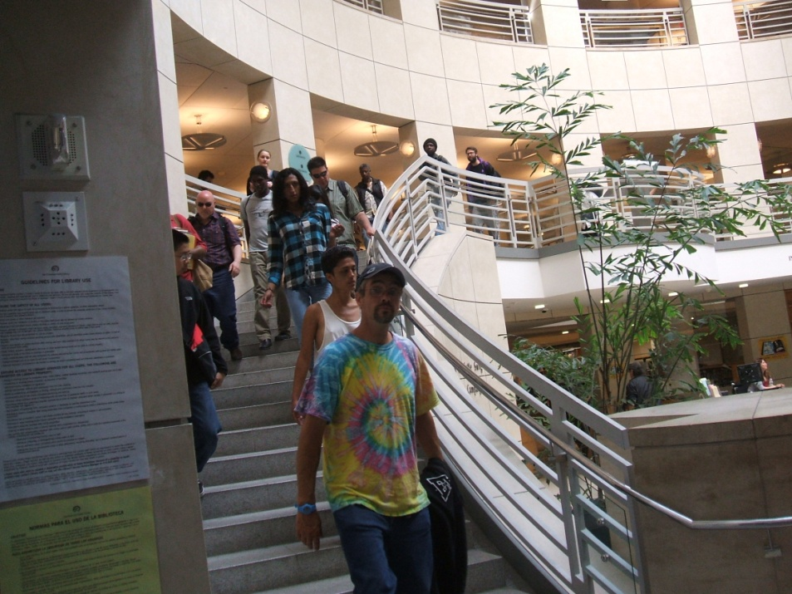
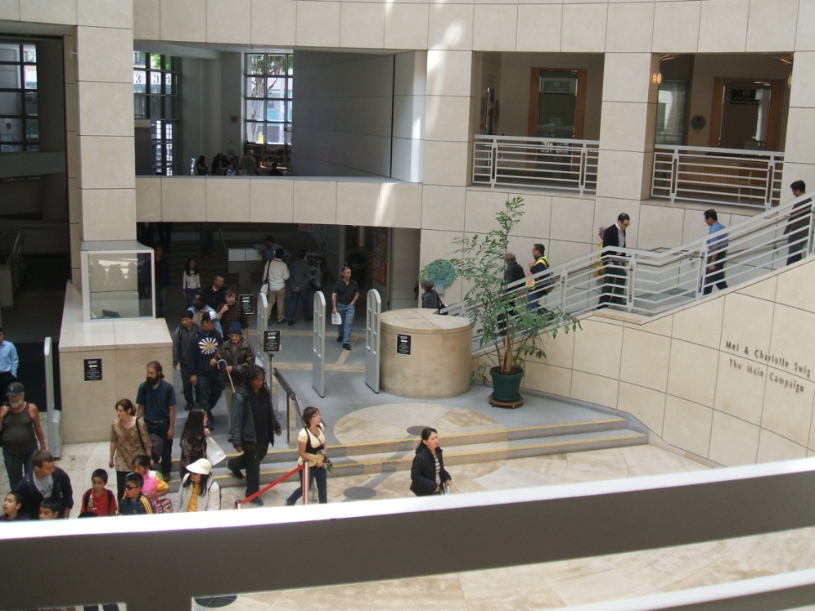

Slide 12
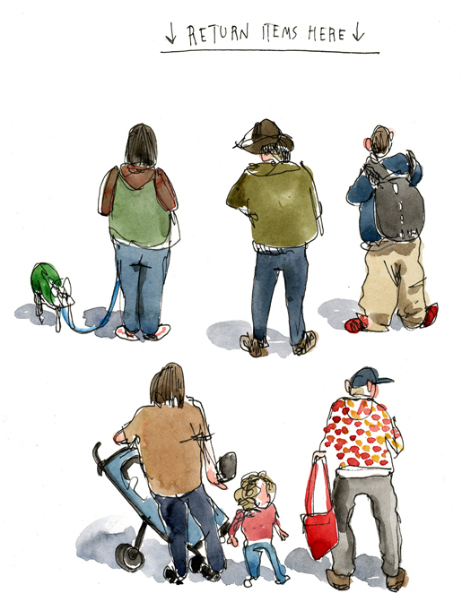
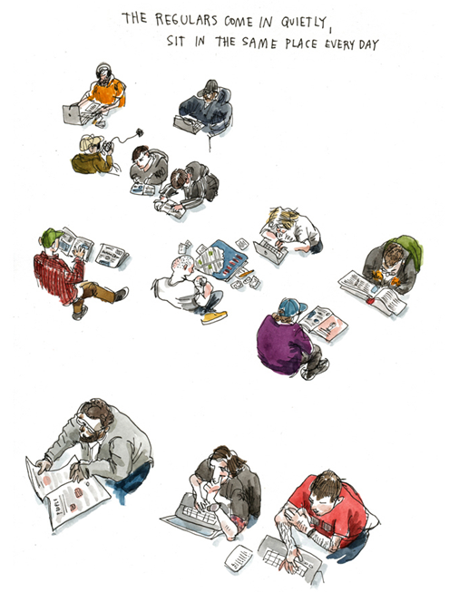
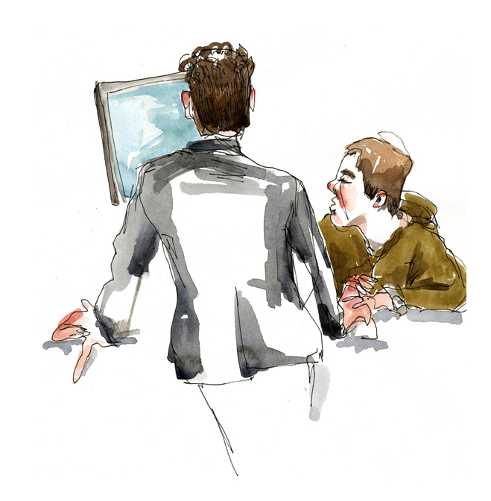
Wendy McNaughton – therumpus.net
May 13, 2011

Slide 13
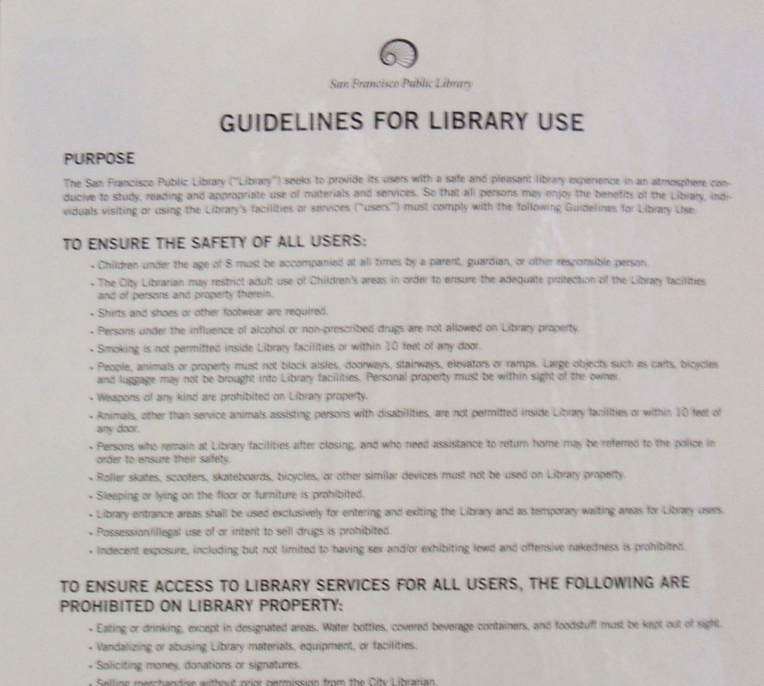
Patron
Behavior Guidelines

Slide 14
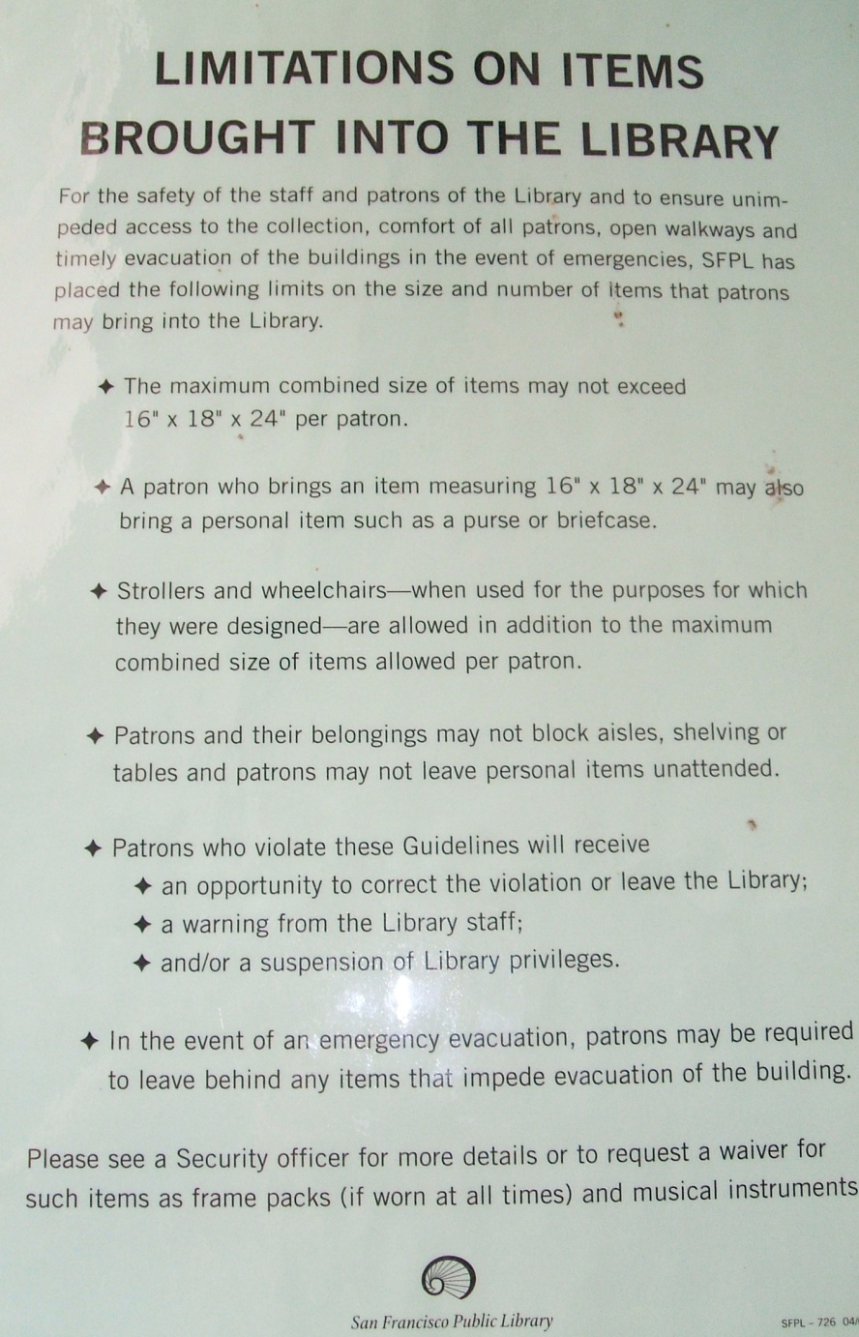
Patron Baggage Limits

Slide 15
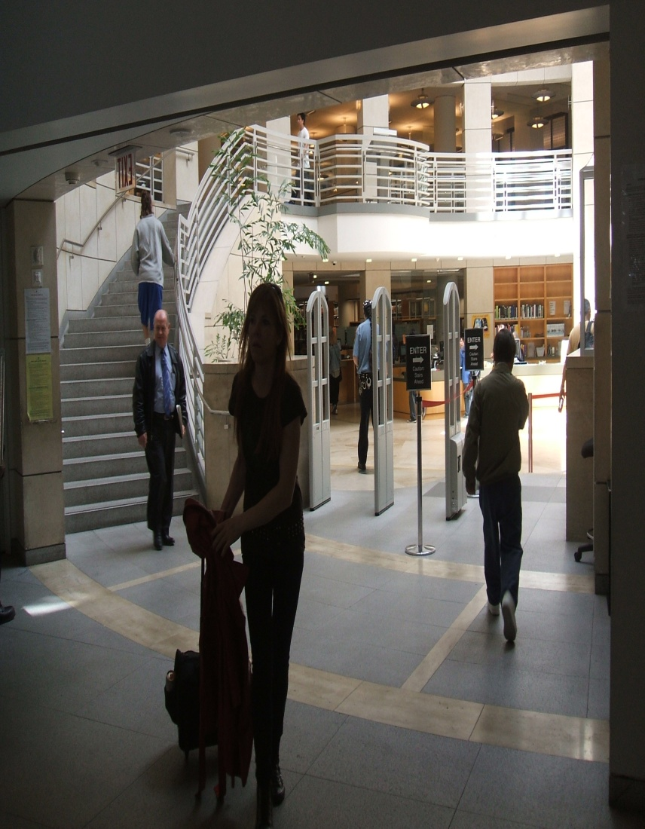
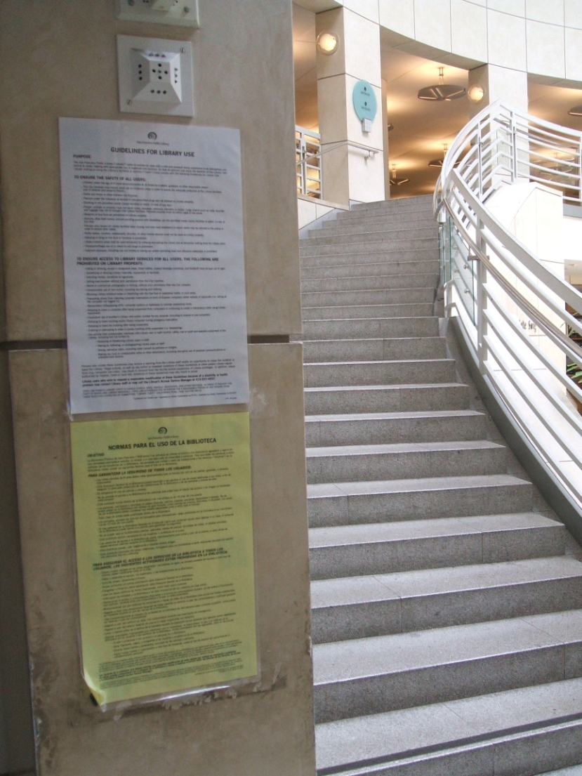

Slide 16
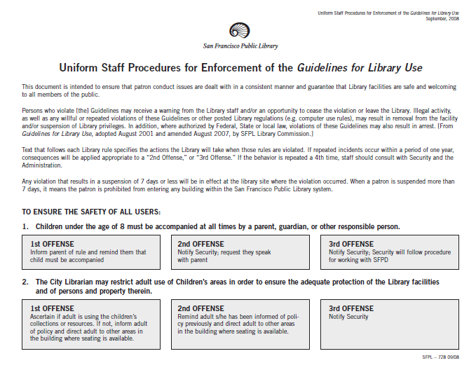
Consequences

Slide 17
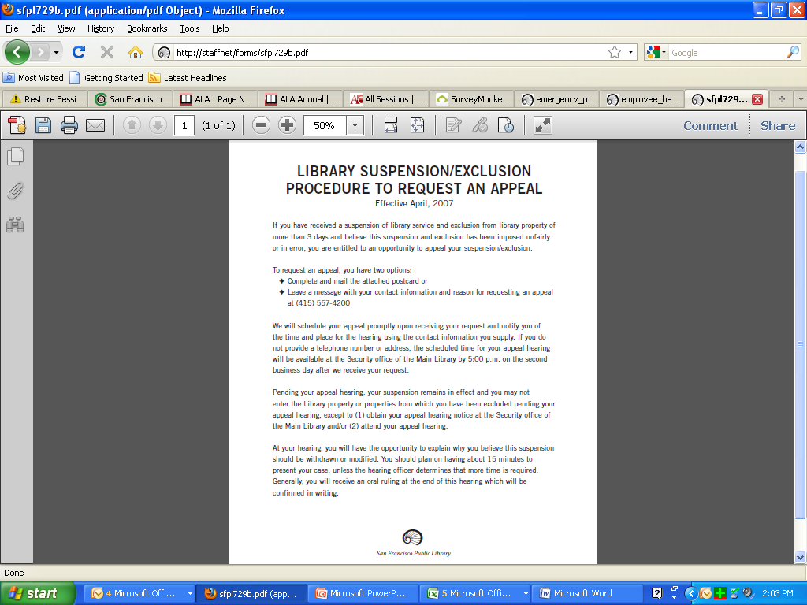
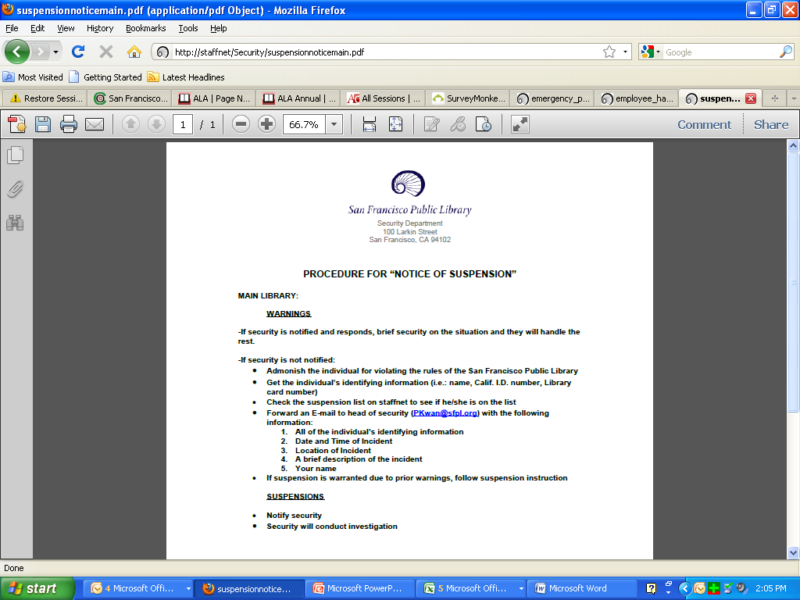
Appeals Process Following Suspension

Slide 18
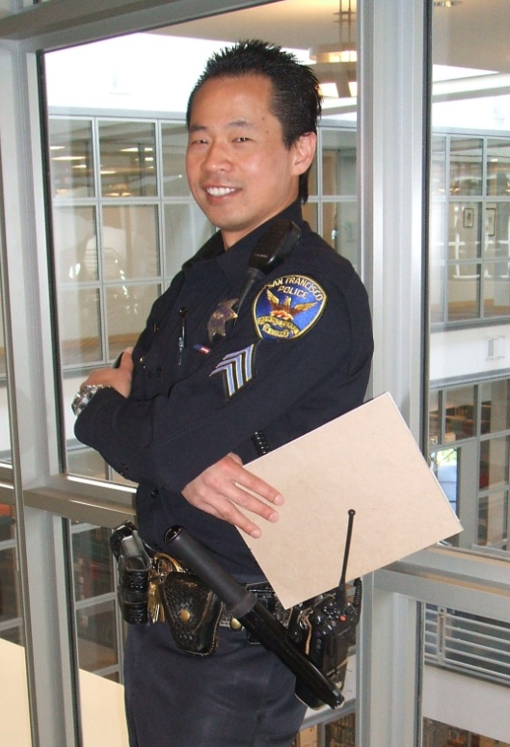
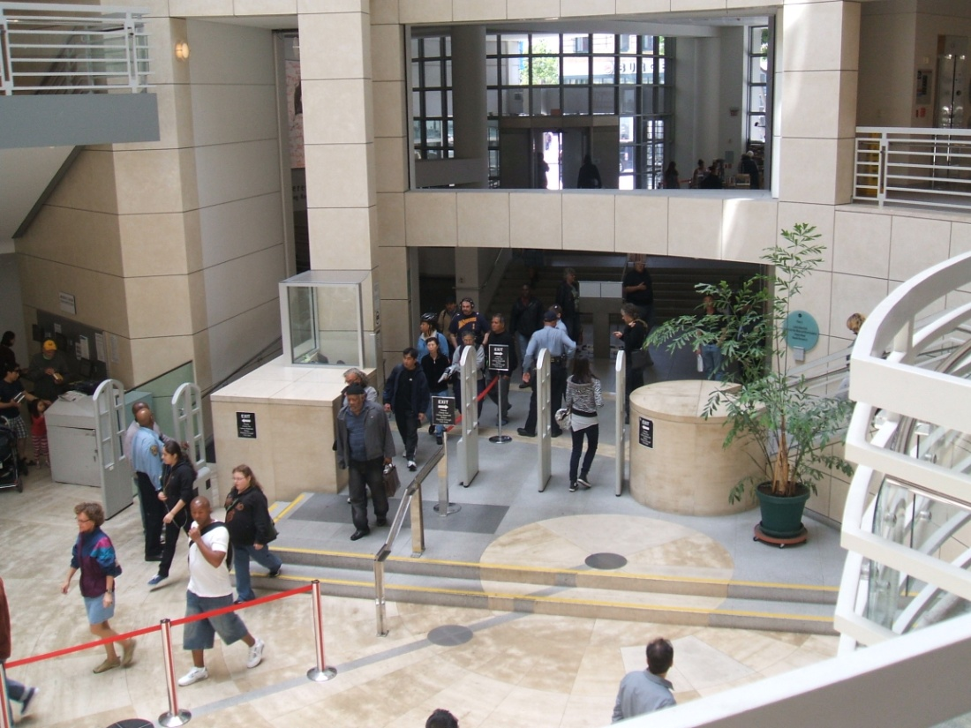

  San Francisco Police Department

Slide 19
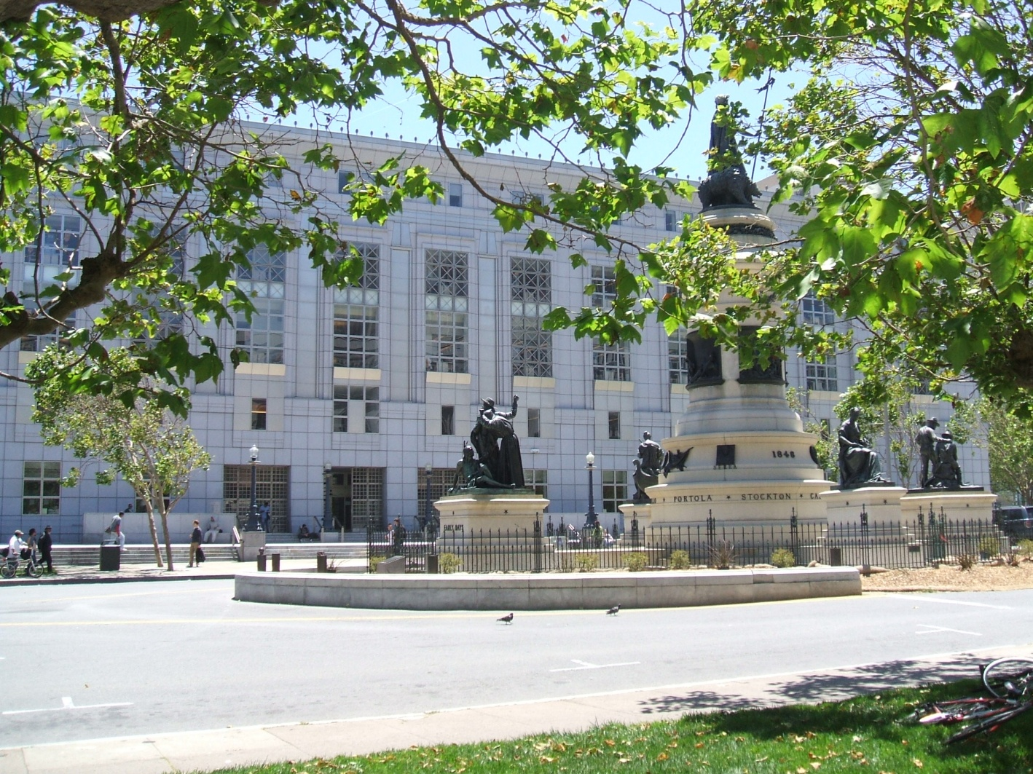

Department of Public Works

Slide 20
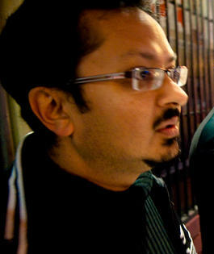
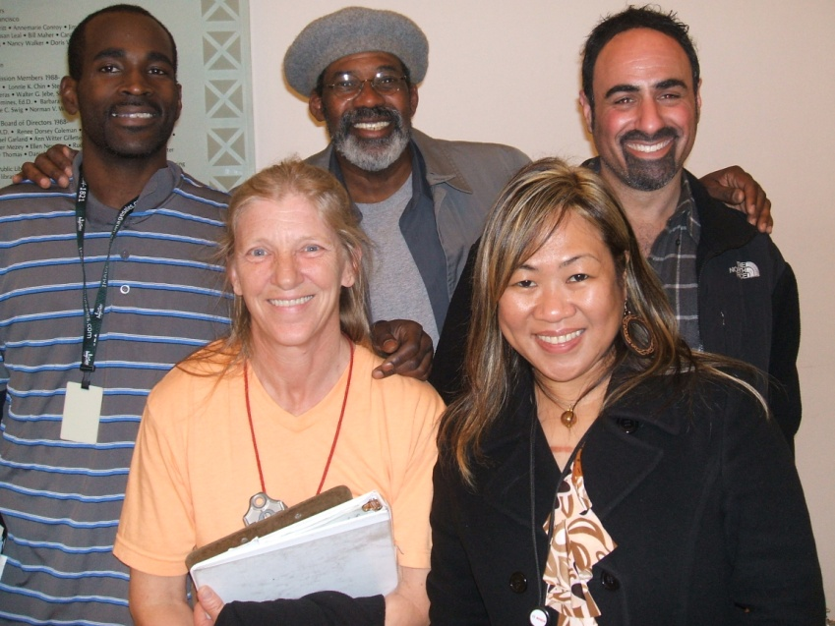
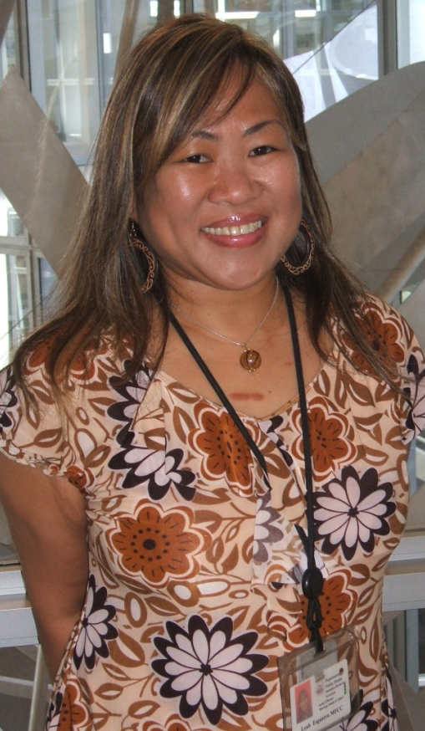
  Department of Public Health

Slide 21
SOCIAL WORKER ACTIVITY
January 2009-March 2012
Patron contacts at Library (unique and repeat) – 1,802
Patrons assessed for services – 664
Patrons assessed and referred to other agencies – 453
Patrons offered housing and case mgmt. services – 169
Patrons placed in permanent housing – 40
Patrons placed in stabilization rooms – 109
Patrons helped to find employment or paid internship – 17

Slide 22
Other Services from DPH
Meetings & Consultations
Staff Training
  ➲ History of homelessness
  ➲ Understanding mental illness
  ➲ Understanding substance abuse
  ➲ Anger management
  ➲ Limit-setting

Slide 23
LIMIT-SETTING WITH LIBRARY PATRONS

Slide 24
Why Set Limits?

Slide 25
How to Set Limits

Slide 26
Helpful Hints

Slide 27
Taking Care of Ourselves

Slide 28

Break!

Slide 29

Questions?

Slide 30
Something to Think About

Slide 31
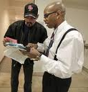
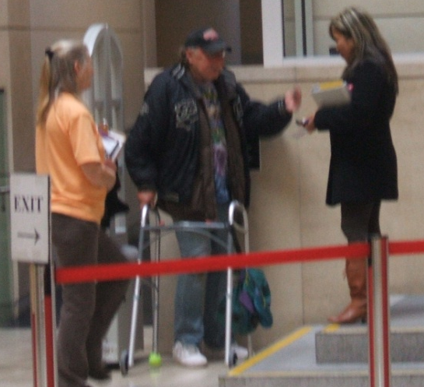
  SFPL Health and Safety Associates (HaSAs)

Slide 32
LAUNDRY & SHOWER RESOURCES
Mission Neighborhood Resource Center
165 Capp Street near 17th Street
869-7977
Monday through Friday 7:00am-11:30am
Tuesday & Wednesday 2:00pm-6:00pm
Men and women
MSC South
525 – 5th Street near Bryant
597-7960
Every day, 24 hours
Men and women
A Woman’s Place
1049 Howard Street near 6th Street
487-2140
Every day, 6:00am-7:00am, 8:00am-10:00am,
11:30am-3:00pm; 4:00pm-10:00pm
Women only
A Woman’s Place Drop-In
211 – 13th Street @ Mission
746-1945
Every day, 24 hours
Women only
a
SFPL makes every effort to provide current information.
Resources are subject to change without notice.
LOW-COST LAUNDRIES
Bayview Hunters Point Multi-Service Center
2111 Jennings Street @ Van Dyke
671-1100
Every day, 7:00pm-12:00 midnight
Mission Neighborhood Resource Center
165 Capp Street near 17th
869-7977
Monday through Friday 7:00am-11:30am
Tuesday & Wednesday 2:00pm-6:00pm
FREE SHOWERS
Bayview Hunters Point Multi-Service Center
2111 Jennings Street @ Van Dyke
671-1100
Every day, 7:00pm-12:00 midnight
Men and women
Martin de Porres
225 Potrero Avenue @ 15th Street
552-0240
Tuesday & Thursday 9:00am
Men and women

Slide 33

Leah Esguerra, Social Worker
lesguerra@sfpl.org
Karen Strauss, Assistant Chief of Main
kstrauss@sfpl.org

